Slide 1
Key steps in the instrument PLC commissioning
Advanced Electronics
03. March 2017

Slide 2
Key steps towards commissioned PLC systems
Testing of component function and conformity to PLC interface (with generic Testracks or Testcrate)
Test of full PLC chain from Karabo downto connectors in the hutches (with Laptop and Testboxes)
Connection of PLC systems to components (incl. connection to components, configuration of parameters, implementation of crucial interlocks)
Including final tests of all equipment of all components and interlocks

Slide 3
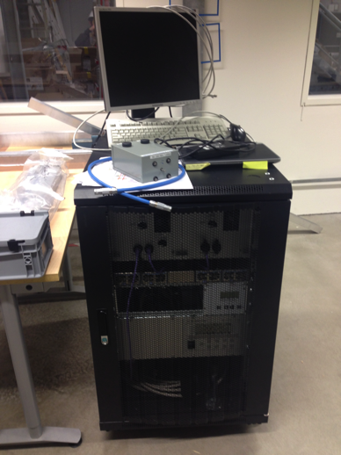
Testing of component function and conformity to PLC interface
Karabo
Component
Testrack
Either generic Testrack (FXE) or other generic crate will be used
This includes
Interfaces to most common hardware (cables and terminals)
PLC firmware
Laptop or PC with Karabo
Usually equipment after equipment (e.g. motor, sensor,…) will be
Parametrized for the equipment to be connected (e.g. motor parameters)
Connected
Key functions tested via Karabo interface (e.g. correct end-switch relation)
Disconnected
If an error was identified, modification on component side might be required
These tests could run in parallel to the following step

Slide 4
Test of full PLC chain from Karabo downto connectors in the hutches
Karabo
This tests involves
Karabo installation
PLC firmware (without interlocks)
Final PLC hardware (modules)
Phase 2 cables
Test boxes (see next slides)
Main aim is to identify any issues before connection of your components like
Wrong wiring
Wrong Names
Mixed-up cables
Broken elements
The tests will be carried out by the instruments in the following way
Connect test box to cable/socket after cable/socket
Identify correct interface in Karabo
Test for key functions (e.g. motor movement, end-switches, sensor readings, correctly assigned supply voltages, etc.)
PLC CPUs
PLC modules
Ph2 Cables
Testboxes

Slide 5
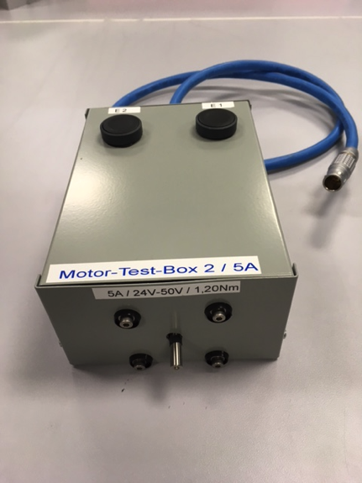
Test of full PLC chain from Karabo downto connectors in the hutches - Motor Test Box -
Tests to be carried
Check / Adjust configured motor parameters to match the test motor
Drive motor in positive/negative direction and verify:
Motor is moving
Direction of motor is correct
Push end-switch button for related direction and check, if
Motor stops (when motor was moving before)
That the end-switch state is correctly displayed in Karabo

Slide 6
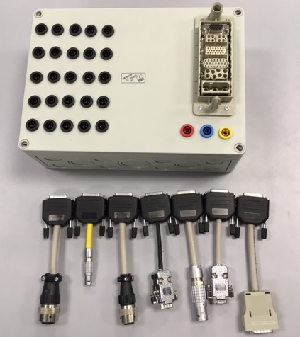
Test of full PLC chain from Karabo downto connectors in the hutches - Generic “Break-out” Test Box -
Provides connections to all possible signals in cable
Labels are missing in the image and will be added
Different adapters for in-field connectors are available
5m connection cable between Test Box and adapter will be provided
Multimeters and Banana jumper cables are available
Possibilities of the Test Box
Check Voltage connections (with multimeter)
Check digital/analog outputs from PLC (with multimeter)
Provide digital input signals to PLC (with jumper cable)
Provide analog input signals (with PT100, power supply, resistor netw.)

Slide 7
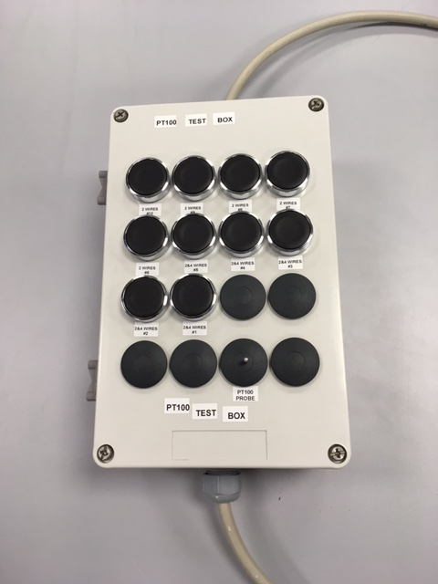
Test of full PLC chain from Karabo downto connectors in the hutches - PT100 Test Box (optional) -
Provides pinout to 4-wire and 2-wire interface
With push-and-hold of individual buttons, the PT100 is connector to individual channel
In that way, channel after channel could be checked

Slide 8
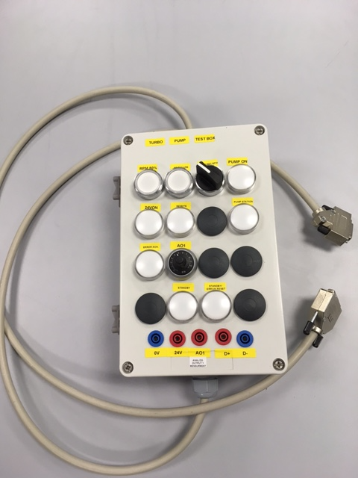
Test of full PLC chain from Karabo downto connectors in the hutches - Turbo Pump Test Box (optional) -
Provides digital and analog interfaces for Turbo Pump
The individual inputs and outputs could be checked

Slide 9
Connection of PLC systems to components
Once the two previous steps are done and possible issues fixed, the connection of the components to the PLC system could be carried out
Critical aspects to done before are
Configuration of important parameters like (could in principle done through Karabo)
Motor currents, speed, (micro)steps per revolution
Conversion factors or formulas to convert units (especially if used in interlocks)
Integration of crucial interlocks (required your input and integration into f/w)
If they are required from the very beginning and no manual supervision is possible
Then connection of cables to components could be done
Testing of all equipment per component and for each component should be done e.g. check
motor movements and end-switches, sensor readings, encoders, valves, etc.
Interlocks

