Slide 1
Pad Probing Results
Julie Segal, Jasmine Hasi

Slide 2
Pad Probing Tests
Standard 20 Ω-cm bare chip
Have 4 probes, with limited current capacity to supply LV, HV.
One pair of probes on bias HV terminals to check leakage current while supply each type of LV in turn with the other probe pair, to see which LV connection is feeding anomalous leakage current
Checking the 3 digital arrays (top,middle),(bottom) in turn
Results looked similar for each type of array.

Slide 3
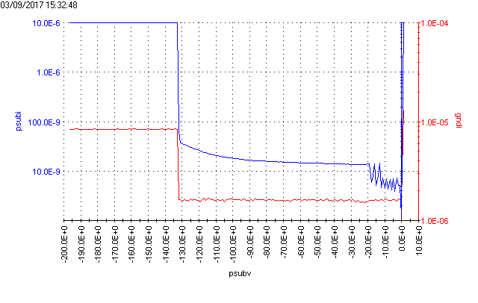
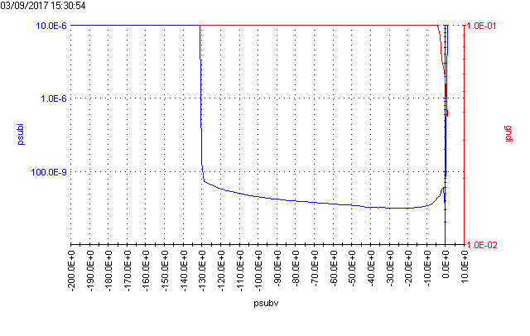
Red=LV supply current
Blue=bias leakage current (compliance clamp at 10μA)
a) (VDDbias,GNDD)=3.3V
& (VDDlvds,GNDlvds)=3.3V
Leakage current normal
b) (VDDD,GNDD)=3.3V
Probe supply reached 100mA limit, but conclusion probably same at full voltage
Leakage current normal
a)
b)

Slide 4
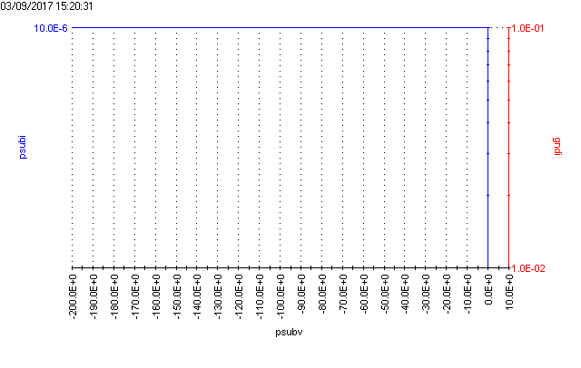
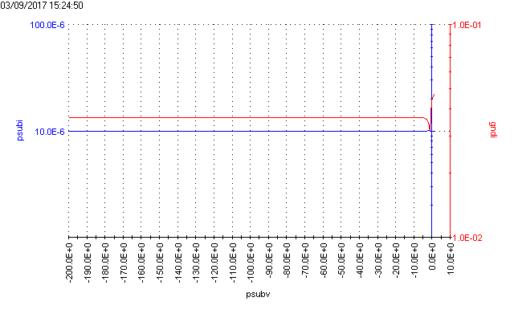
c)
c) (VDDA,GNDA)=3.3V
&(VDDRAM,GNDD)=3.3V
Large leakage immediately (& supply current also reached limit)
d) (VDD18,GNDD)=1.8V
Large Leakage
while supply current still within range.
[ see caveats on GND ref and VDDO next page ]
d)

Slide 5
Discussion with Herve
Tests for VDDA, VDDRAM and VDD18 (all for pixel matrix) may not be at fully legal condition: VDDO/GNDO (connected to VDDD/GNDD internally) for ESD protection should be set to 3.3V for these tests.
GND ref for VDDD18 and VDDRAM should be GNDA.

Slide 6
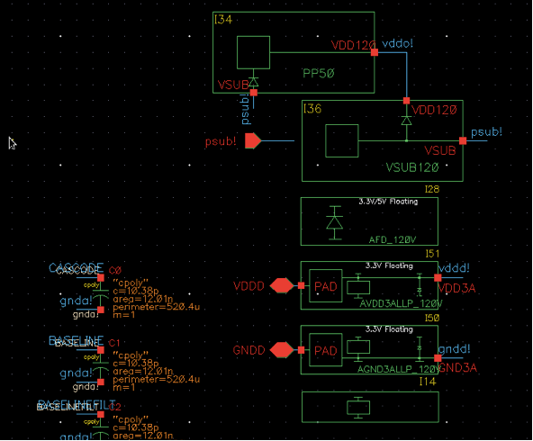
More VDDO Design Info from Herve

Slide 7
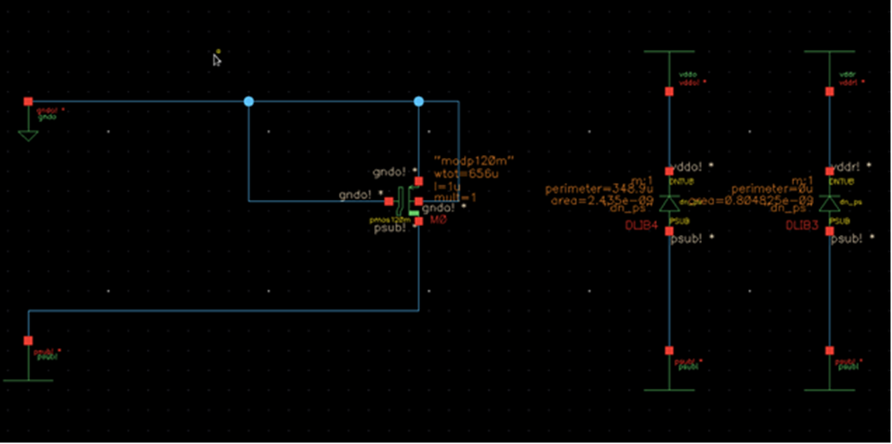
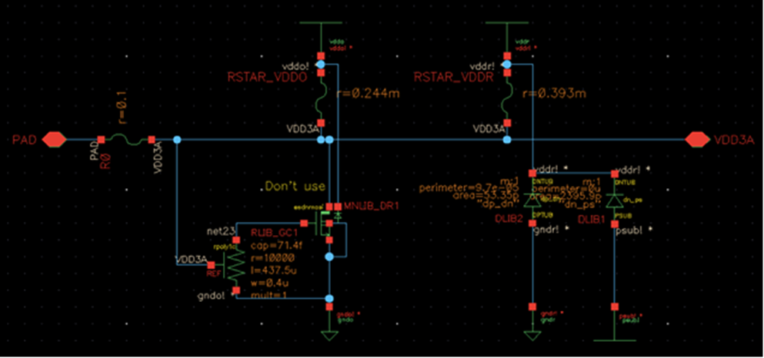
More
VDDO design info

