Slide 1
XGM – progress week 11 / 2017
Dr. Jan Grünert
X-ray Photon Diagnostics
Group Leader
Hamburg, March 17th, 2017
Contains information from WP74 team
and from K.Tiedtke / F.Jastrow from DESY-FS-FL-D

Slide 2
XGM - Progress (w11)
XGM@XTD2
  Installation of cable connection Girder - ADAM&FEMTO crate done
XGM@XTD9
  Internal wiring : done.
  Vacuum part wiring : done (ready for local Beckhoff test).
  Gas Panel wiring : done.
  Installation of cable connection Girder - ADAM&FEMTO crate : done
XGM@XTD10
  HV tests DONE / OK
Preparations for Grounding Works: DONE
Safe state test (friday 17.3.2017) XGM@XTD2:
  Close vatterfly valves of the XGM
  Observe how pressure increases (up to max. 1E-2 mbar)

Slide 3
XGM – Repair Progress Summary (w11)
XGM | Preparation | Resistor exchange | Leak test | HV test | Survey
HERA XGM01 | done | done | done
XTD2 XGM02 | done | done | done | done | done
XTD9 XGM04 | done | done | done | done | done
XTD10 XGM07 | done | done | done | done | done
XHE3 XGM05
XHE3 XGM06

Slide 4
XGM - Plan week 11
Grounding Works
  start Monday 20.3. at XTD2, continue with XTD9+10 immediately
Commissioning of all DOOCS controls (incl. ADAM&FEMTO) at XTD2+9
XTD 2:
  Serial connection from Beckhoff to TCP 350.
  Change cold plug cables into halogenfree cables.
XTD 9:
  INHIBIT connection Iseg HV crate.
  Serial connection from MTCA to RVC 300
  Local XGM VAC Beckhoff test next week Monday (w12)
XTD 10:
  Vacuum part and Gas Panel wiring of XGM
  Internal wiring of XGM
  Installation ADAM & Femto crate
  Measure cable lengths for Imager and prepare cables.

Slide 5
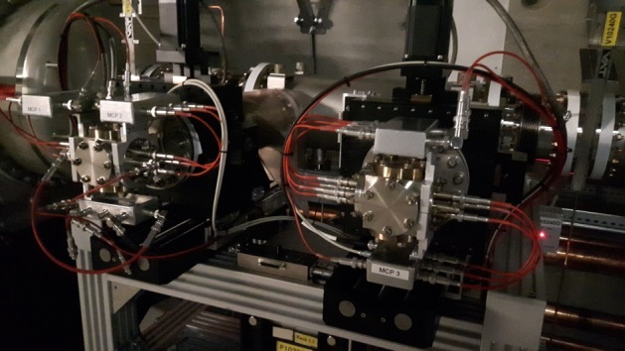
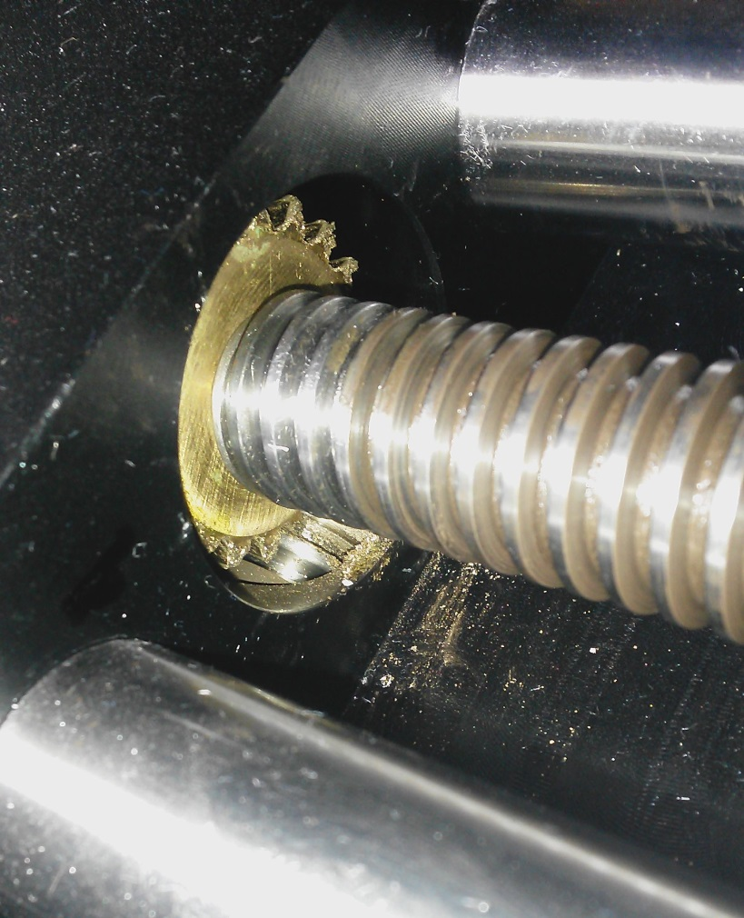
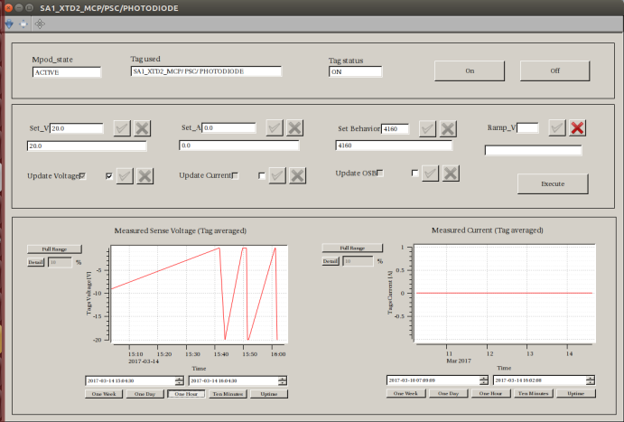
MCP - status
MCP@XTD2: detected big issue with downstream
manipulator during Technical Commissioning:
  Mechanical failure of spindle, friction up to seizure
  Must be replaced, cannot be done in-situ
  Must open UHV
  Remove delicate MCPs under constant N2-flow
  Removal of manipulator Friday 17.3.2017
  Repair of manipulator at Vab in w12
  Reinstallation possibly end of w12 (?)
MCP mpod s/w commissioning (karabo):
  ongoing (CY), detected only minor issues

