Slide 1
Coherent backward transition radiation from ultra short “pancake-like” bunches
A. Potylitsyn
Tomsk Polytechnic University

Slide 2
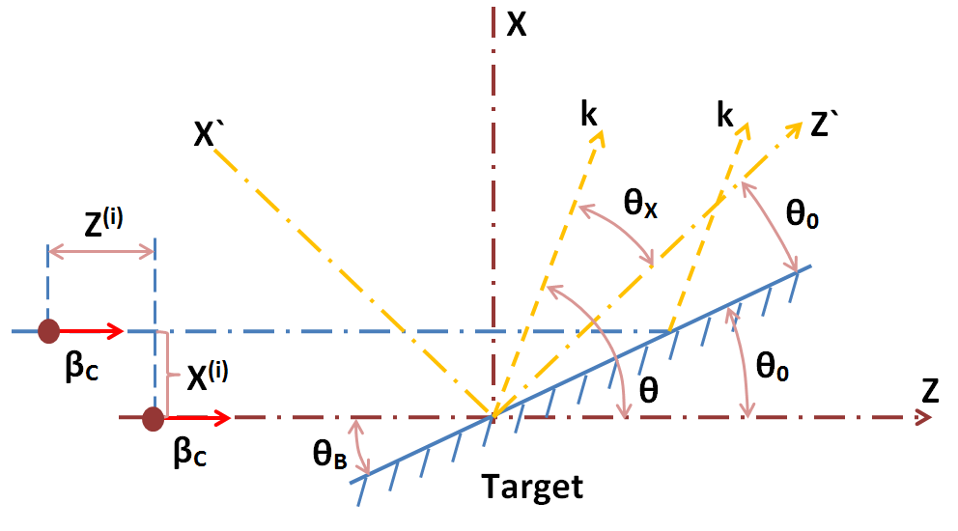
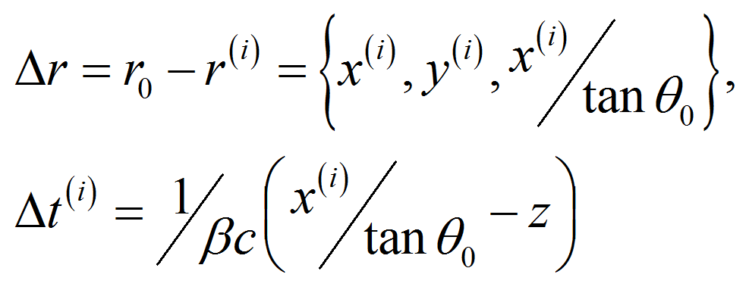
Coherent Transition Radiation
Kinematics of BTR

Slide 3
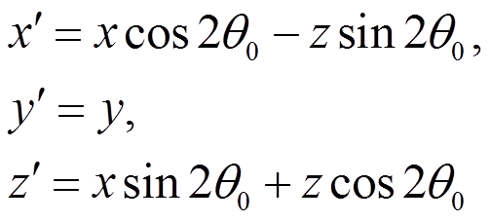
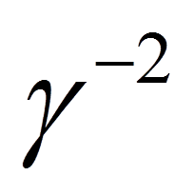
In the frame x`, z`
Subsequently,
neglecting by
terms
Phase shift for forward transition radiation:

Slide 4
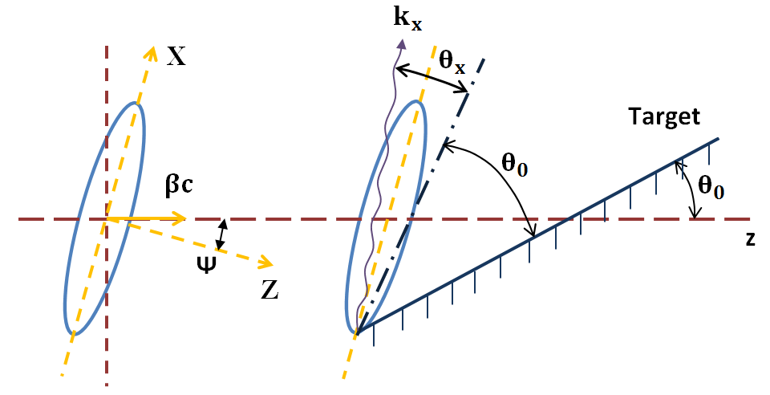
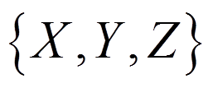
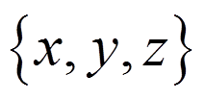
Generation of coherent BTR by a tilted in x-z plane “pancake-like” bunch
In the frame
And in the initial frame

Slide 5
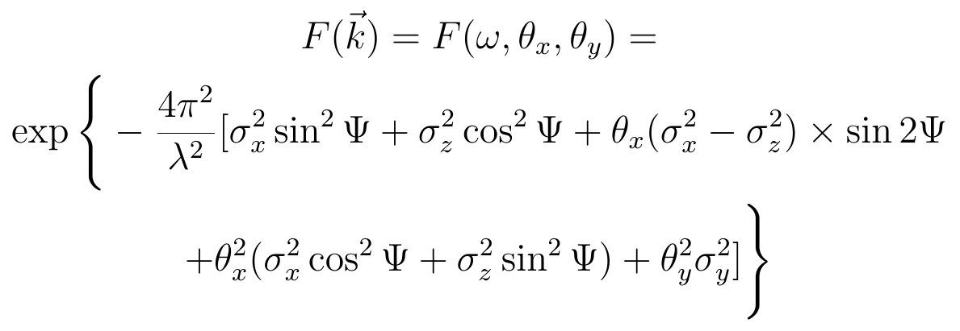
Formfactor for such configuration is calculated analytically:
For the conventional configuration
the effects
of spatial coherency are negligible:
But for a “pancake-like” bunch the “effective” longitudinal size will be defined by the value:

Slide 6
Spectral-angular distribution for coherent BTR can be calculated using well-known expression:
For small tilt angle ( ) formfactor can be written as:

Slide 7
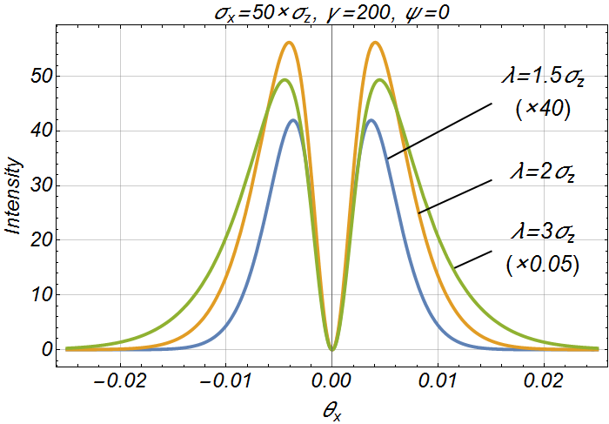
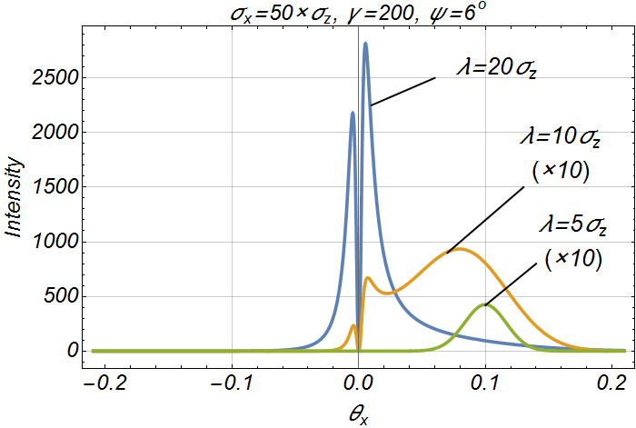
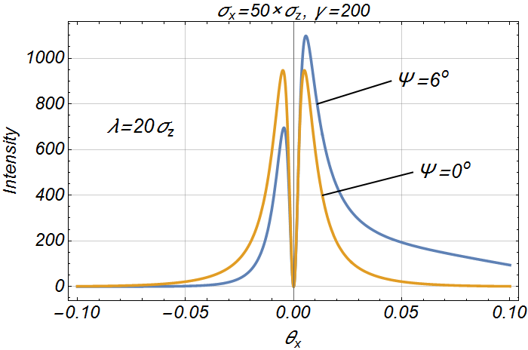
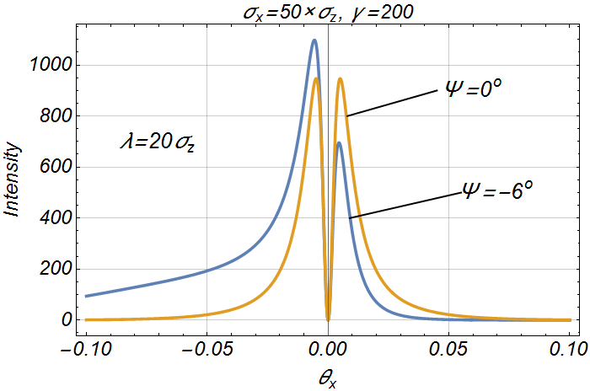
Asymmetry of coherent BTR

Slide 8
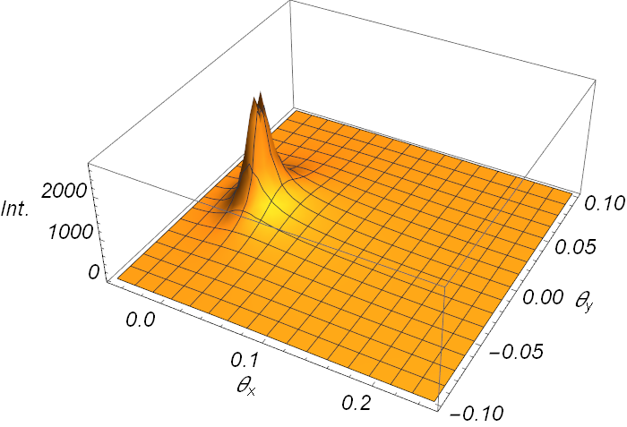
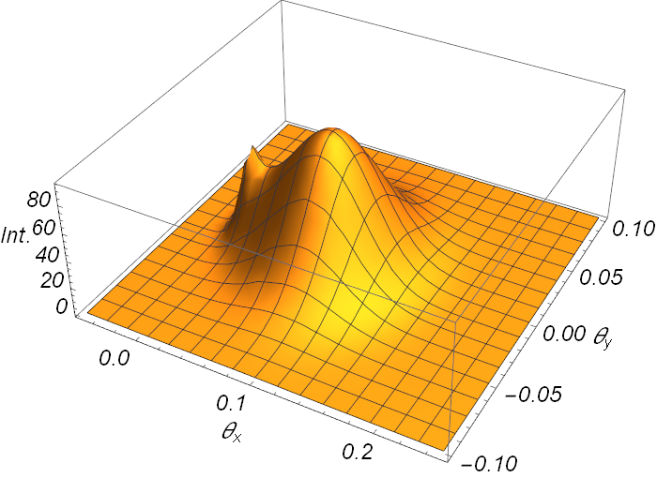
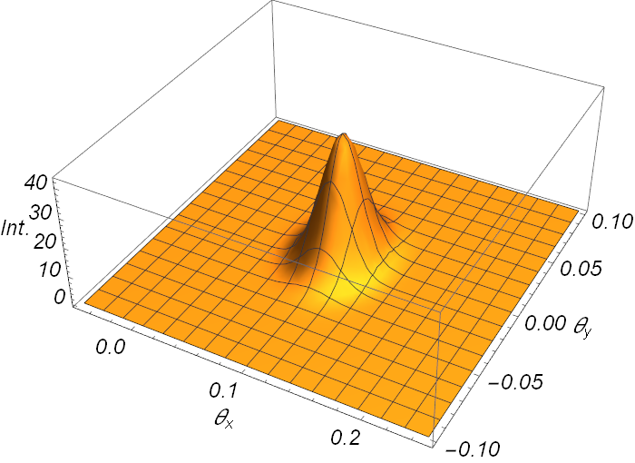
2-D angular patterns
λ = 20σ_{z}
λ = 10σ_{z}
λ = 5σ_{z}

Slide 9
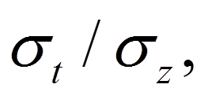
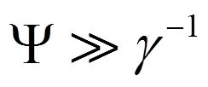
Spectral – angular distribution of coherent BTR, generated by a “pancake-like” bunch is determined by the ratio tilted angle Ψ and wavelength λ/σ_{z}:
there is asymmetry in an angular distribution the sign of which depends on the sign of Ψ;
for λ ≤ 10σ_{z} the angular distribution has a single maximum;
the angle of maximum even if

Slide 10
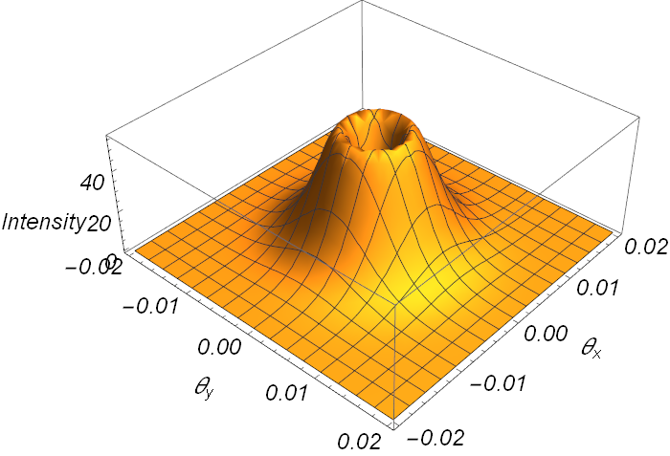
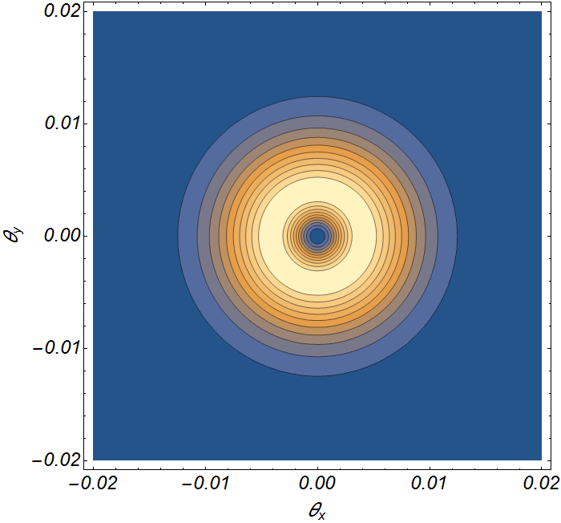
2D distributions of coherent BTR
Ψ = 0
γ = 200
σ_{x} = 50σ_{z}
λ = 2σ_{z}

Slide 11
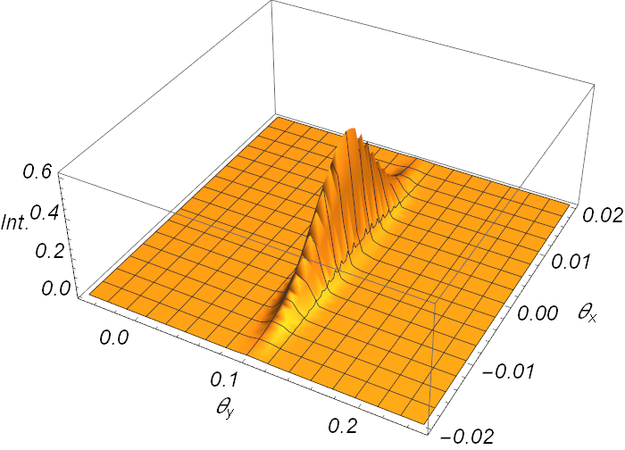
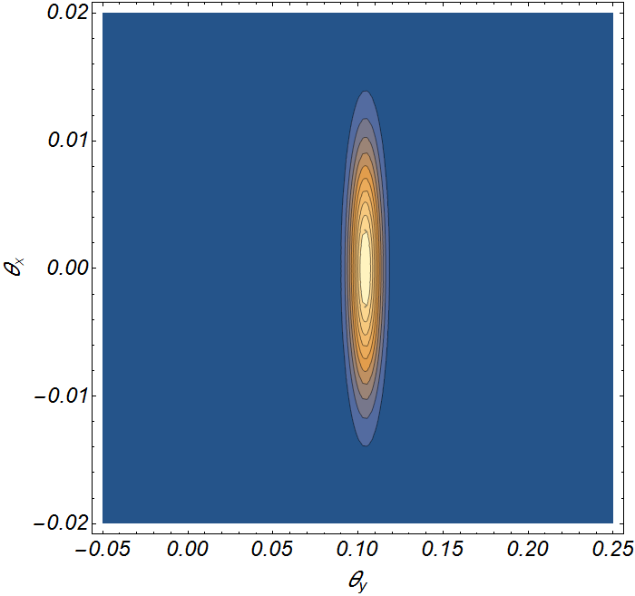
2D distributions of coherent BTR
Ψ = 6 deg
γ = 200
σ_{x} = 50σ_{z}
λ = 2σ_{z}

Slide 12
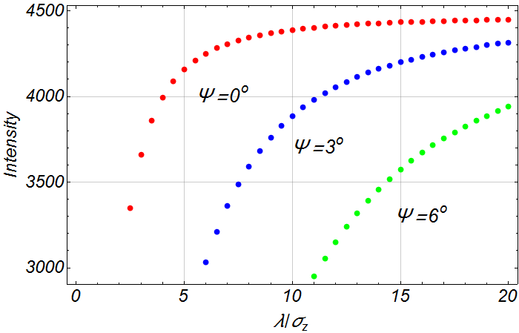
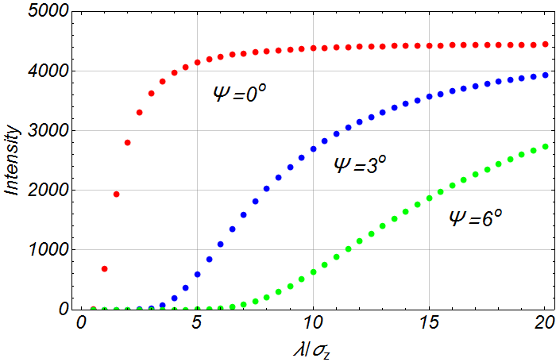
The coherent BTR spectra is determined by tilted angle Ψ, angular acceptance Δθ_{x} , Δθ_{y} and ratio σ_{t} / σ_{z}
γ = 200
σ_{x} = 50σ_{z}
Δθ_{x} = Δθ_{y} = 0.5γ⁻¹
γ = 200
σ_{x} = 100σ_{z}
Δθ_{x} = Δθ_{y} = 0.5γ⁻¹

Slide 13
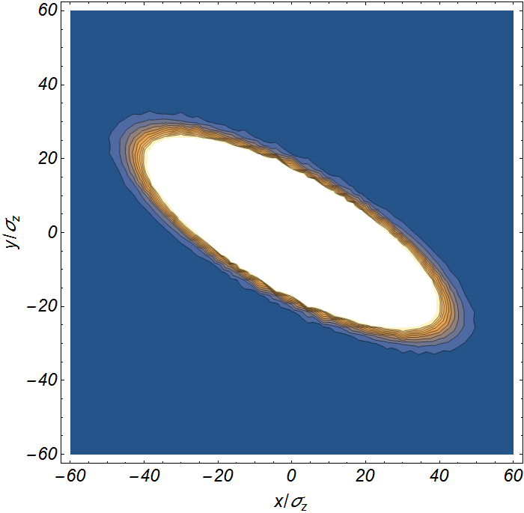
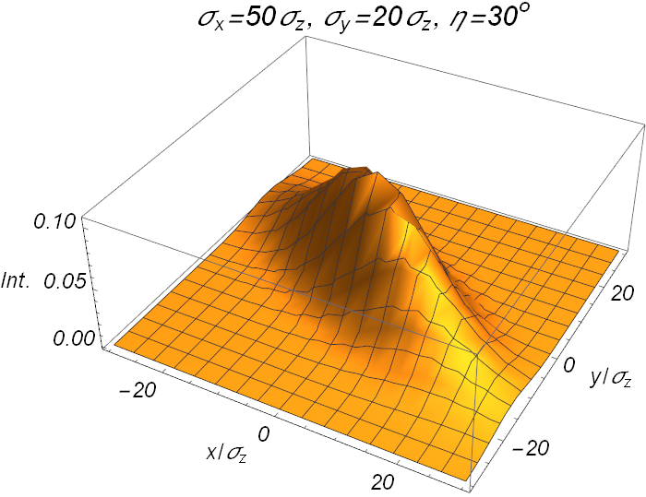
Tilted bunch in transversal plane (x-y plane)

Slide 14
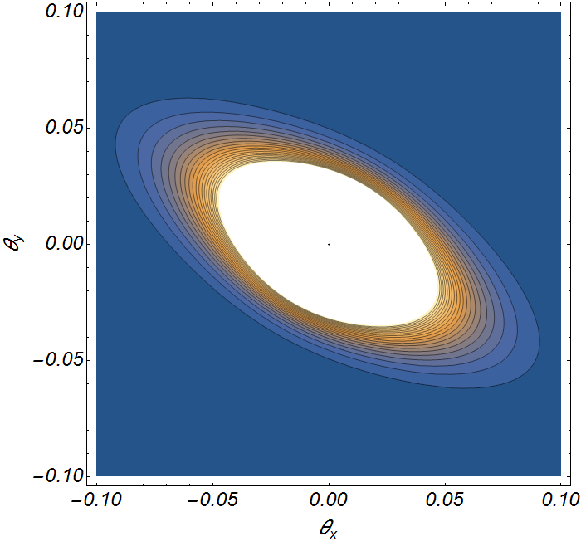
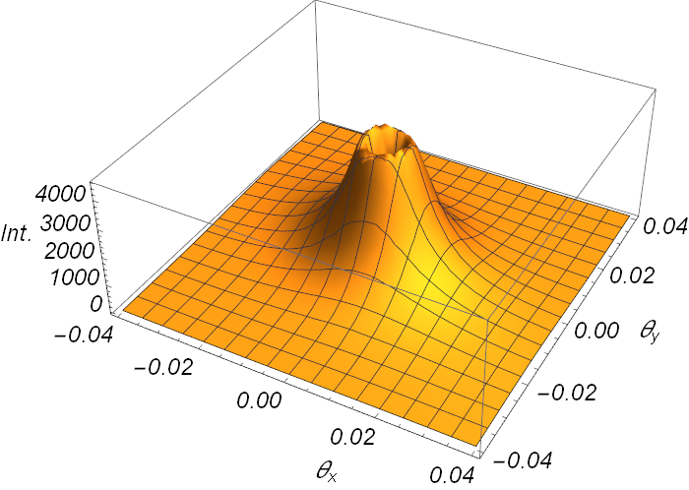
Angular distribution of coherent BTR
η = 30º, γ = 200
σ_{x} = 50σ_{z,} σ_{y} = 20σ_{z}
λ = 5 σ_{z}

Slide 15
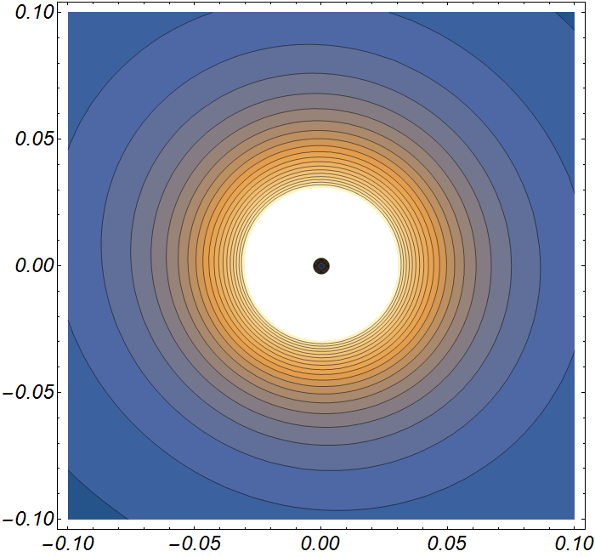
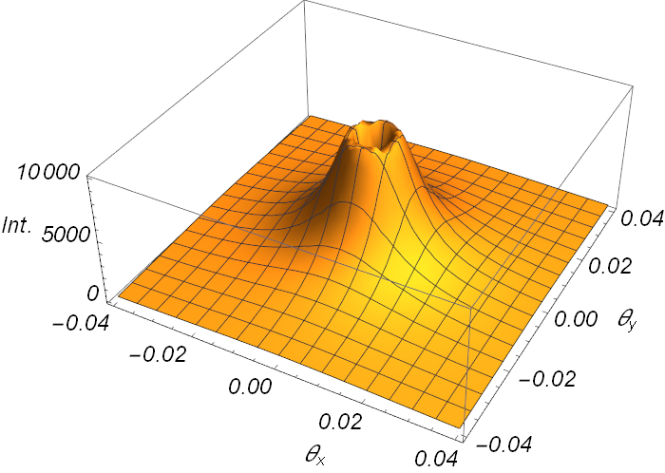
Angular distribution of coherent BTR
η = 30º, γ = 200
σ_{x} = 50σ_{z,} σ_{y} = 20σ_{z}
λ = 50 σ_{z}

Slide 16
Number of photons from coherent optical BTR for σ_{z} ≤ 0.3 μm (γ >> 1):
Formfactor for perpendicular bunch:
Number of photons per bunch:
For the case.
Bunch: σ_{x} = σ_{y} = 50σ_{z} = 15 μm,
γ = 200, Q = 1 pC (N_{e} = 0.6 ∙ 10⁷)
Aperture: Δσ_{x} = Δσ_{y} = 1/γ = 0.005
Wavelength: λ_{blue} = 0.4 ± 0.05 μm
λ_{red} = 0.7 ± 0.05 μm

Slide 17
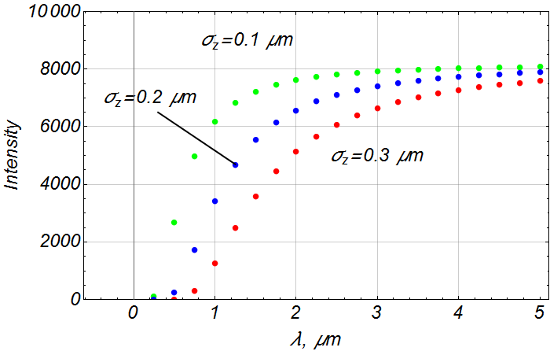
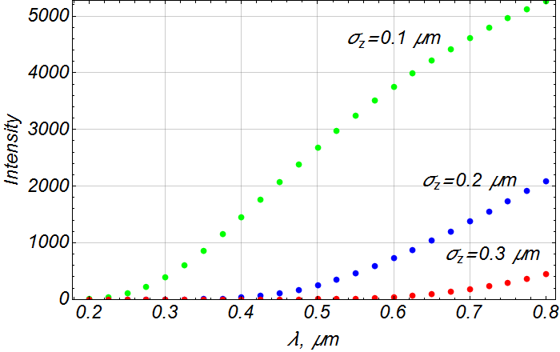
Photon spectral distribution
γ = 200
σ_{x} = σ_{y} = 15 μm
Δθ_{x} = Δθ_{y} = 0.005

Slide 18
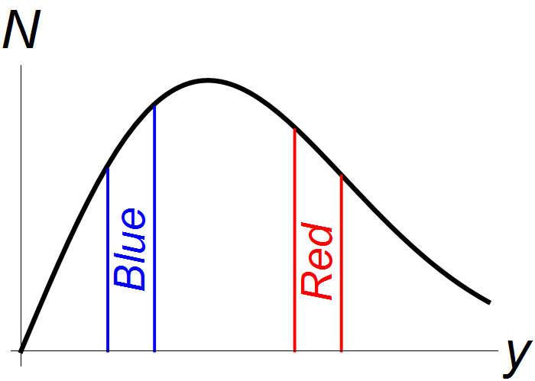
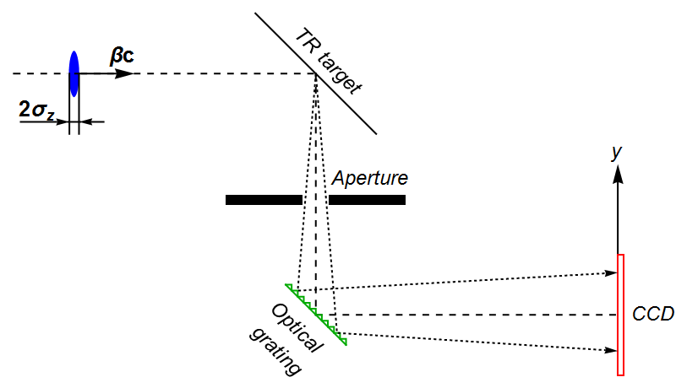
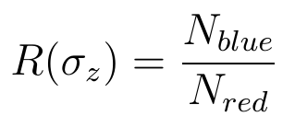
Coherent optical transition radiation for σ_{z} < 0.3 μm
Optical grating (or other dispersive element) allows to transform spectral distribution into spatial one
Spatial distribution affected by CCD sensitivity

Slide 19
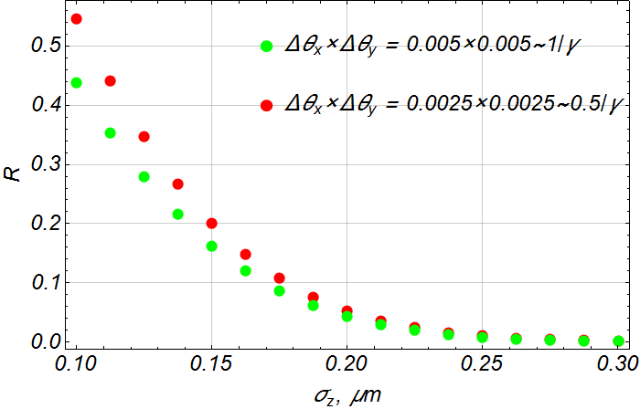

Slide 20
Conclusion
Spectral angular distribution of coherent BTR from “pancake-like” bunch depends on bunch sizes (σ_{x} , σ_{y} , σ_{z}) and its orientation relative to bunch velocity (angles Ψ, η)
The measurement of longitudinal bunch size σ_{z} can be carried out using spectral measurements if other parameters σ_{x}, σ_{y}, η and Ψ are known;
For symmetrical perpendicular ultra short “pancake-like” bunch with σ_{z} ≤ 0.3 μm a bunch length can be measured using photon yield of optical coherent BTR with different wavelength;
Intensity of coherent light is high even for Q ~ 1 pC and σ_{z} = 0.3 μm and photon yield for different wavelengths can be measured without problem.

Slide 21
Thanks for your attention!

