Slide 1

Coherent Cherenkov Radiation
L.G. Sukhikh, A.P. Potylitsyn,
Tomsk Polytechnic University, 634050, Lenin ave., 30, Tomsk, Russia
27 Mar 2017

Slide 2

Introduction and motivation

Slide 3
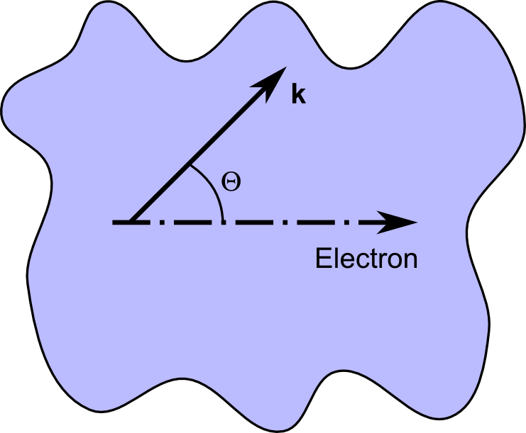
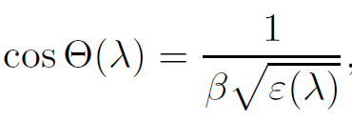
Cherenkov Radiation
Polarization radiation:
Transition radiation
Cherenkov radiation
Diffraction radiation
Smith-Purcell radiation
etc.
Notes:
Поправить рисунок. Нужно показать обычную схему генерации ИВЧ

Slide 4
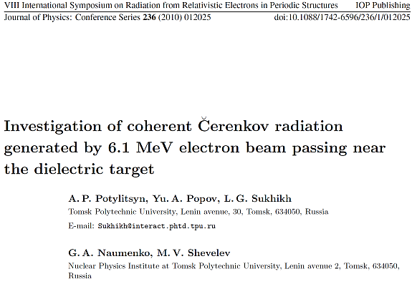
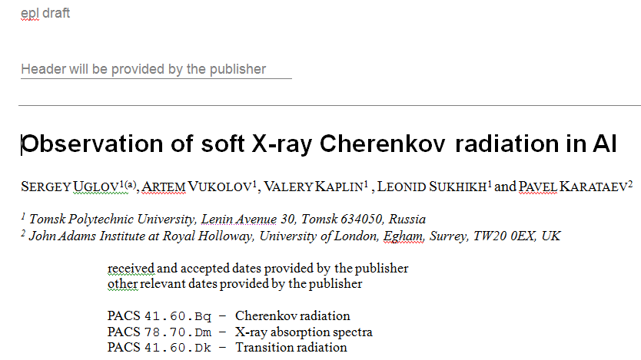
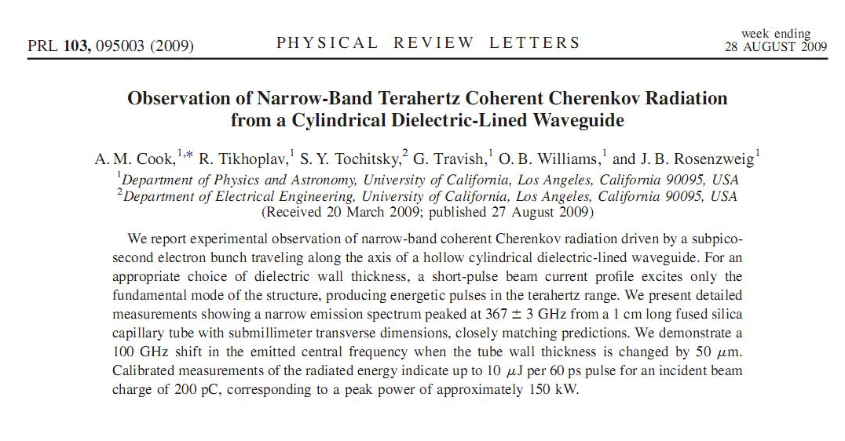
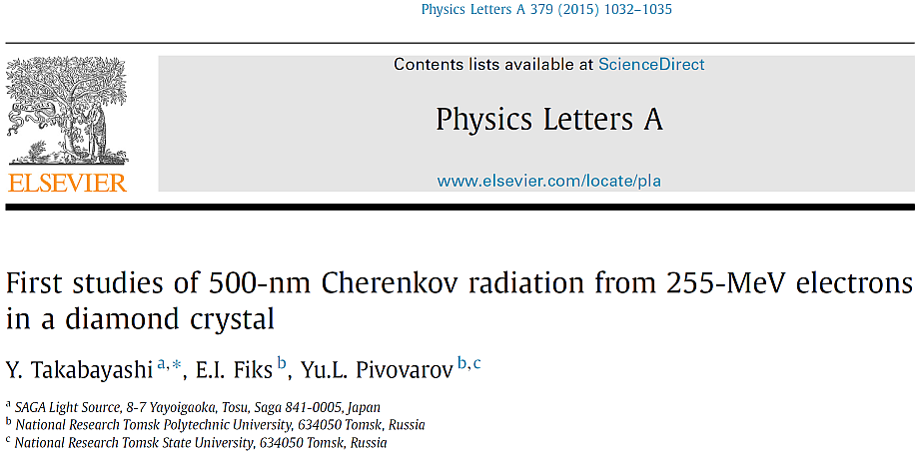
Cherenkov Radiation
Wide spectral range
EUV
Visible
THz
Millimeter
DRAFT
Coherent radiation – bunch length diagnostics

Slide 5
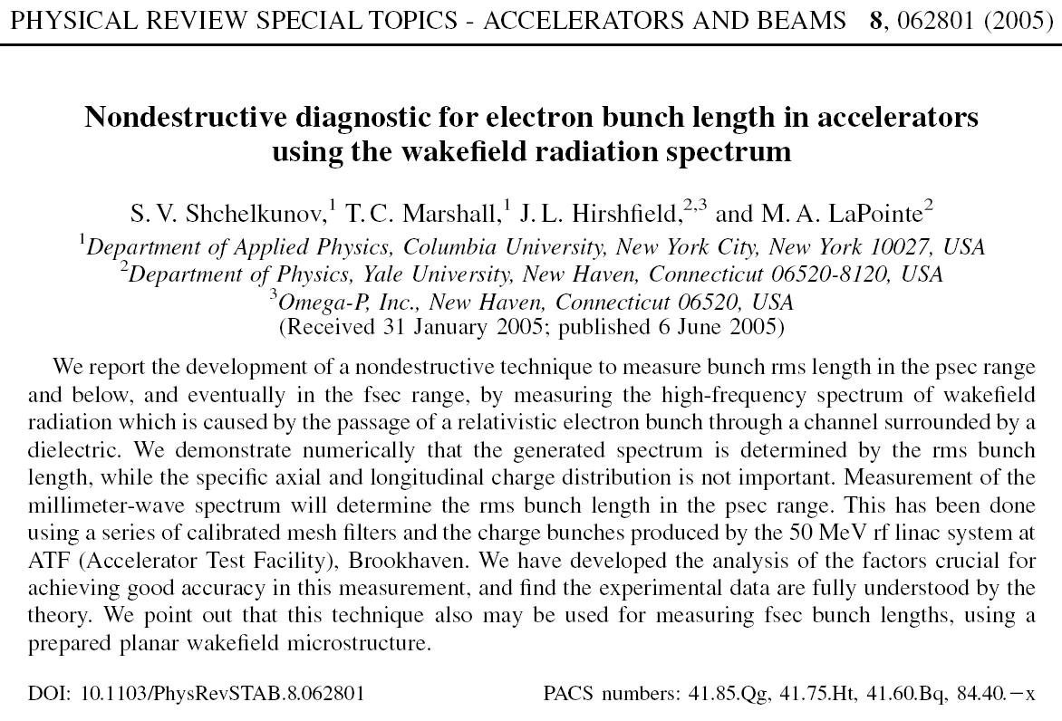

Slide 6
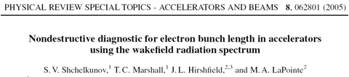
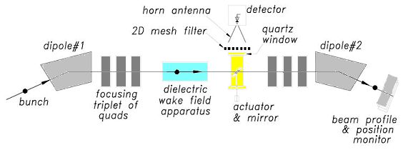
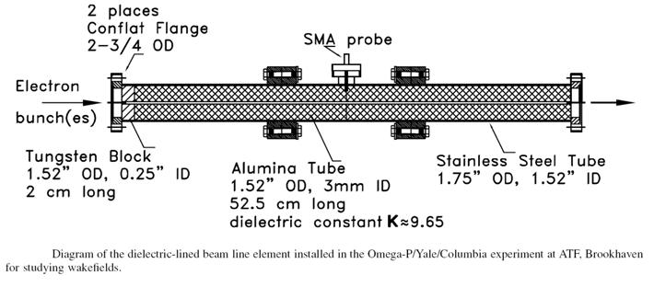

Slide 7
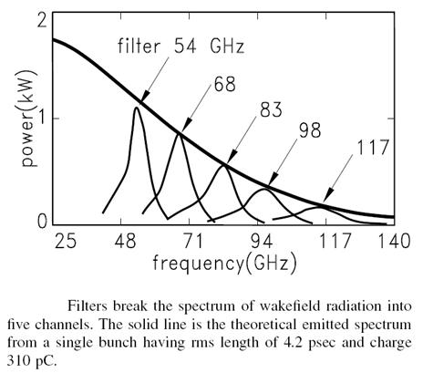

Slide 8
Cherenkov radiation from flat targets

Slide 9
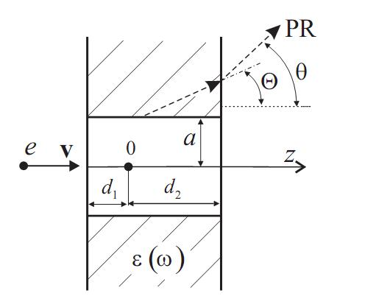
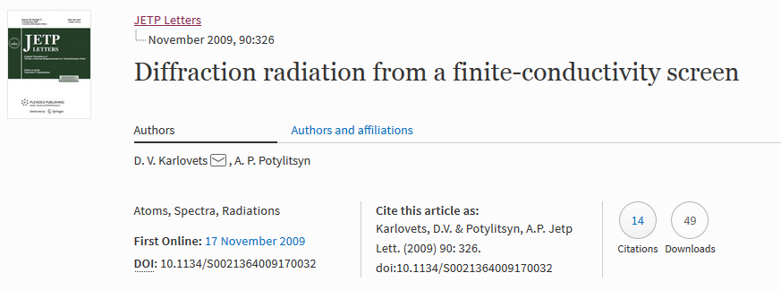
Cherenkov Radiation theory
Polarization Radiation field in the wave zone is found as:

Slide 10

Cherenkov Radiation theory
Snell’s law
ε > 2, radiation is confined
Generation of PR by a charged particle moving a channel in the layer

Slide 11
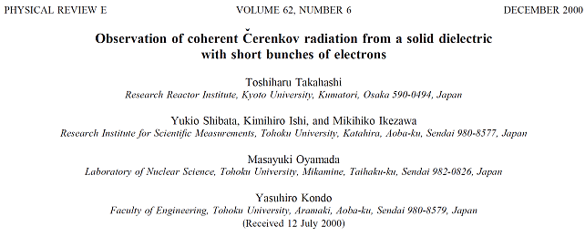
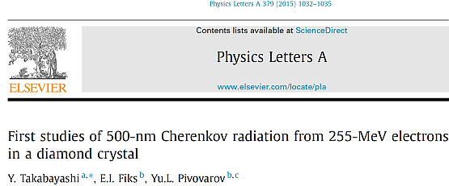
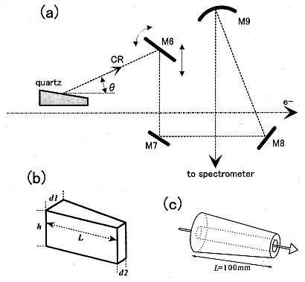
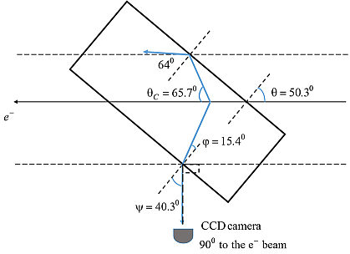
How to overcome confinement

Slide 12
Bunch length diagnostics based on dispersive target

Slide 13
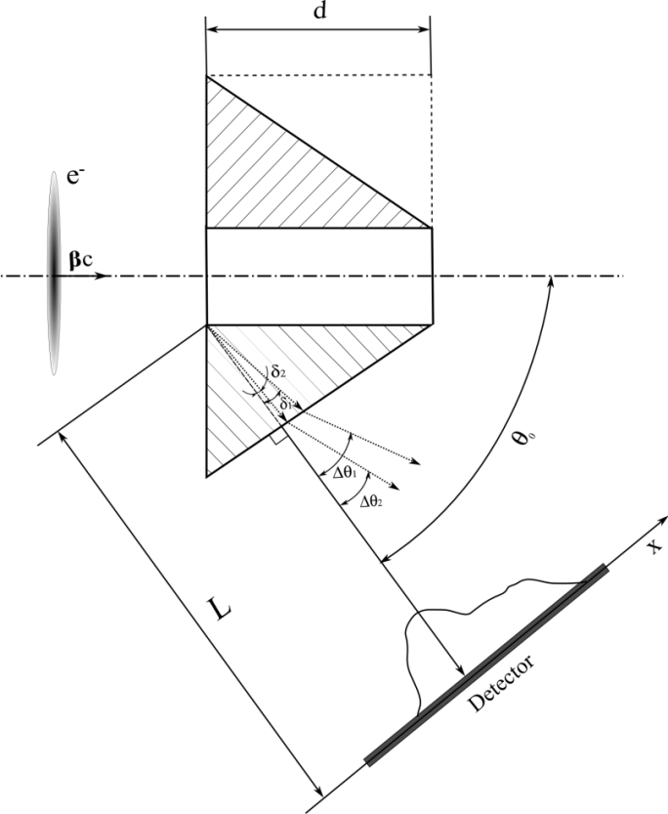
ChR from dispersive target
A normal to the conical surface is closed to Cherenkov angle
Snell’s law:
For small

Slide 14
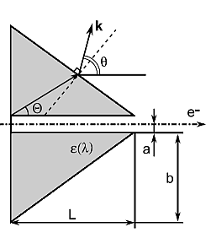
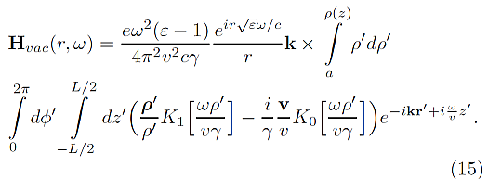
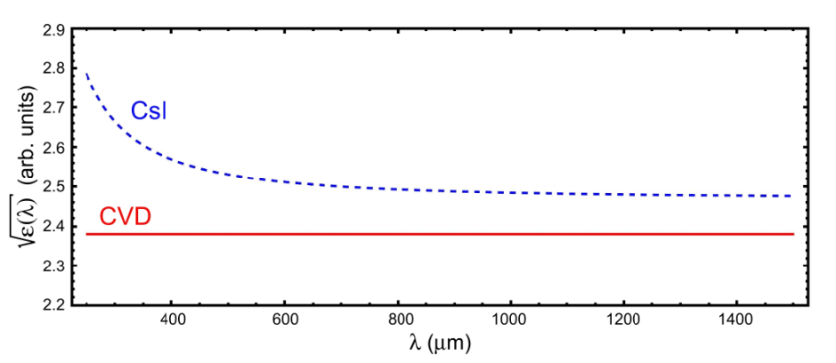
THz range example
Dispersion curves

Slide 15
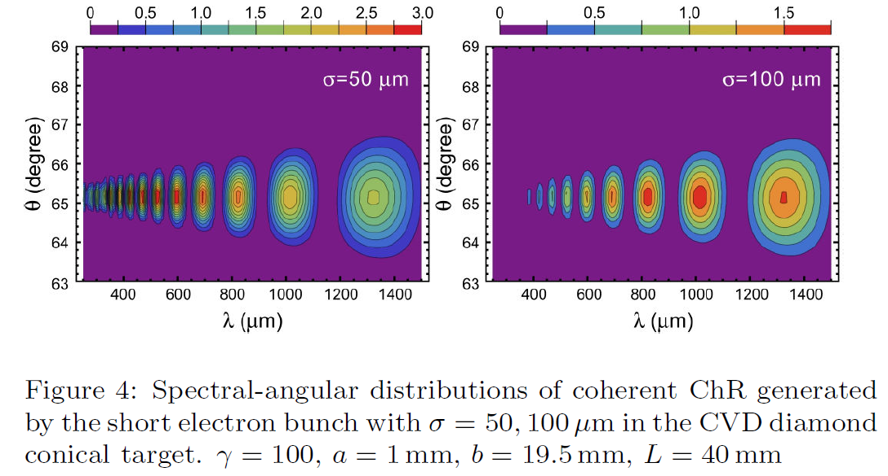
CVD diamond

Slide 16
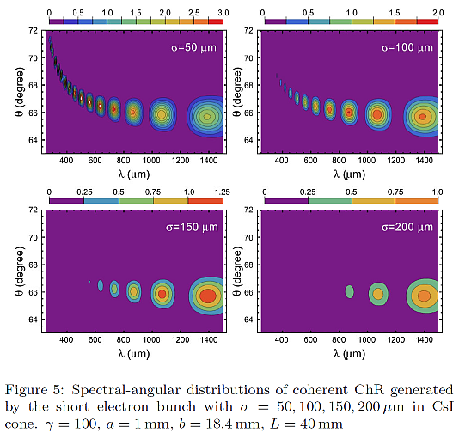
CsI

Slide 17
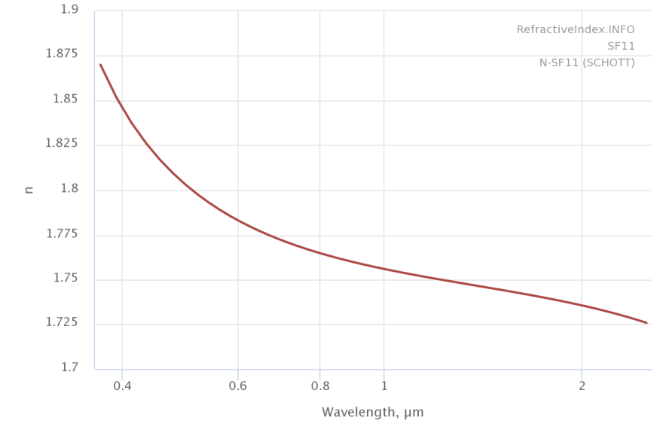

Visible range: SF11 glass

Slide 18
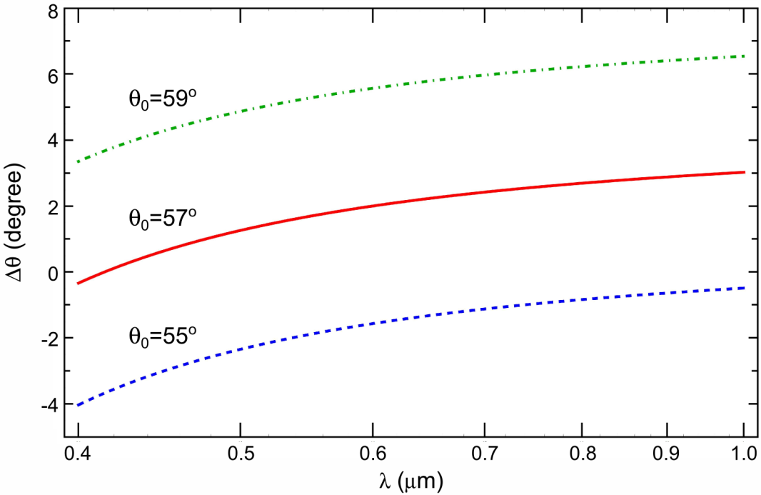
Visible range: SF11 glass

Slide 19
Conclusion
Cherenkov radiation from the dispersive material could be used for radiation spectrum reconstruction measuring angular distribution.
Coherent radiation spectrum could be obtained without external spectrometers
Multiple internal reflections and multiple electron scattering are not taken into account in the model but could give background radiation

Slide 20
Thank You
for Your Attention!

