Slide 1
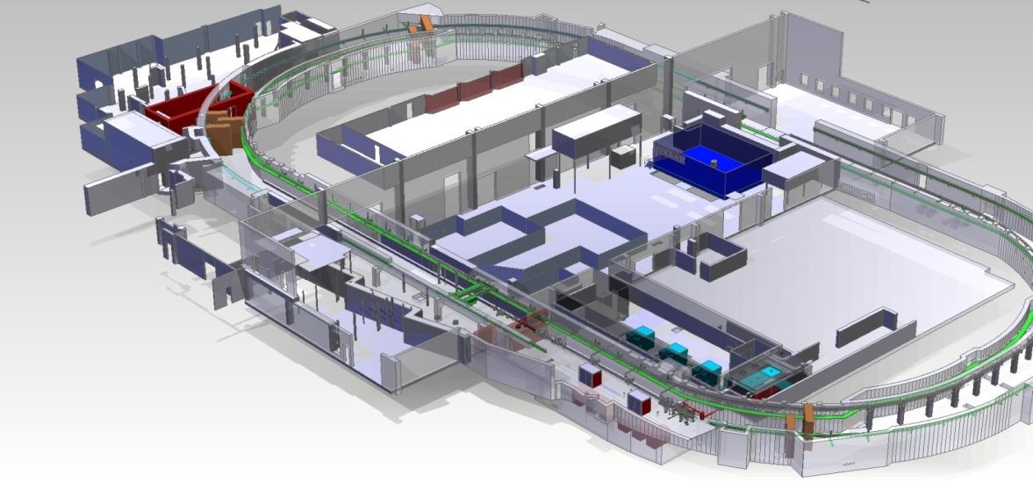
Novel X-band TDS at SINBAD
Daniel Marx
Diagnostics Mini-Seminar
DESY, 27 March 2017

Slide 2
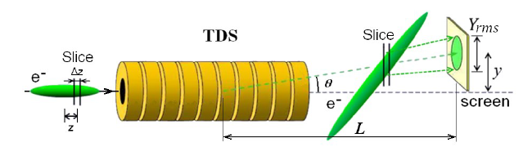
A new design
Give bunch time-dependent kick => convert longitudinal to transverse
High frequency ~12 GHz (X-band) allows 3-4 times higher resolution than S-band
Variable polarization allows deflection at any angle
Fig. Credits: D. Malyutin PhD thesis

Slide 3
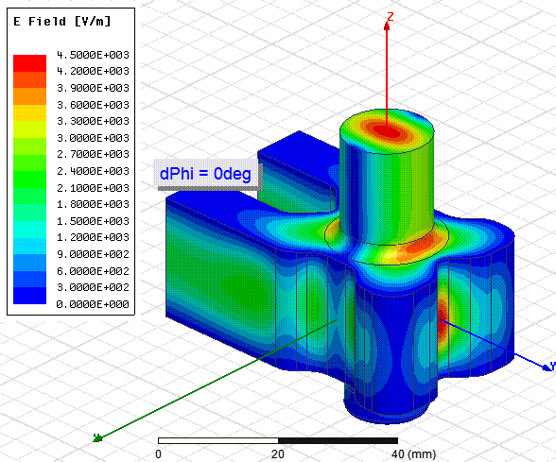



Outline
The technology
Who’s involved?
Applications at SINBAD

Slide 4
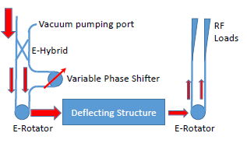
New RF technology
Phase difference between port 1 and port 2:
0 degree -> vertical polarization
180 degree -> horizontal polarization
Variable Polarization Circular TE11 Mode Launcher
A. Grudiev, CLIC-note-1067 (2016).
Courtesy of A. Grudiev
Very precise azimuthal symmetry required!
→ Tuning free assembly procedure at PSI
Notes:
Rotator combines two radially polarized modes and produces one linearly polarized mode with direction depending on phase difference between the two input modes.

Slide 5
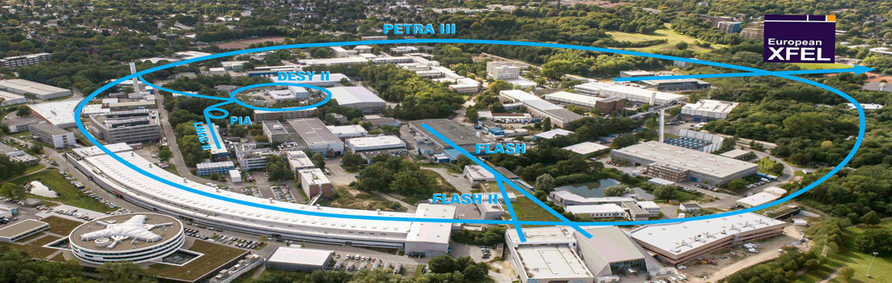



Who’s involved?
Ongoing efforts towards an international collaboration to build and test the first prototype
Collaboration
  FLASH2: measurement of the energy spread induced by FEL lasing
  FLASHForward: characterization of driver and witness electron beams in PWFA
  SINBAD: characterization of ultra-short (fs / sub-fs) electron bunches for injection on novel high gradient acceleration techniques
  SwissFEL
  Potentially also XFEL

Slide 6
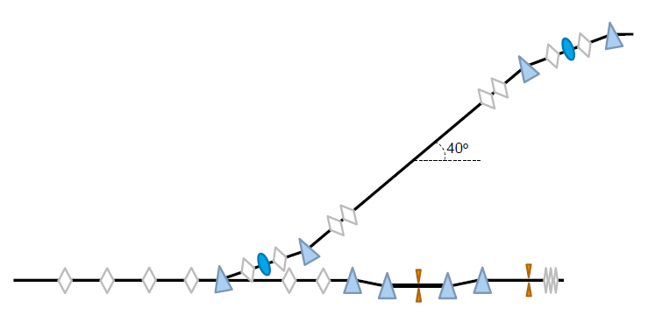
SINBAD-ARES linac
SINBAD overview –
Cfr: U. Dorda et al. “SINBAD – The accelerator R&D facility under construction at DESY”, NIM A 829, p. 233-236 (2016).
Planned delivery: 2019
Dogleg to second experimental area
TDS + diagnostics beamline and experimental area
ARES linac
E=100MeV
Magnetic compressor
Temporary experimental area
Space for future possible energy upgrade

Slide 7
Possible Measurements
Bunch Length
2D charge density profile in one plane
3D charge density profile using tomographic reconstruction (real space)
Slice emittance measurement (transverse phase space)
Energy measurement using dipole (longitudinal phase space)
6D phase space reconstruction

Slide 8
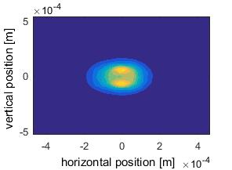
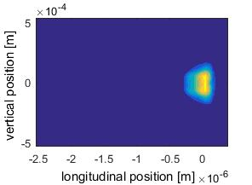
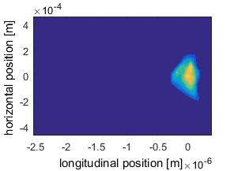
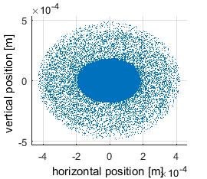
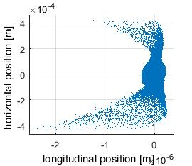
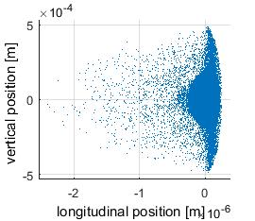
Production and measurement of ultra-short probe for LWPA (1/2)
Beam shape at the TDS
Q=2.7 pC
Energy = 100 MeV
Transverse Normalized Emittance = 0.2 mm mrad
σt=0.461 fs

Slide 9
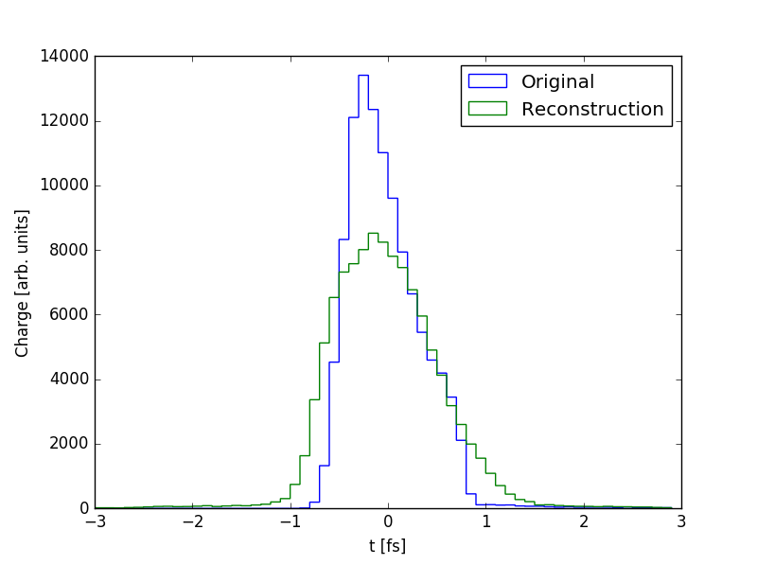
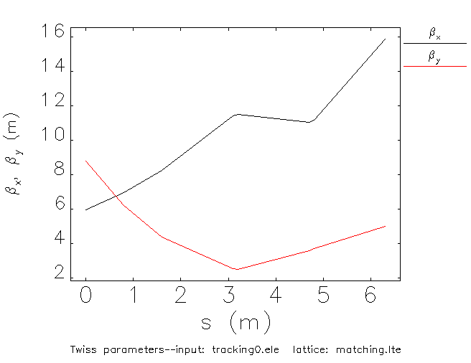
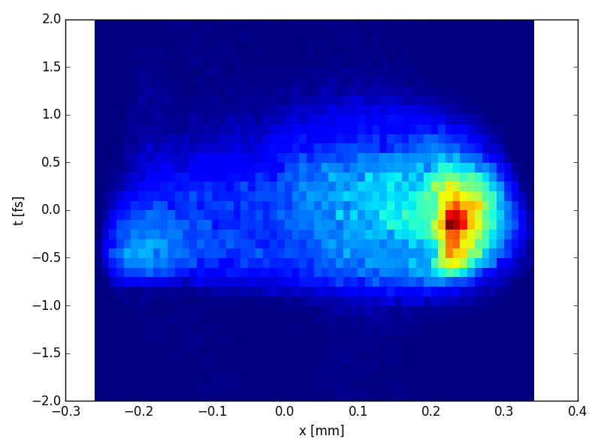

Production and measurement of ultra-short probe for LWPA (2/2)
Beam parameters at the TDS
V = 40MV
β(s0) = 6m (as from bunch compression)
Δφ = π/2
Beam optics between TDS and screen
Simulated Measured Streaked Beam @ Screen
Longitudinal Resolution = 0.42 fs
Calibration done at reduced voltage
Jitter effects non included
Code used: Elegant (Space Charge OFF)
t [fs]
x [mm]
Notes:
S=560 (from calibration ….)
σt=0.461fs
St calculated 0.464fs
(resol 0.42 fs)
Assumptions:
No jitter
Screen resolution:
…..

Slide 10
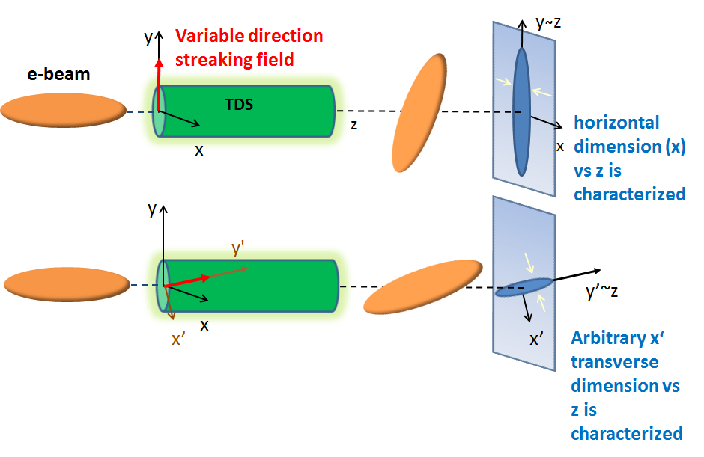
Tomographic reconstruction
Aim: to reconstruct the 3D charge density distribution
Relies on streaking at multiple angles => completely new measurement
Principle:
  Streak beam at different angles and measure intensity at screen
  Slice profiles in time
  Combine 1D profiles from different streaking directions to form a 2D transverse profile for each temporal slice
  Stack slices together to form complete 3D charge profile reconstruction

Slide 11
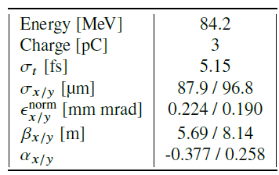
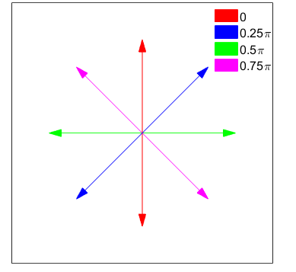
Tomographic reconstruction
Beam parameters:
Lattice: TDS (two 0.8-metre cavities + 5-metre drift)
Four streaking angles:
No space charge
No jitter
No misalignments

Slide 12
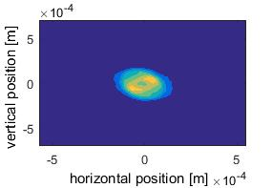
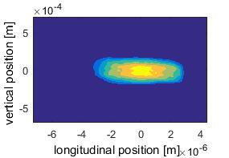
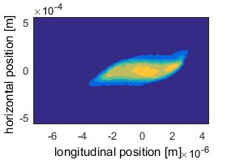
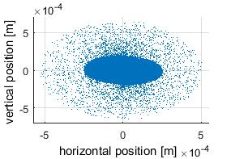
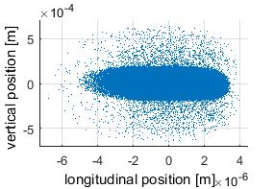
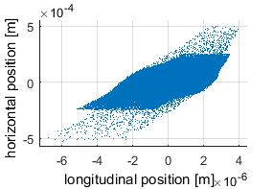
Tomographic reconstruction
Input beam used for test simulations at the TDS
Example of correlation x-z that we wish to detect
Input beam production simulated by J. Zhu

Slide 13
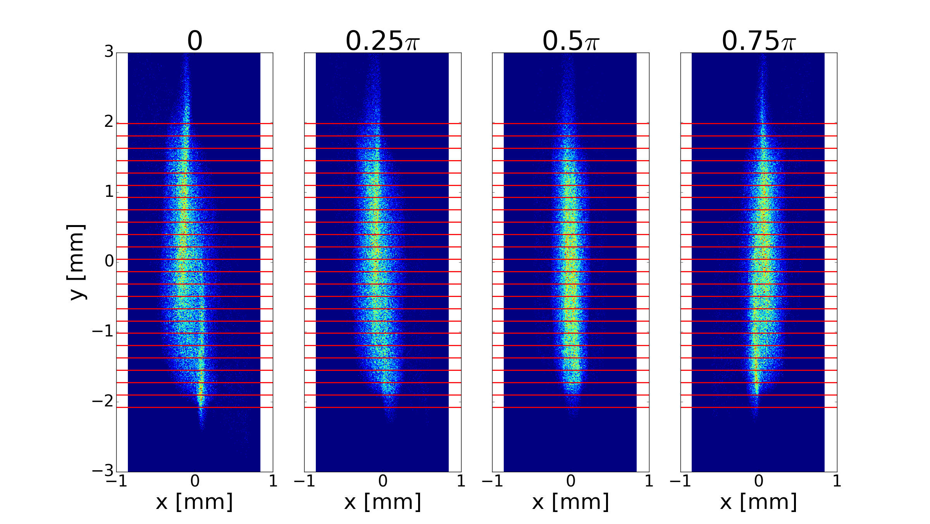
Tomographic reconstruction
Four xy screen profiles [2D]
  Convert y to t and divide into slices (0.85 fs) [2D]
  For each slice, take projection on x axis [1D] and combine using tomographic reconstruction (SART algorithm) [2D]
  Stack slices [3D]

Slide 14
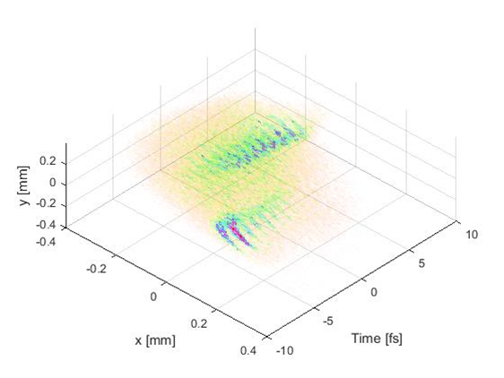
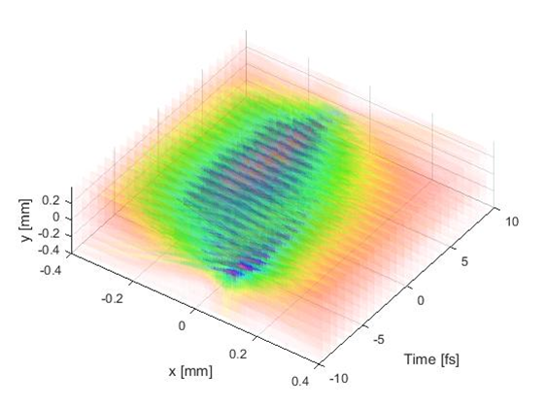
Tomographic reconstruction
Actual
Reconstruction

Slide 15
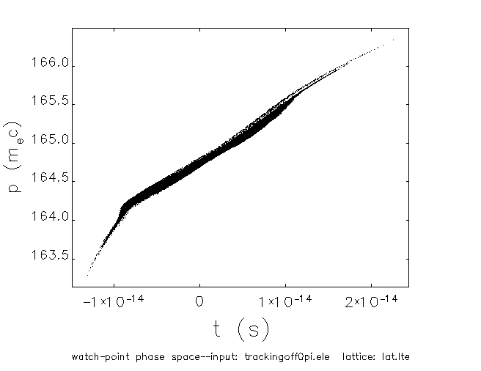
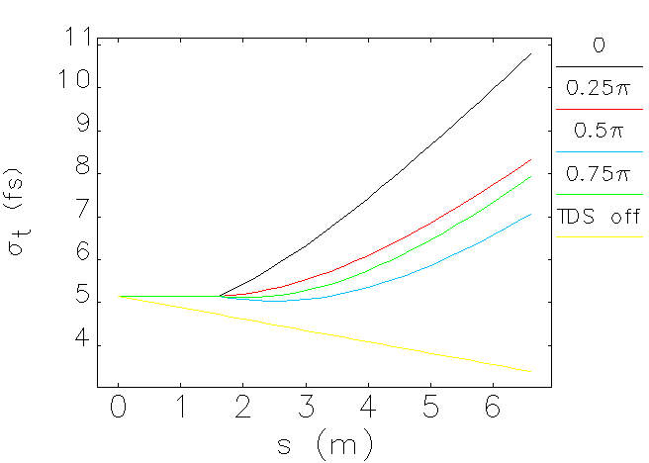
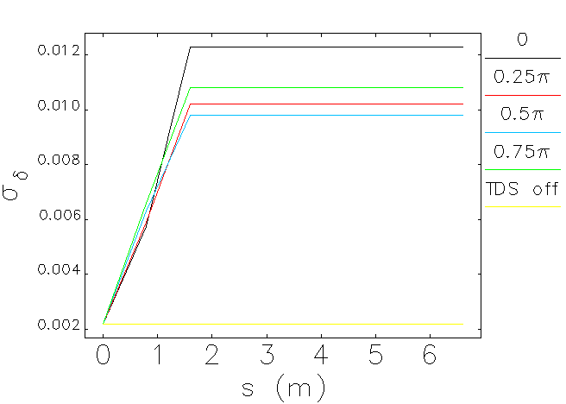
Tomographic reconstruction
Bunch length decreases with TDS off
Bunch length increases with TDS on
Slices don’t match up

Slide 16




Induced Energy Spread
Panofsky-Wenzel Theorem:
  Transverse deflection only possible if there is a transverse gradient of the longitudinal electric field present
Relative momentum gain:
Ez present
C. Behrens and C. Gerth, DIPAC09. TUPB44

Slide 17
Tomographic reconstruction
Further work:
  Test best possible case using matrix calculation
  Possibly investigate modes (how good is RFDF element in elegant)?
  Add space charge, timing jitter, misalignments…
  (Investigate using other reconstruction algorithms, e.g. MENT)

Slide 18
Applications
SINBAD will provide short bunches for use as a witness beam in LWFA experiments and for testing dielectric structures
TDS will allow characterization of 3D charge density profile of input beam
Dielectric structures
  Inject asymmetric beams
  Characterizing beam important for matching & aperture considerations
LWFA experiments
  Plasma fields (and matching conditions) have longitudinal dependence in certain regimes
  Accelerating fields also influenced by beam offsets so charge profile can help, e.g. for beam loading
Could potentially use for testing beam output by taking many measurements for each streaking direction

Slide 19
Summary
New X-band TDS being developed for use at DESY & PSI facilities
Allows streaking of bunch at all angles
Opens up possibility of doing a 3D charge profile reconstruction using tomographic techniques
Induced momentum spread is a problem
Further studies needed
Applications for LWFA and dielectric experiments
Conference submissions to IPAC’17 being prepared

Slide 20
Acknowledgements
Present team working on application of X-band technology at DESY:
B. Marchetti (DESY coordinator), R. Aßmann, R. Bacher, B. Beutner, J. Branland, F. Christie, R. D‘Arcy, W. Decking, U. Dorda, B. Faatz, C. Gerth, J. Herrmann, M. Hoffmann, M. Hüning, G. Kube, O. Krebs, S. Lederer, F. Ludwig, F. Marutzky, D. Marx, J. Osterhoff, I. Peperkorn, J. Rothenburg, S. Pfeiffer, H. Schlarb, M. Scholz, S. Schreiber, J. Rönsch-Schulenburg, M. Vogt, A. Wagner, T. Wilksen, K. Wittenburg.
In addition, we are supported by colleagues from CERN & PSI, including:
A. Grudiev, W. Wuensch, N. Catalan Lasheras, G. Mcmonagle (CERN)
P. Craievich, M. Pedrozzi, H. Braun (PSI)

Slide 21







Defining Shear Parameter, S
This is just ratio between transverse and longitudinal energy
Assuming TDS operated at zero-crossing
Defining matrix transformation between cavity and screen (TDS off)
$ζ$-dependent vertical shift due to TDS
Definition of shear parameter

Slide 22
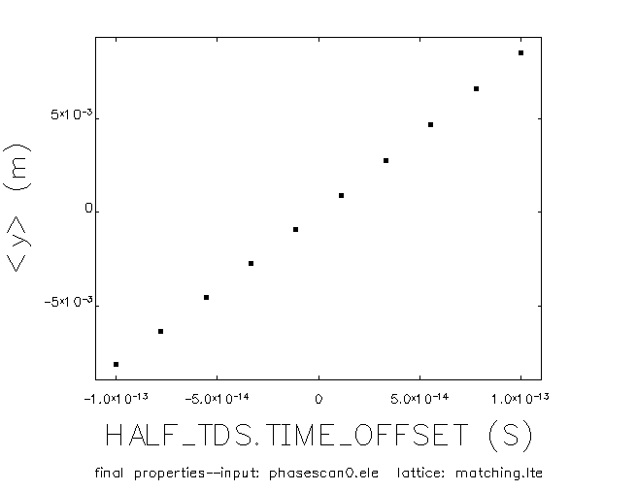
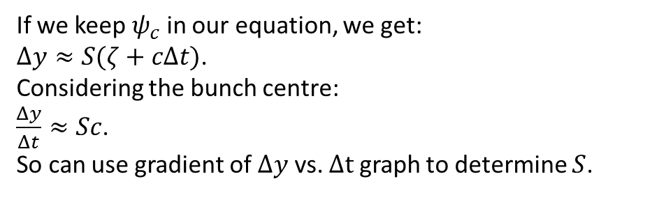
Finding Shear Parameter, S
If we keep $ψ_{c}$ in our equation, we get:
$Δy≈S(ζ+cΔt)$.
Considering the bunch centre:
$\frac{Δy}{Δt}≈Sc$.
So can use gradient of $Δy$ vs. $Δt$ graph to determine $S$.

Slide 23


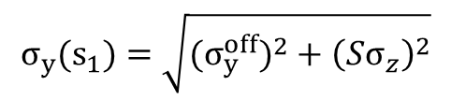
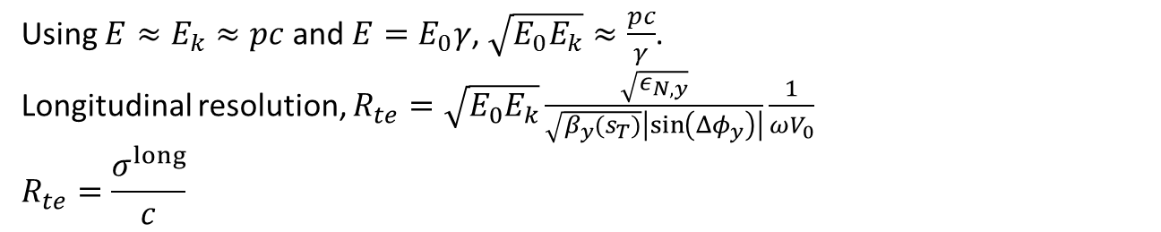
Resolution
$$σ_{y}(s_{1})=\sqrt{({σ_{y}^{off})}^{2}+{\left(Sσ_{z}^{}\right)}^{2}}$$
RMS spot size on screen is due to nominal beam size plus TDS-induced beam size
$$|S|σ_{long}=σ_{y}^{off}$$
This equation defines longitudinal resolution, $σ_{long}$
When TDS is off ($ε_{y}$ is unnormalized emittance)
Transfer matrix element
Second equality is simply the result of using equations above and rearranging (equivalent to Eq. 10 of Emma et al. (2000)).
Using $E≈E_{k}≈pc$ and $E=E_{0}γ$, $\sqrt{E_{0}E_{k}}≈\frac{pc}{γ}$.
Longitudinal resolution, $R_{te}=\sqrt{E_{0}E_{k}}\frac{\sqrt{ε_{N,y}}}{\sqrt{β_{y}(s_{T})}\left|\sin\left(Δφ_{y}\right)\right|}\frac{1}{ωV_{0}}$
$$R_{te}=\frac{σ^{long}}{c}$$

Slide 24
Induced Energy Spread
Panofsky-Wenzel Theorem:
  Transverse deflection only possible if there is a transverse gradient of the longitudinal electric field present
Relative momentum gain:
Ez present

