Slide 1
XGM – progress week 13 / 2017
Dr. Jan Grünert
X-ray Photon Diagnostics
Group Leader
Hamburg, March 31st, 2017
Contains information from WP74 team
and from K.Tiedtke / F.Jastrow from DESY-FS-FL-D

Slide 2
XGM - Progress (w13)
XGM@XTD2
Grounding works performed and completed
XGM@XTD9
SRG RD calibration measurement done (for N2)
Serial connection from MTCA to RVC 300
XGM@XHE3
Repair (exchange of resistors) of XGM005 and XGM006
Free up our UPS at XHE3 to install it at XGM@XTD10
Grounding works planning for XTD9+10 on Friday 31.3.2017
Commissioning of all DOOCS controls (incl. ADAM&FEMTO) at XTD2+9: DONE

Slide 3
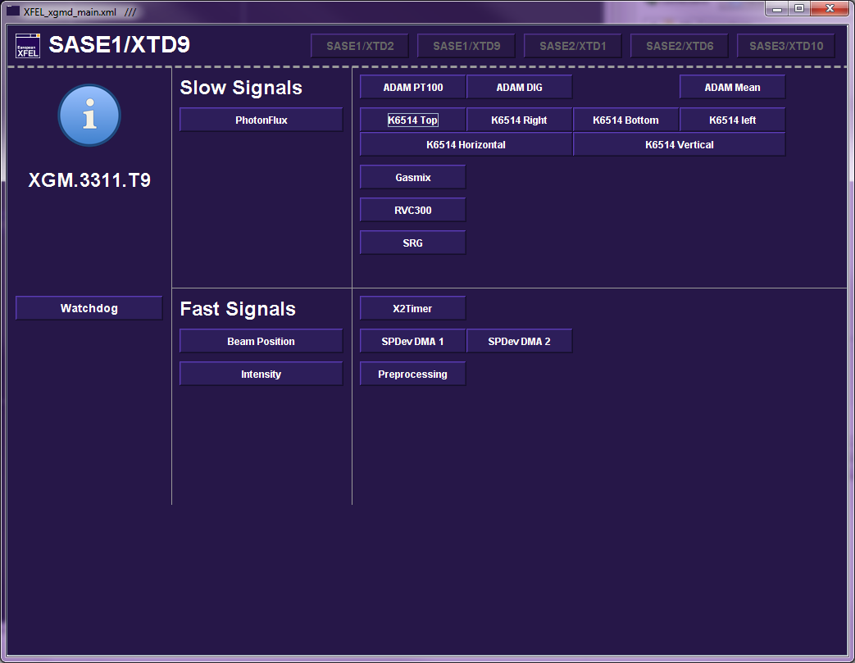
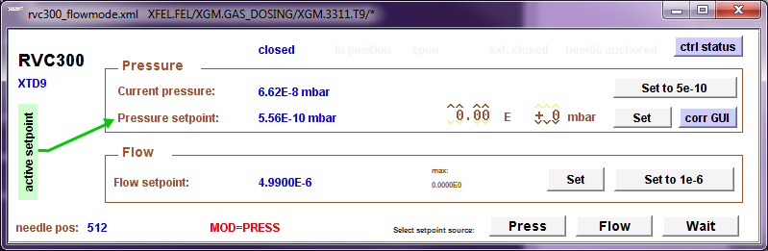
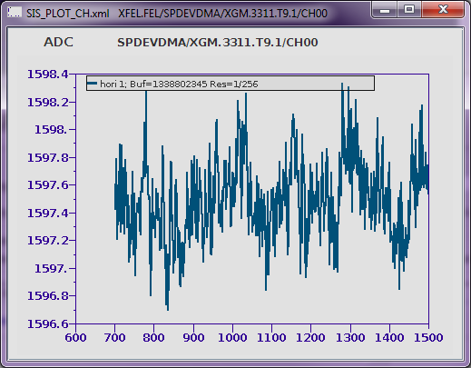
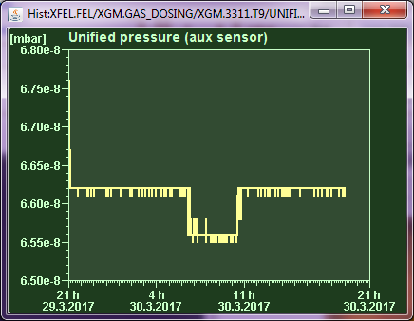
DOOCS control panels operating

Slide 4
XGM – Repair Progress Summary (w13)
XGM | Preparation | Resistor exchange | Leak test | HV test | Survey
HERA XGM01 | done | done | done |  | 25.4.2017
XTD2 XGM02 | done | done | done | done | done
XTD9 XGM04 | done | done | done | done | done
XTD10 XGM07 | done | done | done | done | done
XHE3 XGM05 | done | done
XHE3 XGM06 | done | done

Slide 5
XGM - Plan week 14
Grounding works
continue with XTD9 + XTD10
XTD 2:
Serial connection from Beckhoff to TCP 350.
Change remaining cold plug cables into halogenfree cables.
insert XGM-vacuum into LOOP
XTD 9:
INHIBIT connection Iseg HV crate.
XTD 10:
Vacuum part and Gas Panel wiring of XGM – ongoing
Installation of UPS
Local wiring on XGM chambers; installation ADAM & Femto crate

Slide 6
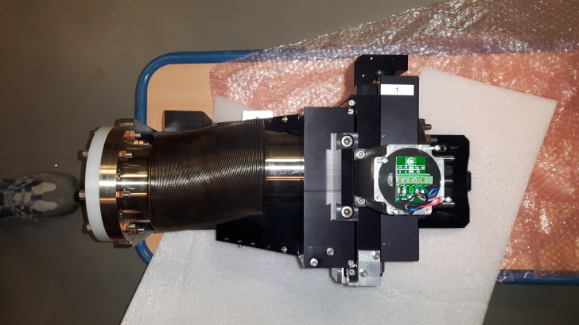
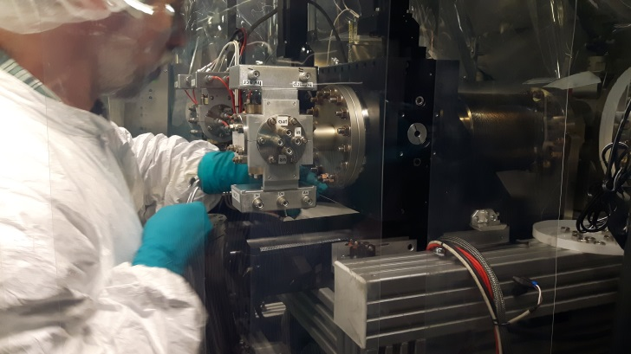
MCP - status
MCP@XTD2: detected big issue with downstream manipulator during Technical Commissioning:
Mechanical failure of spindle, friction up to seizure
Must be replaced, cannot be done in-situ
Repair Status: DONE
Opened UHV, removed delicate MCPs
Remove + repair manipulator at VAb DONE (w12)
Reinstallation DONE (w13)
Recommissioning: HV conditioning
Checking MCP-BOS: OK
MCP s/w commissioning (Beckhoff):
Motor movement using mc2lib / Technosoft controller locally tested, to put in LOOP by AE (end of w13?)
MCP s/w commissioning (karabo):
ongoing (with CY,WE) today 9am at XTD2

