Slide 1
XFEL Operator Training Beam transport beyond B2
Matthias Scholz
MXL
Hamburg, 23.02.2017

Slide 2
What is the aim of this operator training?
This is the continuation of the operator training ‘startup procedure’. where you got a recipe how to restart the machine with beam transport up to B2D.
This training provides a recipe how to transport the beam beyond the B2-section.
So far, the only beamline in operation is the dump beamline TLD.
Recipes for further beamlines ending in T4D or T5D will follow as soon as we have beam there.

Slide 3
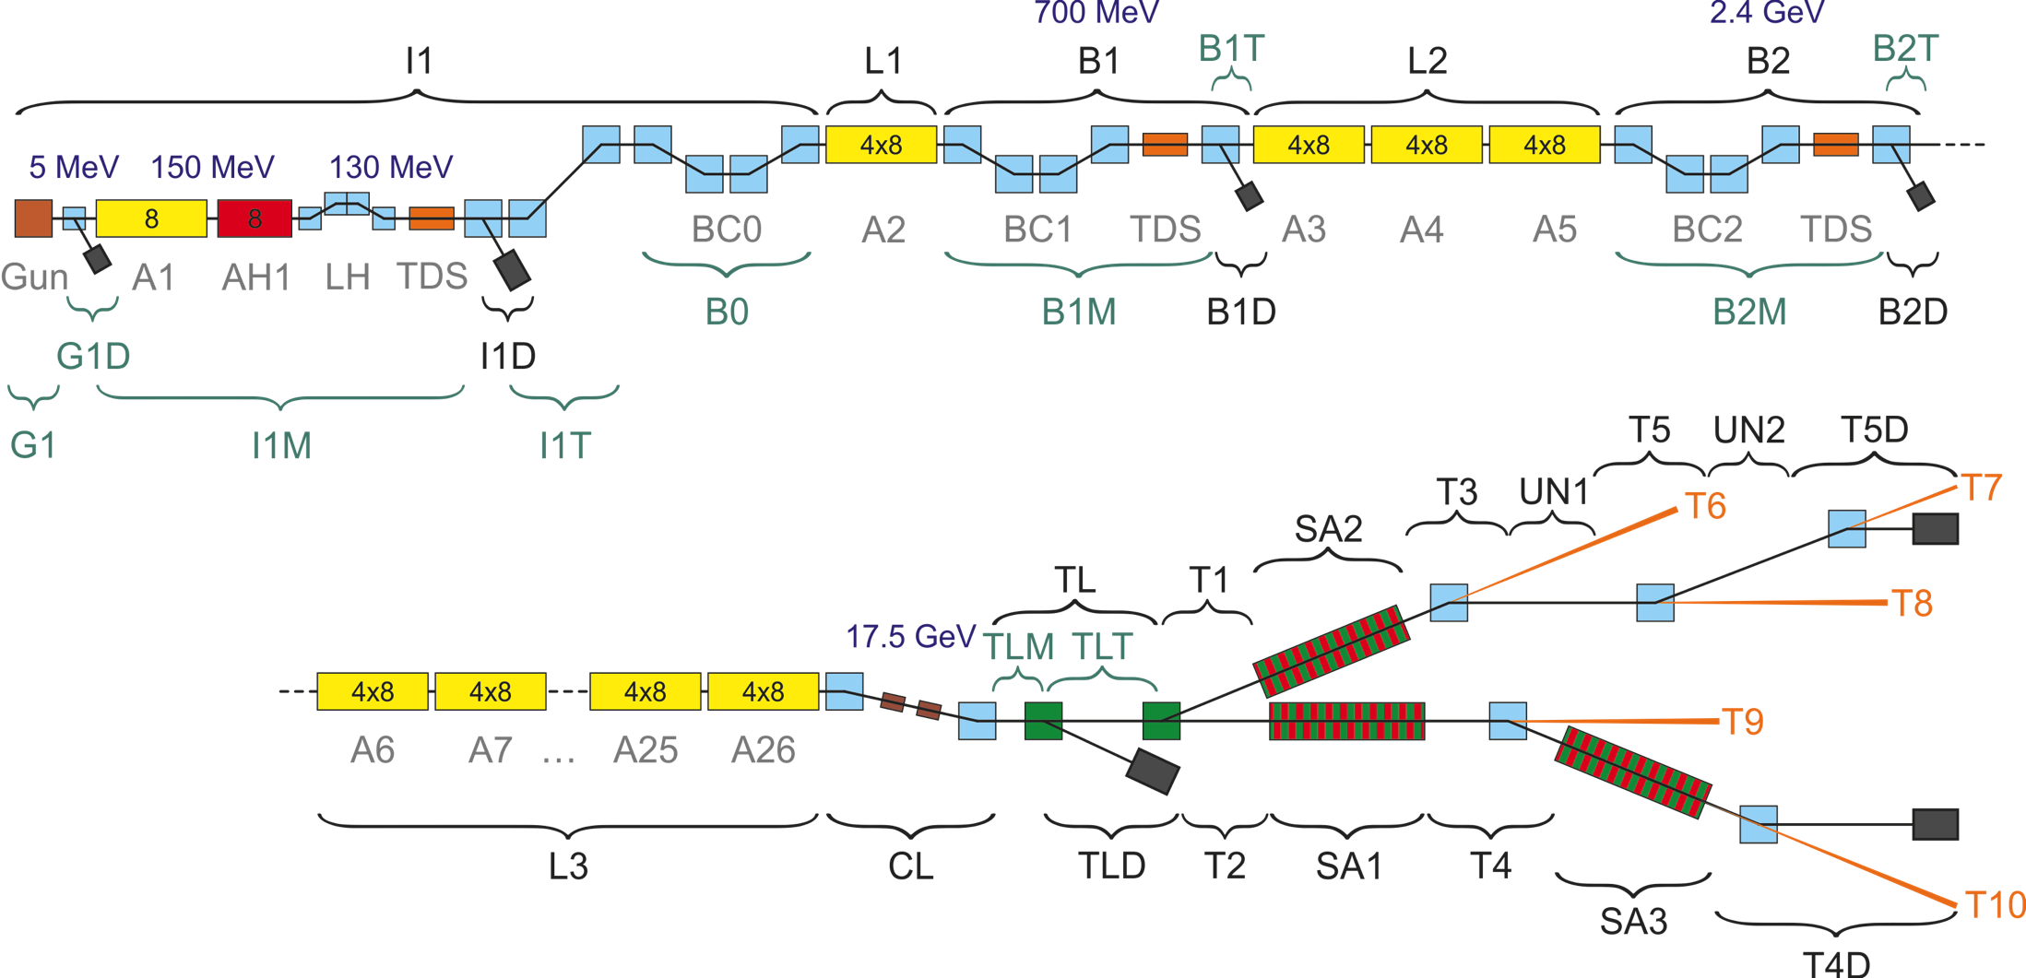
XFEL dumps / dump beamlines
G1D, I1D, B1D, B2D, TLD, T4D, T5D

Slide 4
What has to be done before this recipe can be applied
The beam is matched in the injector.
All phases of the gun, A1, AH1, …, A5 are well known and set up as required.
The beam energies in the injector, downstream L1 and L2 are as required.
Beam is in B2D or at least in the B2 section.
Losses in the sections up to B2 are minimized. No BLM signals above threshold!
Beam optics between injector FODO and up to B2 is on design (matching quads can deviate). Magnets are cycled.
Chicanes are set up as necessary! Changing the chicane settings will change also the phases of the following modules thus is has to be set up earliest possible.
All these steps can be found in the ‘start-up procedure’ operator training!

Slide 5
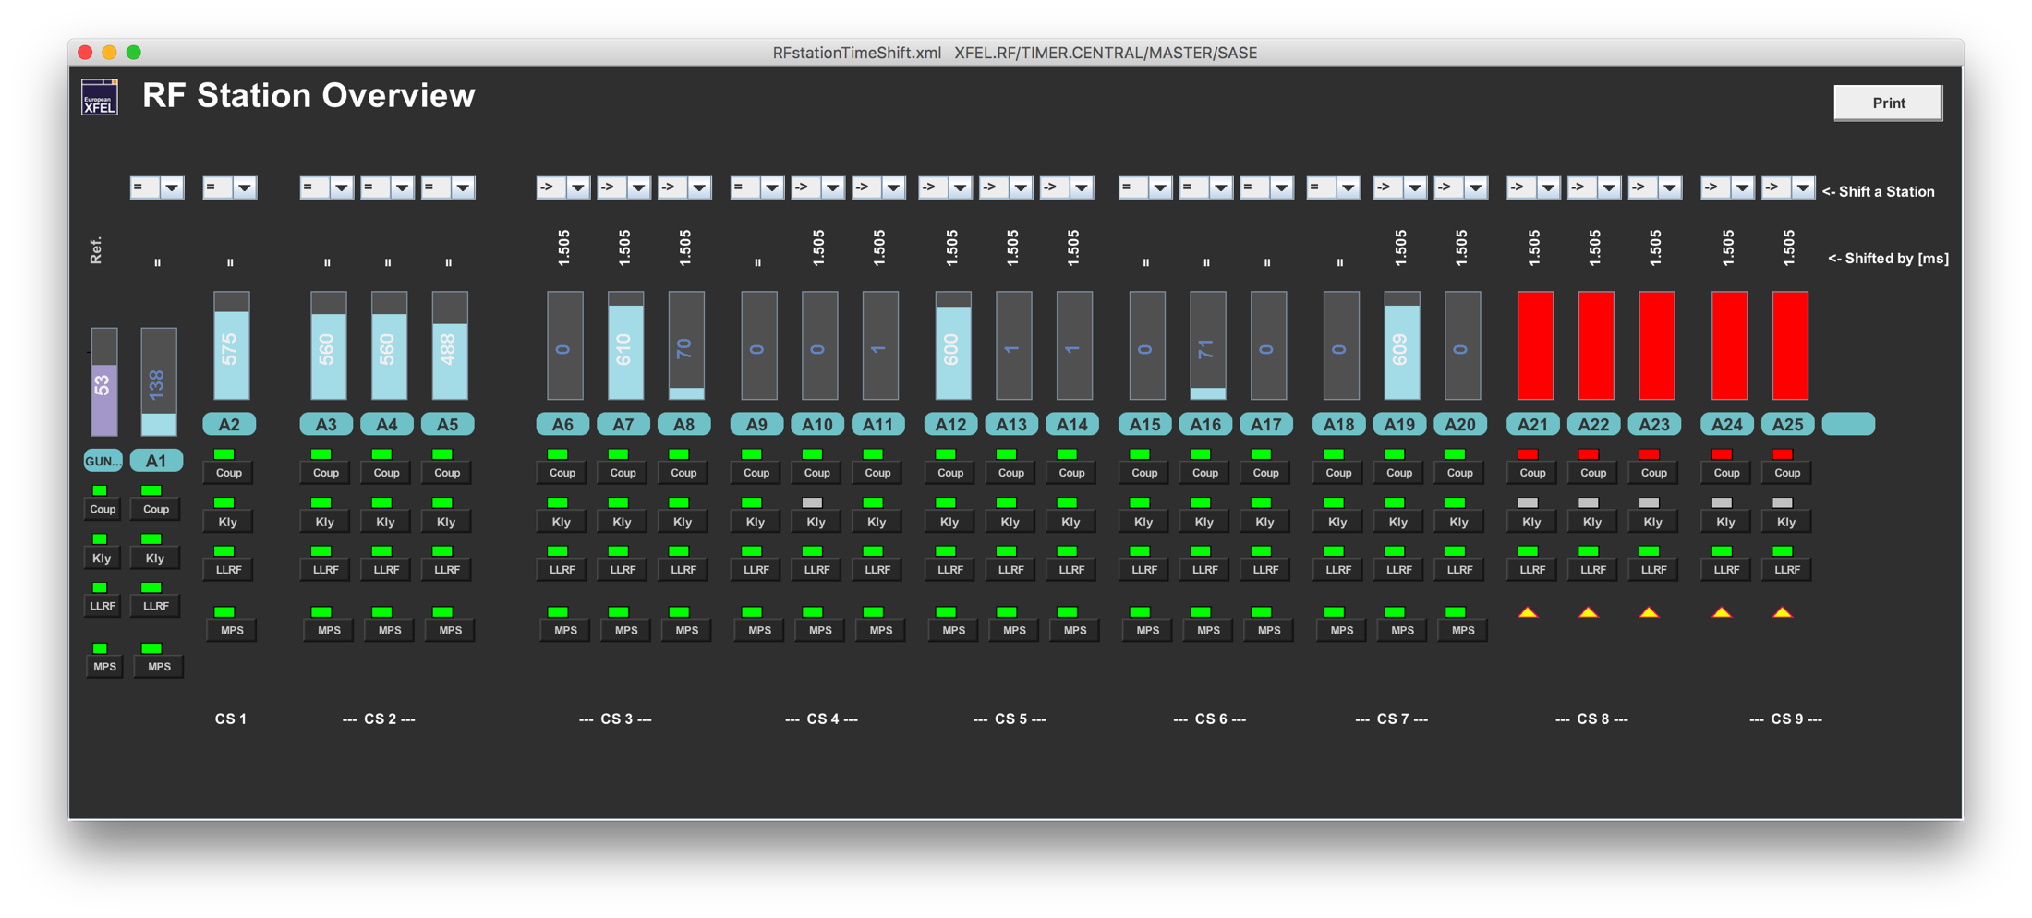
Check L3 LLRF settings
Just for your curiosity: Are the L3 modules on or off the beam?
Main Panel -> Injector -> Main Timing -> Use Expert tab -> Show shifting status of RF stations

Slide 6
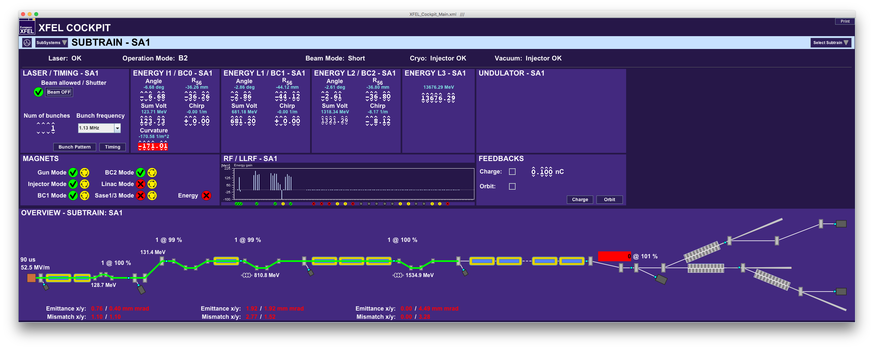
Check L3 LLRF settings
The start panel of the cockpit shows the beam energy at the different steps along the linac. Of coarse the energy can also be changed there.
Main Panel -> Operations Procedures -> Cockpit

Slide 7
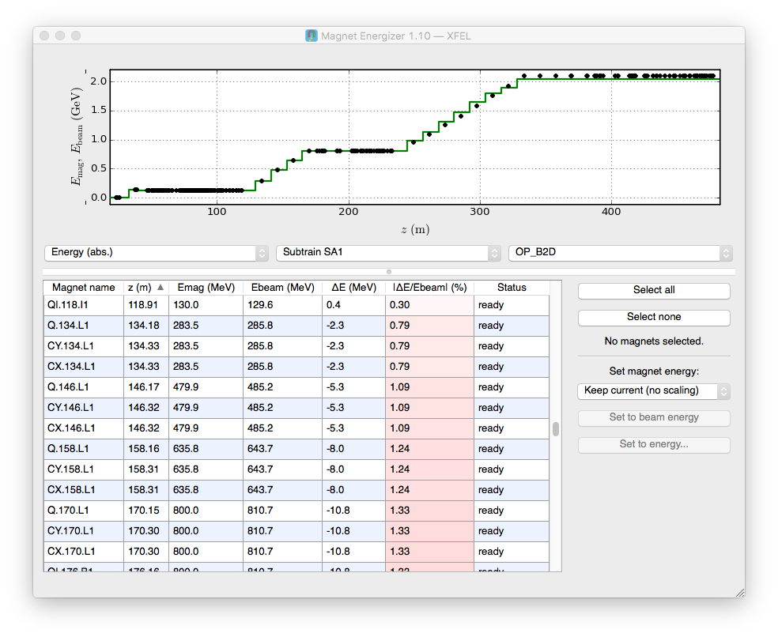
Prepare the magnets downstream the B2 section
In ideal case that is already done because you loaded a file that was dedicated for the required beam energy. Nevertheless, you can check the magnet setup before proceeding.
Load magnet kicks either with the sequencer or from design optics. Both procedures can be found in my ‘start-up procedure’ operator training.
Ensure the correct momentum setup for all magnets using the magnet energizer.
The detailed handling of the magnet energizer is explained in the ‘start-up procedure’ operator training.

Slide 8
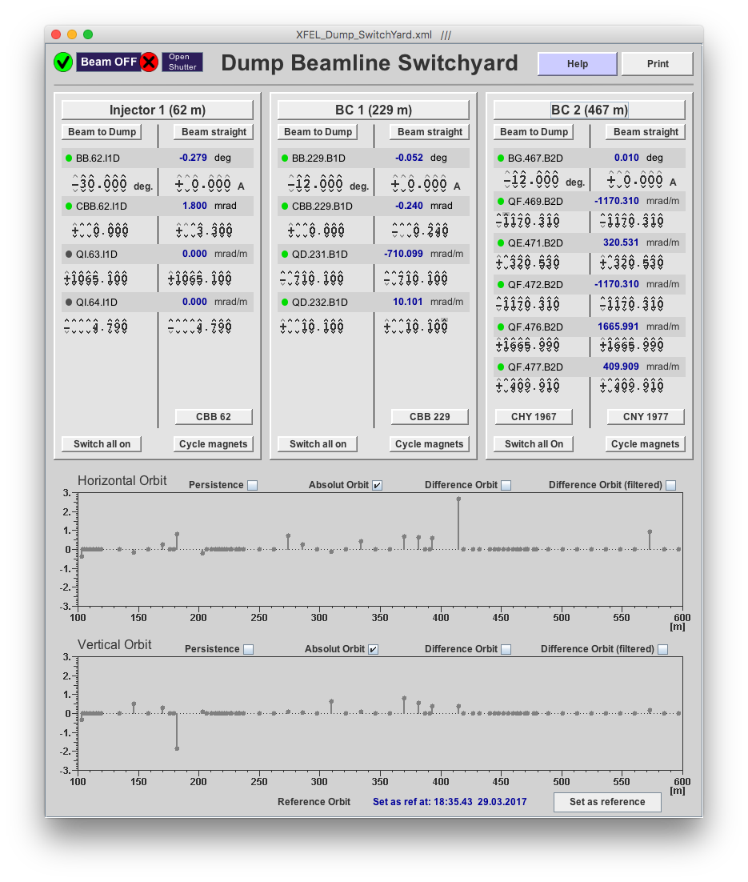
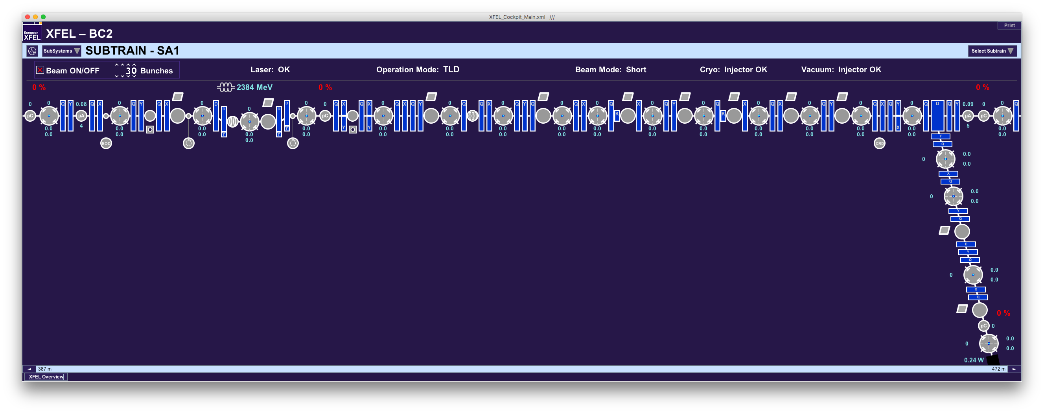
Ramp down BG.467.B2D
Use the dump beamline switchyard panel to ramp down the dump dipole of B2D.
The panel shows also the beam orbit around the dipole.
You can find the panel here:
Main Panel -> Operations and Procedures -> Dump Switch
Correct the vertical beam orbit disturbed by the remanent field of the dipole (See also next slides).

Slide 9
Automated orbit correction
There are three different tools for automated orbit correction. One of the should be used.
Orbit correction tool (Matlab): Main Panel -> Orbit -> Orbit Crawler Correction
Relies on stable BPM information from ML server. The tool crashes if that is not the case. If the data is there, it corrects the beam orbit as expected.
More information can be found in Elena’s operator training.
Orbit feedback: Main Panel -> Feedback and Automation -> Orbit Overview and Orbit Expert
Uses measured transfer matrices and the measurements may take a while (depending on the section length). However, there are already measured sections that should be ready for operation.
More information can be found in Raimund’s operator training dealing with slow feedbacks.
Orbit correction tool (Python)
That tool is still under development by our colleagues from SLAC. I am looking forward to test it at the machine!

Slide 10
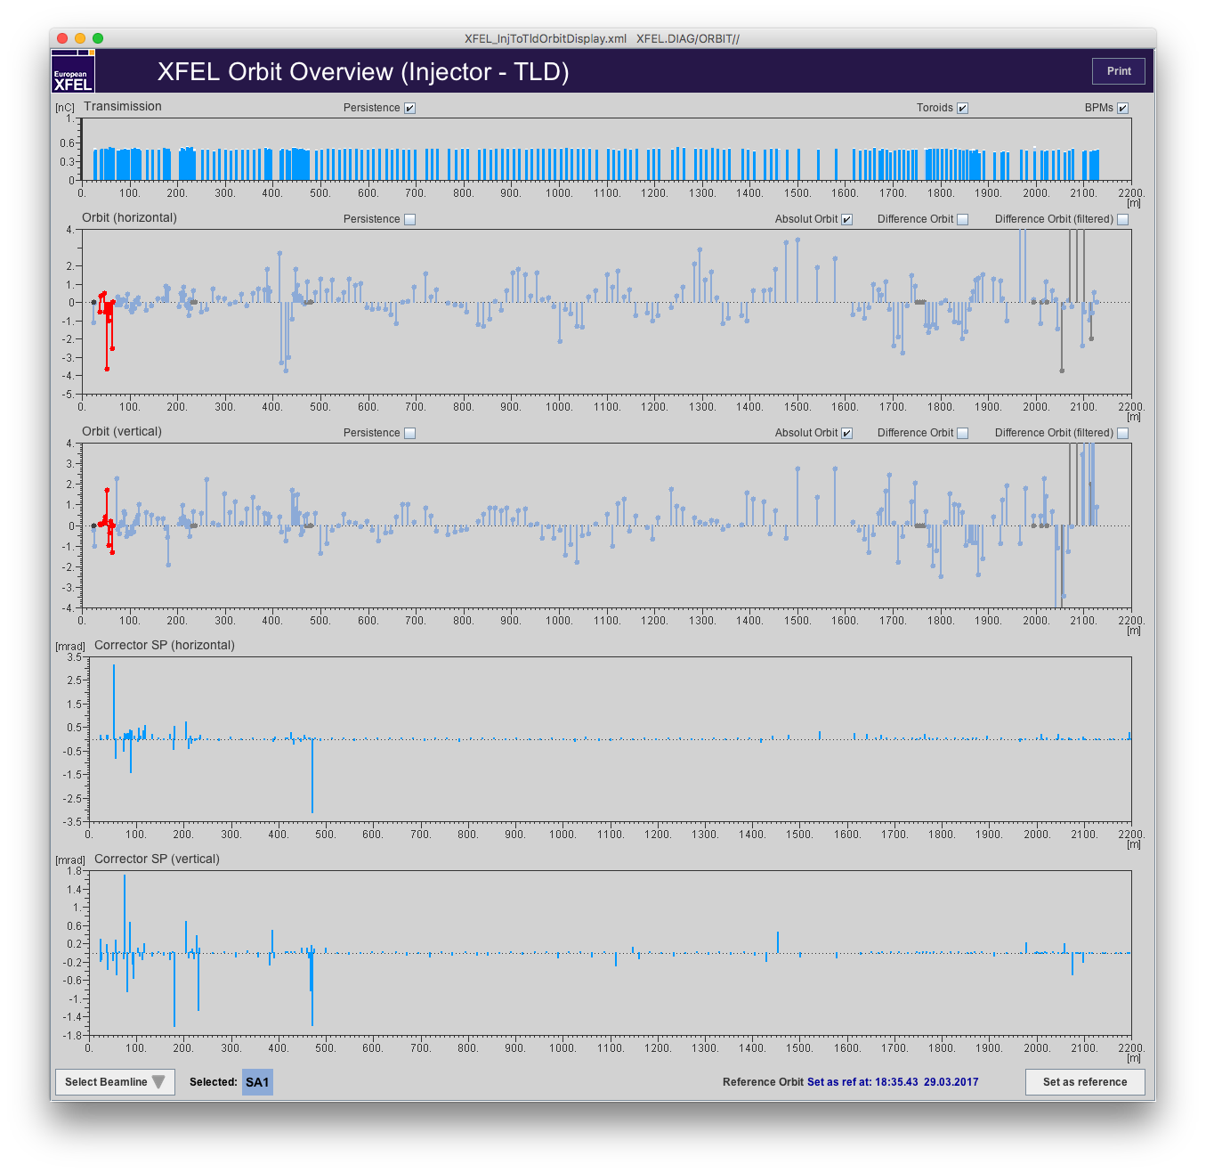
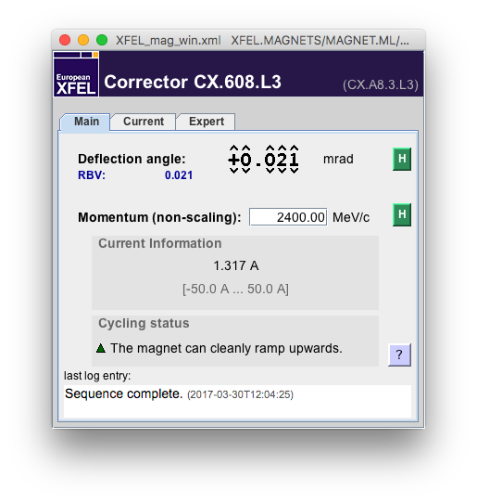
Orbit correction by hand…
At the moment, the tools for automated orbit correction do not work reliably all the time.
If you have to correct the orbit by hand, please use the orbit overview panels shown here ->
Find the position were a betatron oscillation starts.
Select a steerer at the start position of the oscillation and correct the orbit. Double click at the steerer’s position in the panel to open the steerer panel.

Slide 11
What is a good orbit?
The goal is to operate all beamlines with dispersion free orbits.
That does not necessarily mean that the beam has to be at position (0,0) at all BPMs.
We will define/save beam orbits along the beamlines as so called ‘golden orbits’. Those orbits should be the required dispersion free orbits mentioned above.
But… The beam should be steered to the BPM centers as long as no golden orbits are defined/saved. This is still the current status.
Automated tools for orbit corrections are able to correct the orbit in long sections to offsets below several 100 microns within a few iteration steps.
It takes too much time to achieve that by hand e.g. in L3. Thus, offsets below 1 mm in the modules are considered as small enough to continue.

Slide 12
Problems to achieve transmission through L3?
Lets assume you have problems to get transmission through L3 in spite of the fact that the beam orbit is good.
This might be due to wrong RF phases in the modules. We experienced lately that it can happen after a shut down that the on-crest phases of the RF stations are far off after restart.
Large deviations of the on-crest phases lead to a large energy chirp and to less beam energy than expected.
The LLRF colleagues are working on that problem and I am sure they will fix it in reasonable time.
However, you should keep that in mind as long as it can happen. Please arrange a solutions either with the LLRF expert on call or with the run coordinator.

Slide 13
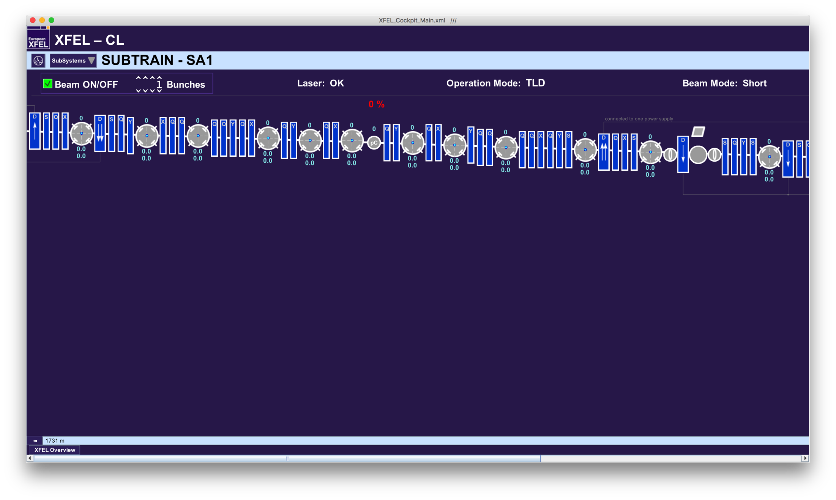
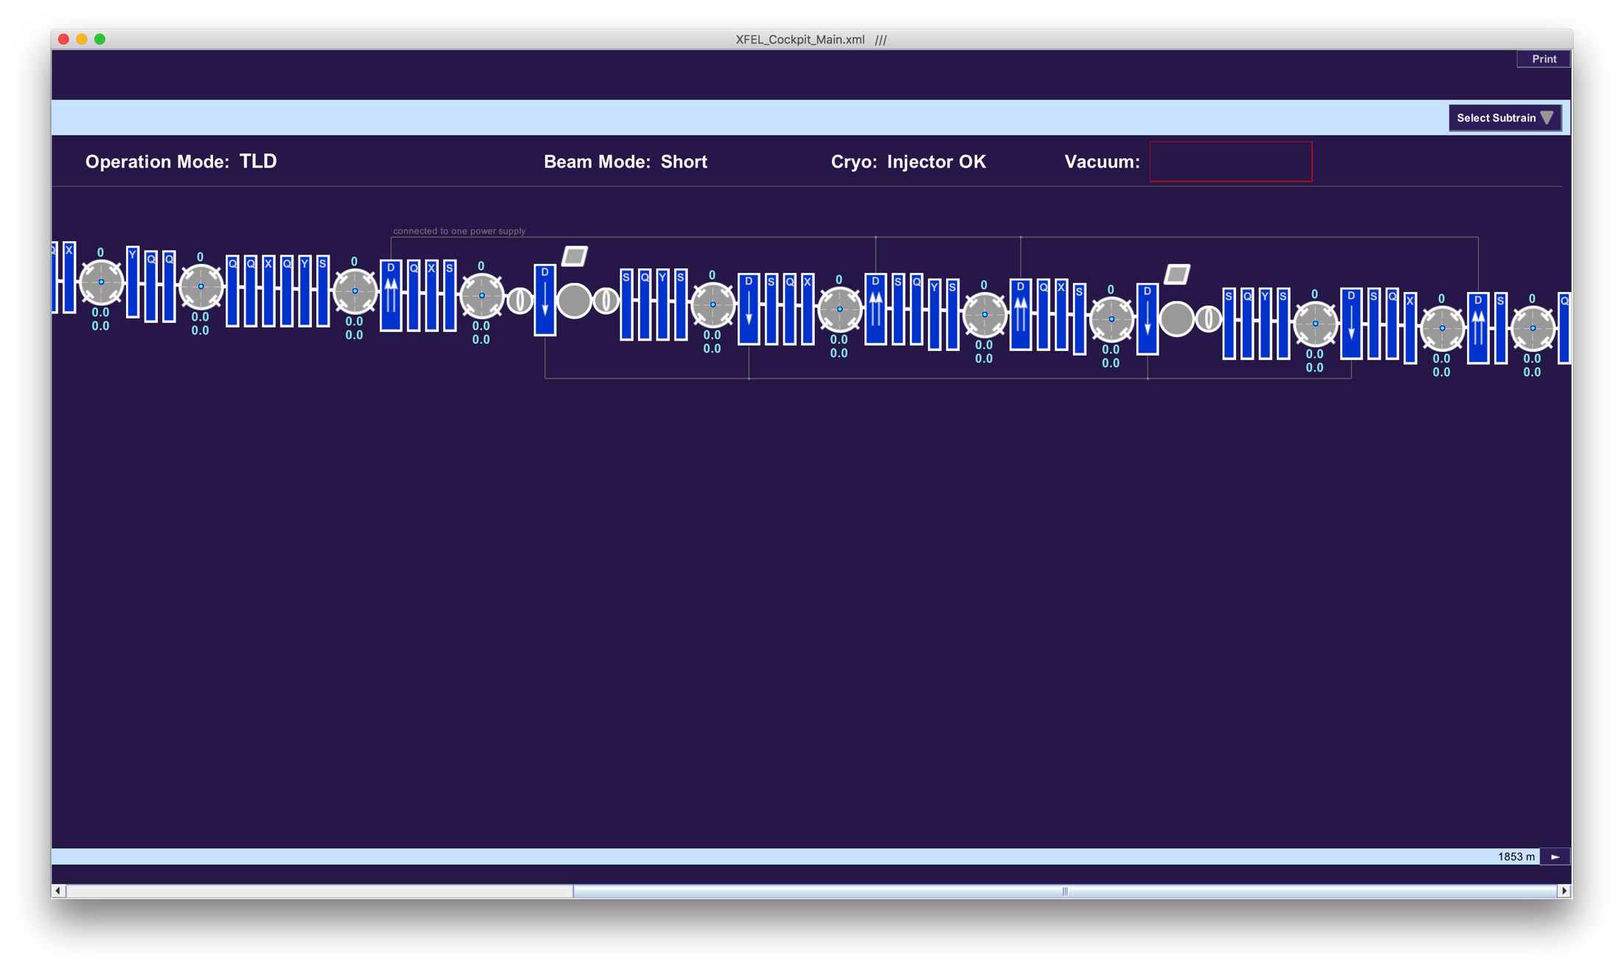
Collimations section CL
Please compare the energy measurement in the collimation section (that you can find e.g. on the cockpit) with the requested beam energy.
The vertical beam orbit in the collimation section (basically between the first and the last dipole) depends also on the beam energy (dispersion). However, if the measured energy and the momentum setpoint of the magnets is the same, that should be no problem.
Orbit correction in the CL section should be done as discussed before. Preferably (!) with one of the correction tools or using the orbit overview.

Slide 14
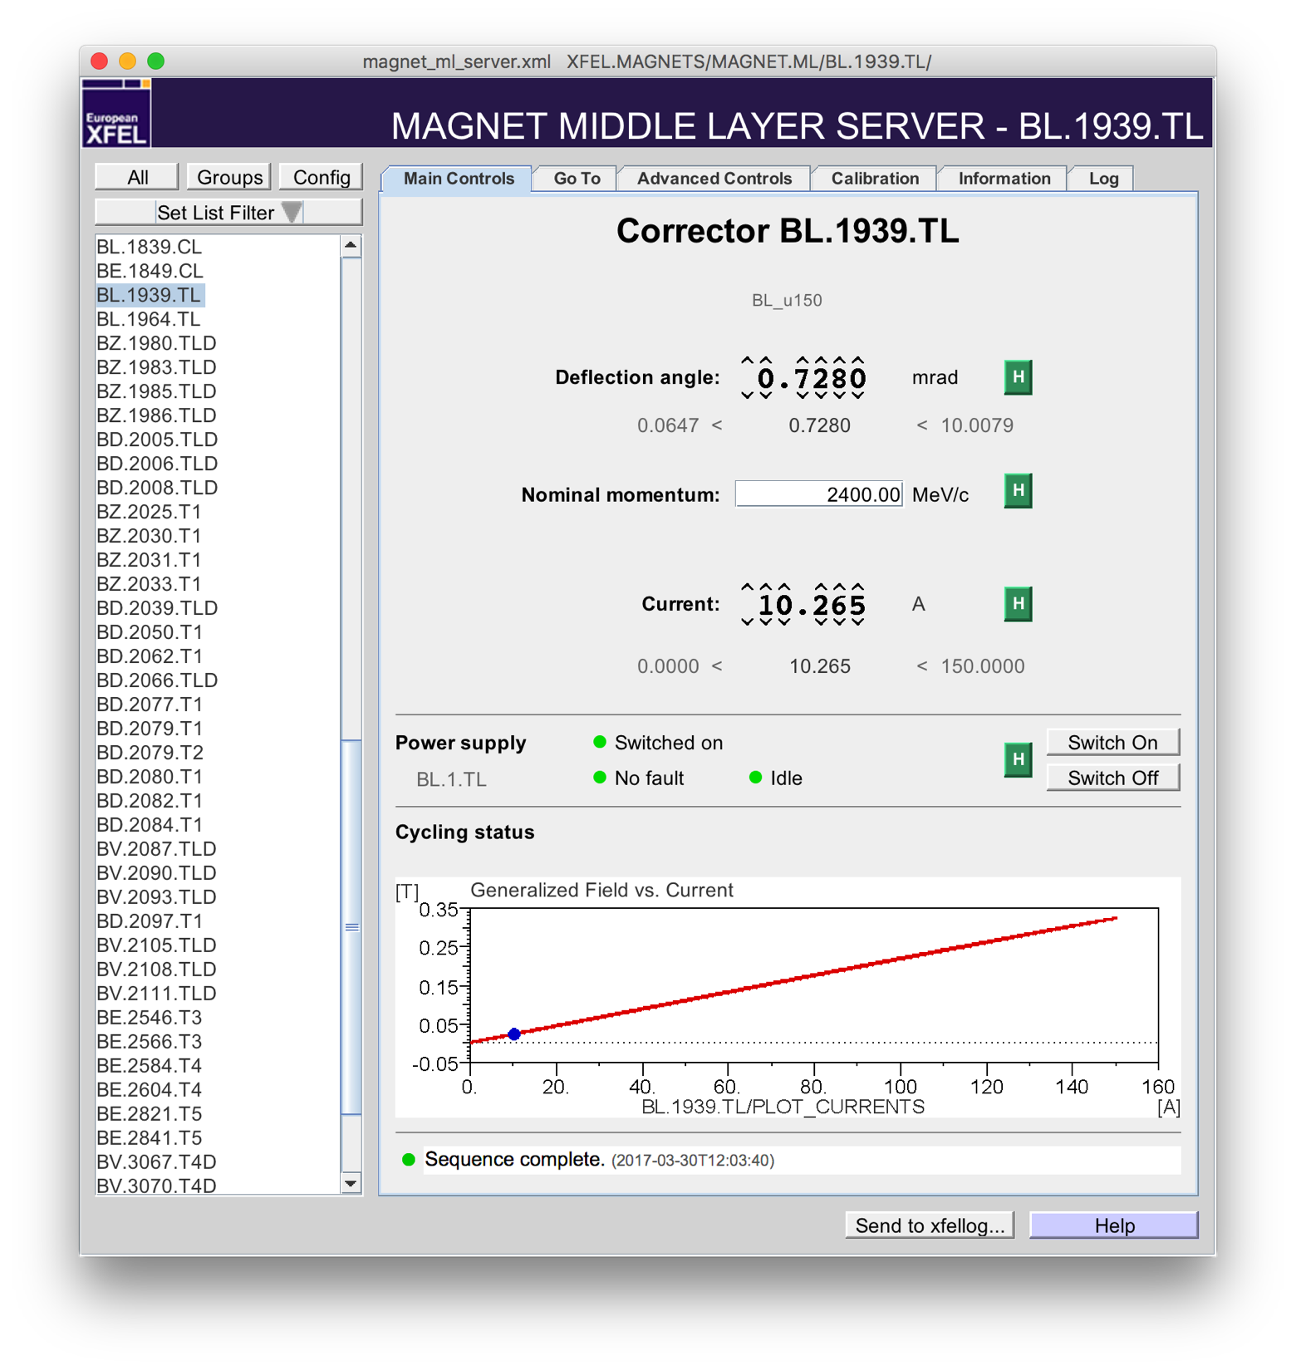
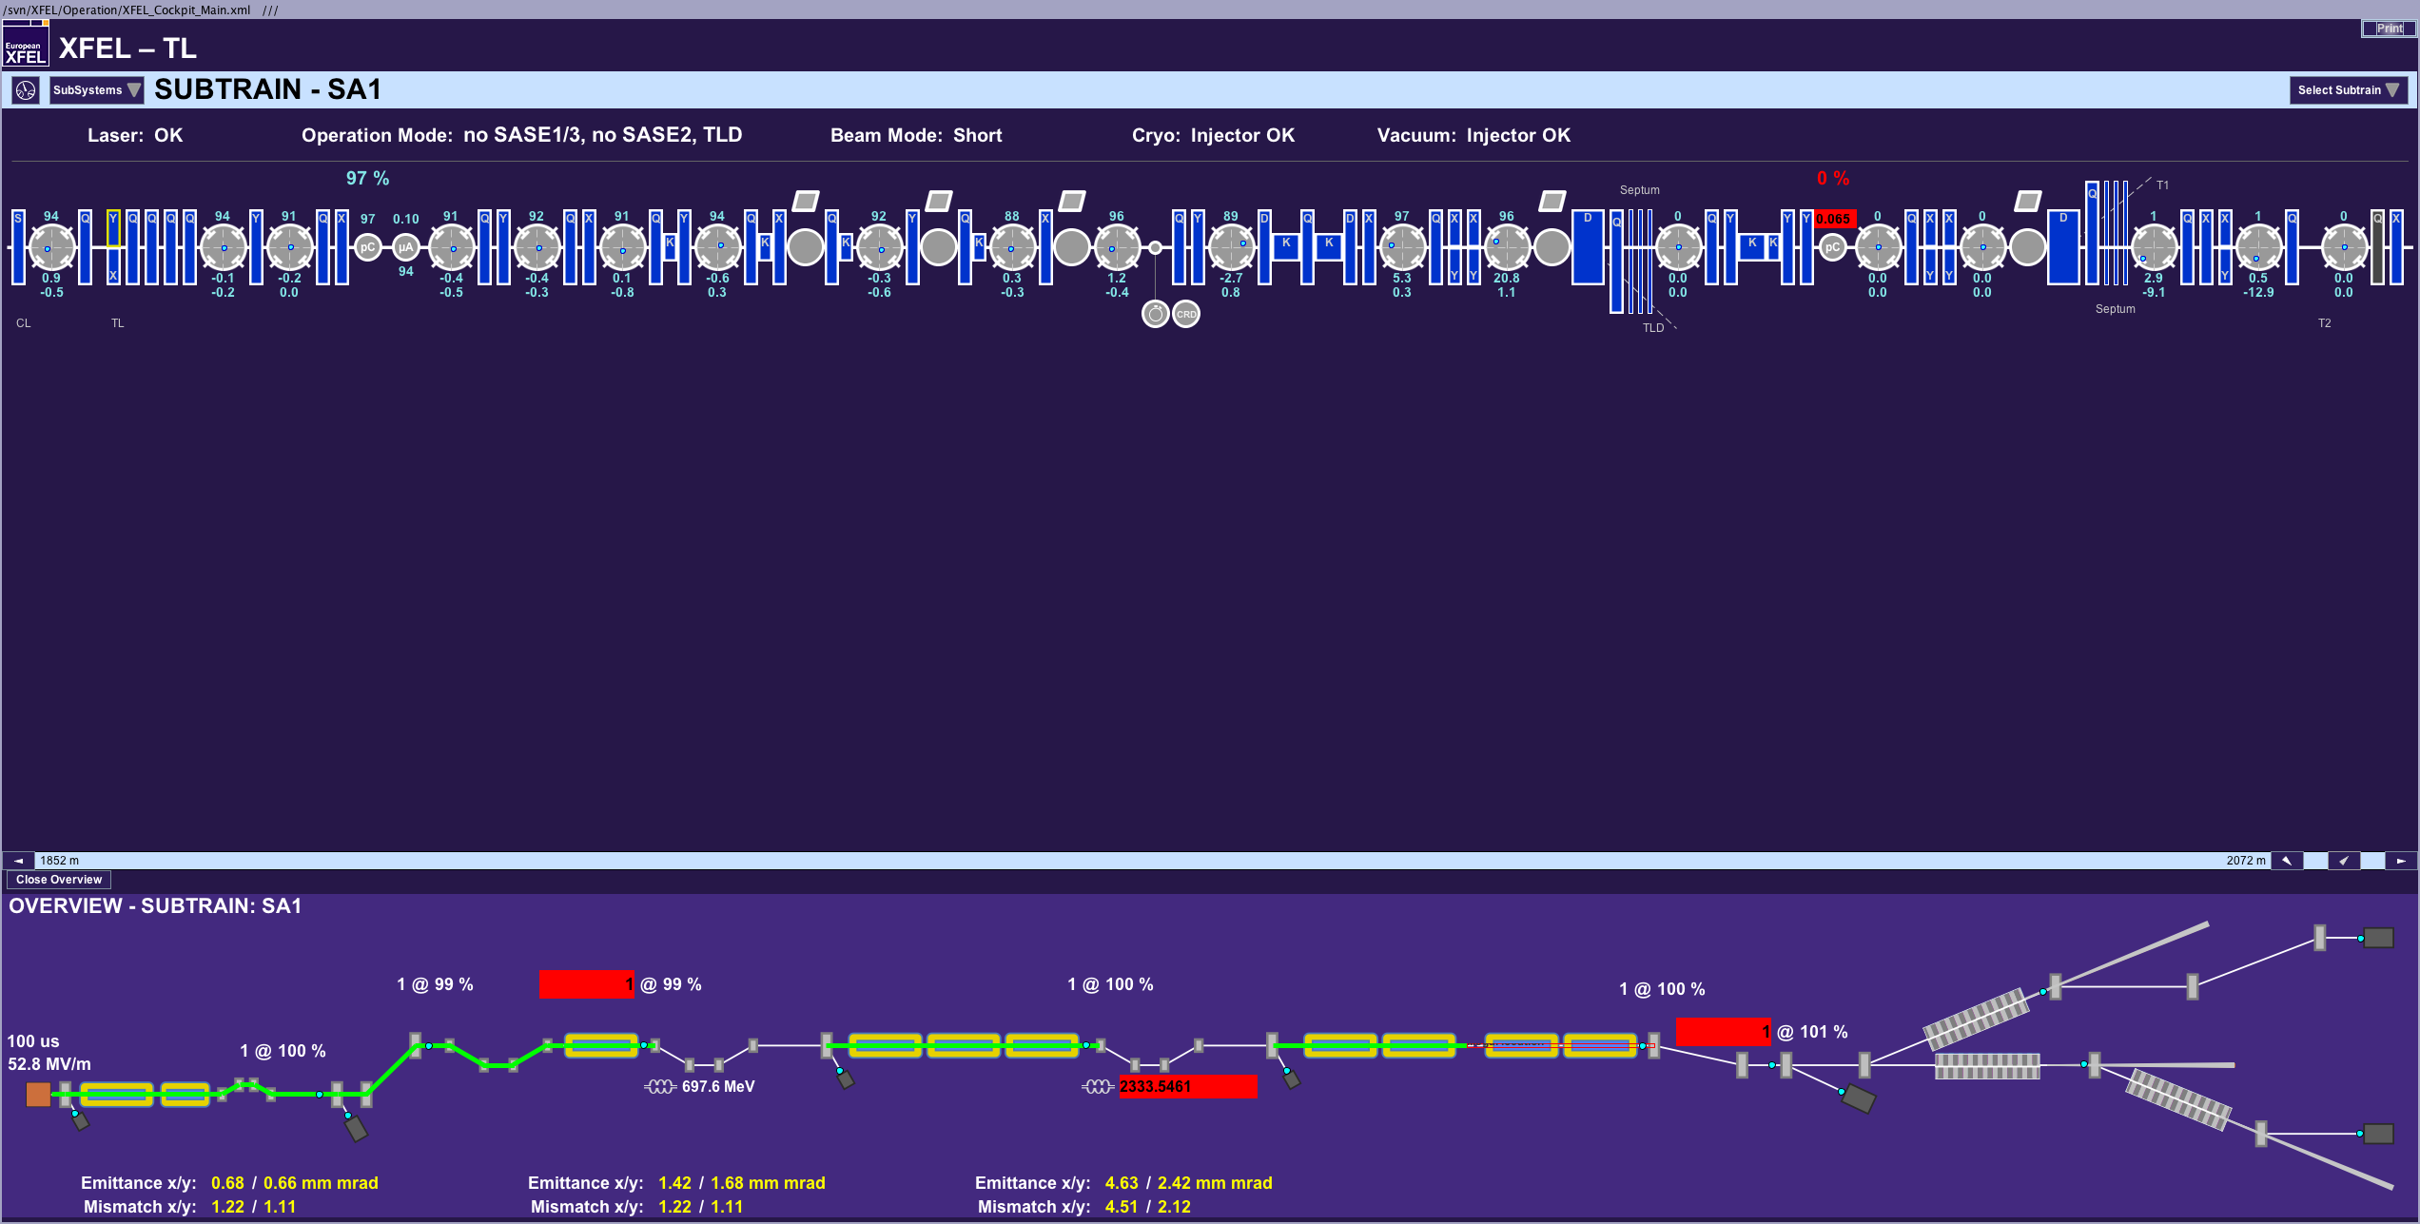
Beam distribution to the TLD beamline
The distribution to the dump beamline (and later also to SASE2 beamline) is realized with so called Lambertson septum magnets.
You need a horizontal offset of 20 mm upstream the septum in order to deliver the beam into the correct beam pipe of the septum.
The offset it not achieved with the normal steerers but the magnets BL.1939.TL and BL.1964.TL.
The beam orbit shown above led to a proper transmission into the TLD beamline.

Slide 15
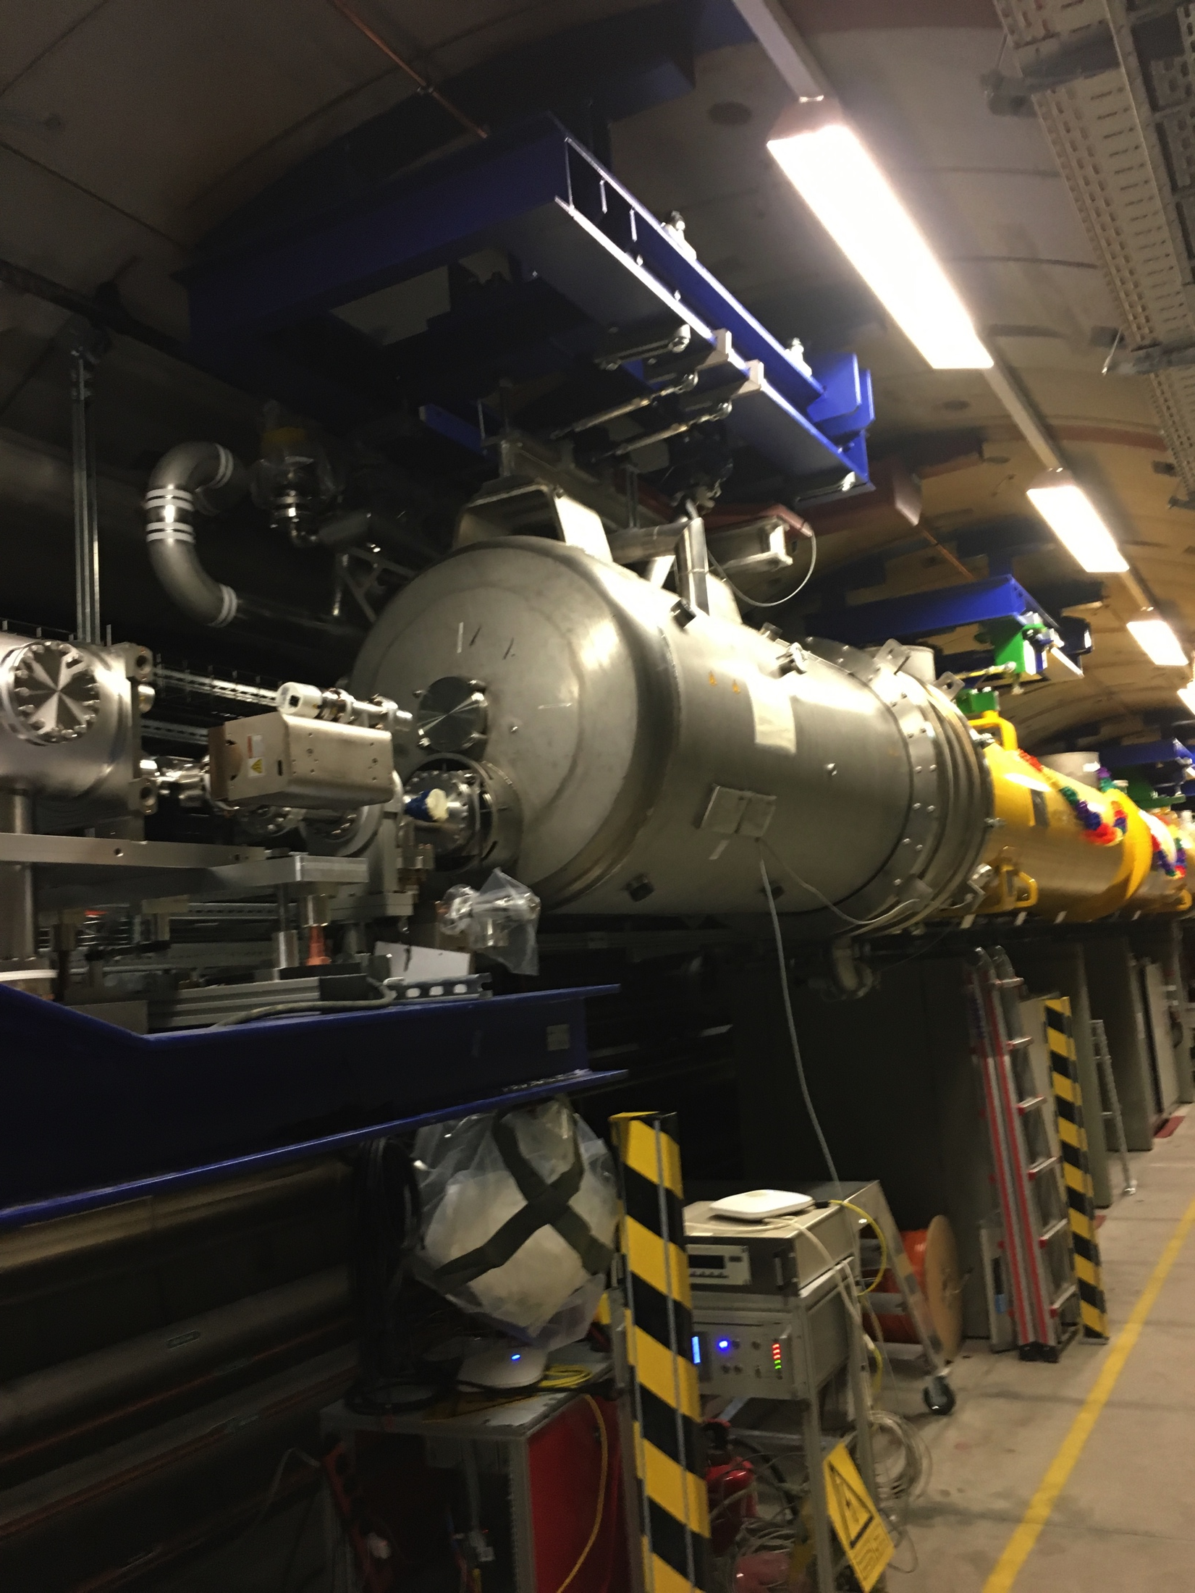
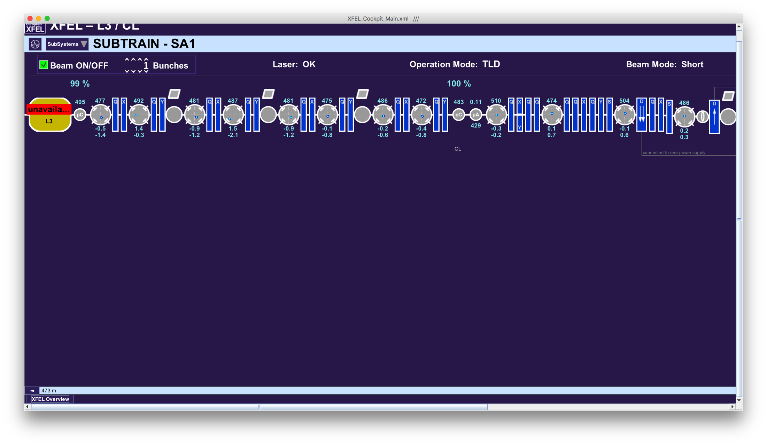
Bottlenecks downstream L3
Differential pump stage at the end of L3. Beam pipe diameter changes from 78 mm to 40 mm.

Slide 16
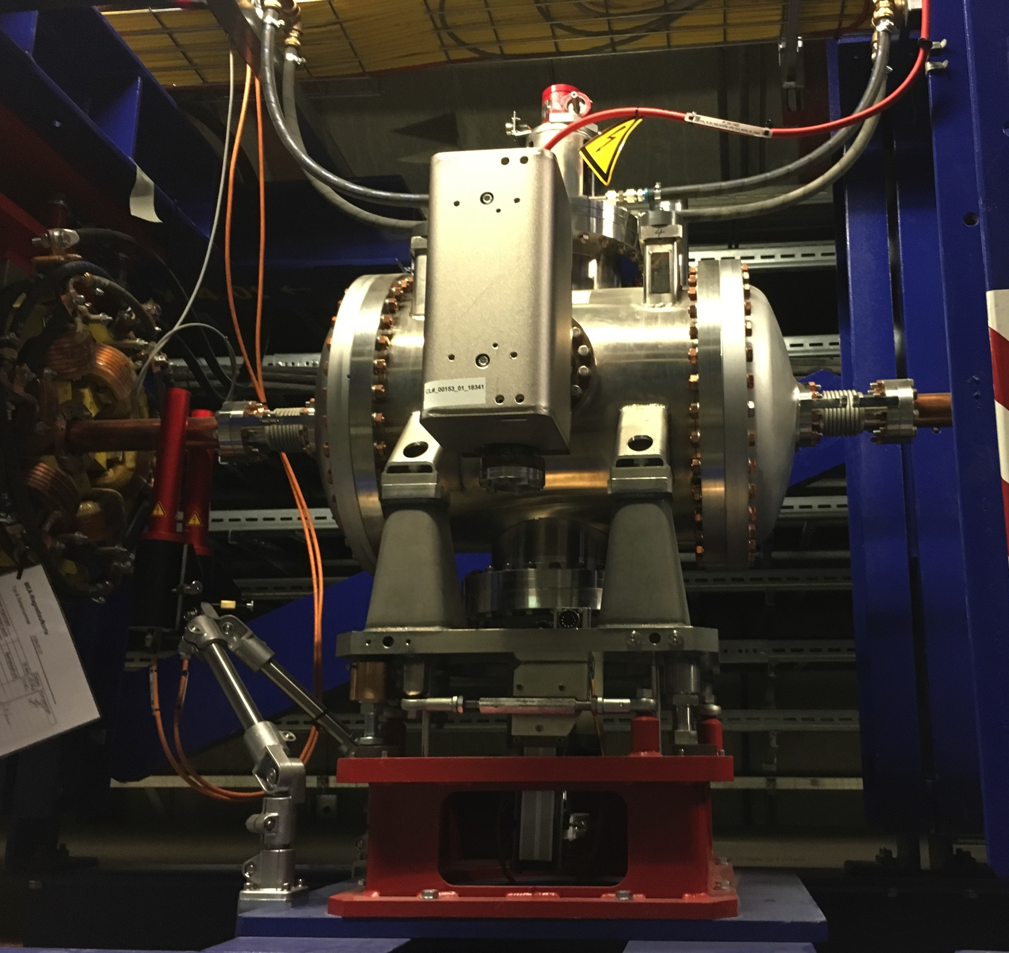
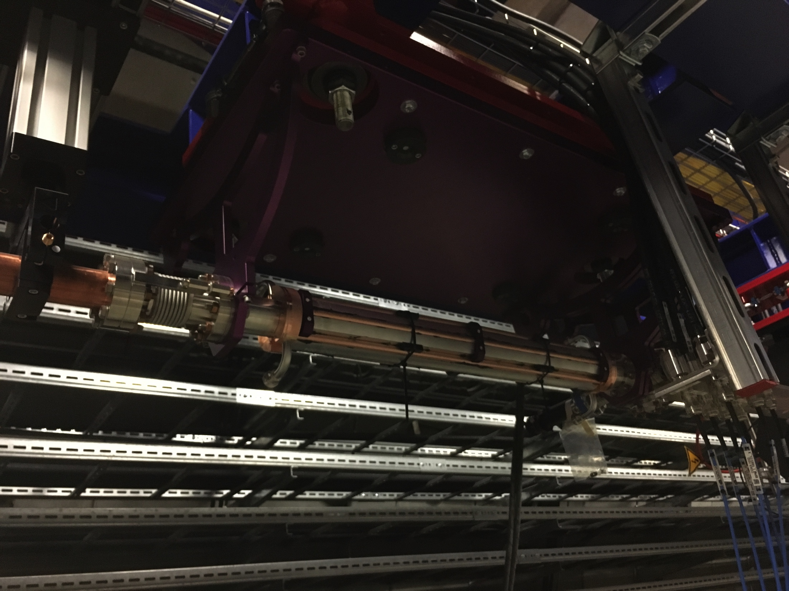
Bottlenecks downstream L3
Pre-collimators and collimators

Slide 17
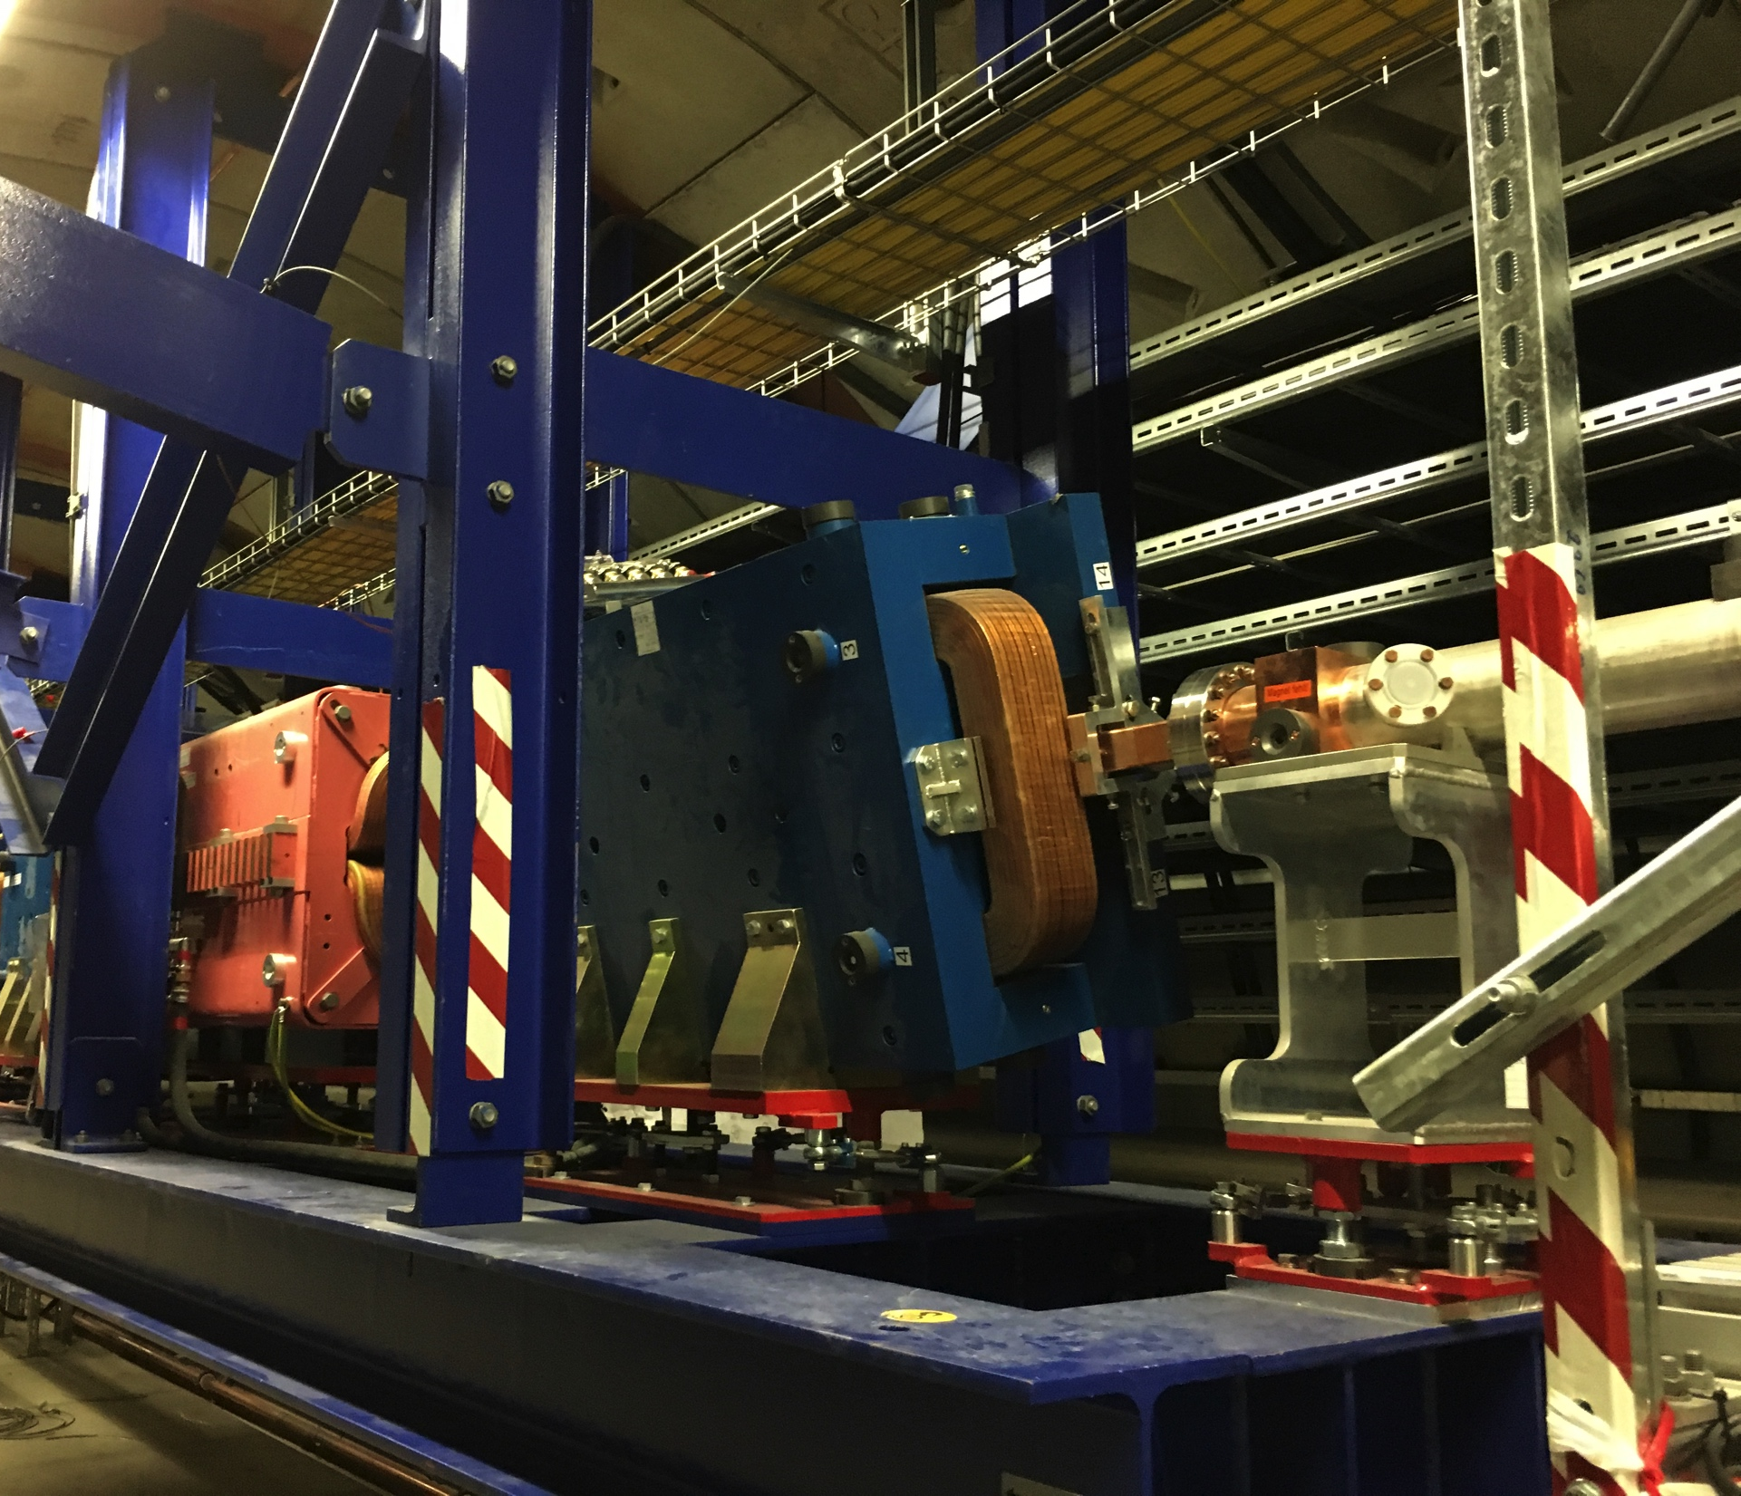
Bottlenecks downstream L3
Septa for beam distribution to TLD and later on to SASE2.
We showed already that we are able to get the beam into TLD beamline with BLM signals below threshold.
However, distributing bunches to TLD and to the SASE sections at the same time will be more complicated.
There will be only 3-4 mm between the beams and the vacuum chambers.

