Slide 1
Slow Feedbacks
XFEL Operator Training
Notes:
How to edit the title slide
Upper area: Title of your talk, max. 2 rows of the defined size (55 pt)
Lower area (subtitle): Conference/meeting/workshop, location, date,
your name and affiliation, max. 4 rows of the defined size (32 pt)

Slide 2
Slow Feedbacks – Introduction
Many feedbacks (FBs) are around:
  RF FBs
  Kicker FBs
  Intra Bunch Train FB
  slow RF FB
  orbit FB
  …
Area of interest very different – but in general two domains
  intra train
  over several pulses

Slide 3
Slow Feedbacks – Introduction
Slow FBs main purpose is to stabilize and
compensate slow drifts
Two most important slow FBs are:
  Transversal FB = orbit FB
  Longitudinal FB = slow RF FB
DOOCS middle layer server based
Exact same software as at FLASH (just configured differently)
Same look & feel as at FLASH (use same panels)
Some differences in underlying interfaces (e.g. magnets)

Slide 4
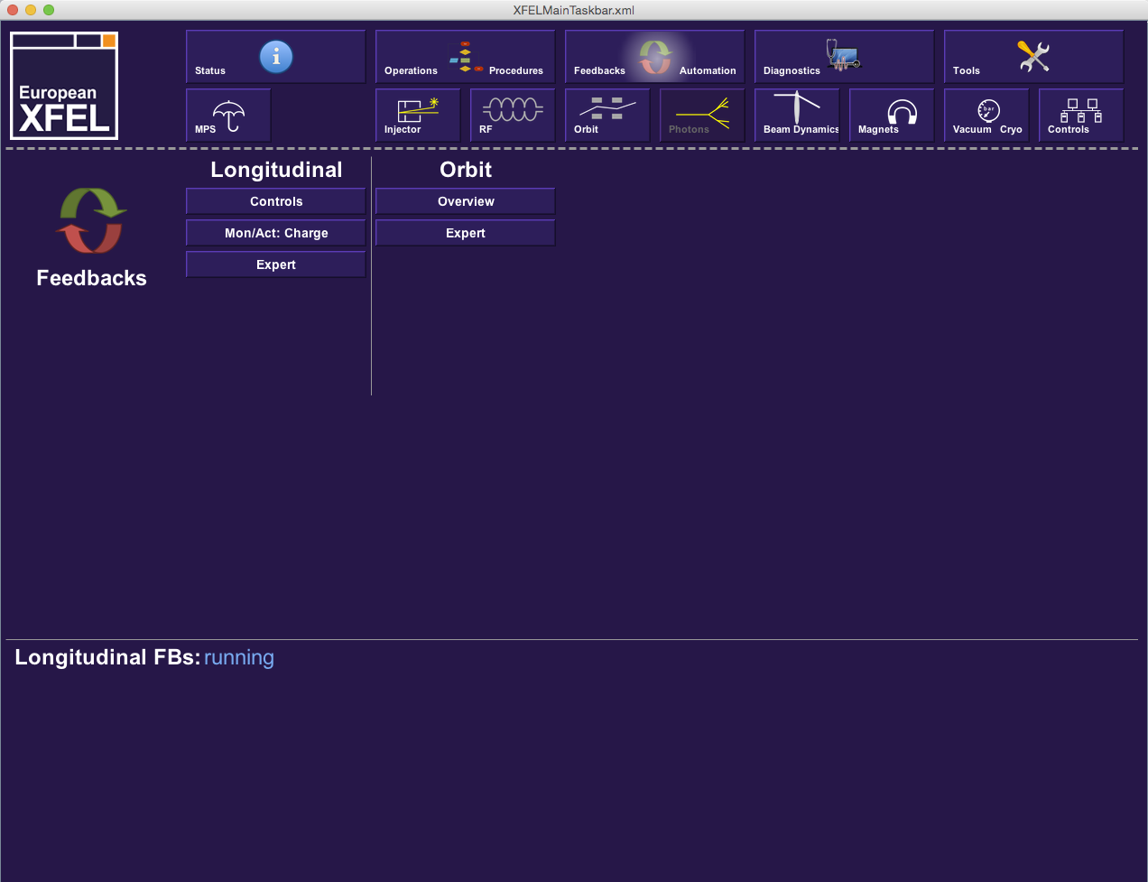
Slow Feedbacks – How to get there

Slide 5
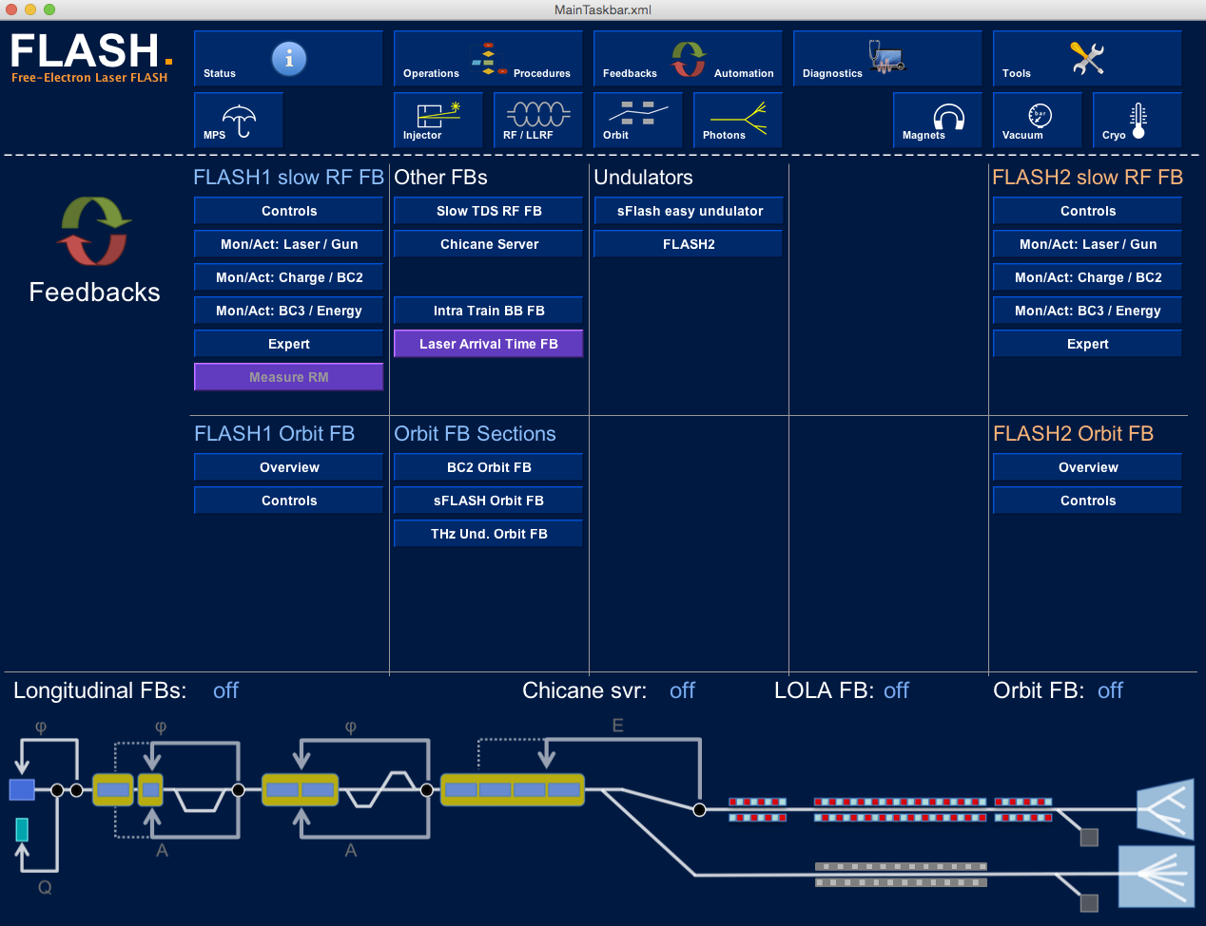
Slow Feedbacks – Outlook → FLASH

Slide 6
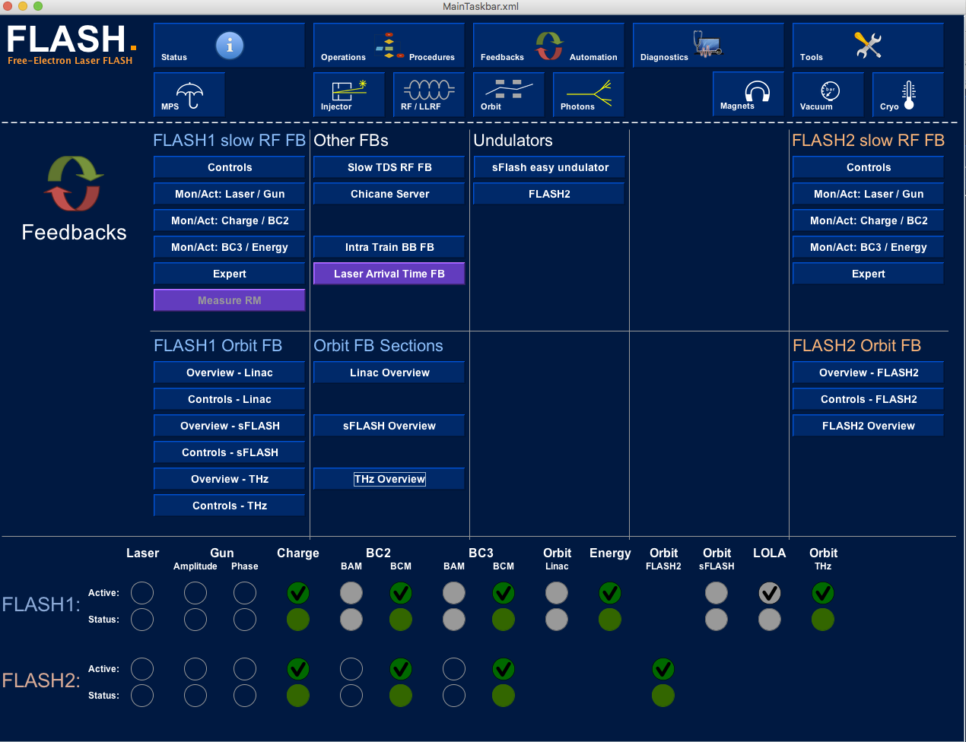
Slow Feedbacks – Outlook → FLASH

Slide 7
The Longitudinal FB
Main motivation
  stabilize longitudinal phase space
  main source for disturbances is RF (phase, energy)
➔ control RF phase + energy relevant for bunch compression
➔ monitor bunch compression process
Actuators: RF phase, energy of A1 + AH1, L1, L2
Monitors: Bunch Compression Monitors (BCMs)
Beam Arrival Monitors (BAMs)
practically linear dependency between actuators and monitors ➔ simple PID controller is sufficient

Slide 8
The Longitudinal FB – FLASH as example
DOOCS DAQ based middle layer server
6 monitors, 6 actuators
P controller with FIR filter
Toroid
BAM
BCM
BAM
BCM
Energy
GUN
ACC1
39
ACC23
ACC45
ACC67
Q
A
φ
A
φ
A
A
Charge FB
Monitor: Toroid directly behind the laser driven photo injector (GUN)
Actuator: rotatable λ/2 plate in laser beam line
Compression FBs
Monitor: pyro-electric detector (BCM)
Actuator: RF phase of nearby module
Energy FB
Monitor: Energy measurement in dispersive section
Actuator: RF amplitude of last modules
Beam arrival FBs
Monitor: beam arrival time monitor (BAM)
Actuator: RF amplitude of nearby module
[Details see e.g.: ICALEPCS 2013 THPPC121]

Slide 9

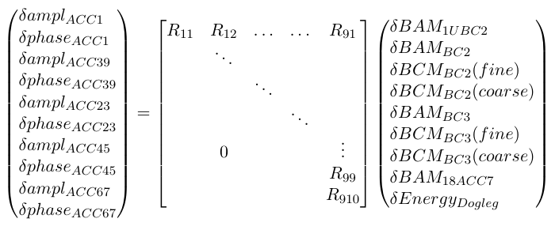
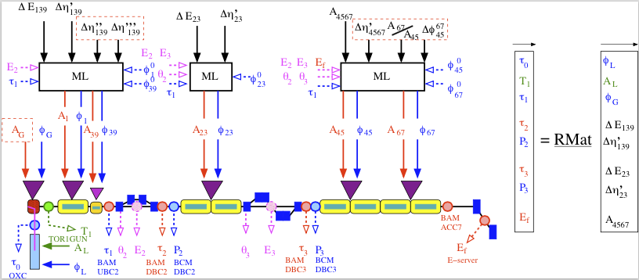
The Longitudinal FB – 'under the hood'
inverse Response Matrix
Matrix formalism (GNU Scientific Library + DOOCS MDFA)
Gets complex if all parameters of the longitudinal phase space are considered
courtesy of M. Vogt

Slide 10
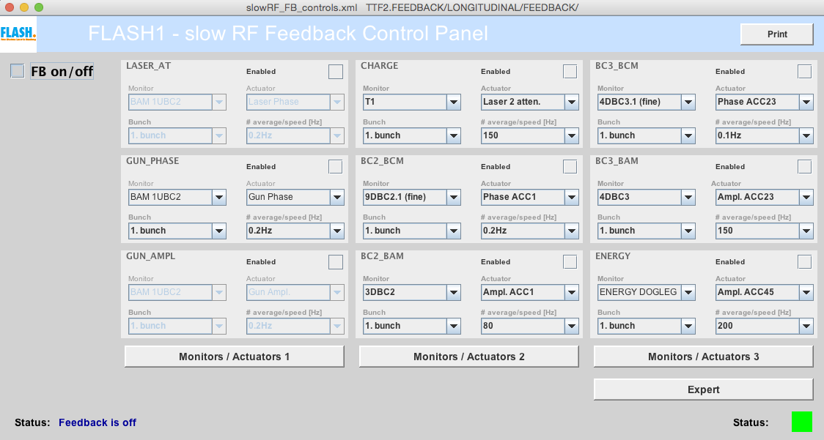
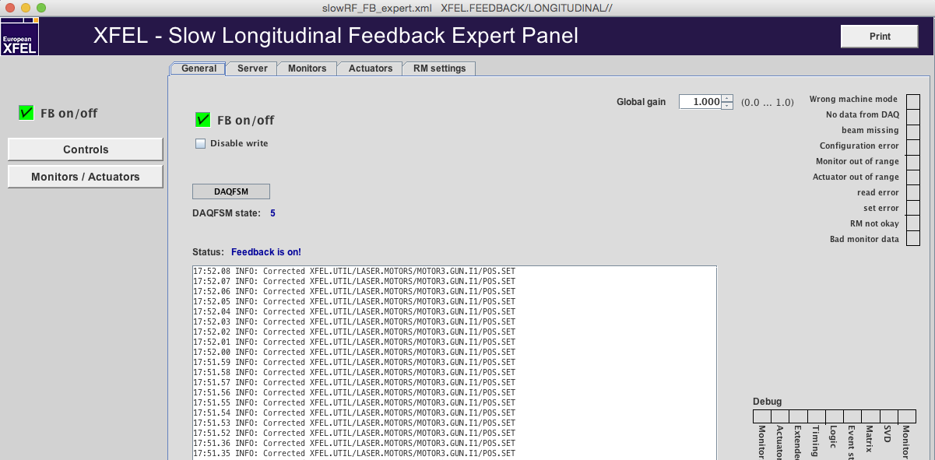

The Longitudinal FB – Operators View
Panels reflect topology and architecture
  Topology: e.g. INJ to L2 (causality!)
  Architecture: e.g. Monitors, Actuators form 'groups'

Slide 11
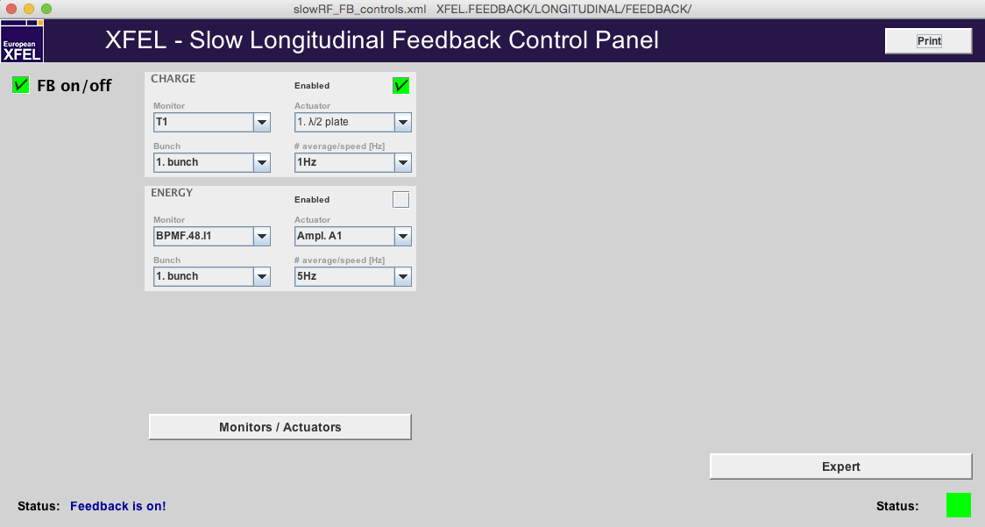
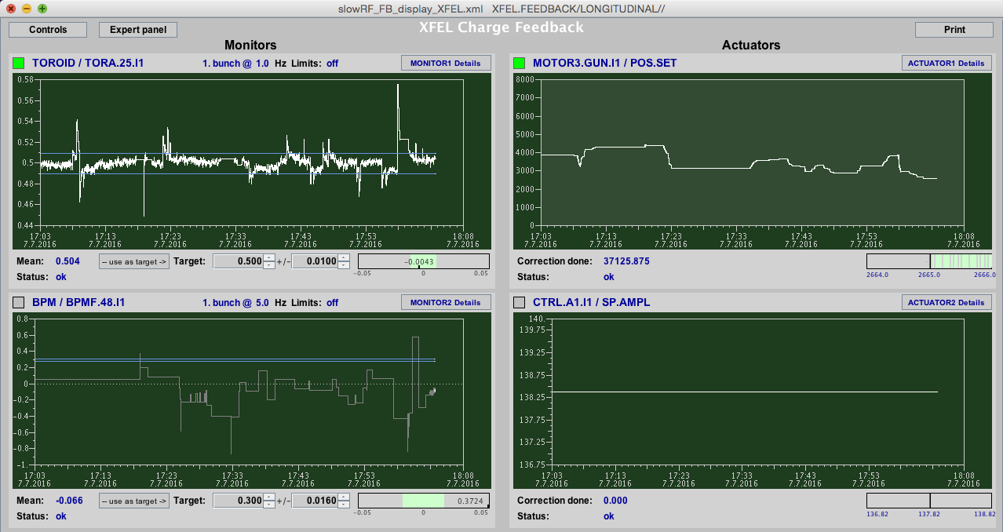

The Longitudinal FB – Operators View

Slide 12
The Transversal FB
Main motivation
  stabilize orbit (trajectory ;) to a given 'golden orbit'
  disturbances e.g.: magnet vibrations, power supply noise, wakefields, …
Actuators: Magnetic correctors (aka steerer, but …)
Monitors: Beam Position Monitors (BPMs)

Slide 13
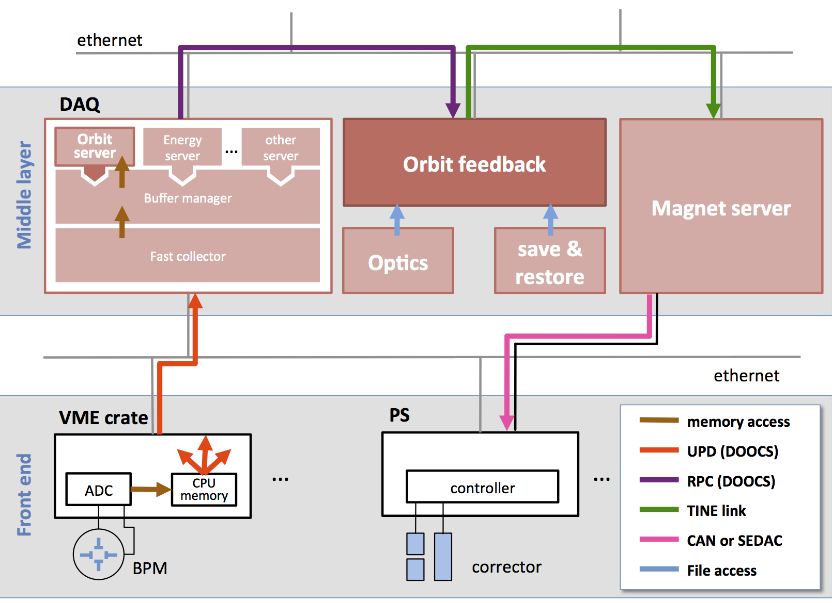
The Transversal FB – Architecture
DOOCS Middle layer based FB (J. Carwardine, R. Kammering)
  Systematically designed controller (P-controller with FIR filter)
  Global FB using inverse Orbit Response Matrix (ORM)
  Tight integration into control system (e.g. decoupled from BPM front-ends)
[see: PCAPAC2010 WEPL015]

Slide 14
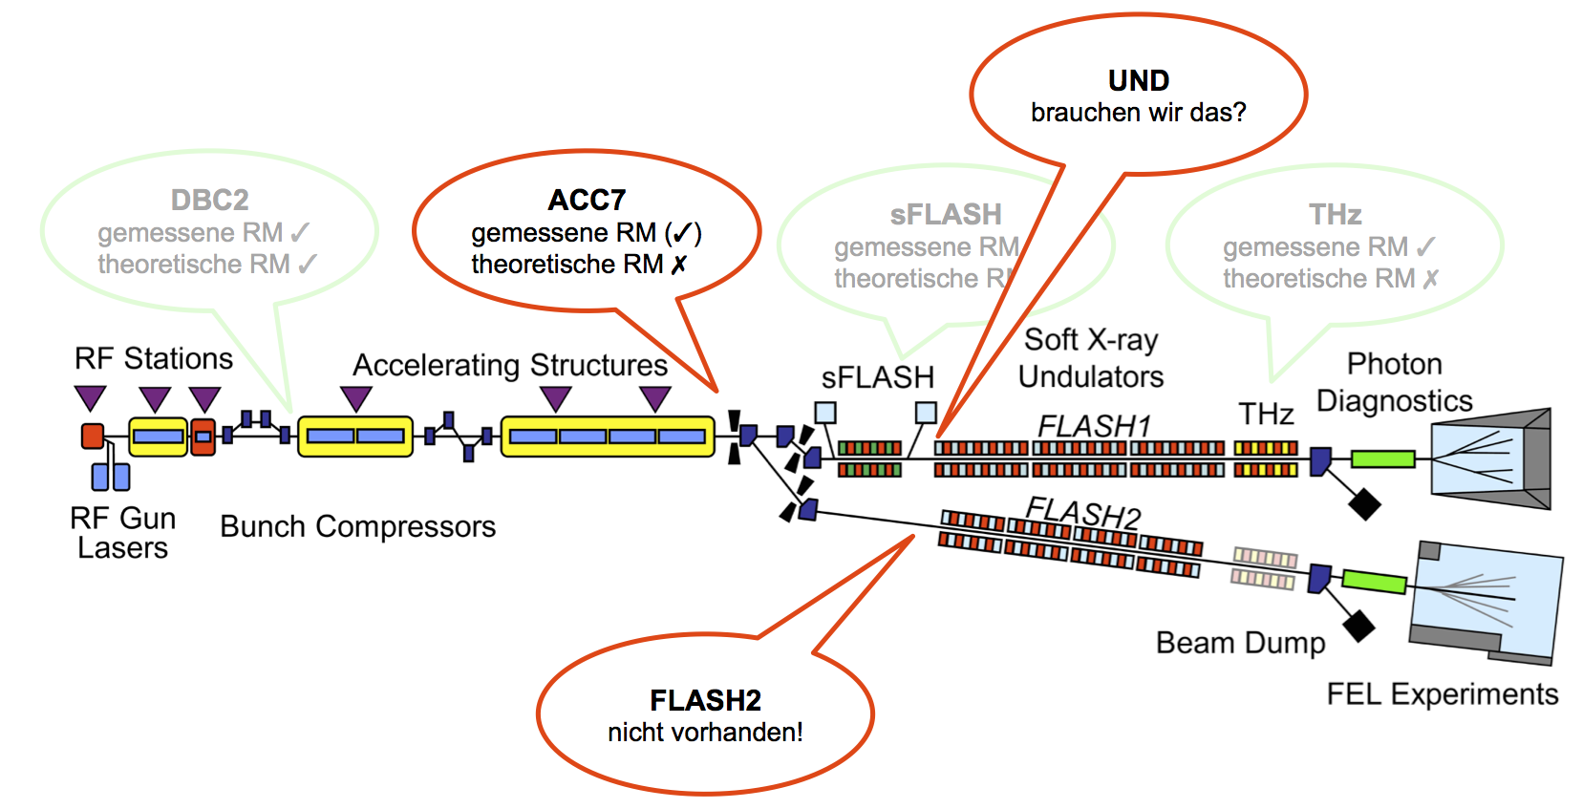
The Transversal FB – Experience
At FLASH failed for long time to use ORM from theory
  failed back to always measure ORM ☹
  "not too much need" to run (e.g. orbit stable if machine untouched)
THIS IS BAD! For XFEL we must have an orbit FB!

Slide 15
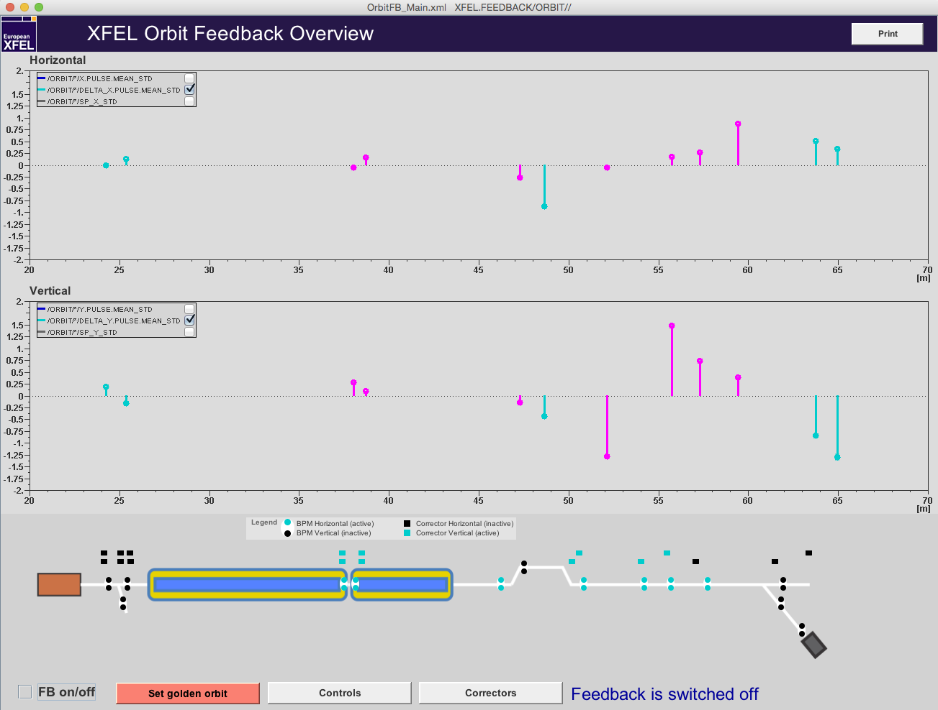
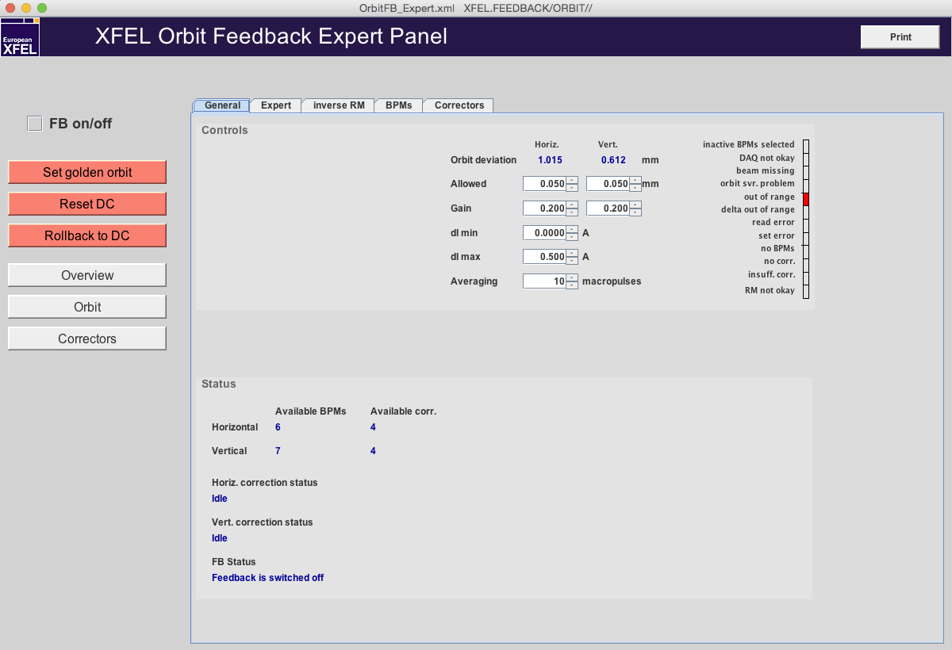
The Transversal FB – Operators View

Slide 16
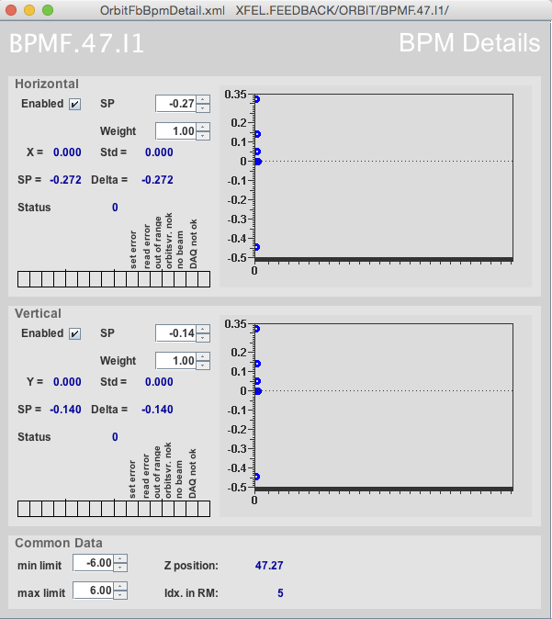
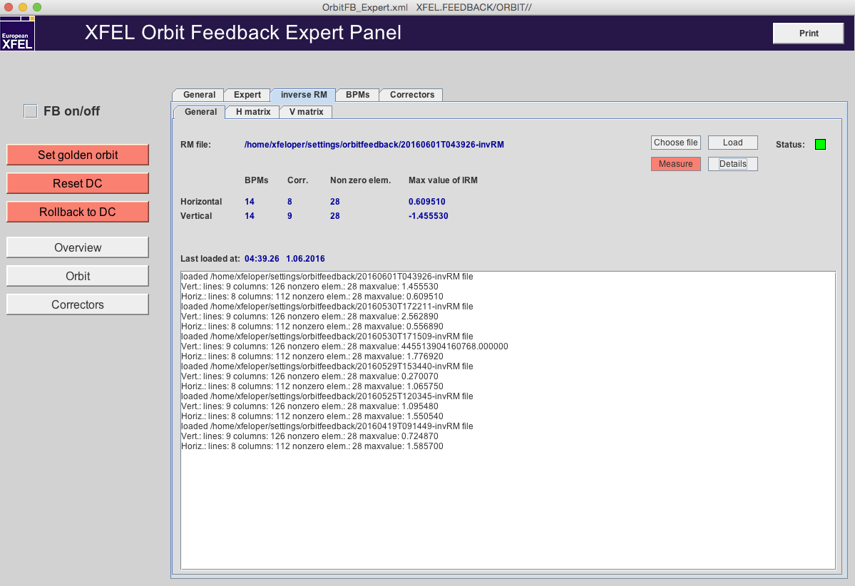

The Transversal FB – How To
Start with overview panel
Select BPMs in section of interest
(Measure ORM)
not necessarily – see next slide
Set golden orbit
Check thresholds, gain
Activate and observe

Slide 17
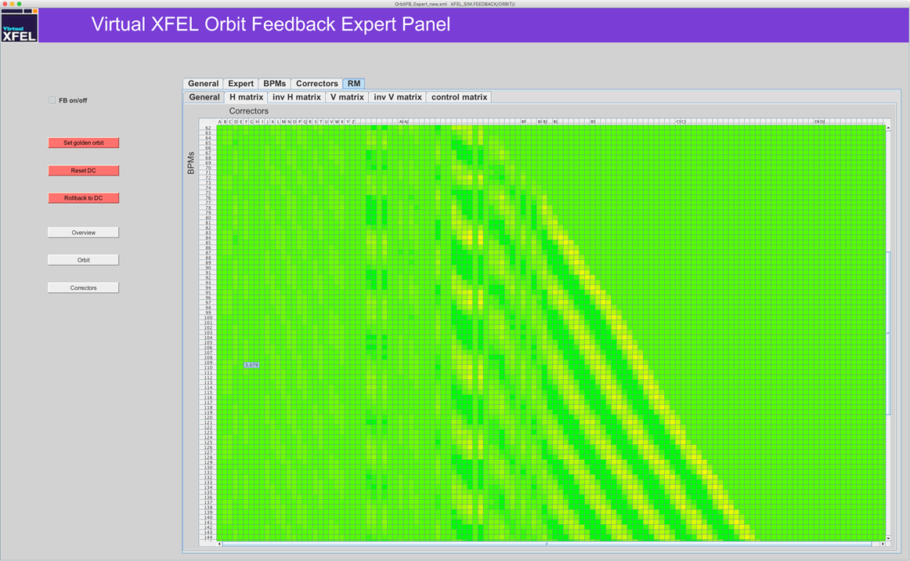
The Transversal FB – How To

Slide 18
The Transversal FB – last words
Workflow and User Interface need improvements (ongoing)
Smarter ORM handling is a must (interface to optics server, integrate inversion, …)
The orbit FB is no wizard! (e.g. steer all BPMs to 0.0 mm might simply be impossible)
Still not clear how to structure orbit FB(s) at XFEL (global vs. only neuralgic sections, …)
Orbit stabilization needs (or other use cases e.g. recovering 'old' orbits) have to match reality!
observe
improve
use

