Slide 1
Chess2 measurements

Slide 2
Schematics
3.3
IFB
RowENB
3.3
ColENB
3.3
Injection
1.8
Load
Th
Inj_EN
3.6
Casc
1/2/4/8
In
InSF
Comp
Baseline

Slide 3
Schematics – FIB points
IFB
3.3
RowENB
3.3
ColENB
3.3
Injection
1.8
Load
Th
Inj_EN
3.6
Casc
1/2/4/8
In
InSF
Comp
Baseline

Slide 4
FIBing points on the pixel

Slide 5
Charge injection behavior
Our pulser seems to emit ”chirps” when it is turned ON.
Our amplifiers seems to respond to these ”chirps”.

Slide 6
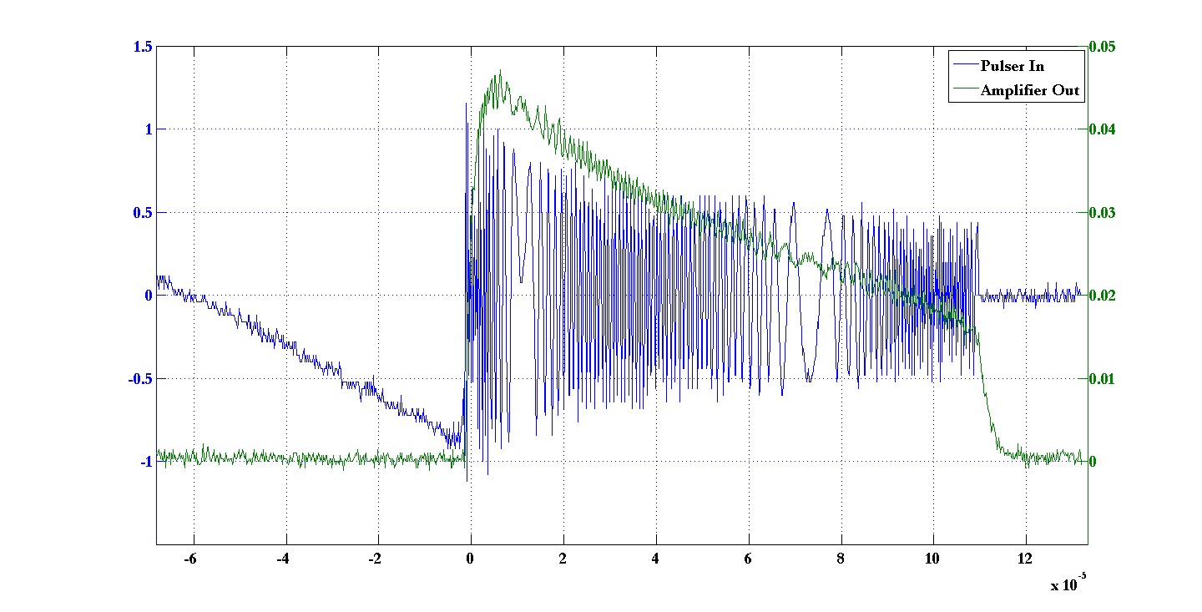
Response of amplifier to pulser chirps

Slide 7
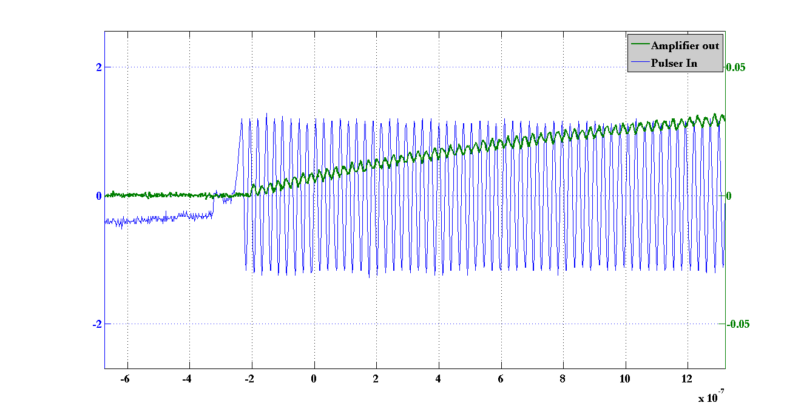
Detail of amplifier to pulser chirps

Slide 8
Summary
When we enable or disable our pulser it has a feature of sending chirps of high frequency ripples ~1ns period.
The amplifier responds to the high frequencies
Adding a DC – to 48MHz to the ouput of the pulser remove the behavior.
Will check is modifying the amplifer biases changes the behavior.

Slide 9
Leakage current during injection setup
Keithley
Current measurement on Keithley with pulser ON
Pulser
GND
HV
CHESS2 motherboard
Inj
Filtering DC- 48MHz doesn’t make a difference

Slide 10
Description of leakage current observed
Pulse width from 1.6ns to 499ms
Pulser high value: above ~2V
Leakage
No leakage
Leakage
Effect observed with pulse height as low as 40mV (couldn’t go lower)
The effect is not observed with a DC power supply (e.g. Keithley)
The effect is observed even with a 48MHz filter on the pulser output

Slide 11
Summary
When using a pulser with a DC level higher than 2.0V we see an increase of current during the high phase of the pulse.
The value of this leakage current doesn’t change for pulse width between 1ns to 499ms. But doesn’t exist for a pure DC supply.
Will use an other pulser capable of lower repetition rate.
Will make a plot of the leakage current vs pulse amplitude.
Will see if the leakage current has a decay time and try to measure it.

Slide 12
Separate observations
HV node on the motherboard is very sensitive to noise pickup.

Slide 13
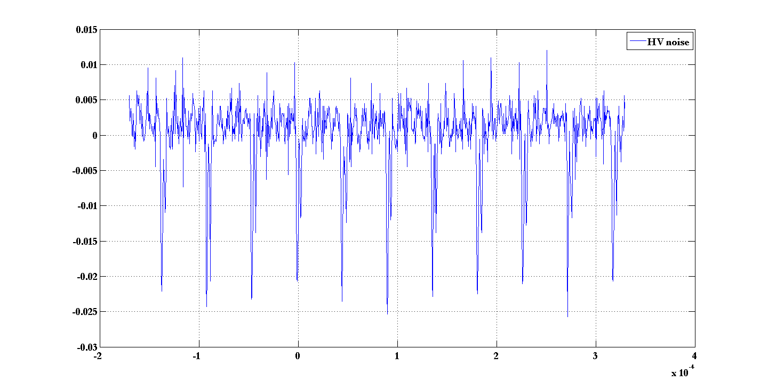
HV node noise
22kHz noise from pulser power supply

Slide 14
HV noise
Turning off the pulser removes the pickup
Putting the pulser in a metal cage helps
Seems that having a grounded connector for HV supply on mother might help too.

Slide 15
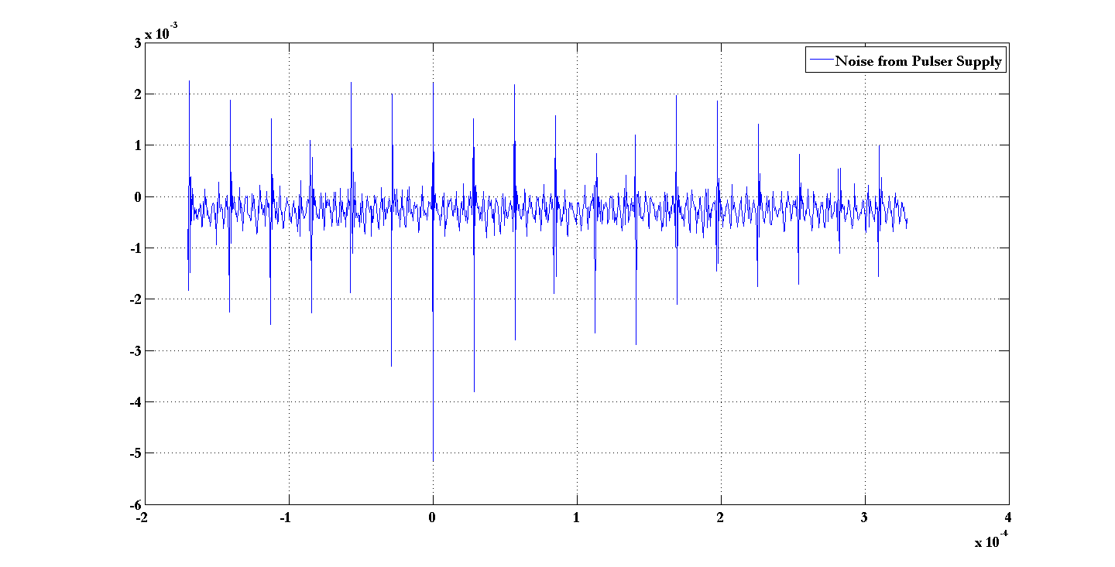
HV node noise
22kHz noise from pulser power supply

Slide 16
Summary
Will try to modify the motherboard HV connector to reduce pickup loop present when using banana plug cables.

