Slide 1
GravitY scale PartiCle Physics with torsion pendulums
Seth Hoedl
Eöt-Wash Group
Center for Experimental Nuclear and Particle Astrophysics
University of Washington
Leptons/Photons 2009 -- Hamburg

Slide 2
Eöt-Wash torsion pendulums probe profound questions in particle physics:
Are there forces much weaker than gravity?
Is there a force that couples to B-L?
Is there a non-gravitational force between luminous matter and dark matter?
Are there “large” extra-dimensions?
Are the light scalar particles of string theory hidden by a self-interaction process?
Are there axions or axion-like particles?

Slide 3
The Eöt-Wash® Group
Six instruments devoted to probing gravitational strength physics.
One instrument devoted to technology development.
Faculty | Postdocs | Grad Students
Eric Adelberger | Frank Fleischer* | Ted Cook
Jens Gundlach | Seth Hoedl | Charlie Hagedorn
Blayne Heckel | Stephan Schlamminger* | Matt Turner
 |  | Todd Wagner
 |  | Will Terrano
*Ph.D. from German institutions.
Primary support from NSF Grant PHY0653863 with supplements from the DOE Office of Science and to a lesser extent NASA

Slide 4
Toy model of a torsion balance
Converts a differential acceleration of A and B towards M into an oscillating twist angle…
Confine the motion of N_{a} atoms to one degree of freedom…
20μm Tungsten Fiber
B
IR Laser Diode
A
M
IR Position Sensitive Detector
Unprecedented sensitivity
to small forces…
and new physics.

Slide 5
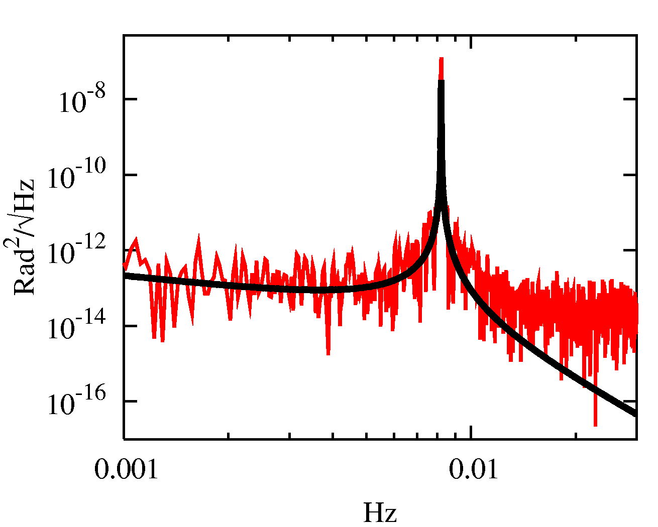
Eöt-Wash torsion pendulums operate at the thermal (300K) noise limit.
Power Spectral density in twist signal
Angular Resolution:
  ~1 nano-radian/√day
  ~10 mm deflection over distance between Seattle and Hamburg
Torque :
  2×10⁻¹¹ ergs or 10 eV/√day
Force:
  0.1 femto-N or
      1 postage stamp / 10¹²
Thermal Noise Theory (Not a fit!)
Data
Force / Atom :
  0.1 femto-N /(N_{a})² or
F_{electric} :
e⁻
e⁻
~ 100 light-years

Slide 6
Are there forces weaker than gravity?
String or M theory provides a promising framework to unify gravity with other forces in nature. Predicts 100’s of massless scalar particles with composition dependent gravitational strength couplings.
The Equivalence Principle,
All objects, independent of composition, fall at the same rate in a uniform gravitational field.
is an ideal test of such forces.

Slide 7
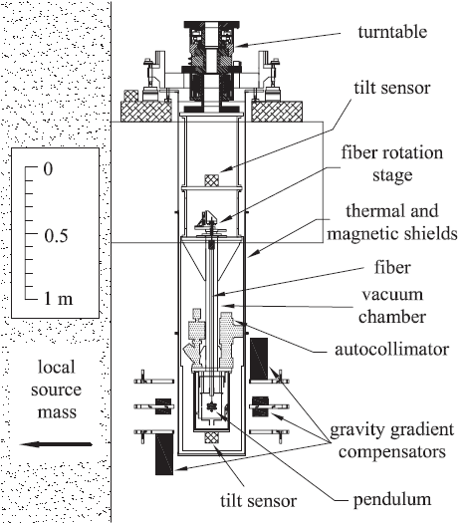
The Recent Eöt-Wash Equivalence Principle Test
S. Schlamminger et .al., PRL 100, 041101 (2008)
In this case we rotate instrument instead of attractor.
Rotation provided by
    Earth.
And, most importantly,
    Air bearing turntable with 20 min rotation period.

Slide 8
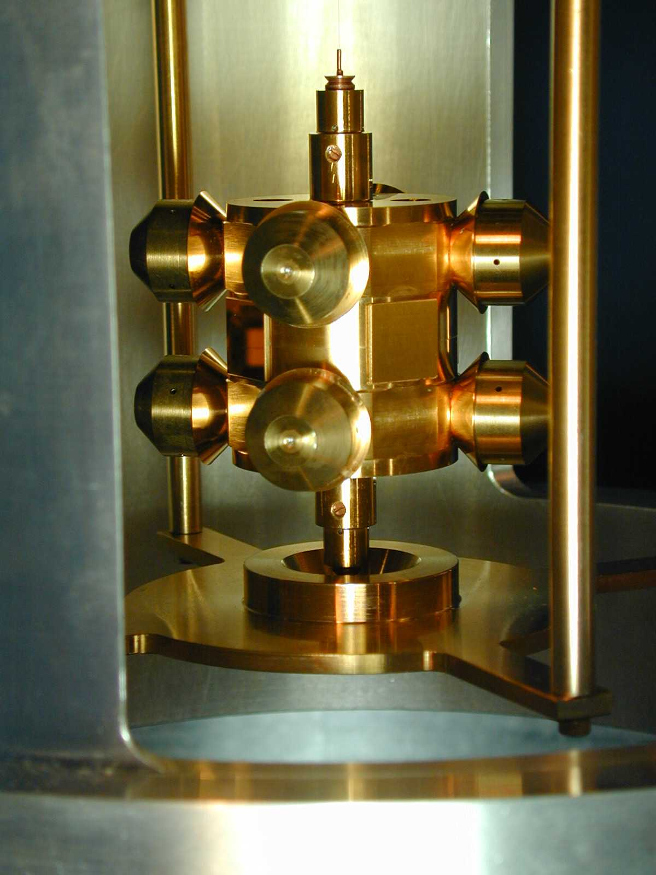
Recent Eöt-Wash EP test torsion pendulum
20 μm diameter
108 cm long tungsten fiber
Eight 4.84 g test masses
(4 Be & 4 Ti) or (4 Be & 4 Al)
Mass matched to within 1 part in 10⁵.
Mass moments minimized to l = 6.
4 mirrors
4 tuning screws adjust the mass
multipole moments & minimize
sensitivity to gravity gradients
free osc freq: 1.261 mHz
quality factor: 4000
decay time: 11d 6.5 hrs
machining tolerance: 5 μm
total mass : 70 g
5 cm

Slide 9
Most Recent EP test results for Ti/Be materials
Source | Δa (cm/s²) | Δa/a_{source}
Earth | (+0.6 ± 3.1)×10⁻¹³ | (+0.3 ± 1.8)×10⁻¹³
Sun | (-2.4 ± 2.8)×10⁻¹³ | (-4.0 ± 4.7)×10⁻¹³
Milky Way | (-2.1 ± 3.1)×10⁻¹³ | (-1.1 ± 1.6)×10⁻⁵
CMB | (-2.9 ± 2.7)×10⁻¹³ | (-2.1 ± 1.9)×10⁻³
1-σ uncertainties dominated by thermal noise in fiber (statistical) and residual gravity gradients (systematic).
Our differential acceleration resolution is comparable to the difference in g between 2 spots in this room separated vertically by ≈1 nm
If an object had been given this steady acceleration starting in the time of Pericles (450 BC) it would now be moving as fast as the end of the hour hand on a typical wall clock.

Slide 10
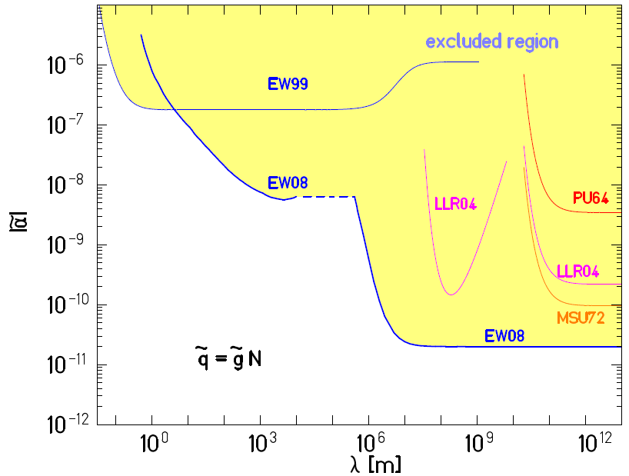
2-σ exclusion plot for interactions coupled to B-L
Are there weak forces coupled to B-L ?
In GUTs, B-L is exactly conserved, thus one expects yukawa couplings to B-L.
For electrically neutral matter, B-L coupling implies:

Slide 11
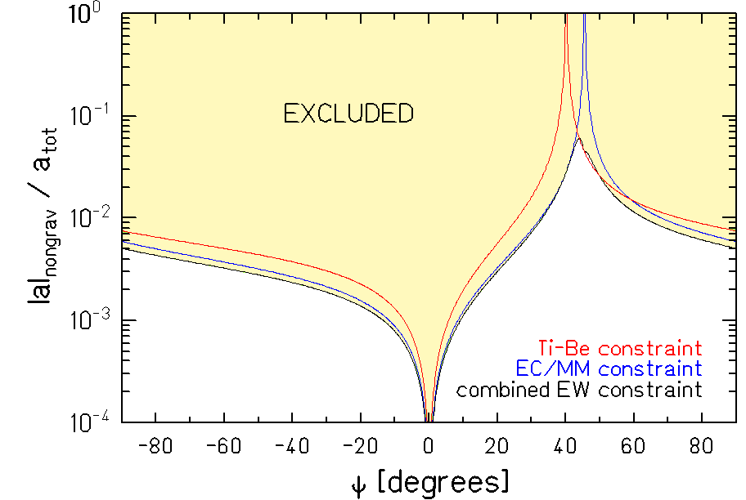
2-σ exclusion limits on non-gravitational acceleration of hydrogen towards galactic dark matter
Is gravity the only long range force between luminous matter and dark matter?
Most of the galaxy (90%) is thought to be dark matter.
At the Earth’s location,
a_{gal} ≈ ¾ a_{matter}+¼ a_{dm}
a_{dm} ≈ 5×10⁻⁹ cm/s²
By looking for an EP violation towards the center of the galaxy, we can constrain the differential acceleration of different elements to dark matter.
C.W. Stubbs, PRL 70, 119 (1993)
At most 5% of the acceleration towards dark matter can be non-gravitational

Slide 12
Tests of the gravitational Inverse Square Law can answer interesting questions:
Are there “large” extra dimensions?
Does the chameleon mechanism hide forces weaker than gravity?
Are there scalars that couple to two photons?

Slide 13
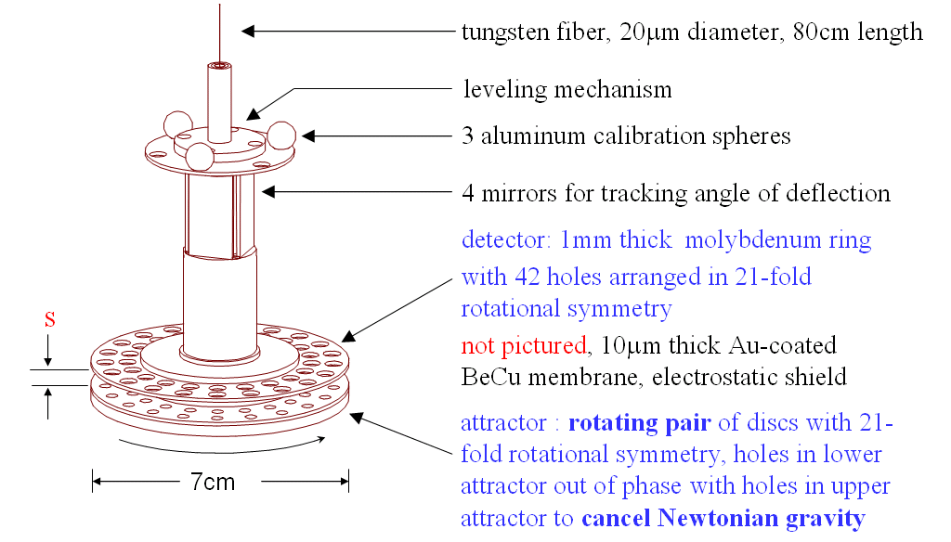
Most recent published Inverse Square Law pendulum
D.J. Kapner et al., PRL 98, 021101 (2007)
Not shown: gold coated housing
Key features: Planar geometry maximizes mass. Signal at high multiple of disturbance frequency prevents spurious 1- ω signals and maximizes S/N.

Slide 14
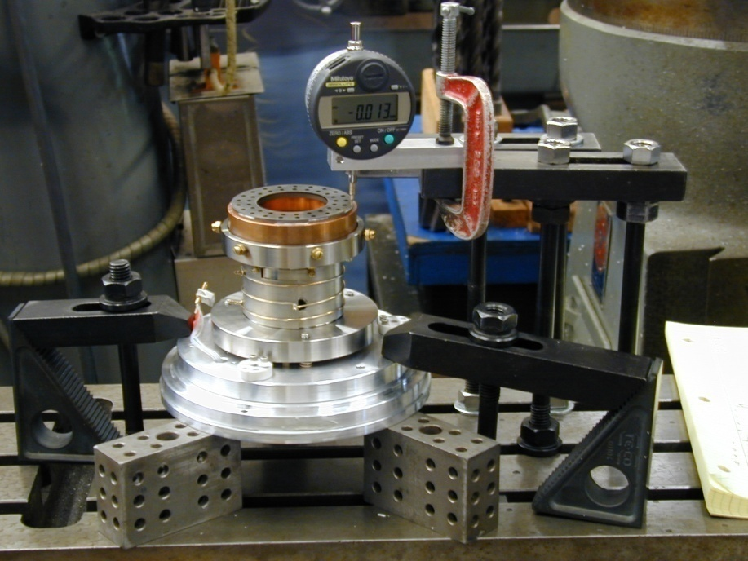
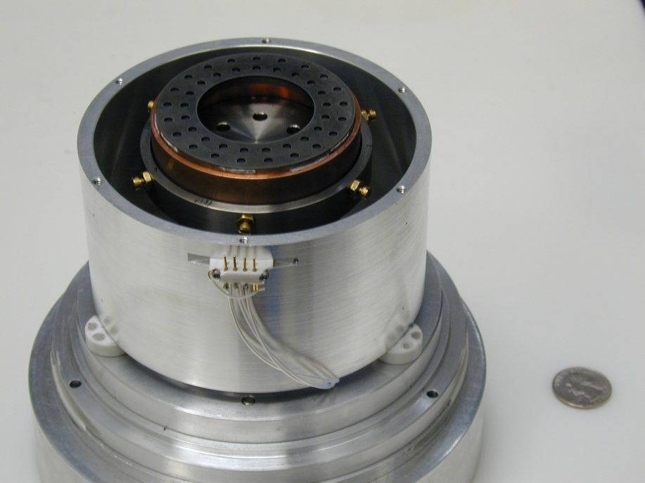
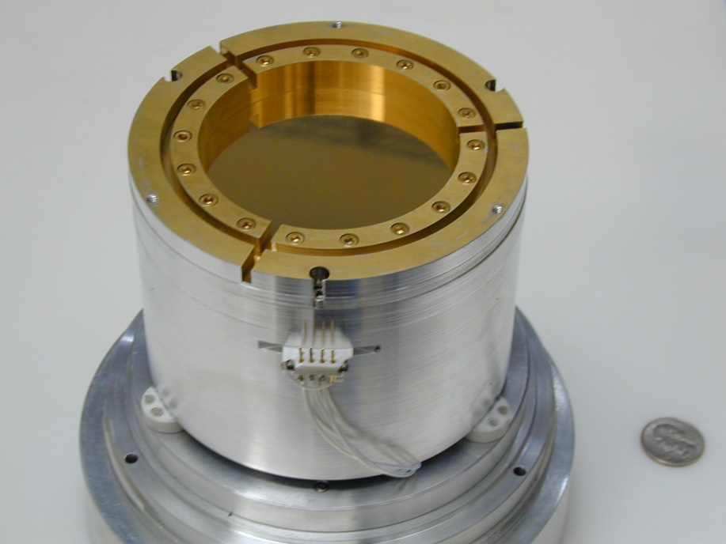
Rotating attractor and its electrostatic shield
Tightly stretched, 10- μm thick, Au-coated BeCu foil, 12 μm above rotating attractor, shields electrostatic effects.

Slide 15
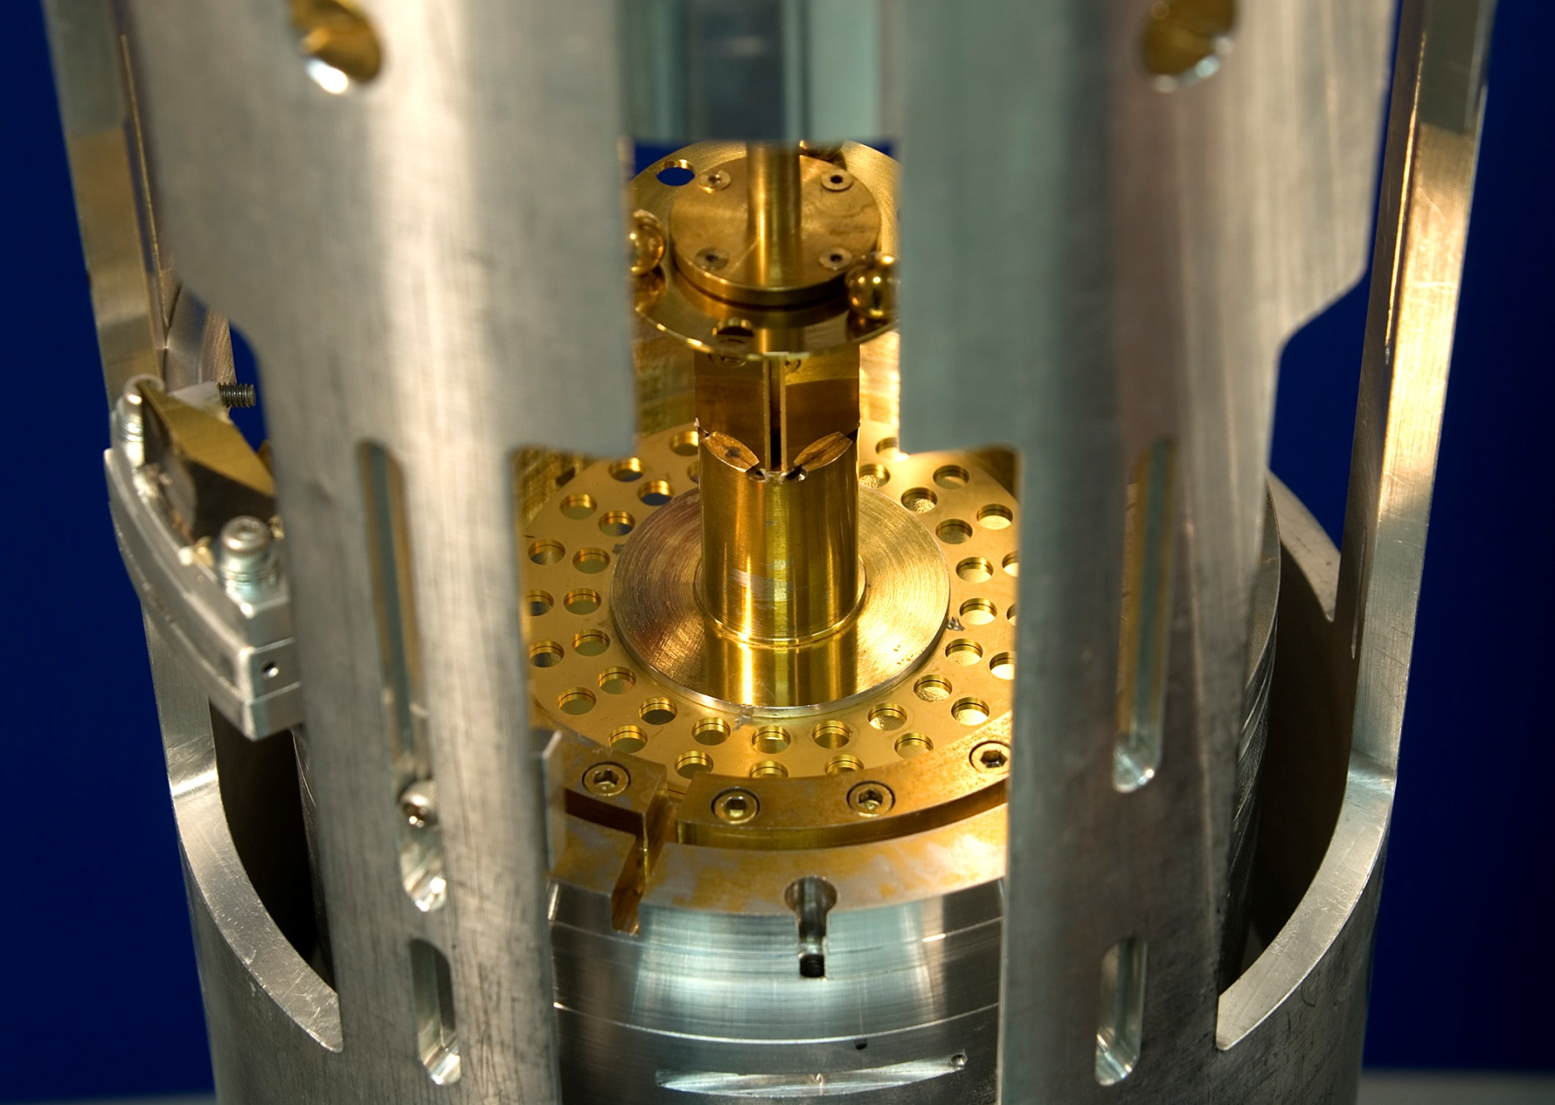
The ISL pendulum with upper shield removed

Slide 16
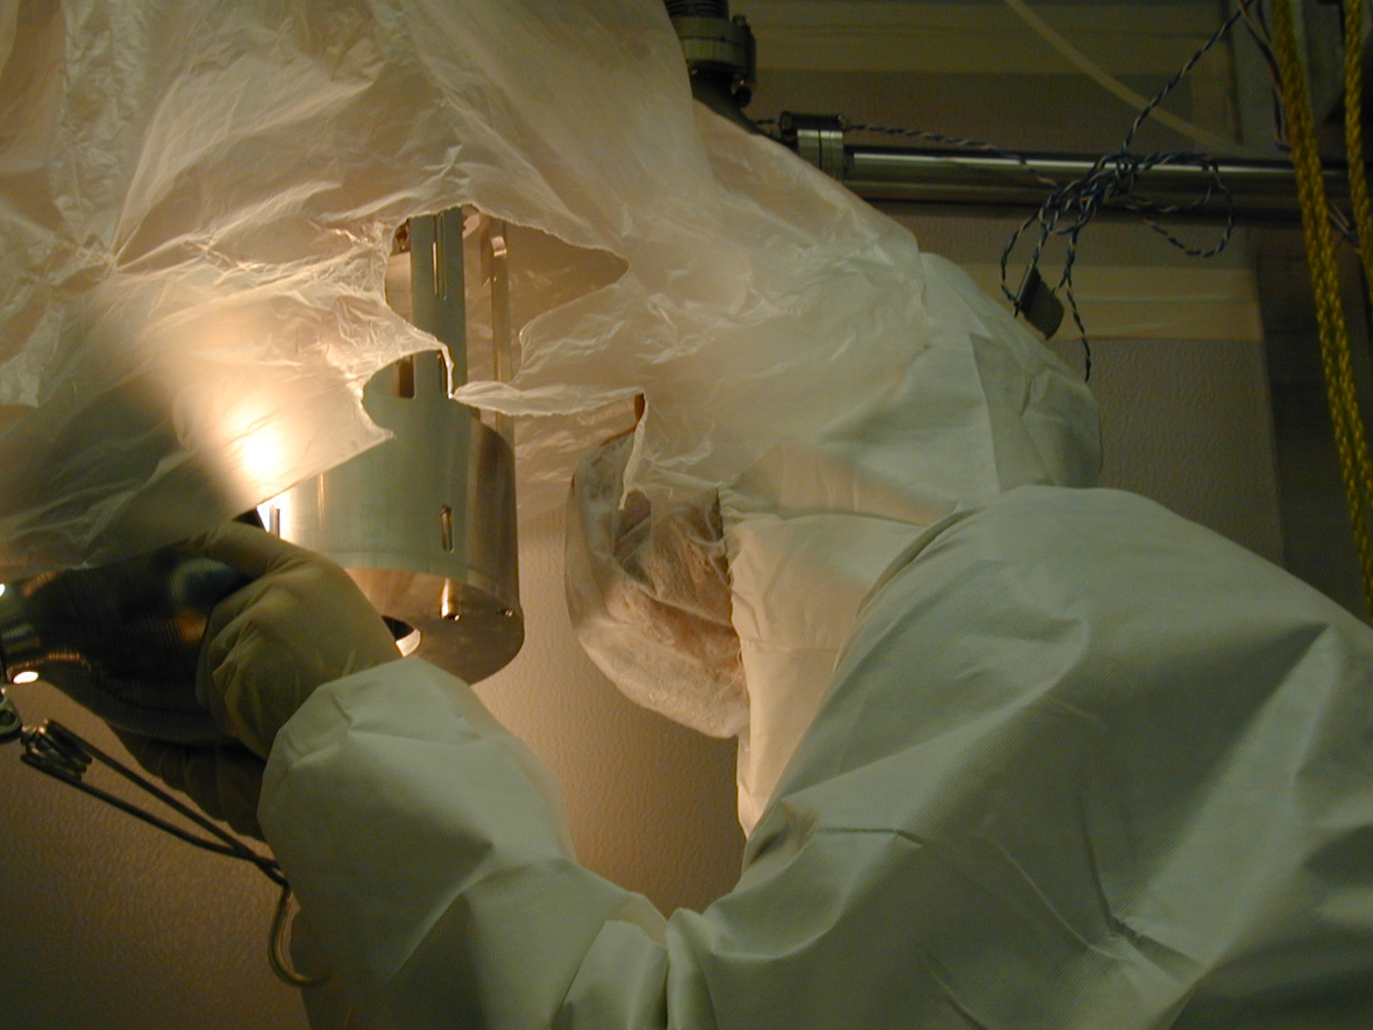
Dan Kapner assembling the 42-hole instrument
One piece of dust is deadly!

Slide 17
power spectral density of twist signal
21ω
resonance
42ω
calibration
d = detector/foil separation

Slide 18
Data from 42-hole experiment III
42ω
21ω
Upper attractor only
Three experiments, anomalies at short distances are not reproducible.
21ω
21ω
Lower attractor only

Slide 19
2-σ exclusion plot on non-gravitational forces
Most recent published results from 42-hole ISL pendulum
Uses all data from all three experiments.
For |α| = 1, λ < 56 μm
For thorough discussion of implications for particle physics see:
E.G. Adelberger et al., PRL 98, 131104 (2007)

Slide 20
Could there be “large” extra dimensions?
Extra dimensions could solve the hierarchy problem. Gravity may be just as strong as the other forces – but – in our 4 dimensional world it appears much weaker because most of its strength acts in n other dimensions.
N. Arkani-Hamed et al. Phys. Lett. B 436 p.257 (1998).
Expect that gravity strengthens at scales comparable to the largest extra dimension.
Our 2-σ exclusion bounds imply that the maximum size of any extra dimension must be less than 44μm.
If there are two extra dimensions, our result implies that M*≥3.2TeV/c².
In string theory, the size of the compactified extra dimensions is dynamic, and stabilized by radions, that mediate additional yukawa forces.
Our limit implies that for 6 extra dimensions M*≥6.4 TeV/c².

Slide 21

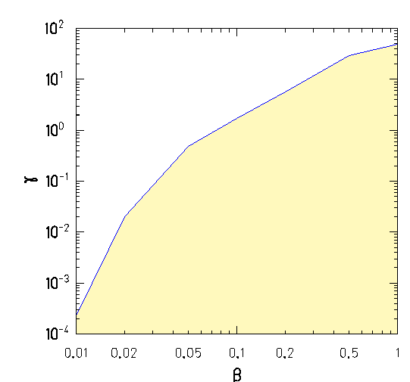

Can the strong bounds on gravitationaly coupled scalars be evaded?
String theory predicts gravitationally coupled low mass scalars.
EP/ISL tests place very strong limits.
These experimental bounds can be circumvented if scalars are self-interacting, i.e., chameleon’s:
2-σ bounds on Chameleon parameters
In presence of matter, they acquire an effective mass:
Thus, only a thin skin of material,
can generate long-range fields.
Natural Value
Excluded by ISL
For Mo, λ_{s}~60μm
J.Khoury and A. Weltman PRL 93, 171104 (2004)
A. Upadhye et al PRD 74 104024 (2006)

Slide 22
Are there scalars that couple to two photons?
An early version of the PVLAS experiment¹ observed a large dichroism and birefringence of the vacuum in the presence of a magnetic field. This suggested the existence of a low mass scalar particle that couples to two photons with
Through a second order interaction, the ISL pendulum is sensitive to a scalar/photon vertex:
A. Dupays et al PRL 98 131802 (2007)
Our ISL result gives a 2σ limit:
φ
10¹¹ times smaller
than original PVLAS claim.
p
p
¹E. Zavattini et al PRL 96, 110406 (2006)
E. Zavattini et al PRD 77, 032006 (2007)

Slide 23
Are there axions or axion-like particles?

Slide 24
Low mass pseudoscalars will mediate a macroscopic P,T violating force
Virtual Axion Exchange
σ_{e}
Example: QCD axions or axion-like particles (ALPs).
F_{axion}
Virtual Axion Exchange
σ_{e}
F_{axion}
Unpolarized Matter
Polarized Matter (Magnetized Iron)
N
e⁻
g_{s}
g_{p}
a
N
e⁻
Advantage: Does not depend on cosmology or astrophysics.
Disadvantage: Coupling proportional to θ_{QCD}.
Moody and Wilczek PRD 30 130 (1984)

Slide 25
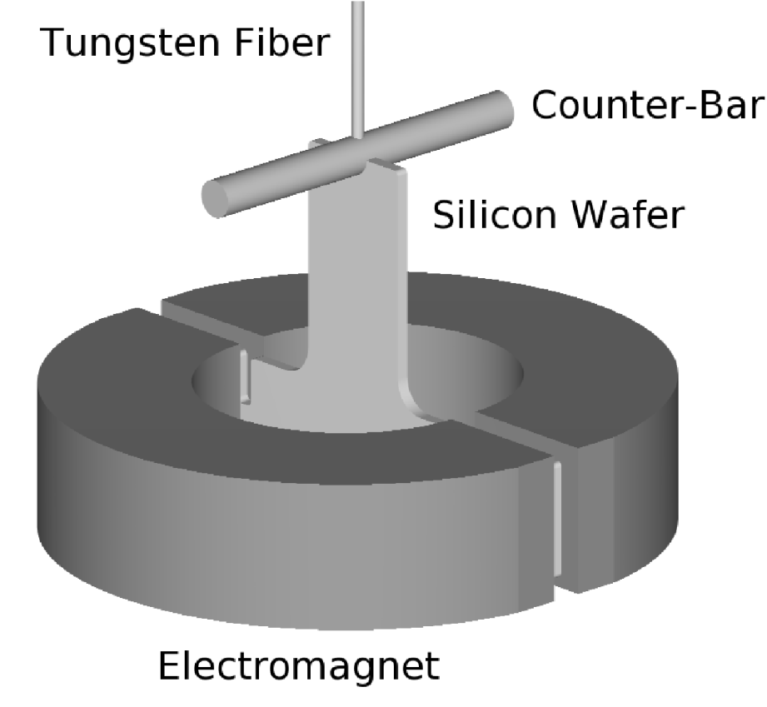
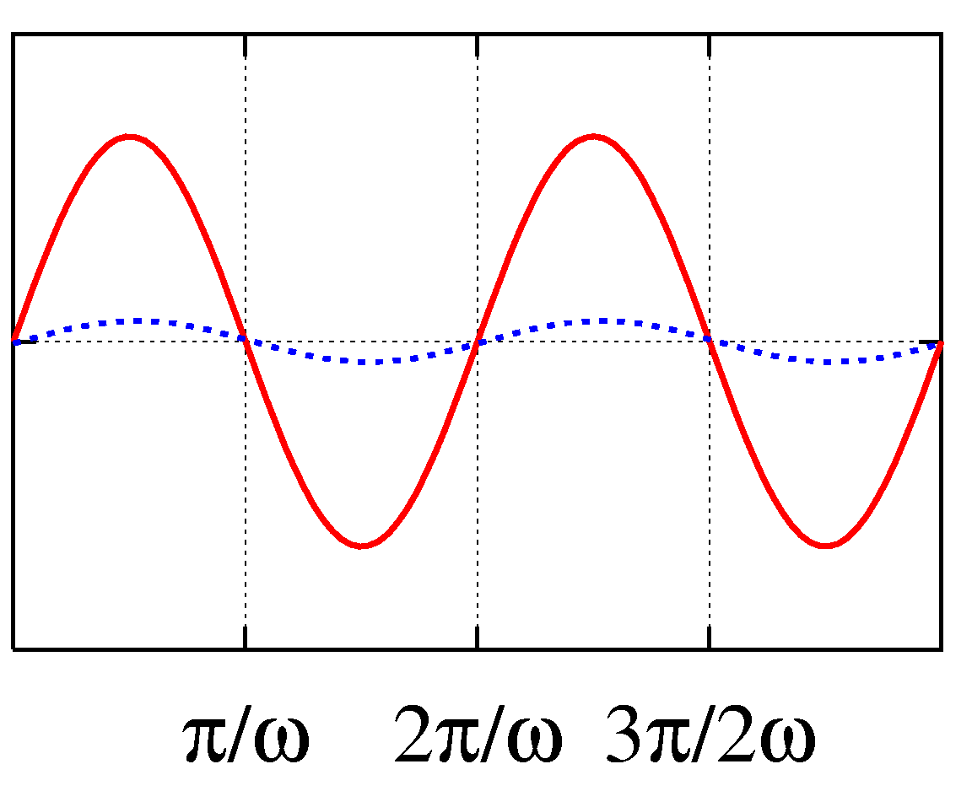
Our ALP Detector
Top View
Conductive Plates for Electrostatic Feedback
Magnet
d₁
θ
σ_{e}
Pendulum
B(t)
Virtual ALP exchange
Angle(t)
Strategy:
Modulate magnet polarization.
Record pendulum angle signal.
Move pendulum with respect to pole faces to exclude systematic errors or measure mass.

Slide 26
Systematic Errors are hard…
G_{QCD axion} ≈ O (10⁻⁴⁴)
G_{magnetism}≈ O (10⁻²⁰)
Can we really beat that?
Expect spurious 1-ω signal from…
Pendulum made of zone refined silicon (pure to better than 10⁻¹⁰).
Extra effort to clean surface
2 Layer magnetic shield
Null κ with paramagnetic Terbium.
We can distinguish a true axion signal from these effects:
  The axion torque depends on the distance to the pole faces.
  Magnetic systematics depend only on B.

Slide 27
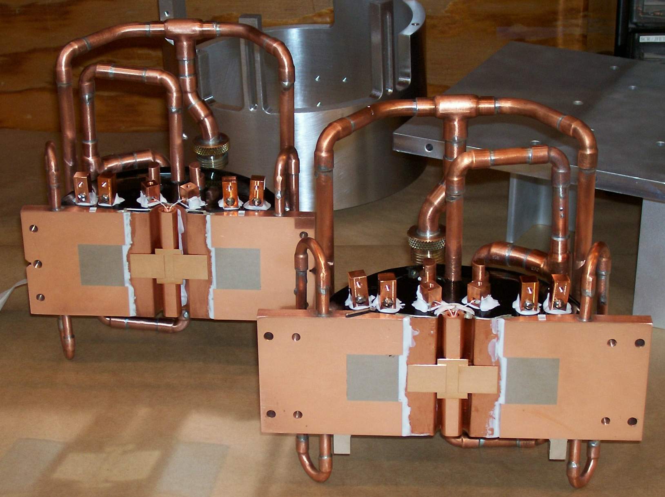
Magnets without electrostatic shield

Slide 28
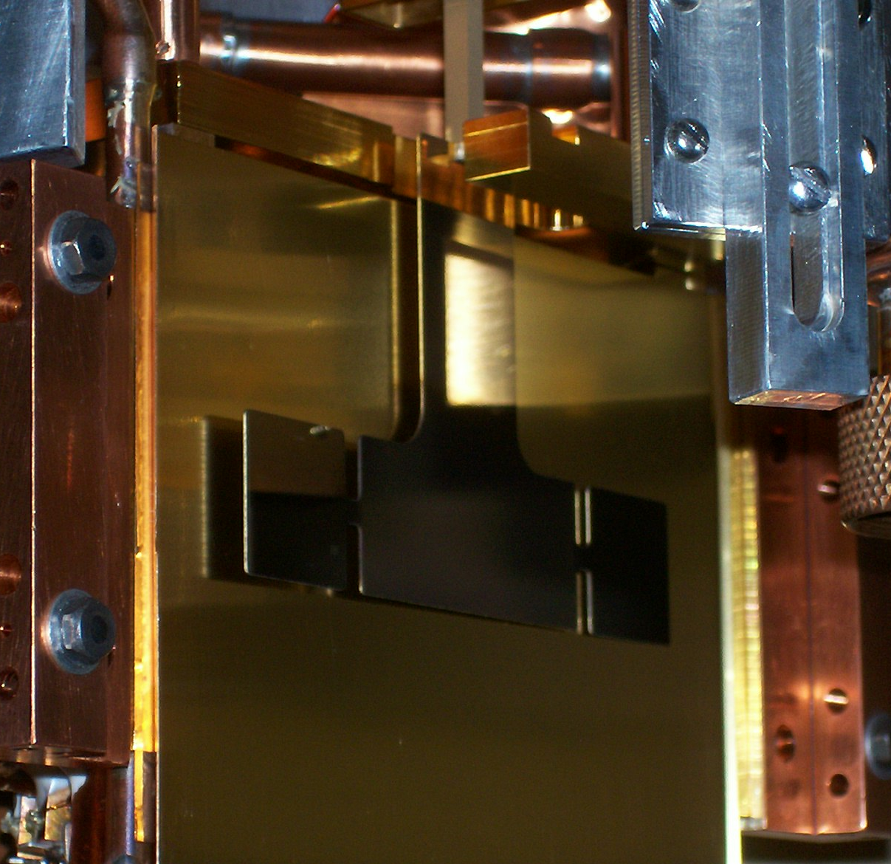
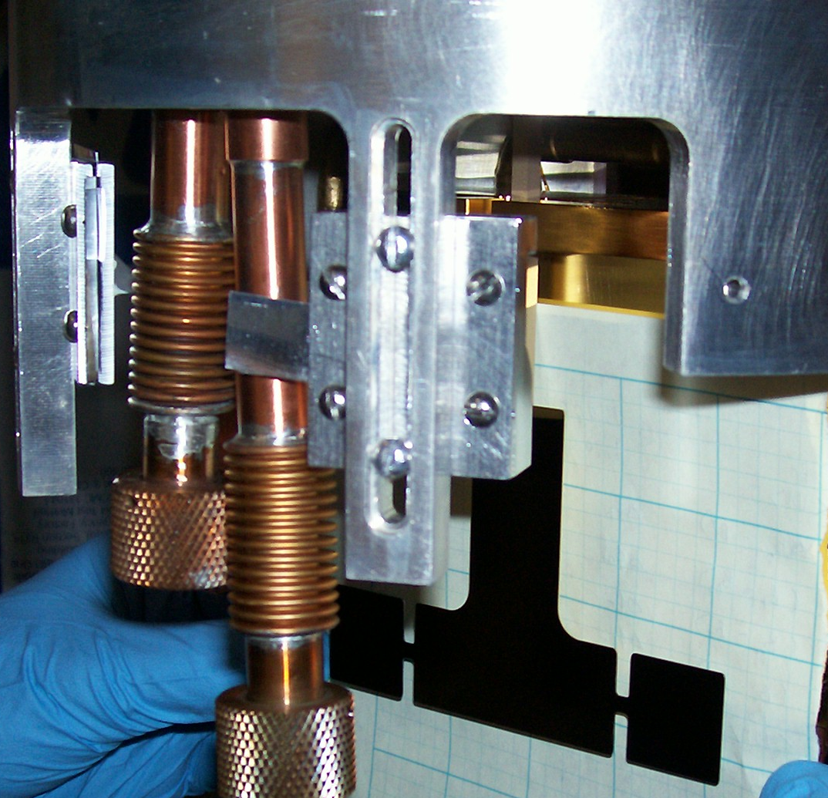
Installing the Pendulum
Electrostatic Shield
Pendulum
Feedback electrodes hidden behind Pendulum
Mirrors

Slide 29
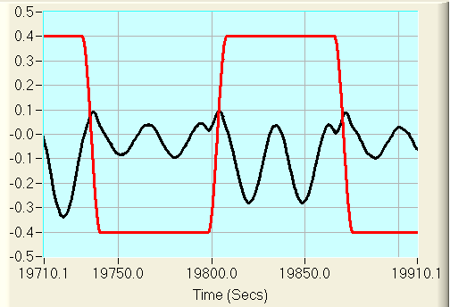
The measurement strategy
Feedback on during transitions
Magnet Current (Amps/10)
For each magnet state, we fit for the equilibrium angle, amplitude, frequency, and phase.
Axion signal is equilibrium angle difference between positive and negative magnet states
The diamagnetic silicon seeks a magnetic field minimum.
Thus, the B field acts as a strong torsion spring.
Pendulum Angle (mrad/10)
Nevertheless, by moving the pendulum we can still impose a strong constraint.

Slide 30
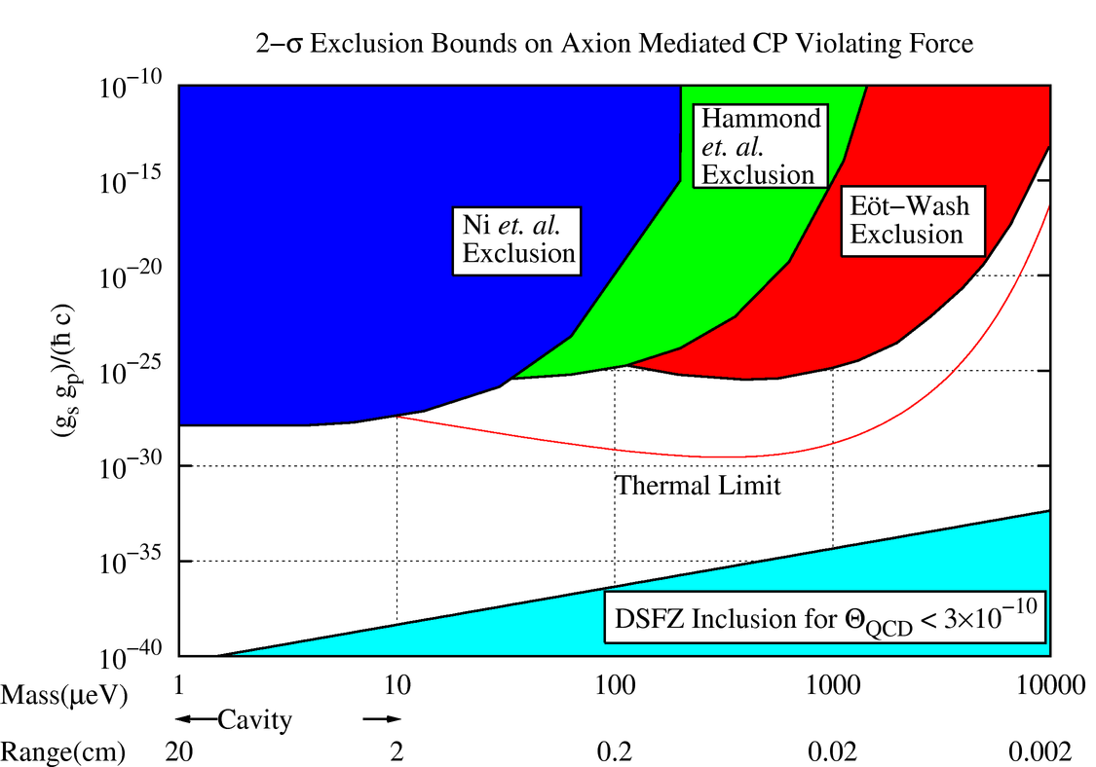
Preliminary exclusion plot
Factor of 10¹⁰ improvement at m_{a} = 1meV

Slide 31
Summary
Torsion pendulum based experiments provide some of the most stringent constraints on new particle theories.
Impressive numbers from Eöt-Wash instruments:
  Any infinite-range interaction which couples to B-L must be 2×10⁻¹¹ times weaker than gravity.
  At most 5% of the acceleration of hydrogen towards the center of the galaxy could be due to a non-gravitational force between luminous matter and dark matter.
  Any extra dimension must have size less than 44μm.
  A pendulum with 10²³ polarized electrons reveals that the energy scale in a non-commutative geometry must be greater than 10¹³ GeV.
Recent review article:
  Torsion balance experiments: A low-energy frontier of particle physics.
    E.G. Adelberger, J.H. Gundlach, B.R. Heckel, S. Hoedl, S. Schlamminger

Slide 32
Extra Slides

Slide 33
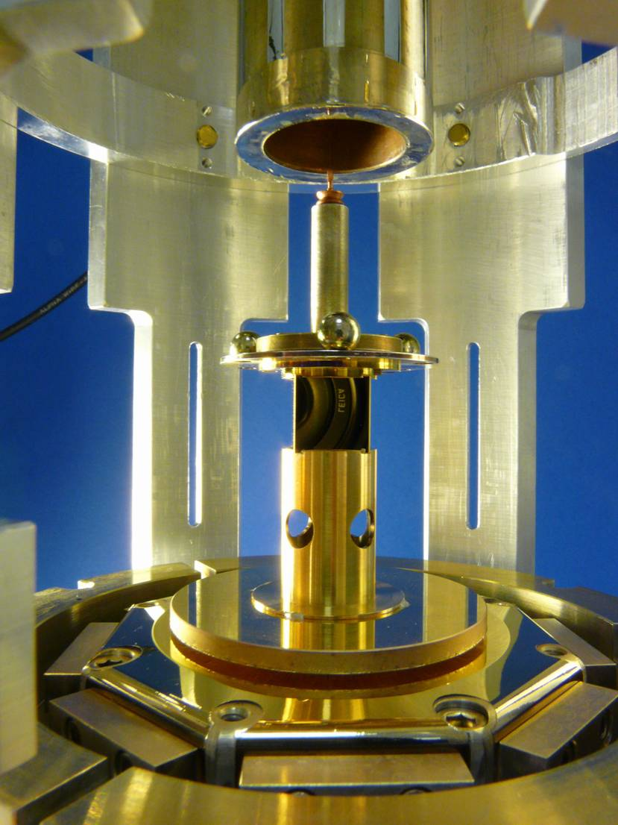
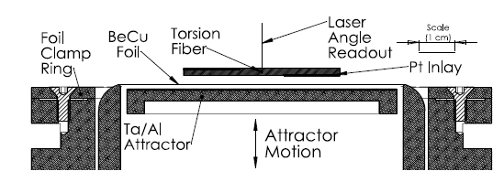
We are constructing two new ISL test pendulums.
Ted Cook’s Ph.D. Thesis:
120-fold symmetry
Charlie Hagedorn’s Ph.D. Thesis:
“Plate-Wash”
Top View
Other groups use different techniques.
See:
    L.-C. Tu et al PRL 98, 201101 (2007)
    A.A. Geraci et al PRD 78 022002 (2007)

Slide 34
QCD Axions and the PQ symmetry
Recall that the PQ mechanism makes θ_{QCD} a dynamic variable in the QCD Lagrangian and explains why θ_{QCD} ≤3×10⁻¹⁰.
In addition, the PQ symmetry is spontaneously broken at a very high energy scale f_{a}, and generates a new particle, the axion.
Axions, if they exist, are very light.
Virtual axions mediate macroscopic forces.
Maybe accessible with a torsion pendulum.
Axions would be copiously produced in the early Universe. They are:
    Non-baryonic.
    Very weakly interacting.
Axions could be most, if not all of the dark matter.

Slide 35
The QCD Axion Window
Excluded by understanding:
Supernova 1987A
HB Lifetime
White Dwarf cooling rate
Hot Dark Matter
K⁺→π⁺+a
Inclusion Plot
Battye and Shellard Axion “Strings”
Hagmann and Sikivie Axion “Strings”
Fine Tuned Inflation
m_{a} = 1μeV
λ_{a} = 20cm
10 μeV
100 μeV
2 mm
1000 μeV
10,000 μeV
20 μm
Microwave Cavity
Experiments
What if axion is here?
Our experiment is one of few efforts underway which may be sensitive to heavy axions.

Slide 36
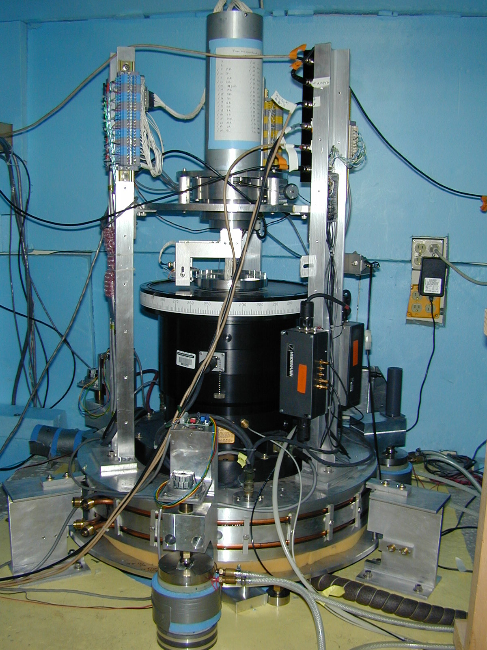
turntable of the new EP balance
servoed rotary contactor for electric signals
thermal insulation
air-bearing turntable
angle encoder electronics
thermal expansion feet fedback to keep turntable rotation axis level
torsion balance hangs
from the bearing which
rotates at 0.833 mHz

Slide 37
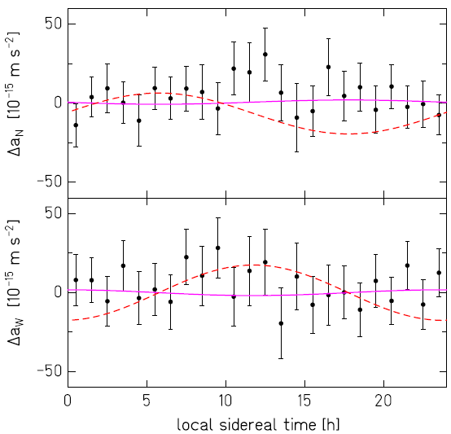
Most recent EP test results to galactic center
Best fit,
Δa = -2.1±3.1 ×10⁻¹⁵ m/s²
Hypothetical,
20×10⁻¹⁵ m/s²

Slide 38
signal processing
raw signal
2-pt digital filter
used in our
10-hole work
these data
Were taken
with
calibration
turn-table
stationary
5-pt digital filer

Slide 39


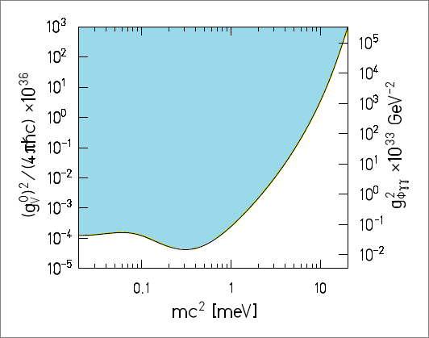
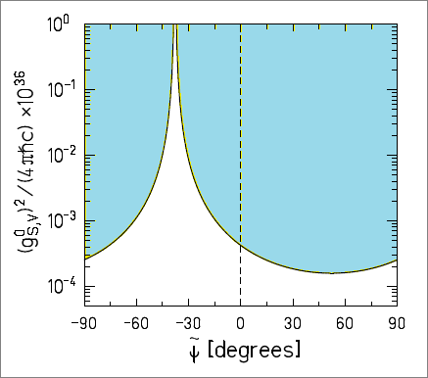
Constraints on Yukawa interactions from scalar or vector boson exchange
m_{φ} = 1 meV
Excluded
q= B-L
Excluded

Slide 40
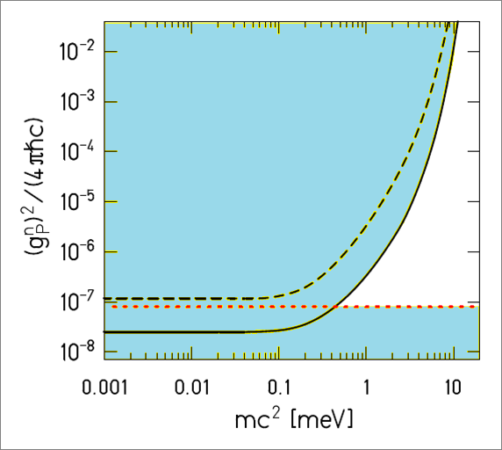
Constraints on pseudoscalars
1σ constraint on γ₅ coupling to neutrons
First order force by exchange of psuedoscalars vanishes for unpolarized bodies.
But, 2nd-order exchange generates a spin independent force.
Excluded
SN1987A constraint

Slide 41
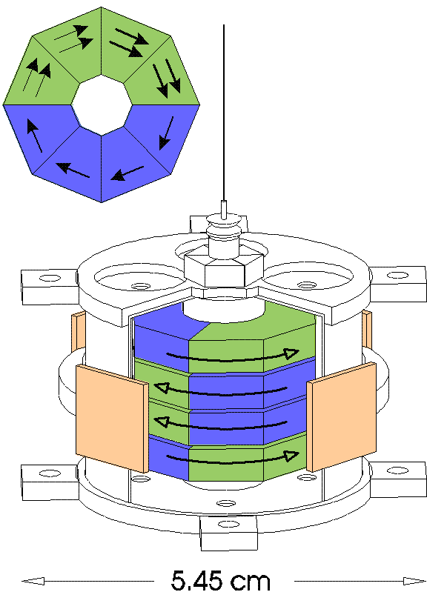
The Eöt-Wash spin pendulum
Electron Spin
AlNiCo
Net Spin
  Key point:
    AlNiCo: almost all B generated by electron spin.
    SmCo₅: half of B generated by net spin, half by orbital motion.
  Net spin (9.8 x 10²² polarized electrons)
  Negligible mass asymmetry
  Negligible composition asymmetry
  Flux of B confined within octagons
  Negligible external B field
  Sensitive to preferred frames
  Pseudoscalar exchange (axion-like particles).
SmCo₅

Slide 42
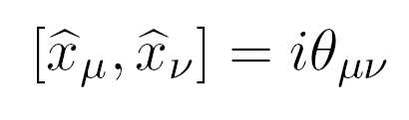
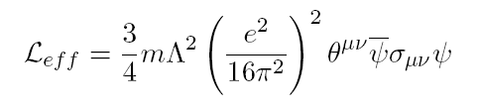
Non-commutative space-time geometry
string theorists have suggested that the space-time coordinates may not commute, i.e. that
where Θ_{ij} has units of area and represents the minimum observable patch of area, just as the commutator of x and p_{x} represents the minimum observable product of Δx Δp_{x}
Non-commutative geometry is equivalent to a “pseudo-magnetic” field and thus couples to spins
B
Λ~TeV
A
If the commutator is the same over the space/time of the experiment, then this effect also defines a preferred frame for the spin pendulum.
I. Hinchliffe, N Kersting and Y.L. Ma hep-ph/0205040
Anisimov, Dine, Banks and Graesser PRD 65, 085032 (2002)

Slide 43
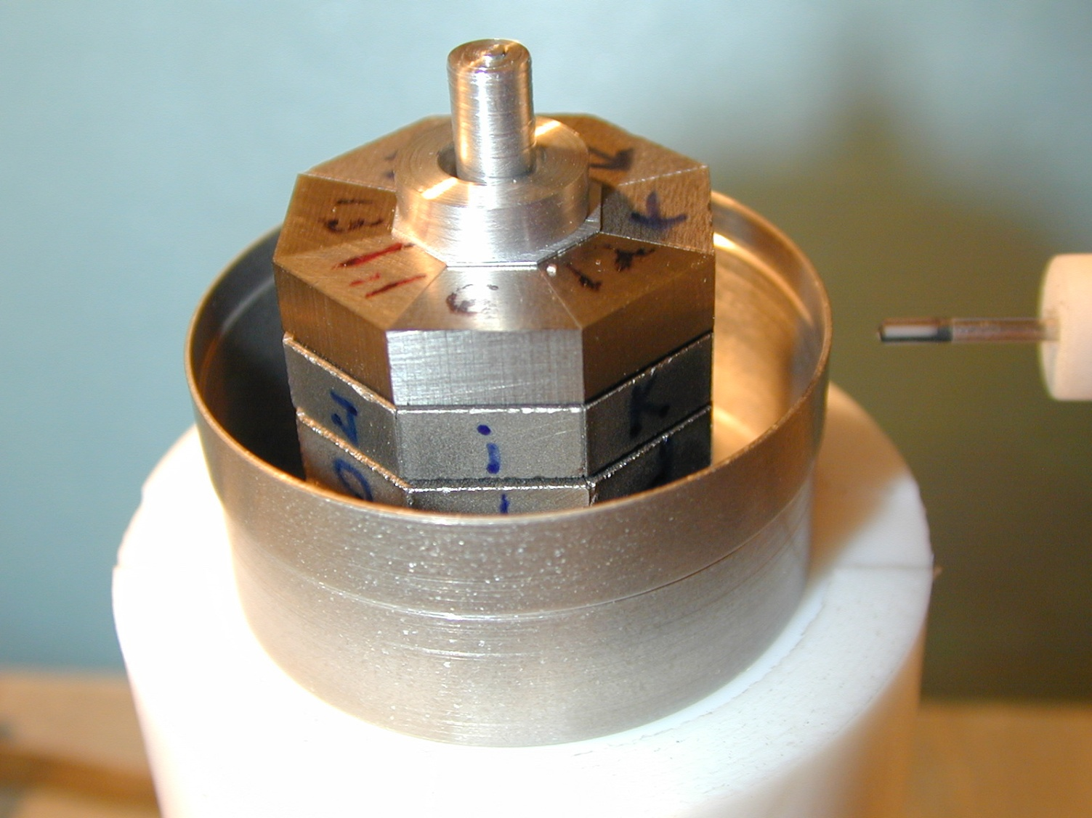
measuring the stray magnetic field of the spin pendulum
B inside = 9.6±0.2 kG B outside ≈ few mG

Slide 44
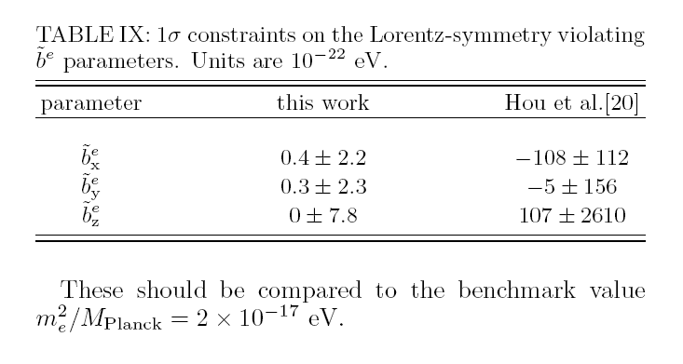
Lorentz-symmetry violating rotation parameters
our work
Cane et al, PRL 93(2004) 230801
Phillips et al, PRD 63(2001) 111101
Our limit is comparable to the electrostatic energy of two electrons separated by ~ 90 astronomical units

Slide 45
Minimum observable patch of area
implied by our results
Equivalent to:
  (10⁶ L_{p})², where L_{p} is the plank length:
  (10³ L_{u})², where L_{u} is the Grand Unification Length:

Slide 46
95% confidence upper limits on monopole-dipole interactions

