Slide 1
XGM / MCP – progress week 15 / 2017
Dr. Jan Grünert
X-ray Photon Diagnostics
Group Leader
Hamburg, April 13, 2017
Contains information from WP74 team
and F.Jastrow from DESY-FS-FL-D

Slide 2
XGM - Progress (w15)
Achievements:
  SRGs at XTD2 and XTD9 in DOOCS (Fini)
  Remote control of HV crate by ISEG software and Telnet (in XTD9)
  Grounding completed in XTD2+XTD9 (power cycle of rack was needed)
  Connected XGM@XTD10 on UPS (and activated network connectivity for alarm notifications)
  Gas supply:
    Calibration of gas supply pressure sensors at XS3 and XTD2
    Installation of T-parts in Nitrogen gas line for future turbo venting in XTD1, XTD2, XTD6, XTD9, and XTD10
    Power connection of pressure sensors in XTD2
    Gas Supply Flushing with N2, Ar, Kr, and Xe at XTD2
    Gases ready to be used in XTD2
  XGM inserted into vacuum loop and interlock (in XTD2 and XTD9)
  XGM @ XTD2 ready for beam (need DOOCS middle-layer servers activated)
Open tasks:
  Establish HV inhibit (didn’t work)
  Power connection of pressure sensors in XS3
  Finish local tests at XTD9
  Get all required DOOCS servers running for operation
Problems:
  Turbo failure at XTD2 (2 turbos) and XTD9 (1 turbo) – vacuum control software bugs

Slide 3
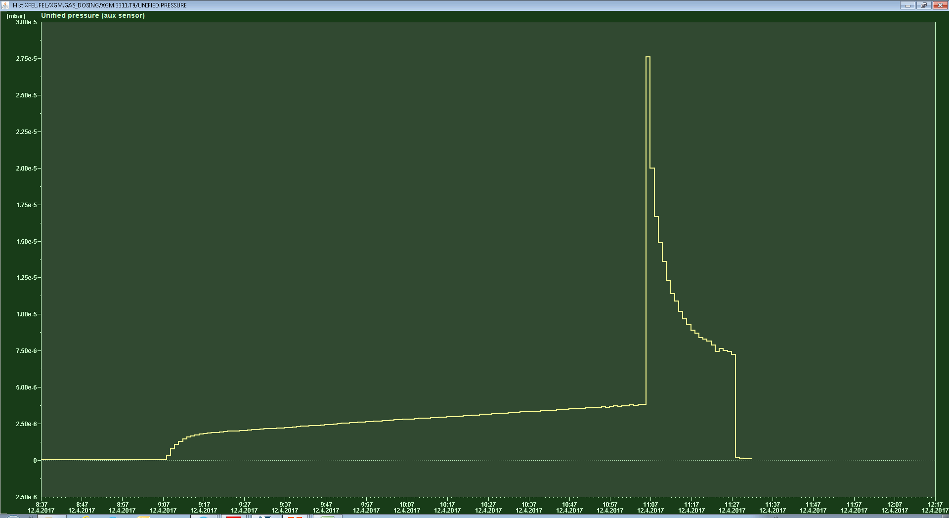
Vacuum control issue XTD9 (12.4.2017)
3E-5 mbar
9h06
5E-6 mbar

Slide 4
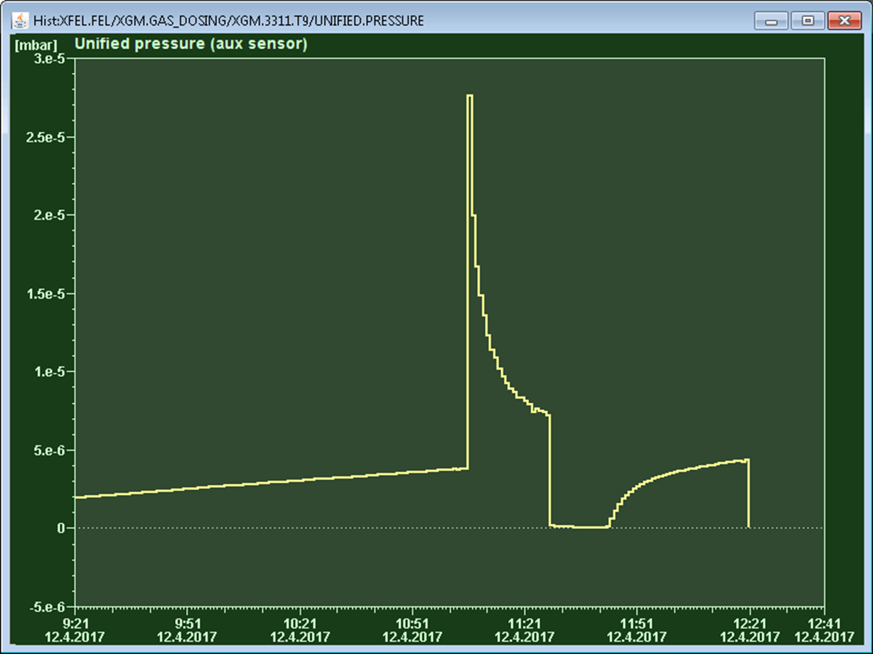
Vacuum control issue XTD9 (12.4.2017)
open vatterfly
only 1 TP pumping
Vatterflies closed

Slide 5
XGM - Plan week 16
XTD 2:
  Test to solve / remove failure causing communication issue for XGM-vacuum
  Put XGM-vacuum back into LOOP
  Ready for final tunnel closure
XTD 10:
  Vacuum part and Gas Panel wiring of XGM
  Local wiring on XGM chambers; installation ADAM & Femto crate

Slide 6
MCP - status
Added UVLAMP remote control
  Inserted additional Beckhoff terminals
  Inserted into LOOP firmware and karabo name list
  Tested hardware in tunnel using karabo
  Detected wiring problem (5V lines switched), rewired
  Detected trigger issue (trigger cable had again been unplugged inside rack by somebody !)
  Successful triggered operation of UVLAMP by remote enabling
MCP s/w commissioning (Beckhoff):
  Motor movement w/ Technosoft controller to be put in LOOP
  whenever mc2lib is deployed by AE (will require ZZ to XTD2 for test !)
MCP s/w commissioning (karabo):
  HV interlock is now operational (thanks Chris !)
  had issues with mpod panels (to be followed up)

