Slide 1
Utrecht University
Hilbert Space
in
DETERTMINISTIC
THEORIES
Gerard ’t Hooft, Berlin, October 5, 2009

Slide 2
Deterministic Quantum Mechanics
We imagine three scales in physics:
Pico: e.g.: The Planck scale: 10⁻³³ cm
Micro: The microscopic, or atomic, scale: 10⁻⁸ cm
Macro: The macroscopic scale (people, planets): > 1 cm
At the Planck scale (pico) there are strictly
deterministic laws.
At the atomic scale (micro) everything seems chaotic.
We shall argue that, at that scale, quantum mechanical behavior would be quite natural!
At the macroscopic scale, these deviations tend to
to adopt classical behavior (“classic limit”)

Slide 3
Our model: A
CELLULAR AUTOMATON

Slide 4
an example (any number of space dimensions)
variables:
The evolution law:

Slide 5
(when x + t is odd)
Alternatingly, the sites at even t and the ones at
odd t are updated:

Slide 6
A and B are operators. Write them as
is the
permutation operator
for the variable F
equal-time commutators:

Slide 7
Write:
What is H ?
Use Baker-Campbell-Haussdorff:

Slide 9
Intermezzo: it is better to write
is in the same conjugacy class as

Slide 10
appears to be a perfectly local, bounded
quantum operator, similar to the Hamilton density
operator of a QFT.
similarly: stays
outside the “light cone”: information does not
spread faster than velocity v =1=c
as an operator, is (practically) bounded
(from below and above), so H should have a
lowest eigenstate. This is the vacuum state of
the cellular automaton.
only if one may terminate the BCH series!
But does the Baker-Campbell-Hausdorff
expansion converge ?

Slide 11
Expand in powers of s and t .
and converge well
But writing their product as an
exponent, , will lead to singularities, if at
some values of s and t , two eigenvalues of the
product are exactly apart.
This means that divergence occurs when two
energy eigenvalues of H are considered that are
apart.
“Planck energy” ?

Slide 12
As long as we restrict ourselves to energy scales much lower than the “Planck energy”, our theory appears to behave as a quantized field theory, with a genuine Hilbert space, and the correct “Copenhagen interpretation”
The problem will be to generate a “realistic” QFT: approximate Lorentz invariance !!

Slide 13
Qu: time translation invariance only strictly holds
for time tranlations over integral multiples of Δt ,
the lattice time unit. Is conservation of energy
violated by multiples of ?
A1: yes, if you introduce a classical perturbation:
allow the cellular automaton to be perturbed:
Then, acts with the beat of the lattice clock.
It only respects energy conservation modulo .
Such perturbations are not allowed by General
Relativity.

Slide 14
A2: no, if you expand the complete Hamiltonian
H into a linearlized part and an interaction
piece . The total energy, defined by
is exactly conserved.
This distinction may be of crucial importance
for the following discussion:
The EPR Paradox and
BELL s inequalities
,

Slide 15
“Alice and Bob have the free will
to choose which observable to measure.”
But is there “Free Will” ???
What is Free Will ??

Slide 16
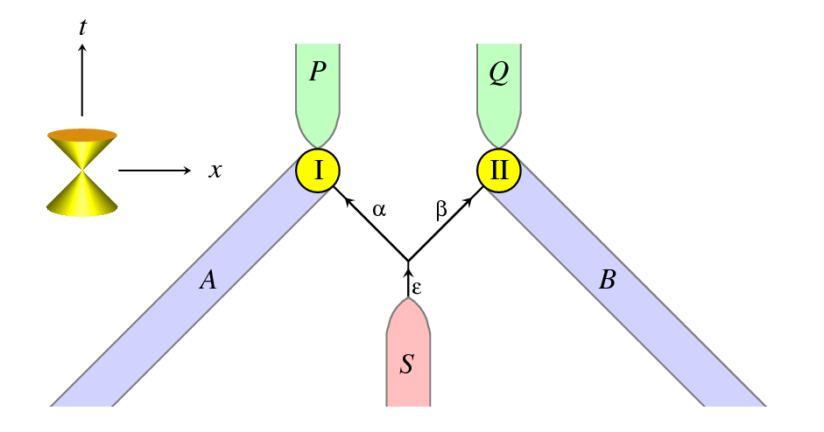
α and β are entangled. P cannot depend on B , and
Q cannot depend on A → Bell’s inequality → contradiction!
t = 0
And yet no useful signal can be sent from B to P
or A to Q.

Slide 18
Symmetries on the lattice.
1. the momentum operator.
Normally, momentum is
only defined inside its
Brillouin zone.
Can we do better?

Slide 19
Define an anti-commuting field on the
lattice sites x , creating or annihilating a particle
according to the anti-commutation rules
(No spin yet)
Each fermion is limited to its Brillouin zone.
But all of them together can have much larger
momentum !
Define

Slide 20
However: this only works for non-interacting
“fermions”. Interactions would allow creation of
integral multiples of 2π ℏ / L _{Planck}
Interactions:
What is needed is an explanation why the
elementary particles prefer to sit only in
low momentum states (much lower than π ℏ / L _{Planck} )
information loss !
― π ℏ / L _{Planck}
π ℏ / L _{Planck}
Low temperature states contain far less information.
The Universe cooled during its expansion.

Slide 21
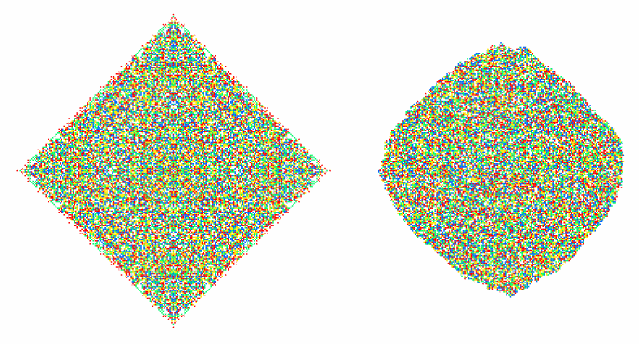
Rotation invariance ?
a
b

Slide 22
Rotations: a single particle is only invariant
under the lattice rotations, over angles that are
multiples of angles such as 90° (or 60°). So,
a single fermion can only be in an angular
momentum state of ℓ = 0, or 1. We can get
higher angular momenta by taking many
fermions.
However
These are 4 states. How to Fourier transform?

Slide 23
m is defined modulo 4. Do we take
Both break parity, or higher D rotation inv.
This has a sign switch.
Best to give the fermions an internal spin
value of ½.

Slide 24
In 3 dim, we have
states. Write
6 = 3 × 2:
orbital ang. mom. is 1,
spin ang. momentum is ½ .
Even on a lattice, before considering
Lorentz transformations, half-odd spins
for the fermions are required.

Slide 25
Monte-Carlo lattice simulations of QCD are in 4 dimensional Euclidean space × 1 stochastic time variable.
Our deterministic models would be in 3 dimensional Euclidean space × 1 real time coordinate.
Generating realistic models of this type would be a promising challenge

Slide 26
THE END

