Slide 1
Digital Test Status @ SLAC
Su Dong

Slide 2
Digital Test Status
Still trying to create partial connected setup to isolate the bias anomaly and diagnose matrix response.
Digital readout firmware/software in Git and instructions linked to Twiki (up and running at UBC ?).
Dionisio Doering/Larry added firmware (microBlaze softcore) to force DACTH swing in synch to Qinj to artificially create a hit at designated pixel to allow digital tests to continue
Functional Q/A by students: Rob Mina (Stanford), Mazin Khader (UIUC), Murtaza Safdari (Stanford)
Matrix mask control appears to function at some level but some noise hits from disabled pixels ?

Slide 3
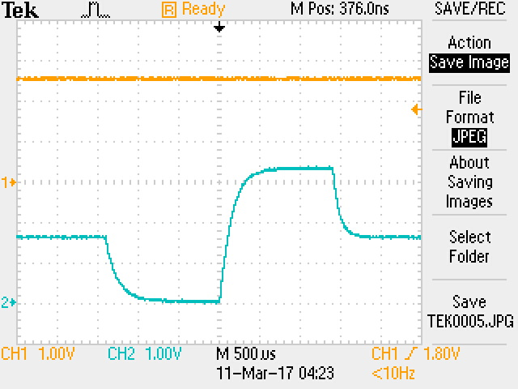
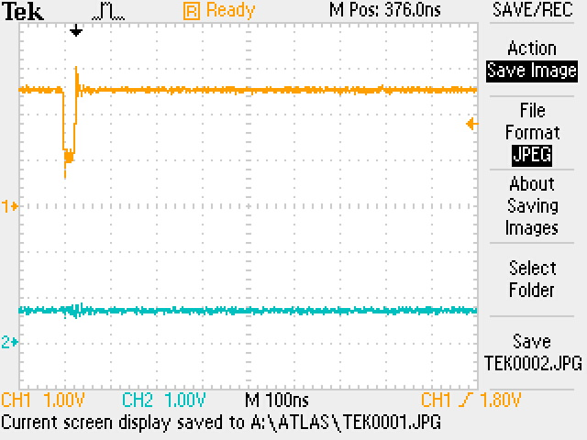
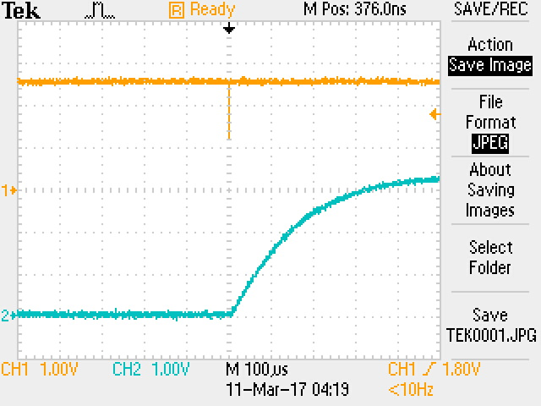
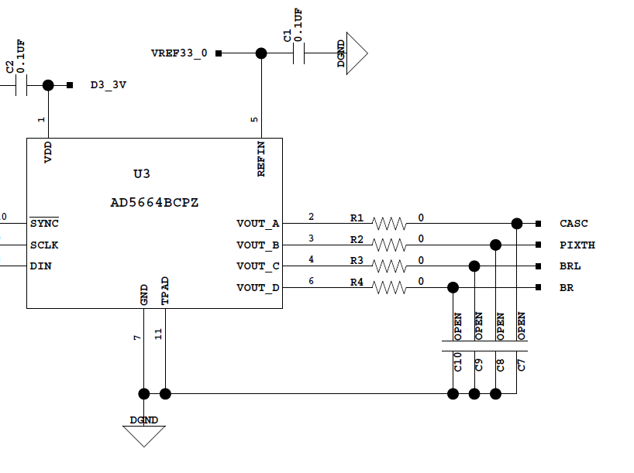
Threshold Swing Hits
Dionisio Doering
DACTH
Charge Injection Pulse
@ INJ1 connector

Slide 4
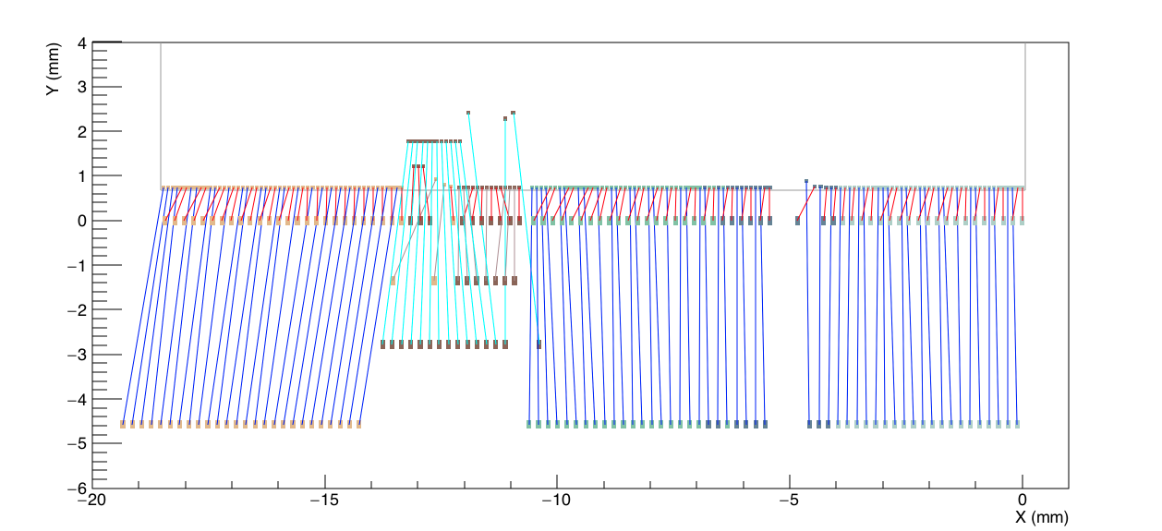
Digital Daughter Board Layout
First prototype C00
Many large angle neighboring wires
First row of PCB pad ~0.7mm from ASIC edge is too close ?

Slide 5
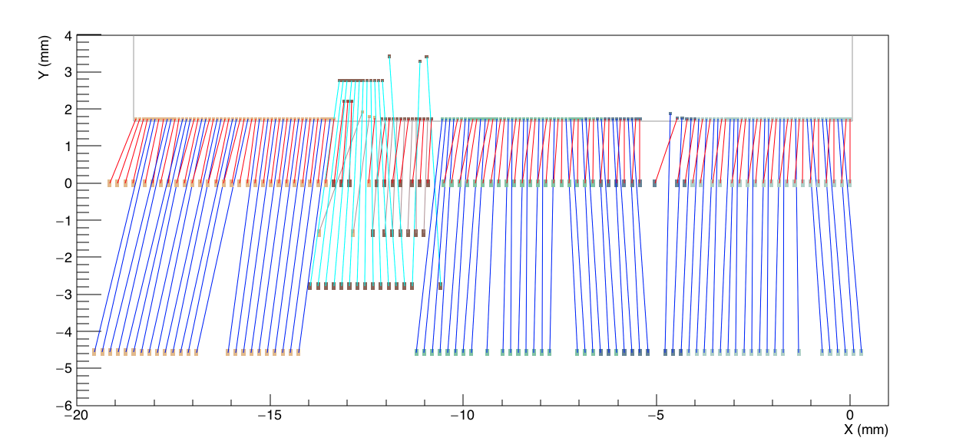
Digital Daughter Board Layout
Current interim C01
Made neighboring wires more parallel in some regions but still have more fairly large crossing angles.
ASIC pull up by 1mm to be clear from ASIC edge, but wire bonds are getting too long (6.5mm) ?

Slide 6
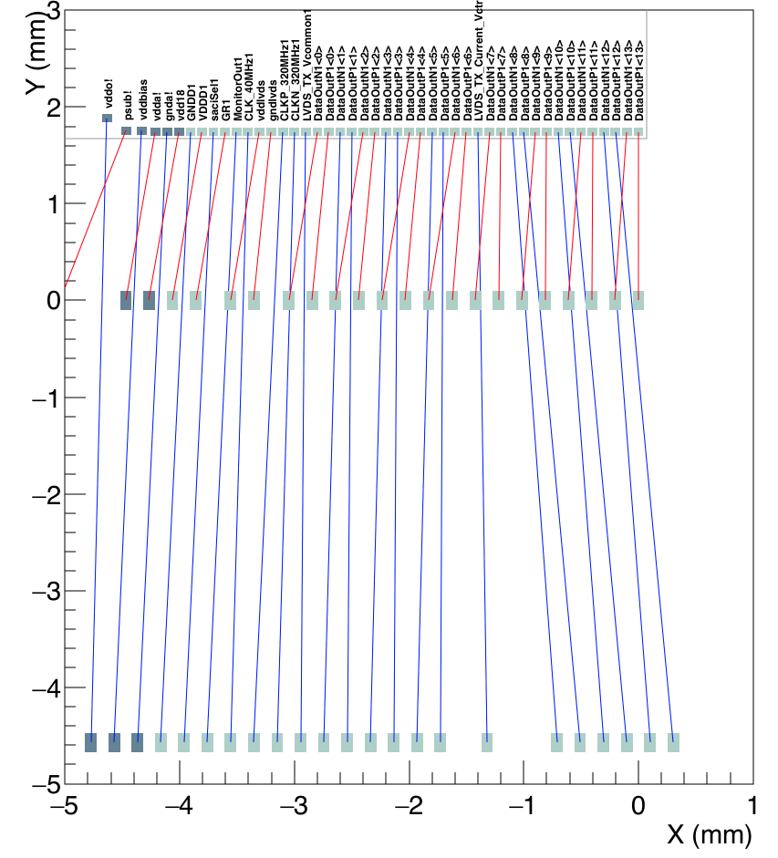
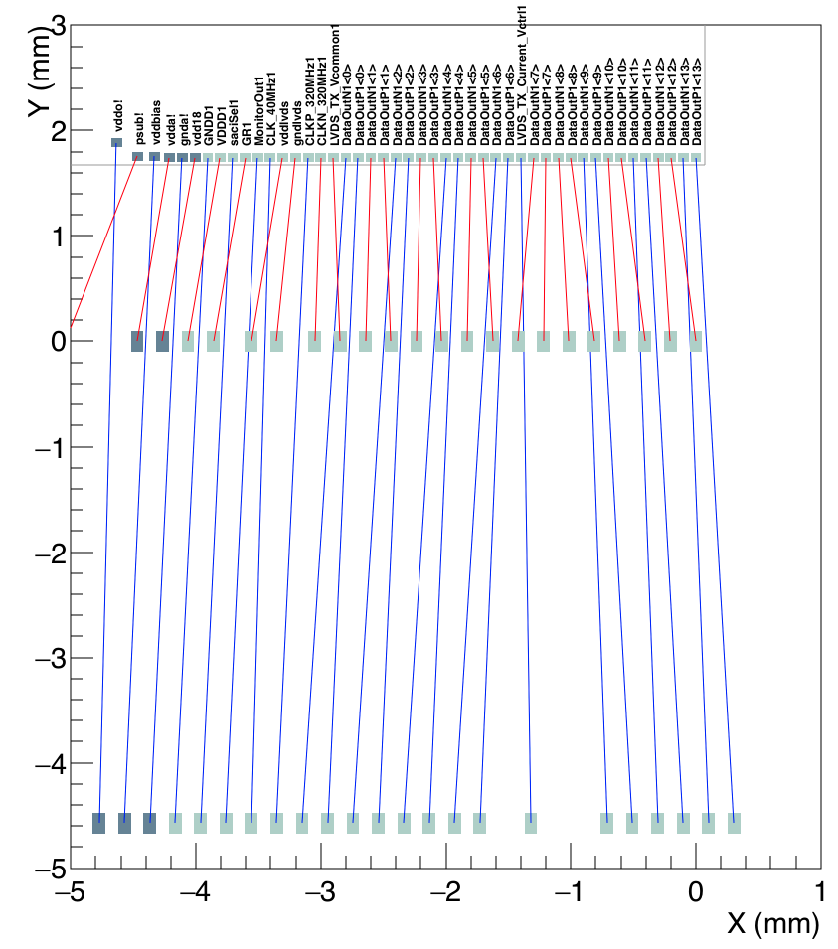
Digital Daughter Board Layout (Top array)
Current interim C01
Test ideas for C02
Reasonable prospect to reduce crossing angles still

