Slide 1
Emergency off concept for rackrooms
How the concept works
Infrastructure / Emergency off buttons
Labelling of racks / markings
Emergency response procedures related to the emergency off

Slide 2
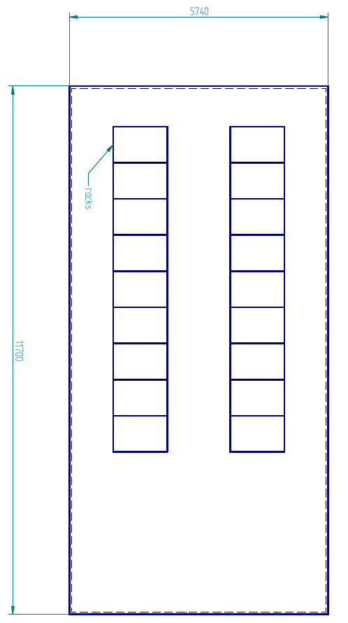
Concept
One emergency off button for standard racks per entrance door
  Pressing the button cause a power cut in all racks
  No impact on racks with SV connection
  No further alarms activated
One emergency off button for racks with SV connection per entrance door
  Pressing the button cause a power cut in all racks with SV connection
  No impact on standard racks
Occuring alarm (fire protection system pre-alarm, water alarm, …) in control room
Investigation by trained staff
Depending on the alarm use of emergency off button (leakage, fire, accident, …)
Call for help (push-button fire alarm, leakage TS/FM, 2500 TN, …)

Slide 3
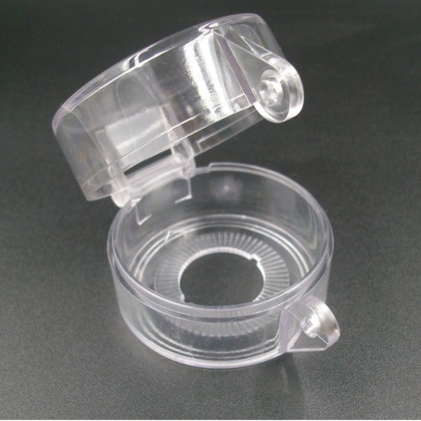
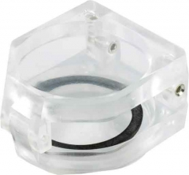
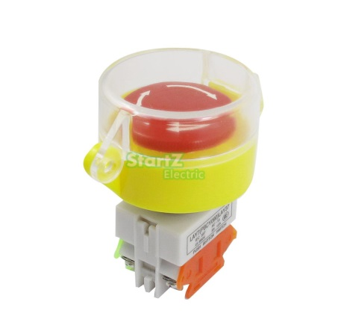
Infrastructure
The already installed infrastructure supports the concept
The power distributions allow the installation and usage of the emergency off buttons in the way presented
No reconstruction needed
“Just” addition of the necessary infrastructure for the buttons and the buttons itself
SV emergency off buttons will be marked in line with the racks
SV emergency off buttons will be a type with protective cap to prevent accidents and put an additional barrier before pressing the button
On-site training for the emergency off system has to be adapted for the additional type
The installation of emergency off buttons in the presented way is mandatory for all rackrooms according to occupational health and safety

Slide 4
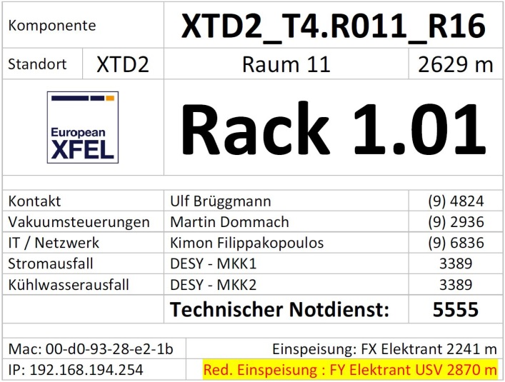
Labelling of racks / markings
All racks will be labelled with a unique identification
The labelling will be comparable to the racks and labelling present in the XTDs
All racks connected to the SV system will get an additional so they can be identified easily
The chosen mark is a coloured stripe on the label
According to the label and colour code it can be clearly identified which emergency off button will shut down the power supply for which rack

Slide 5
Emergency response procedure
Occuring alarms from the central building control system related to installations in the rackrooms have to be forwarded into the control hutches and to the TN
An investigation has to be carried out by trained staff (common handling, investigation time 3 min)
Example: Fire alarm
  A fire pre-alarm (two detector dependency) is triggered by one fire alarm system (RAS)
  Trained staff enters rackroom for investigation
  Small fire in a standard rack caused by an accident of a coworker installing components in the rack
  Pressing the emergency off button powering down all standard racks to prevent helpers from getting an electrical shock
  Rescue the injured person from the hazardous area
  The fire is a bigger one not extinguishable with the present fire extinguishers → pressing the fire alarm button next to the emergency off button
  Calling for additional help (shouting for colleagues, phone TN)
  Giving first aid to the injured
Training for staff will be provided by SRP (internal and external trainings mandatory)
SRP is at the moment collecting all requirements to organize the trainings
One trained person per beamline has to be present all the time

Slide 6
Activation of fire alarm systems in XHEXP1
Most fire alarm systems installed in the free volume of XHEXP1 were offline until today late afternoon
The reason was the ongoing construction of the SASEs and programming of the central fire alarm system (false alarms showed weaknesses in the programs that had to be fixed)
DESY TN prepared everything and the system is ready for activation starting today at 18:00
The components will be inactive between 07:00 and 18:00 from Monday to Friday

Slide 7
Activation of fire alarm systems in XHEXP1
Beside the given timeframe the components have to be shut down separately and with permission
The hot work permit procedure is still mandatory and even more important if the systems are inactive
  Responsibles aware of work causing a fire risk
  Definition of (fire) protection measures to be taken
  …
Excluded from the deactivation are all rooms with direct connection to the XHEXP1 (all rooms in the east and west wall of the XHEXP1 like f.e. balcony rooms, ante rooms elevator, power distribution, SASEs, …)

Slide 8
Status risk assessments SASE1
Preliminary risk assessments available for control rooms, rackrooms
  Update necessary and ongoing
Risk assessments as well as laser safety risk assessments available for PP-Laser, SPB-Laser
Risk assessments for experimental hutches ongoing → finalization planned latest 19. KW
Risk assessments open: SPB Optics, SPB Prep, Upper levels SASE1 (technical areas), Transport, Synchutch
Finishing date end of May (21. KW)
Dependencies:
  Central gas supply SASE1 (N2, pressurized air)
  Storage of hazardous substances and samples
  Full operation of installations
  Work instructions for machines and hazardous substances

