Slide 1
SASE1 readiness meeting
Status Photon Diagnostics
28.4.2017
Jan Gruenert, WP74

Slide 2
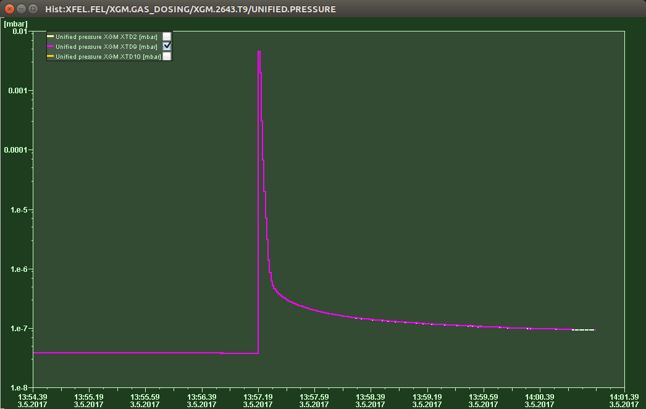
XGM
Past week (w18):
HV inhibit problem seems to be an iseg company issue (under investigation)
Karabo (partially) offline over night from Tuesday to Wednesday
induced 3h evening intervention of Jan+Wajid
First DOOCS plus Karabo operation of the XGMs at XTD2 and XTD9
(without beam): needle valve test, panels in DOOCS and Karabo etc.
→ gas delivery to chamber in XTD9 is OK
Induced “Vacuum event” at XTD9
→ Interlock reacted properly (DONE !)
Next:
Support Relaunch VAC PLC loop
Set XTD2 shutoff valve to remote (ZZ today) and check proper gas delivery
Induce “Vacuum event” at XTD2 to check interlock
Can somebody check rack 3.3 today (smelled like some smoldering) ?
Plan: start operation of XGM @ XTD2 on 15.5.2017

Slide 3
General
Supported Commissioning with X-rays last weekend with our transmissive imager IMGTR / OTRC.2615.T9
First Lasing in SASE1 at 1.5keV happened on 2.May 2017
(as everybody knows by now)

Slide 4
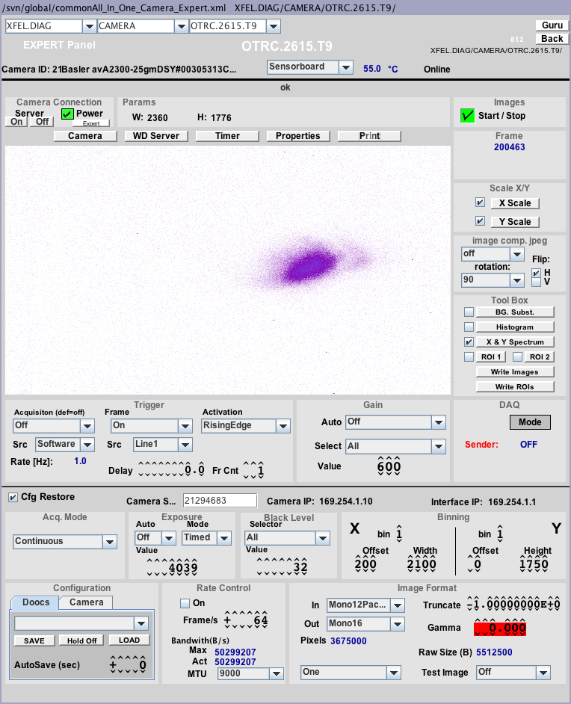
02.05.2017 22:46 | xfeloper

Slide 5
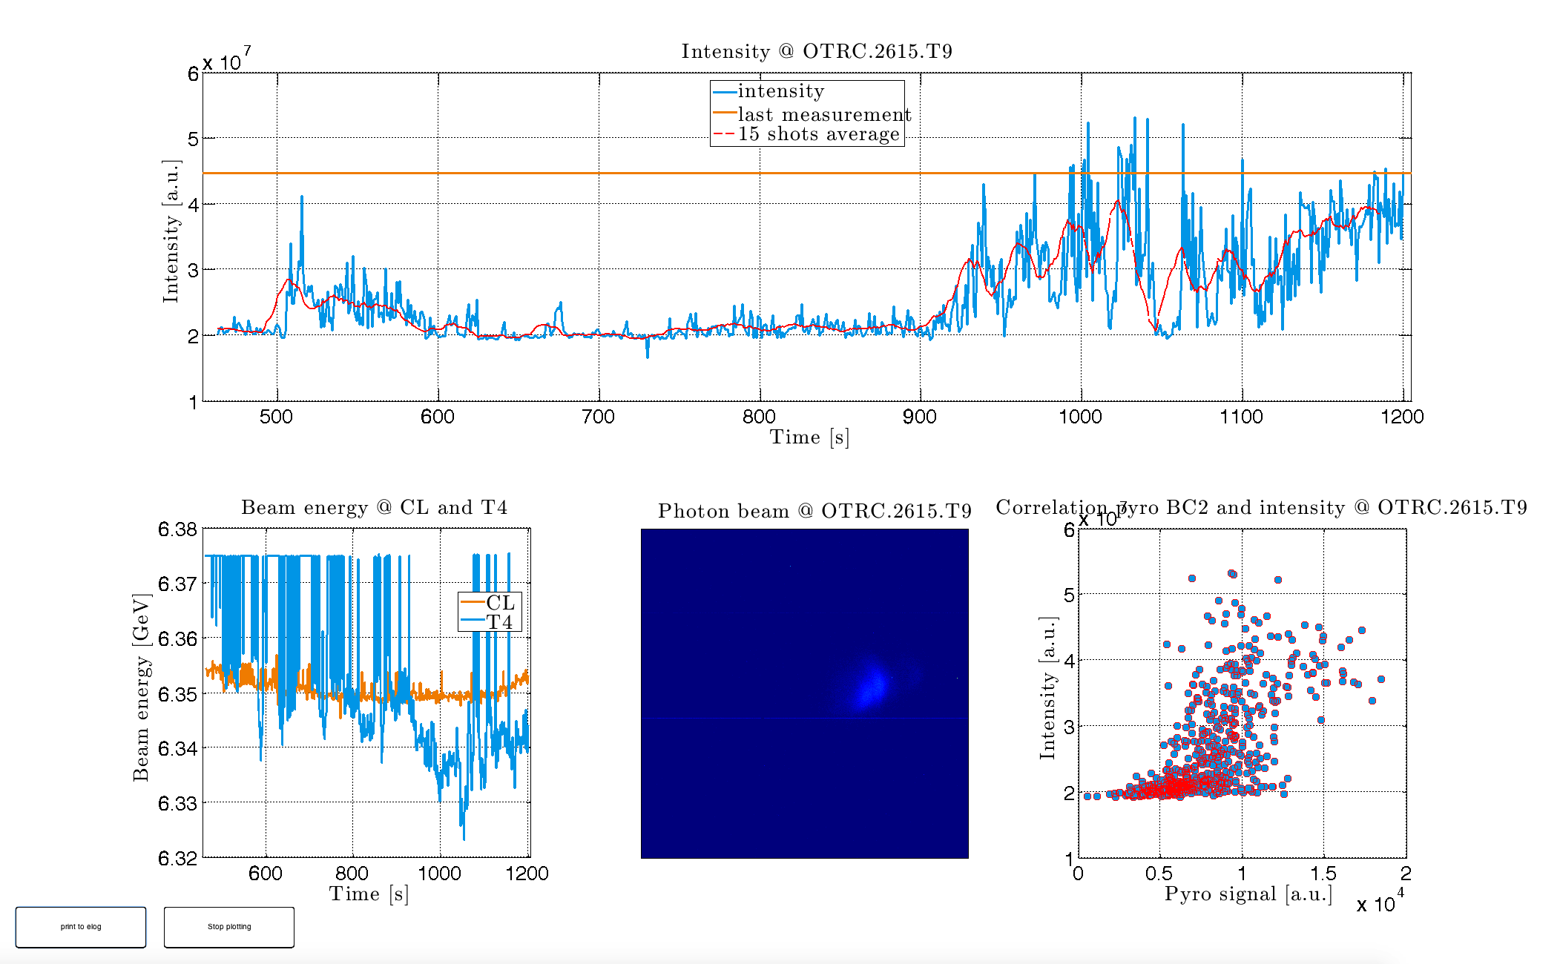

Slide 6
General
Supported Commissioning with X-rays last weekend with our transmissive imager IMGTR / OTRC.2615.T9
First Lasing in SASE1 at 1.5keV happened on 2.May 2017
(as everybody knows by now)
SA1_XTD2_FLT was not yet used, maybe next week
Our Diagnostics/optics commissioning starts May 12 (open V0)
Preparing plans for commissioning period until July
Potential ZZ end of next week for local checks at MCP and KMONO if Technosoft and ELMO can be included in loop firmware
Reminder: still need the postponed SASE2 rack review

