Slide 1
SLAC Test Status
Su Dong

Slide 2
Tests with Threshold Swing
Mazin Khader/UIUC; Rob Mina, Murtaza Safdari/Stanford, with help from Larry and Dionisio
Continued digital hit pattern tests using the threshold swing kluge synched to Qinj (but not real Qinj) to force hits at designated pixel locations
Found initial implementation of threshold swing had too short a wait (~1μs) before latching the hit, while the threshold swing has a ~300μs ramp up
=> new firmware from Larry extended the latching wait.
Nominal setup with BLR=BL+500mV showed no hits still with threshold sweep in either direction.
Hits appeared when setting BLR < BL !?
Could we have an updated matrix design circuit diagram with all control voltages marked as to where they are applied ? BLR is the gate voltage of the Baseline control FET ?

Slide 3
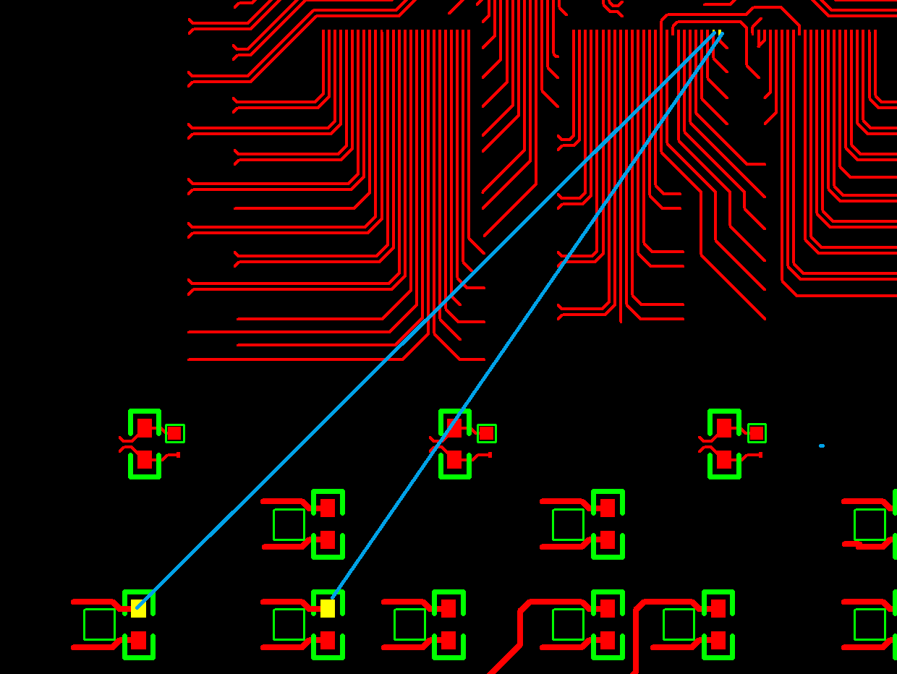
Check on BL/BLR Control
Recall C00 daughter board had patch for BL(BR)/BLR(BRL) symbol mismatch missed routing for BL/BLR.
Patch correctly done with BL->J1-127 and BLR->J1-125
Tracing back the DAC control code and verifying actual voltages on daughter board next.

Slide 4
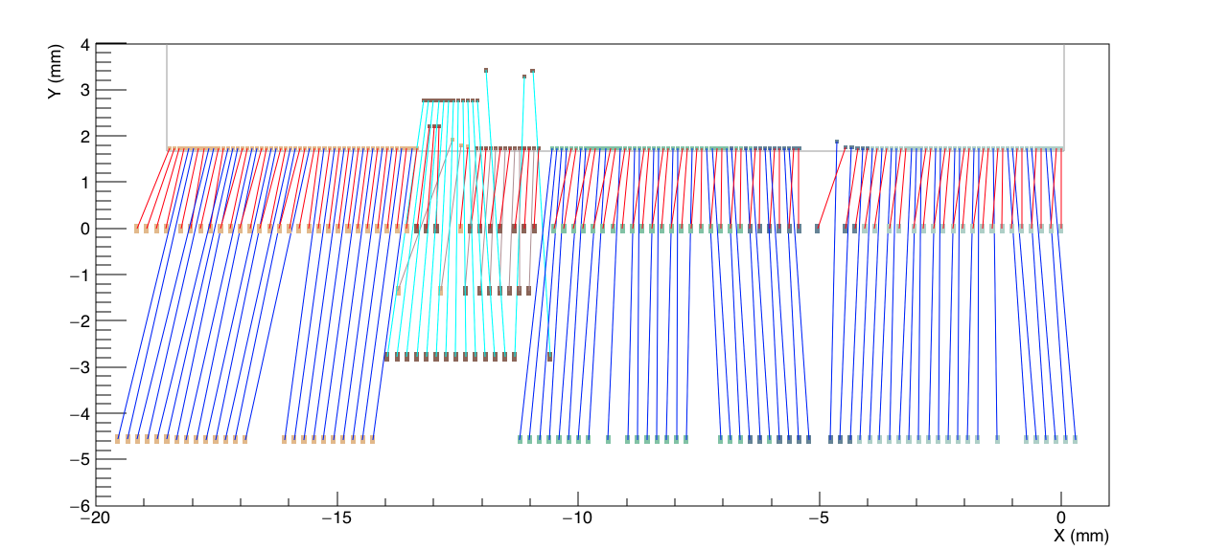
Single Array Probe Cards
Wire bonds for single array ~58, just fit 64 pin standard probe card.
Option a) Bottom array – most thoroughly checked at design
Option b) Middle array ? - copy of bottom array, not tangled with test structure.

Slide 5
Digital Daughter Board
Layout Investigation
Conceptual analysis to get an agreeable target – not yet actual implementation
More tests to determine any further patches might be needed to make the matric/bias work before launching production ?

Slide 6
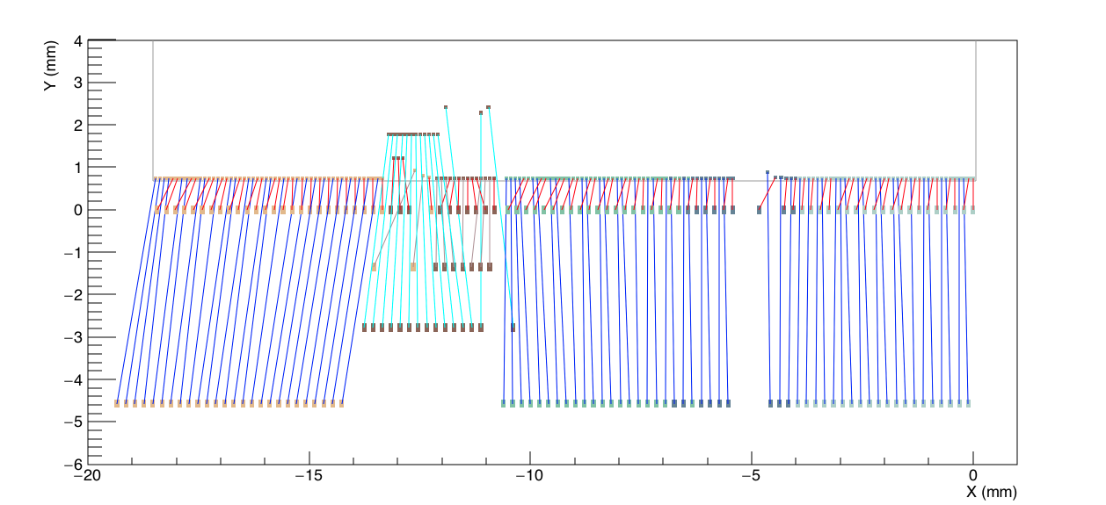
Digital Daughter Board Layout
First prototype C00
Basic issue: ASIC pins are 100μm pitch, PCB layout need to avoid exotic PCB technologies – adhere to 8 mil (203μm) pad/trace separation
Many large angle neighboring wires near ASIC
First row of PCB pad ~0.7mm from ASIC edge is too close

Slide 7
Digital Daughter Board Layout
Current interim C01
Made neighboring wires more parallel in some regions but still have some fairly large crossing angles cases.
ASIC pull up by 1mm to be clear from ASIC edge, but wire bonds are getting longer (6.5mm)…

Slide 8
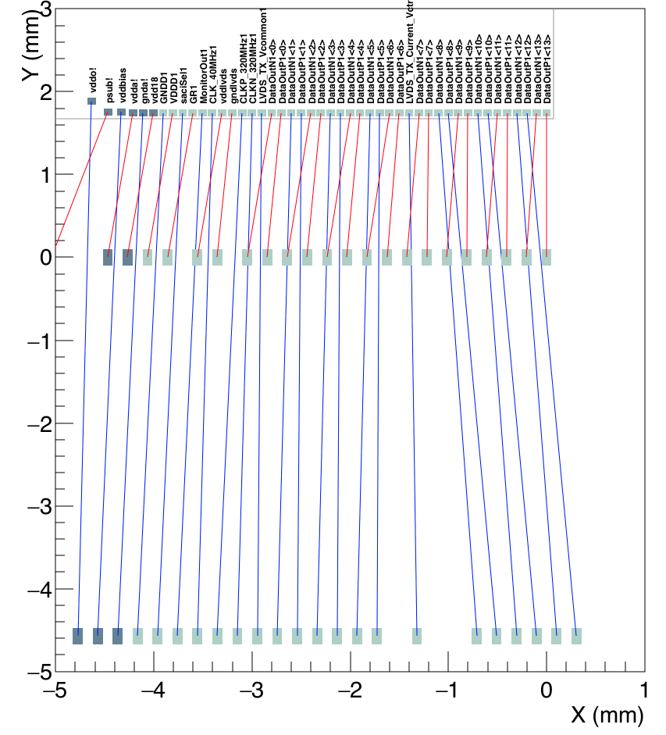
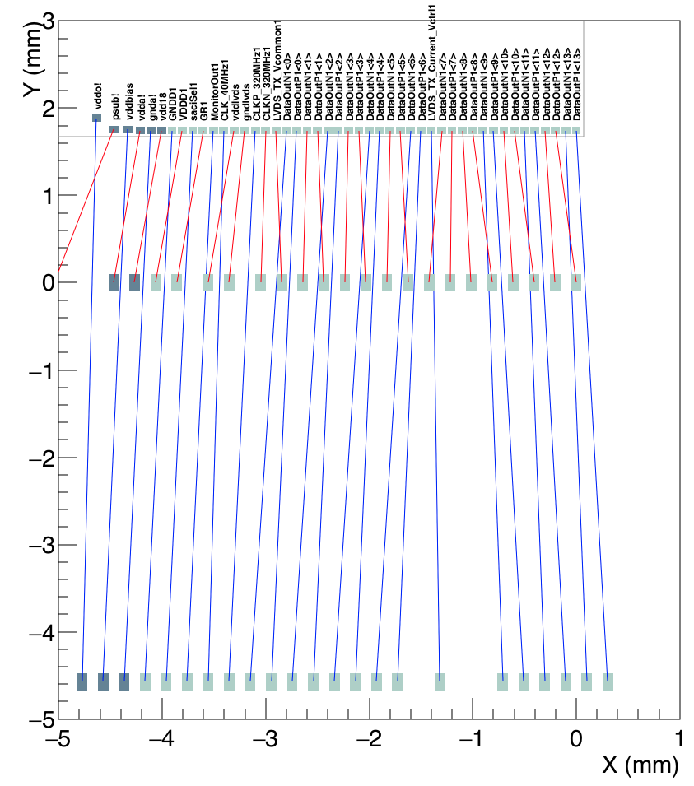
Digital Daughter Board Layout (Top array)
Current interim C01
Test ideas for C02
LVDS pair array re-indexing should be harmless

Slide 9
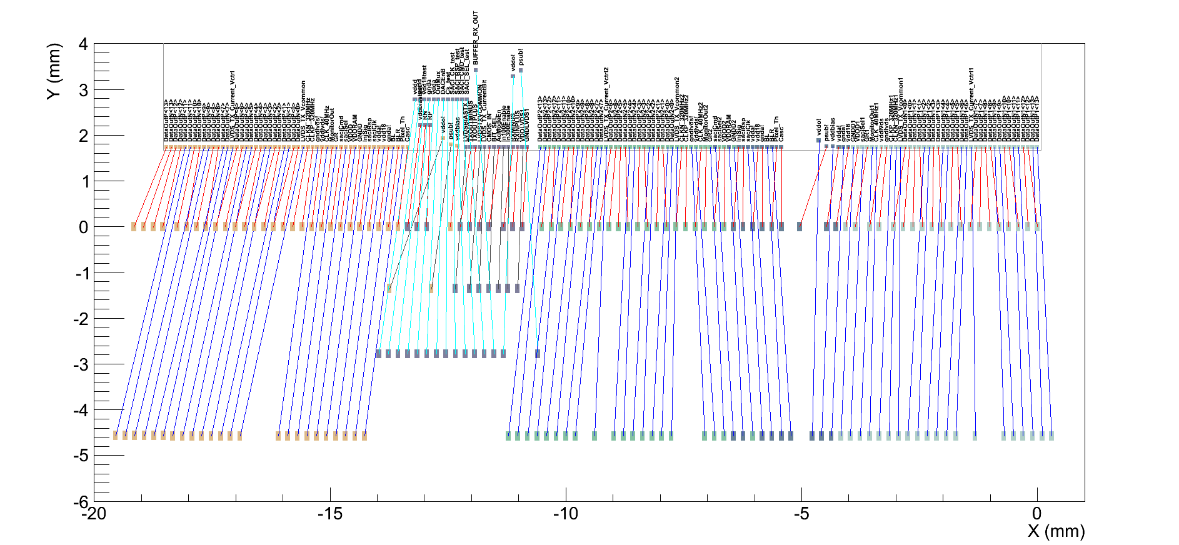
Test Layout Adjustments
X1
X2
X3
M3
M2
M1
T3
T2
T1
After simple swaps of LVDS data pairs for wire bonds without touching C01 Y+1mm layout

Slide 10
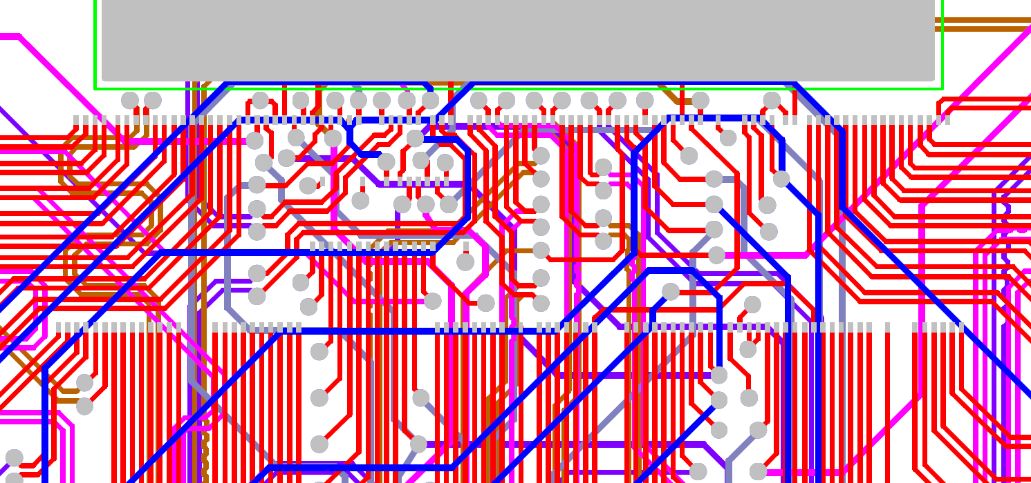
Layout space constraints
ASIC go up by ~1mm
This area will open up for traces & vias
X1
X2
X3
M3
M2
M1
T3
T2
T1
Desired group pad shifts seem to have the space in layout to accommodate
Red lines = top layer Grey circle = via (all layers !) Grey rectangle = wire bond pads
X2 (vddo) can relocate; X3 (psub) is bias HV -> needs clear space

