Slide 1
Progress and next steps 11 May 2017 this version is the minutes of the meeting
J. J. John on behalf of the team

Slide 2
Agenda
Discuss progress and steps for next week:
ABCN’ testing
CHESS-2 news
ABCStar/HCCStar news
TWiki page for CHESS and its test hardware: https://twiki.cern.ch/twiki/bin/view/Atlas/CHESSStripTestChip

Slide 3
ABCN’ testing
Status:
.
Next steps:
Robin will add control in firmware of the 4 digital lines needed.
Look at testing with the digital daughterboard, using deterministic outputs from CHESS-2 first.
Then look into “digital hits” via changing DACTH as SLAC has done.

Slide 4
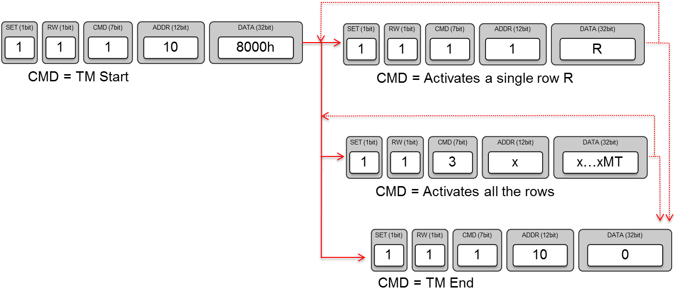
Test Mode
Activate hits on one row
TM Start
Activate a single row
TM End
or Activate hits on all rows
TM Start
Activate all of the rows (middle part of Figure 13, 'x' means the value doesn't matter, so can use zeroes)
TM End

