Slide 1
Photon Commissioning Status
PCT team members
TC meeting 19-05-2017

Slide 2
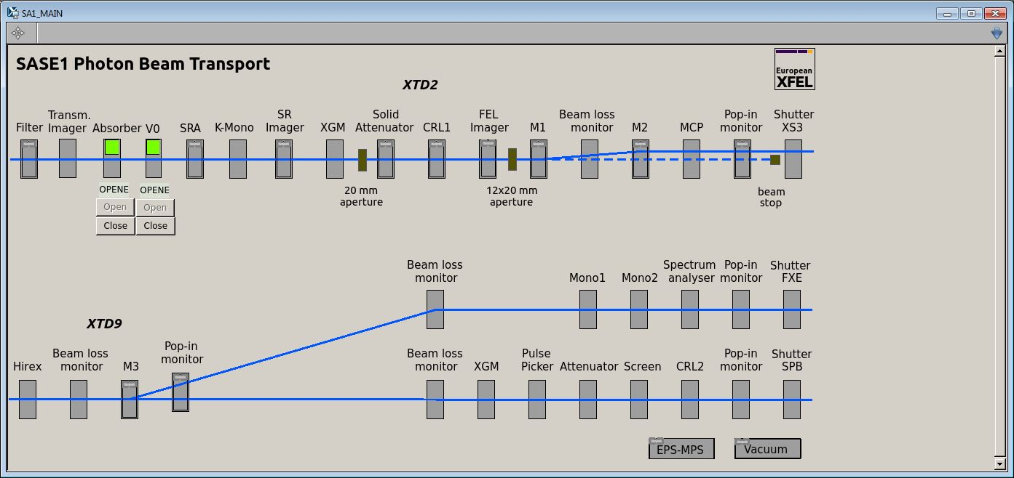
Karabo Scene of SA1

Slide 3
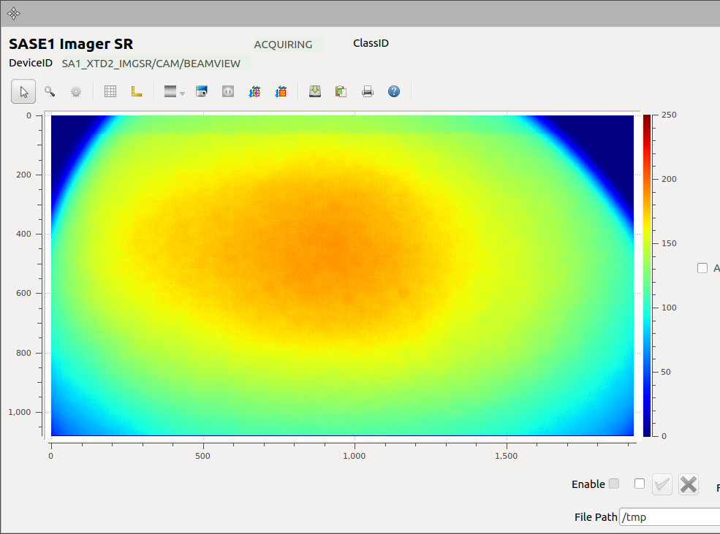
Spontaneous Radiation on SR imager
FOV= 20mm x 15mm

Slide 4
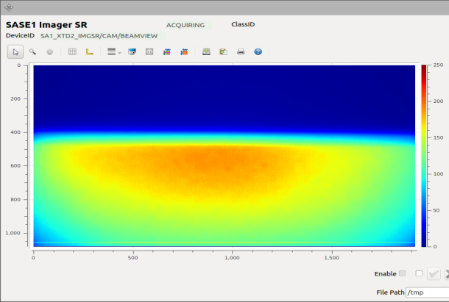
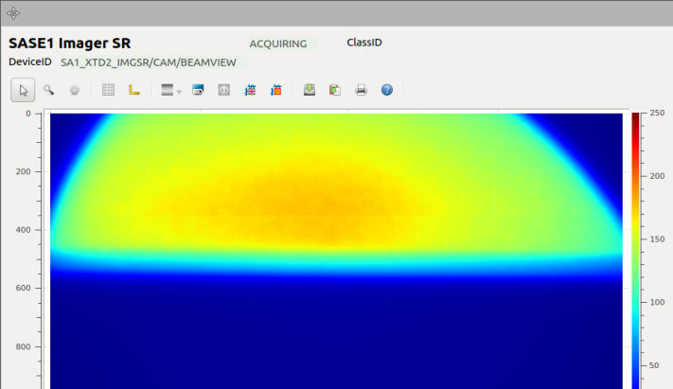
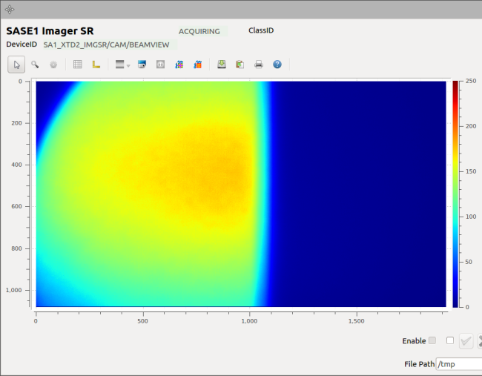
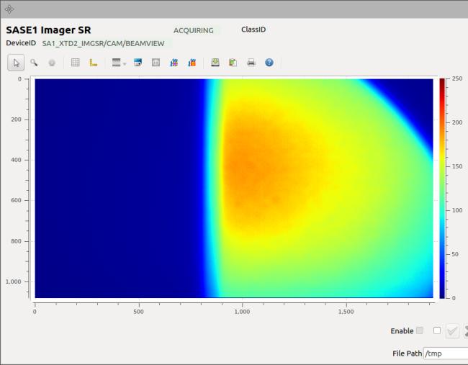
Commissioning of Spontaneous Radiation Aperture (SRA)
Top blade
Bottom blade
Right blade
Left blade

Slide 5
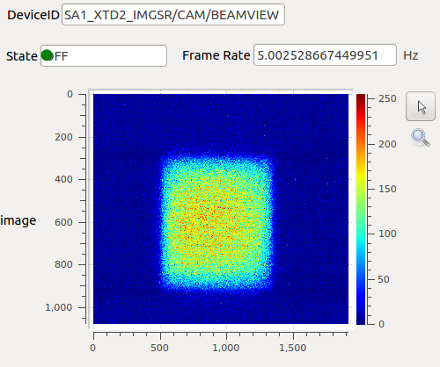
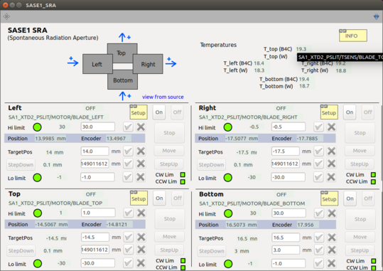
Beam slit down using SRA
Karabo scene for SRA

Slide 6
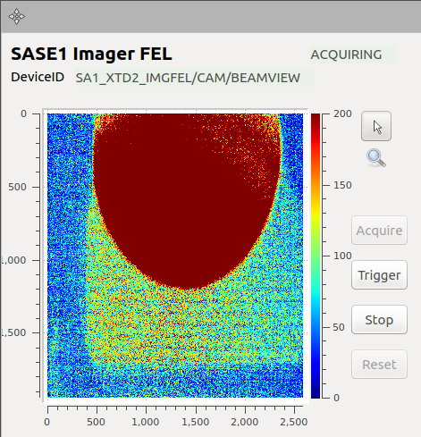
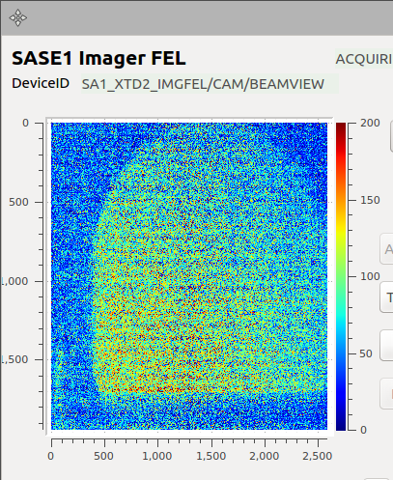
Spontaneous radiation and OTR on FEL imager
Spontaneous radiation on FEL imager

Slide 7
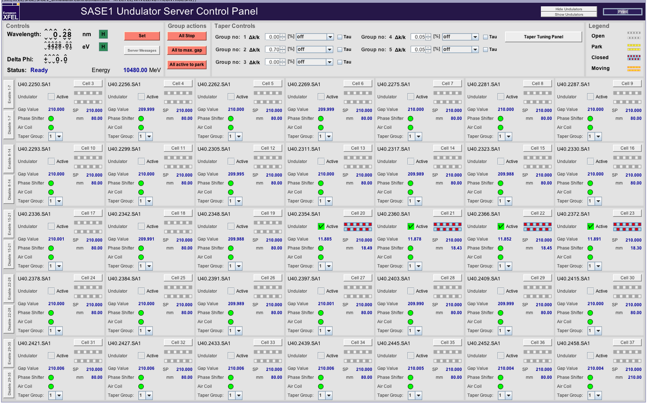
Undulator control panel

Slide 8
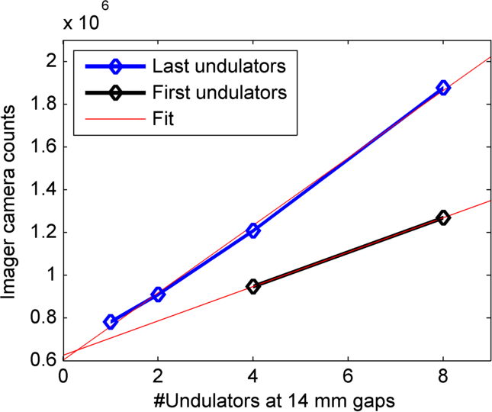
Intensity of the spontaneous radiation as function of undulators with gap of 14mm
Linear scaling of x-ray intensity (synchrotron/spontaneous radiation!)

Slide 9
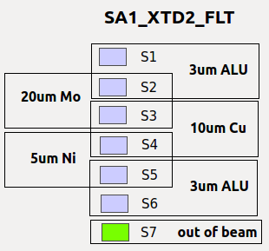
Filter panel scene

