Slide 1
FIB instructions

Slide 2
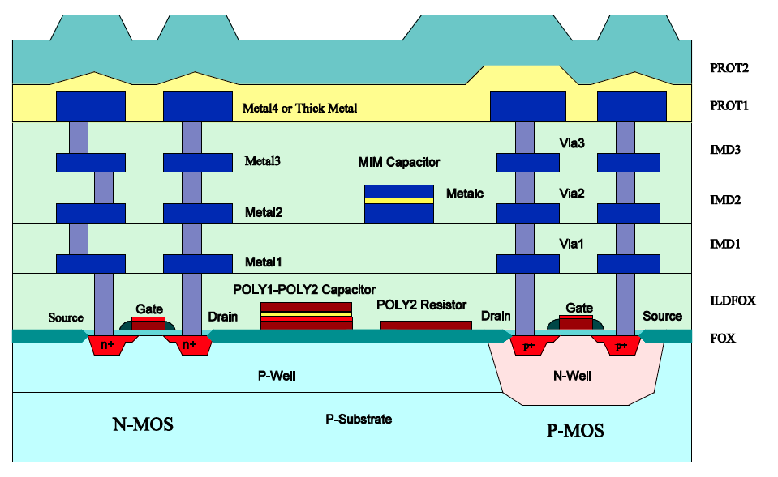
Technology information
4 sets of modifications
Total number of modified chips: xxx
Technology: AMS 0.35µm 4metals
Layer map provided (see file layermap.txt)

Slide 3
Origin
Definition of origin

Slide 4
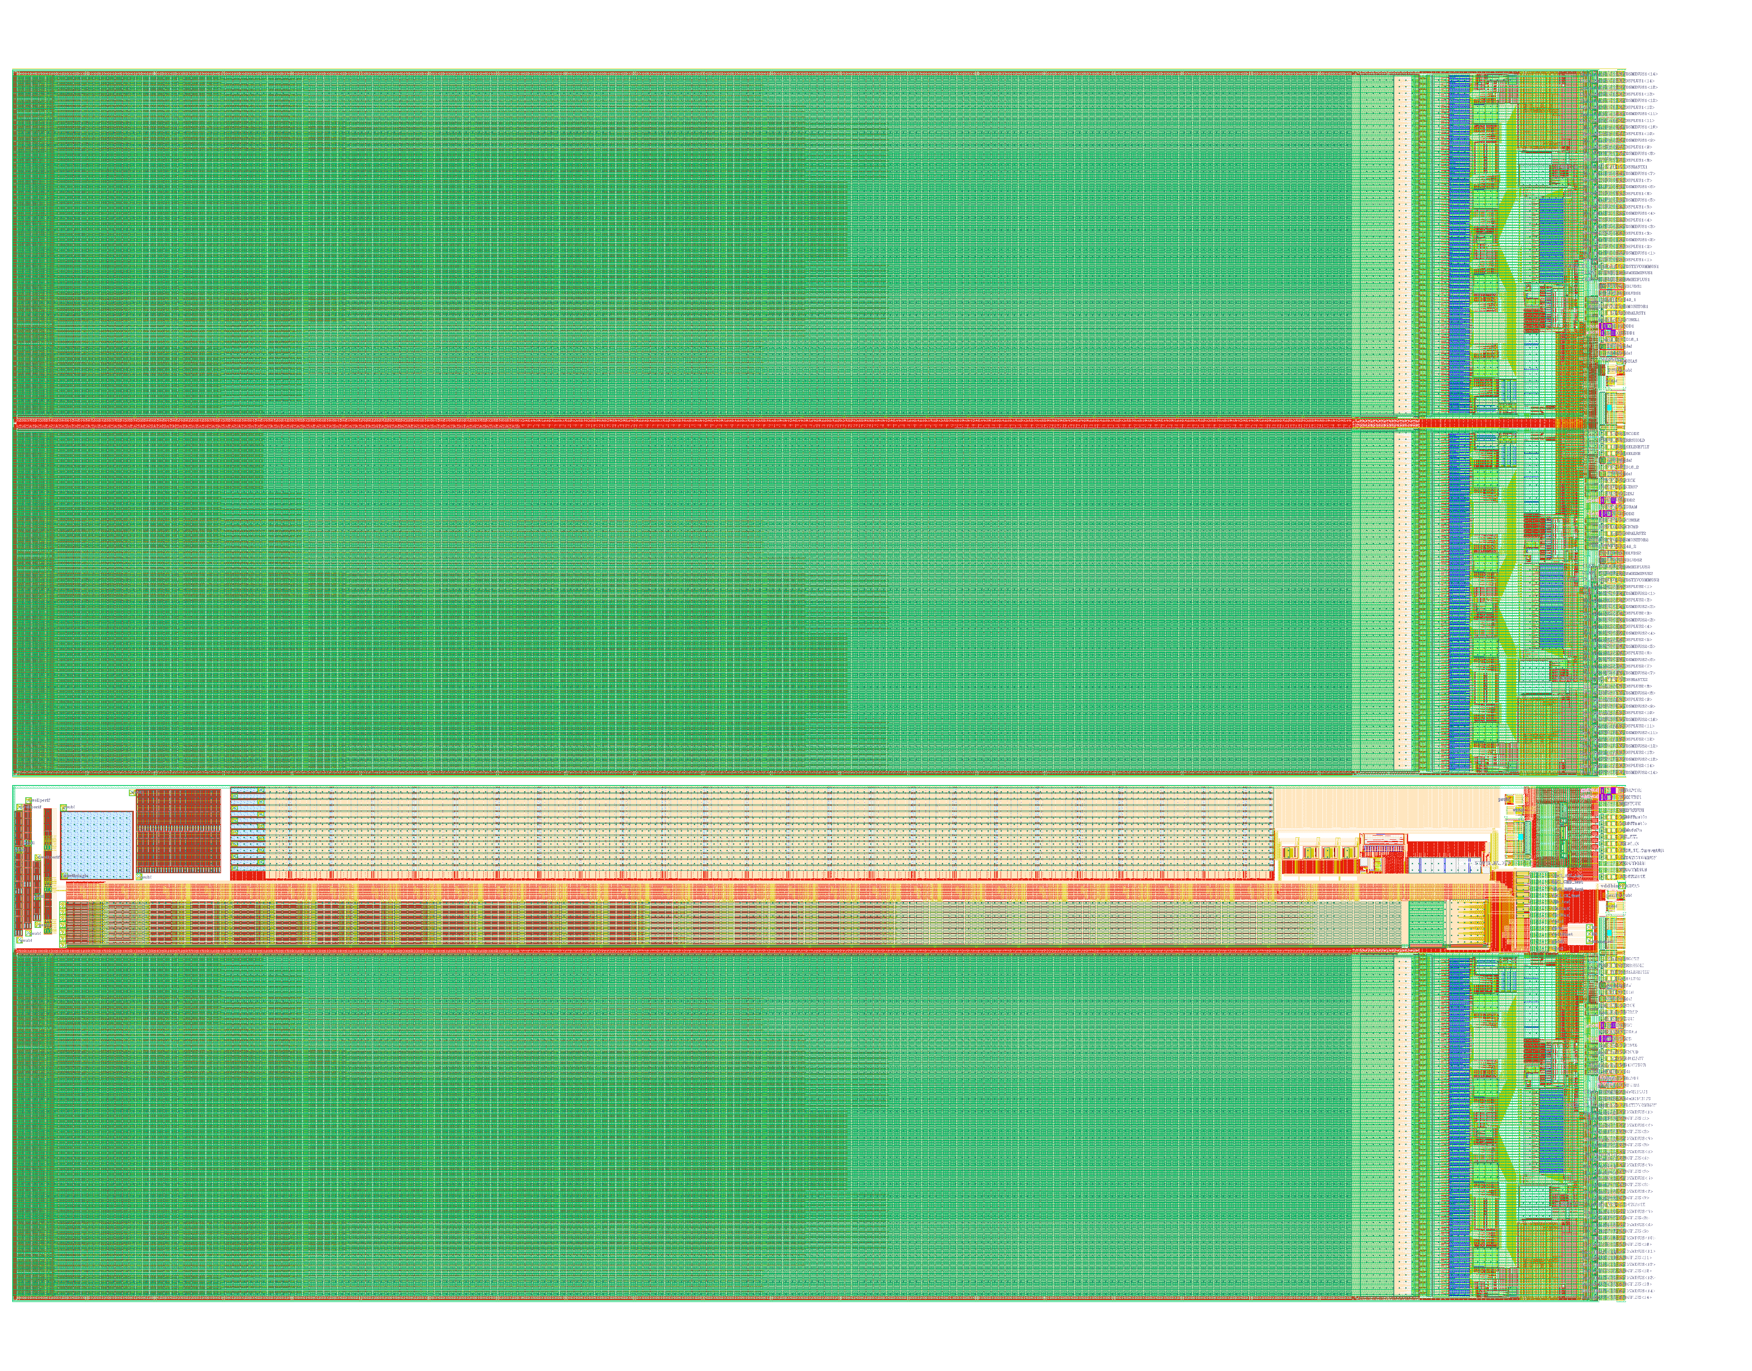
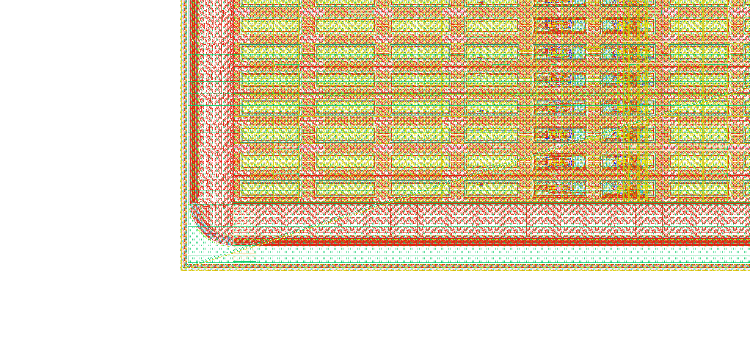
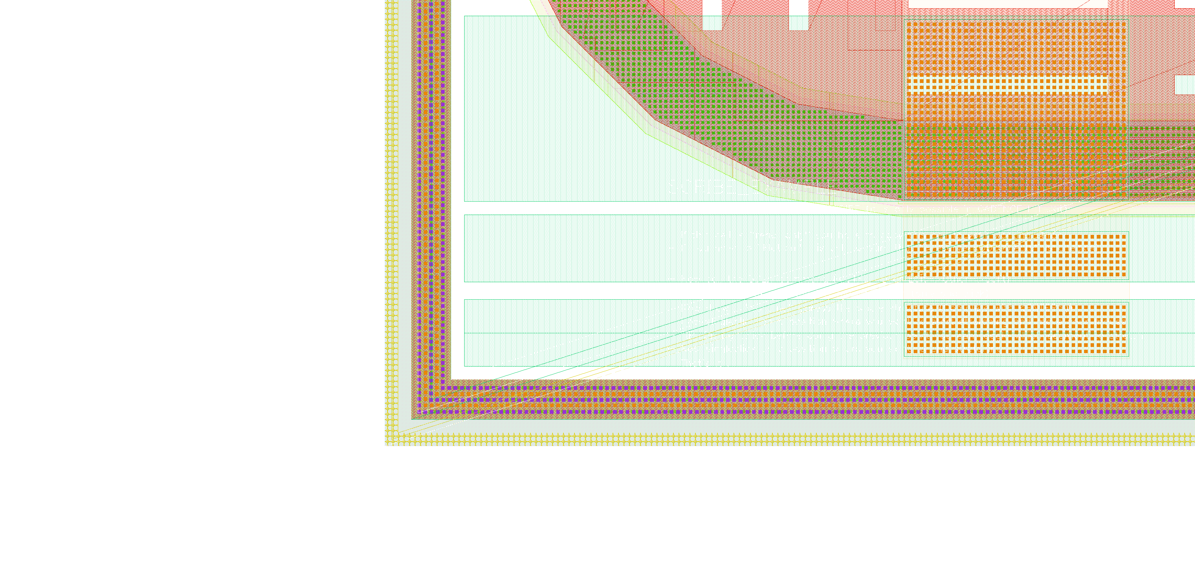
Origin
Origin (x=0, y=0) is at the bottom left corner of the GDS. PAD layer

Slide 5
Fibing operation #1
First operation
Connect Nwell

Slide 6
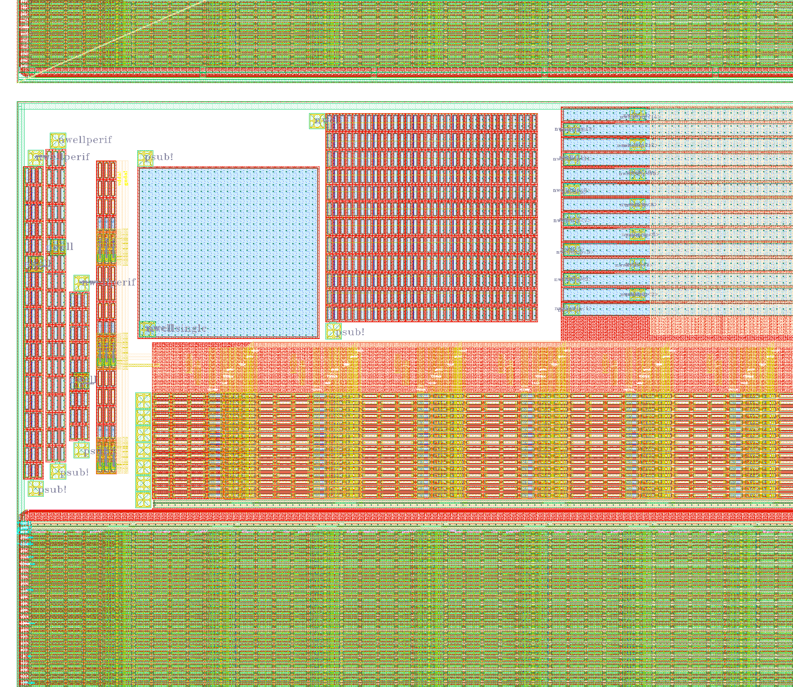
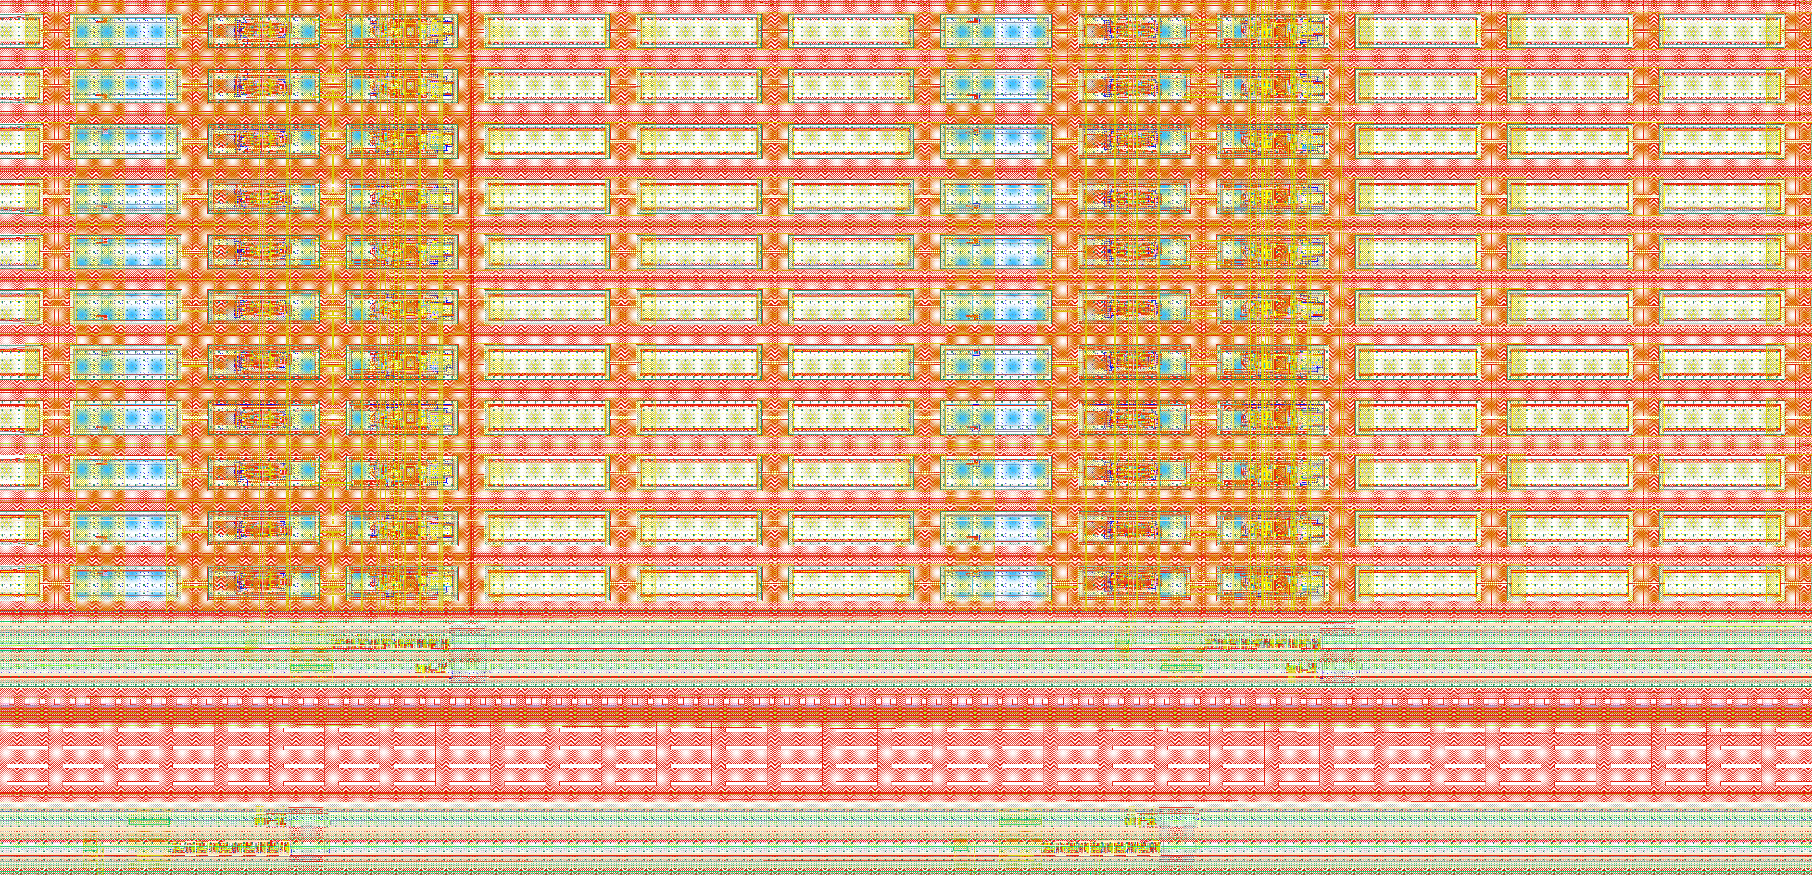

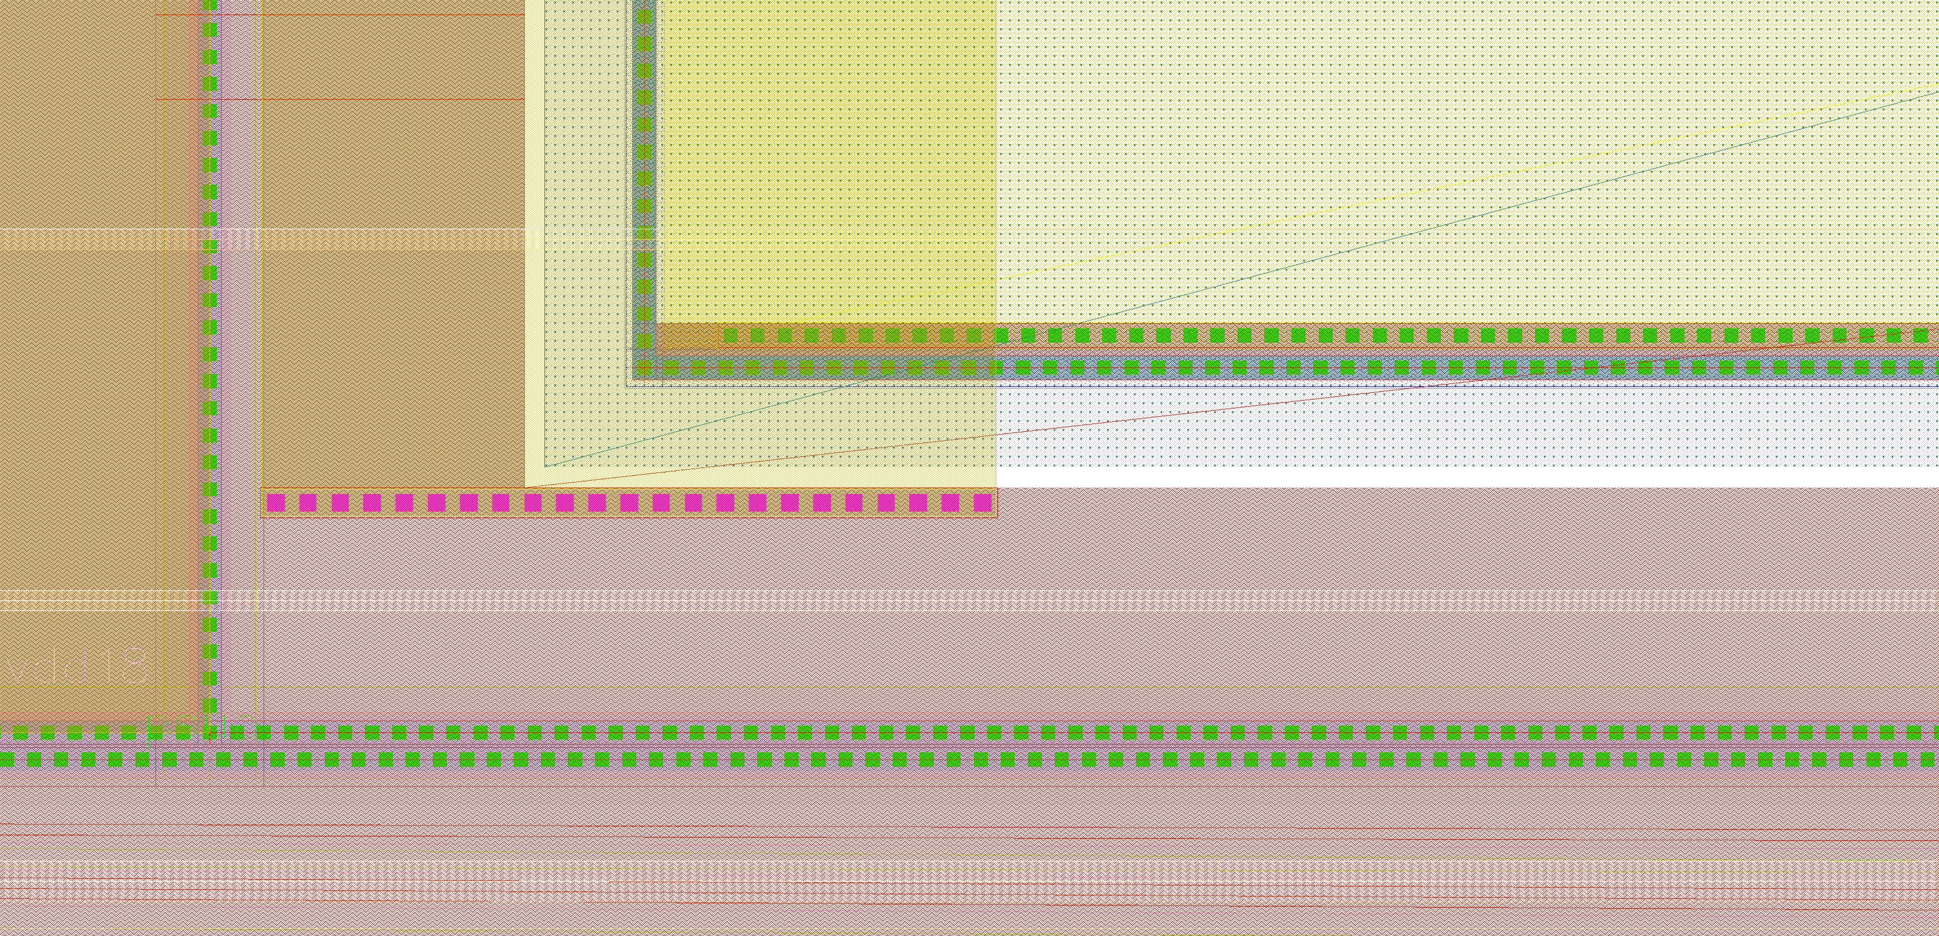
Nwell monitoring | Cut & connect
Cut M3
Connect M3 to M1
Connection line: [x1, y1] – [x2,y2] = [1482um, 5429um] – [1482um, 5425.6um]
Cut line: [x1, y1] – [x2,y2] = [1503um, 5430um] – [1503um, 5428um]

Slide 7
Fibing operation #2
Second operation
Monitor VPFB

Slide 8
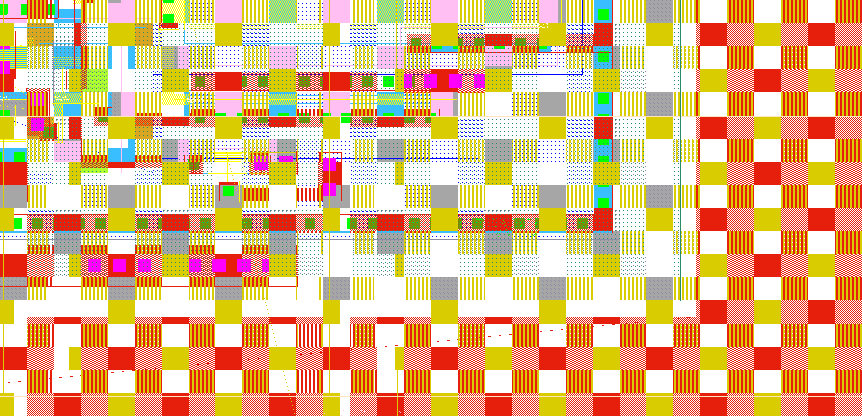
VPFB monitoring | Cut & connect
Cut M3
Via position: [x1, y1] = [1432.65um, 5508.975um]
Cut line: [x1, y1] – [x2,y2] = [1436um, 5510um] – [1436um, 5508um]
Create via M3 to M2

Slide 9
Fibing operation #3
Third operation
Connect amplifier input

Slide 10
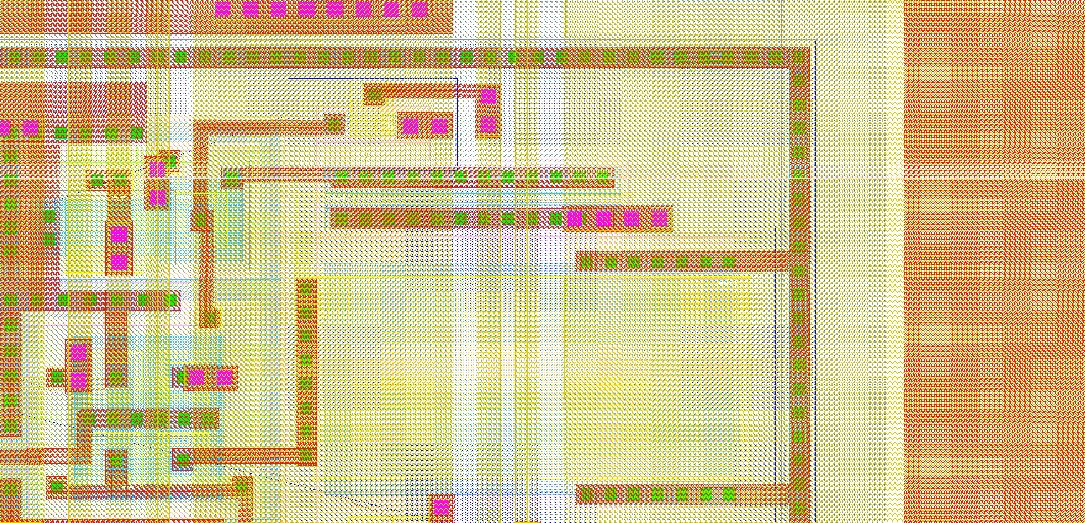
Amplifier input monitoring | Cut & connect
Cut M3
Connect M3 to M1 – avoid M2
Connection line: [x1, y1] – [x2,y2] = [1425.2um, 5639.775um] – [1425.2um, 5635.75um]
Cut line: [x1, y1] – [x2,y2] = [1437um, 5641um] – [1437um, 5639um]

Slide 11
Fibing operation #4
Fourth operation
Connect amplifier output

Slide 12
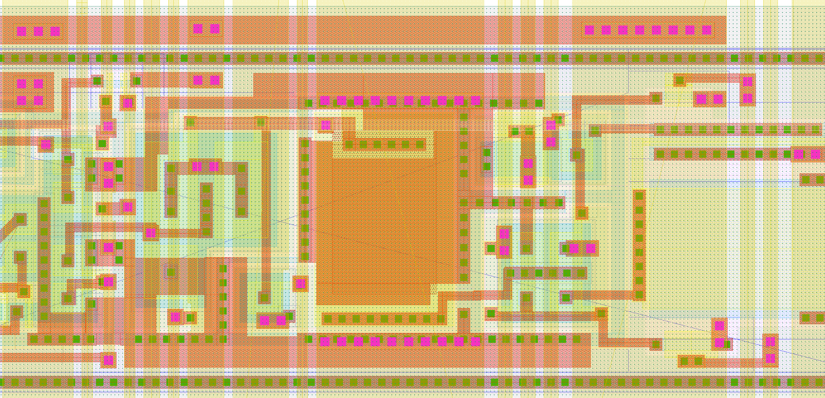
Amplifier output monitoring | Cut & connect
Cut M3
Connect M3 to M1 – avoid M2
Connection line: [x1, y1] – [x2,y2] = [1410um, 5719.8um] – [1410um, 5708.8um]
Cut line: [x1, y1] – [x2,y2] = [1425um, 5720.5um] – [1425um, 5719um]

Slide 13
End
End of file

