Slide 1
Future Opportunities for Test Beams at DESY: ATLAS ITk Strips
Andy Blue

Slide 2
Introduction
I’ll try to outline
Who we are
What we’ve done
What we need to do (and when)
Wish list of things that would make our life better

Slide 3
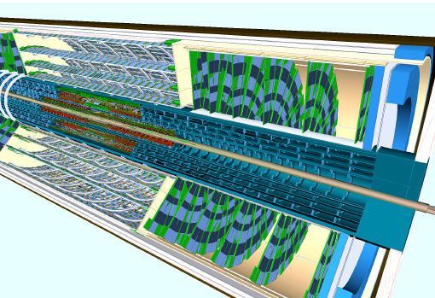
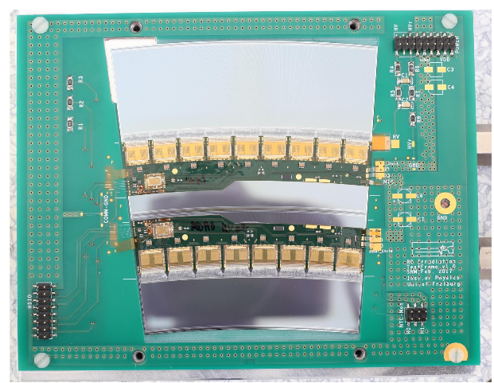
ATLAS ITk - Strips
We are involved in the upgrade of the Inner Detector (SCT and TRT) of ATLAS
Inner Tracker (ITk)
Using
Semiconductor Strip sensors
7 Sensor shapes for barrel and endcap regions
Around 10x10cm in size
75-80um pitch
Binary Readout

Slide 4
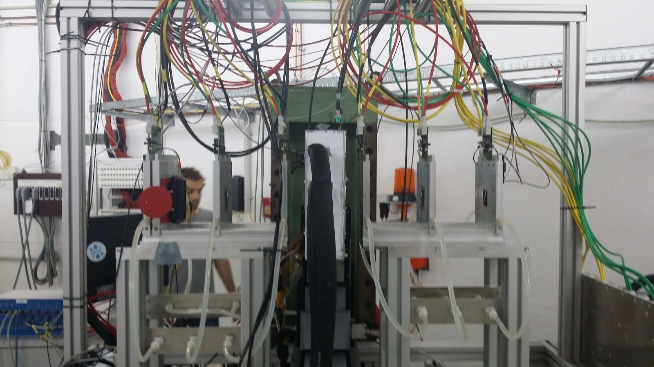
Previous DESY testbeam campaigns
Our setup at DESY
Beam energy: 4.4Gev
Beam profile: ~1 x1 cm
Covers 1 section of strips readout by a single ASIC
Rate: ~ 350 Hz
Use of FEi4 for timing plane
Use of EUDAQ with custom written producers
Data reconstruction done in EUTelescope
Custom changes made for
Strips (instead of pixels)
Radial as well and Cartesian Coordinates
Telescope set up from May 2017

Slide 5
Previous Testbeam Campaigns
We have had 4 testbeam campaigns at DESY over 3 years
May/November
Our model is to have 1 device/week of tests
Each DUT needs a custom jig and dark/cooling box
ITk strip testbeams are co ordinated by myself, Jiri Kroll (Czech Academy of Sciences, Prague) & Jens Dopke (RAL, UK)
Integrated with irradiation and system tests
Module | Description | Testbeam | Comment
DAQload1 | Barrel hybrid with 1 ABC130 wire bonded to mini-sensors. | May 14 SLAC | First testbeam. Using electrons ( 2-16 GeV @ 5Hz)
DAQload10 | Barrel hybrid with three ABC130s, two wire bonded to mini-sensors. | May-15 DESY
LS2 | Full barrel module with ten ABC130, short and long strips. | November-15 DESY
SS1 | Full barrel module with ten ABC130, short strips. | May-16 DESY
LS4 | Full barrel module with ten ABC130, short and long strips. | May-16 DESY
DAQload13 | Two ABC130 and two ATLAS12-mini sensors. | May-16 DESY | Sensors neutron irradiated (2x1015neq/cm2), ABC130-1 non-irradiated, ABC130-2 X-ray irradiated (4 MRad with 0.85 MRad/hr at RAL at -5C).
LS3 | Full barrel module with ten ABC130, short and long strips. | July-16 CERN | Irradiated at PS with protons (8.0x1014neq/cm2 and TID=37.2 MRad)
R0 |  | May-17 DESY
SS2 |  | May-17 DESY
Full list of ITk Strip testbeams. Non DESY testbeams in red

Slide 6
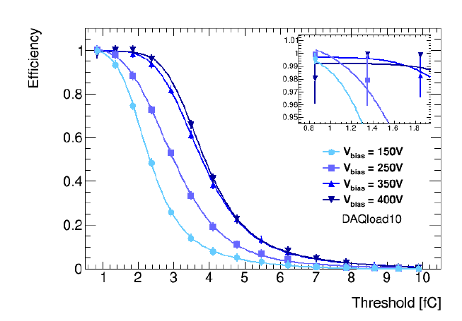
Results
Results from the DESY testbeam campaign have been vital to the ITK strips work
Many plots formed the basis of a chapter in the now approved Strips TDR earlier this year
Results included
Efficiency Curves
Inter strip efficiencies
Cluster size v position
Efficiency of a DAQload DUT
for a range of biases

Slide 7
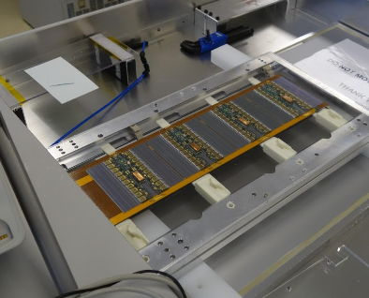
What we need to do
The work we need to do at DESY (short-medium term) will cover 3 categories
New DUTs with new chips sets and sensors
Multi module devices (Stave/Petal)
QC verification though production
Batches of modules tested per year
Barrel Module mini Stave (stavelet)

Slide 8
What we need to do - Timelines
Now
Module Production ends

Slide 9
What changes would help us?
All of our work will happen before any replacement of the PETRA III accelerator
In 2024
However we would be taking data during the R-weg Upgrade phase

Slide 10
What changes would help us? - 1
1: Instrumentation
We have found the ‘EUDET’ telescopes very good to work with
1 drawback is the rolling shutter which means we need to install a timing plane on the telescope
One idea: Full timing of each event, i.e. something like an absolute timestamp with 64 bit length, from start of run
Or from January 1st 1970
The present pointing resolution performance is great for us (our pitch is ~75um)
2: Beam
Higher energies of electrons always welcome
Reduction in scattering
Our rates are restricted by our DAQ integration
Unsure if we could take advantage of higher rates (or would need to)
Outside of DESY we have worked with asynchronous (Diamond Light Source), Bunch train (CERN) and synchronous (SLAC) beams
In general we are adaptable

Slide 11
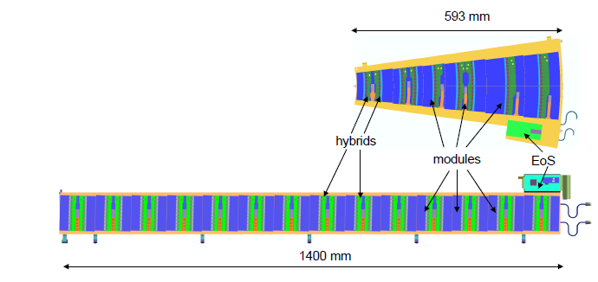
What changes would help us? - 2
3: Infrastructure
We will want to test large objects
Mechanisms needed for
Being in beam
Controlling position
Cooling
More similar to a systems test
Possibly with a magnet
We have found it challenging to test irradiated devices
Managed to do with at CERN with the ‘MPI’ box
A common test box that was useable for different groups would be ideal
Schematic of the Petal and Stave structures

Slide 12
Summary
DESY testbeams have been essential for the understanding and verification of the ITk strip devices
Thanks again to the DESY testbeam coordinators
There are some things that would make our time easier
However I would say we are not the most demanding of groups for changes
But we do have some suggestions

