Slide 1
CHESS-2 BUG REPORT

Slide 2
Power Supply On: 0.232 A

Slide 3
Provide Global Reset: 0.351 A

Slide 4
Set DAC Voltages: 0.837 A

Slide 5
Enable Comparator on All Pixels: 0.758 A
All Data goes to zeroes, which is what we expect

Slide 6
Enable Test Mode: 0.758 A
However, test mode doesn’t appear to work

Slide 7
Disable Comparator on All Pixels: 0.830 A
If we disable comparators, we begin to get back data

Slide 8
Enable Test Mode: 0.775 A
Row 0 gets “hits”, multi-hit is always valid which isn’t supposed to happen, column data is random (should be 0); also hits not on every ‘event’

Slide 9
Test Mode Enable Row 3
Row data is correct, column data is still bad and multi-hit is still on

Slide 10
Test Mode Enable Row 4
It looks like rows can be selected, however other data is wrong

Slide 11
End Test Mode: 0.843 A
Random data again

Slide 12
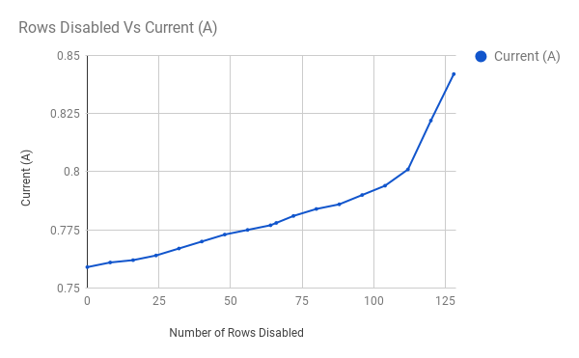
Disabling Rows Sequentially
Data begins being picked up by the chipscope after 66 rows have been disabled

