Slide 1
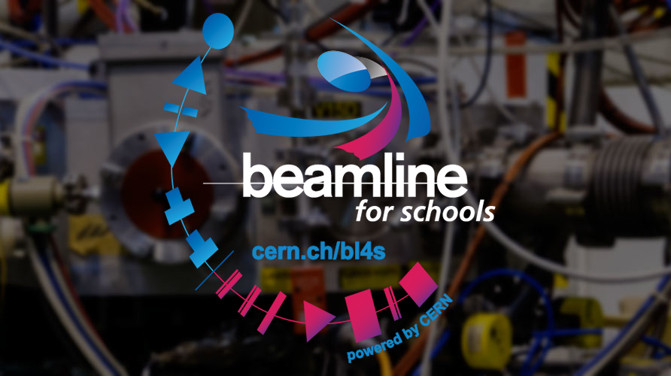
The CERN Beamline for Schools (BL4S) Competition
6th Beam Telescopes and Test Beams Workshop 2018
Markus Joos & Sarah Aretz

Slide 2
BL4S - Overview
Worldwide competition for teams of high school students, guided by a teacher or coach, to design and carry out an experiment at a beam line at CERN’s Proton Synchrotron (PS)
Teams have to design an experiment which uses a particle beam. They have to submit a written proposal (max. 1000 words) and a one-minute video
The main goal is to motivate the students to learn about physics by treating them as if they were professional scientists
Launch: summer, proposal submission: 31 March of the following year
Publicity made via: CERN social media, alumni of teacher programs and BL4S, visitors of CERN, IPPOG and many other channels
Teams can get support and advice from CERN’s BL4S team or from volunteer physicists from all over the world, mainly via the International Particle Physics Outreach Group (IPPOG)
The students may also ask other experts for help

Slide 3
Selection
Criteria for evaluation of proposals and videos:
Motivation of the students
Creativity
Feasibility of the proposal
Demonstration of ability to follow the scientific method
Step 1: Volunteers from CERN (including member state universities and laboratories) select the best 20 proposals and 10 winners of a special prize
Step 2: A team of physicists as well as accelerator, beamline, detector, and safety experts select best 10 proposals
Step 3: Members of CERN’s SPS and PS Experiment Committee, SPSC, review the 10 proposals from step 2 and select the two winners

Slide 4
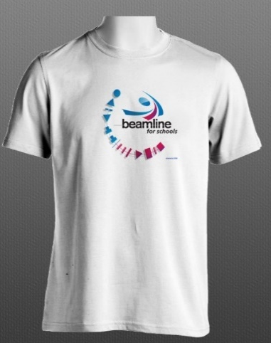
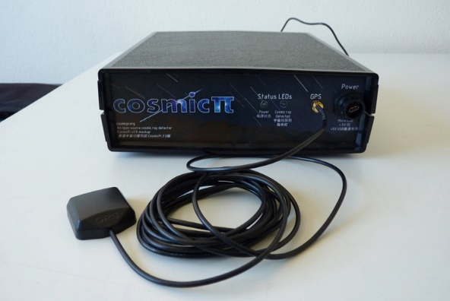
Prizes
An invitation to CERN for two teams (up to 9 students and 2 teachers each) for 10-11 days to conduct their experiments
Additional prizes for shortlisted and noteworthy* teams
BL4S t-shirts
CosmicPi detectors
Certificates for all participants
Main prize:
All participants will have gained new and
exciting knowledge of particle physics!
* Teams that made a well motivated but unfeasible proposal

Slide 5
Overview participants
 | 2014 | 2015 | 2016 | 2017
Full proposals | 292 | 119 | 150 | 180
Countries | 50 | 28 | 37 | 43
2/3 boys, 1/3 girls
1/3 from non member states
In total ~7000 students have participated since 2014
Teams spend on average 30 hours on making their proposal
Short listed teams spend on average 40-50 hours (effort pays out…)
Four winning teams have written scientific papers about their experiment, more are on the way

Slide 6
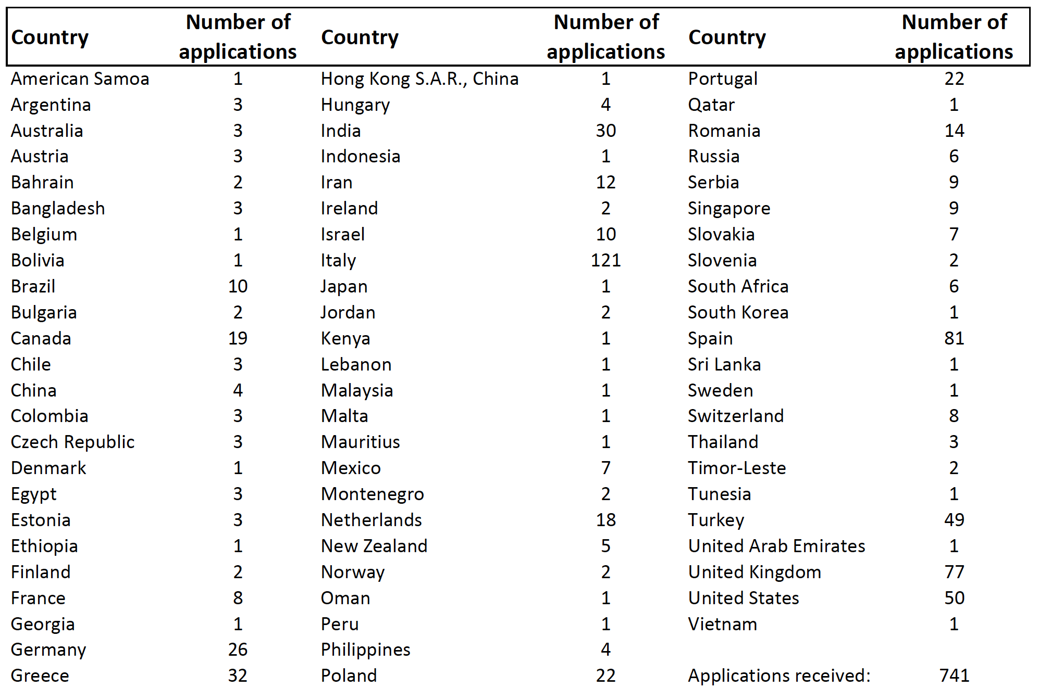
Overview participants

Slide 7
Scientific support
Each year two young scientists implement the experiments of the winning teams
They do an experiment from A to Z (quite unusual for a physicist at CERN)
They learn a lot in many fields in a short time (test beam, detectors, TDAQ, communication, etc.)
We are looking for volunteers who want to do a placement at CERN

Slide 8
The TDAQ system
Software
We are using the ATLAS TDAQ system (more precisely the RCD) as the basis for data taking
The S/W is very scalable and experts are available at CERN
BL4S members develop additional S/W modules (e.g. for monitoring and data analysis)
Central element: A VMEbus SBC
Electronics
Trigger: NIM
Digitizers: ADC, QDC, TDC in VMEbus format
Special modules (e.g. APV for MicroMeags)

Slide 9
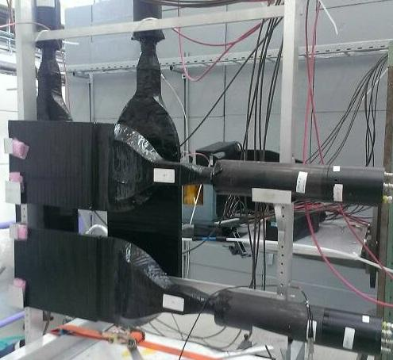
Detectors
Cherenkov detectors
2 units (integral parts of the T9 beamline)
Max. pressure: 3 bar (Air, CO₂)
Plan: Install UV sensitive PMTs to improve the signal quality / efficiency
Scintillators
~10 units with different shapes
Read out with PMTs and CAEN V792 QDC
V1742 ADC tried (but we had to give up….)
Good relations with the scintillator workshop
Delay Wire Chambers
Up to 3 units
10 x 10 cm
Read out with VMEbus TDCs (CAEN V1290)

Slide 10
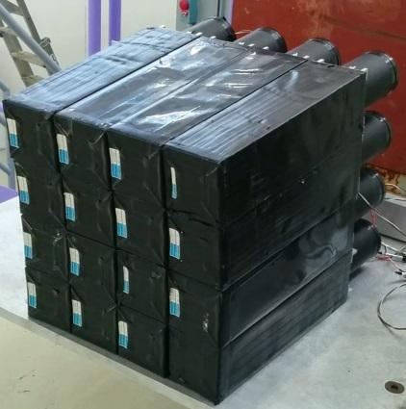
Detectors (2)
EM Calorimeters
~20 lead glass calorimeters (ex. Opal)
Read out with V792 QDCs
BGO calorimeter
On loan from NA62 (Aarhus)
Used in 2015 to detect gammas
Medipix
On loan from EP/ESE
Used in 2015 to detect beam in a small area

Slide 11
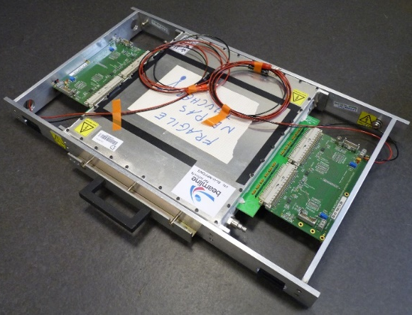
Detectors (3)
MRPCs
3 units of ~30 x 30 cm built in 2015 / 2016 by BL4S team with (a lot of) help from Crispin Williams
Read out with V1290 TDC
Used in 2016 for time of flight measurement
MicroMegas
4 units of 45 x 45 cm built in 2017 with (a lot of) help from Rui de Oliveira
Currently read out with APV (RD51) electronics
Used in 2017 to visualize the beam profile
Planning to purchase ATLAS MMFE8 modules to increase the read-out performance by ~x10

Slide 12
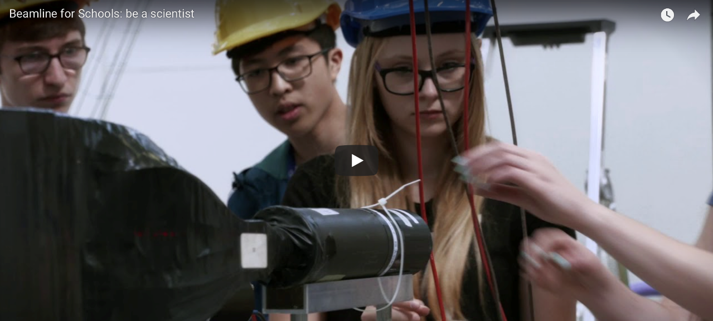
Timeline 2018
BL4S 2018 is confirmed and has already been announced
So far about 190 teams worldwide have pre-registered
Deadline for proposal submission is 31 March 2018
Winners will be announced in June 2018
Winning teams come to CERN in September 2018
Notes:
Link to promotion video: https://www.youtube.com/watch?v=EHRZw9HtpEI^

Slide 13
Future of BL4S
2019 and 2020
CERN’s accelerators will be switched of for maintenance and upgrade
BL4S may be hosted in another institute: DESY, PSI, INFN (Frascati) and IN2P3 contacted
2021+: BL4S will be possible in the refurbished East Hall at CERN
The main challenge every year: Funding & Publicity
World wide there are ~470 million students of the right age….

Slide 14
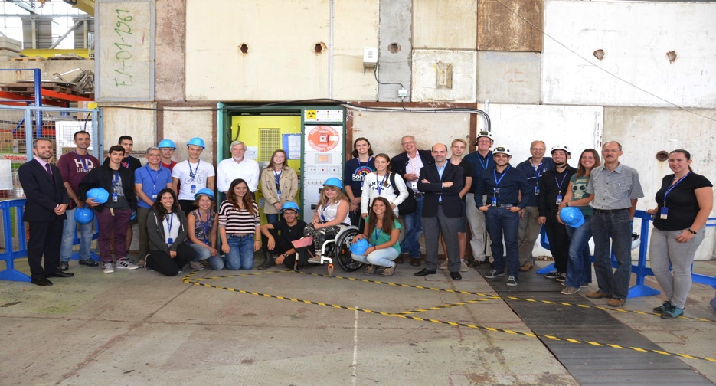
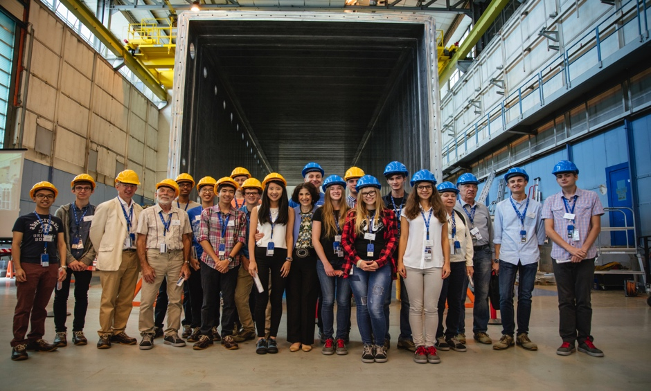
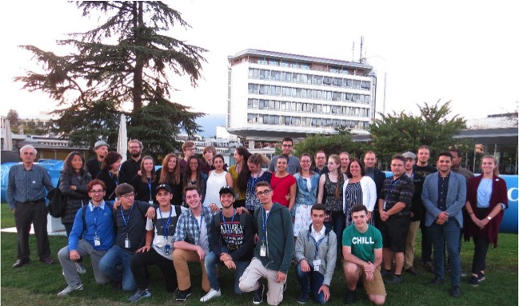
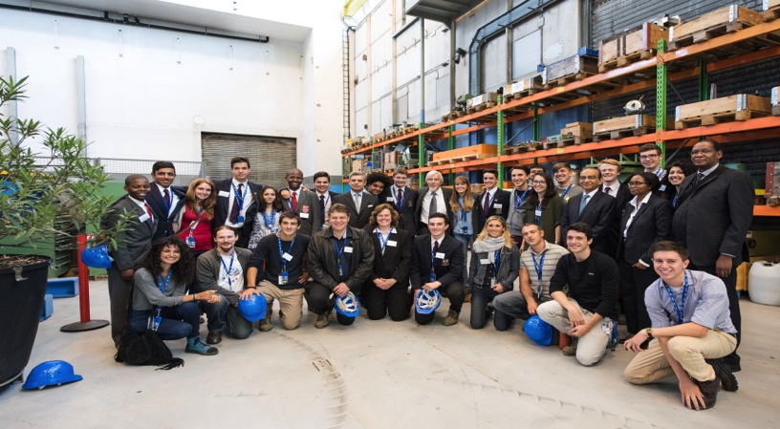
Thank you!
2016
2014
2015
2017

