Slide 1
Chess2 measurements

Slide 2
Schematics
3.3
IFB
RowENB
3.3
ColENB
3.3
Injection
1.8
Load
Th
Inj_EN
3.6
Casc
1/2/4/8
In
InSF
Comp
Baseline

Slide 3
Schematics – FIB points
IFB
3.3
RowENB
3.3
ColENB
3.3
Injection
1.8
Load
Th
Inj_EN
3.6
Casc
1/2/4/8
In
InSF
Comp
Baseline

Slide 4
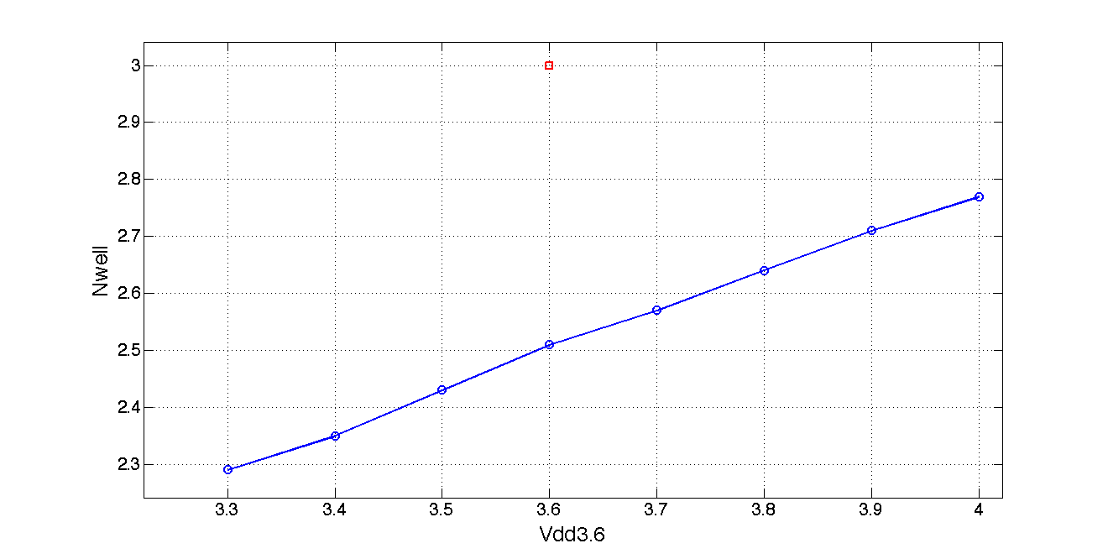
First observations
The DC value of the Nwell is 500mV lower than expected

Slide 5
List of other observation
  No time to make a nice presentation
  The feedback control voltage on the amplifier seems too low 1.8V instead of what shoud be 2.8.
  Theory confirmed by the fact that amp_in ~ amp_out under current settings
  Will investigate if an external VPFB solves the problem
  The amplifier output responds to charge injection and light when the output after AC filter doesn’t which confirm the theory that there is a capacitive division
  Unexpected coupling between VNLogic (controls the comparator) and some of the amplifier nodes
  There seems to be voltage limitation on the chip as the maximum voltage observed is 2.9V instead of 3.3

