Slide 1
78th Section Coordination Meeting XHEXP1
9.6.2017

Slide 2
Agenda
SASE1-3 Status Updates (G. Wellenreuther)

Slide 3
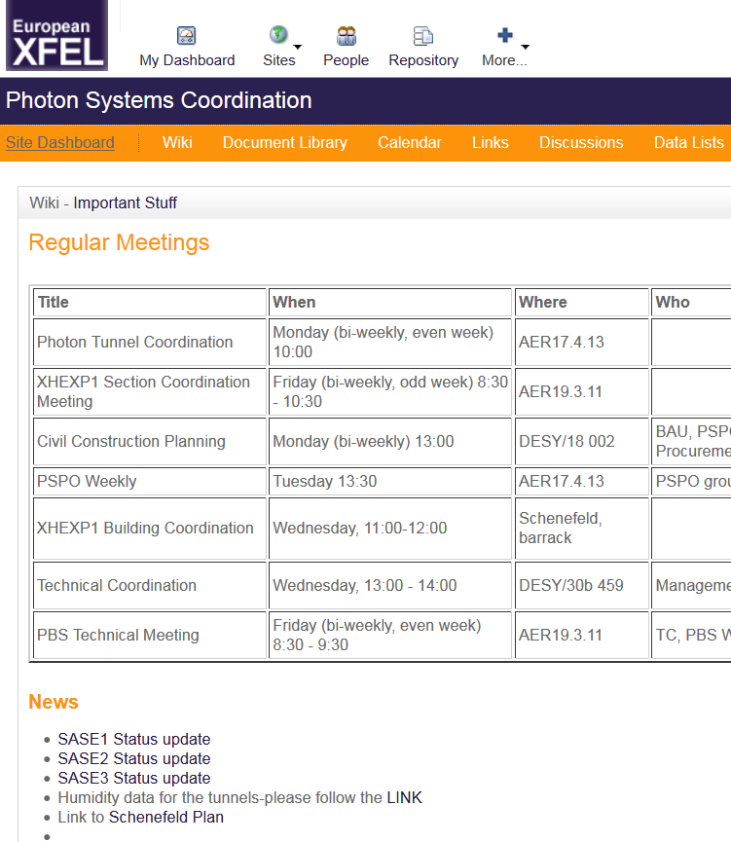
SASE1-3 status update
Summarize most recent and current time-critical tasks / dates for each SASE individually.
At least weekly updated.
In Alfresco:
Document Library/Planning
SASE1 Status update
SASE2 Status update
SASE3 Status update

Slide 4
SASE1

Slide 5
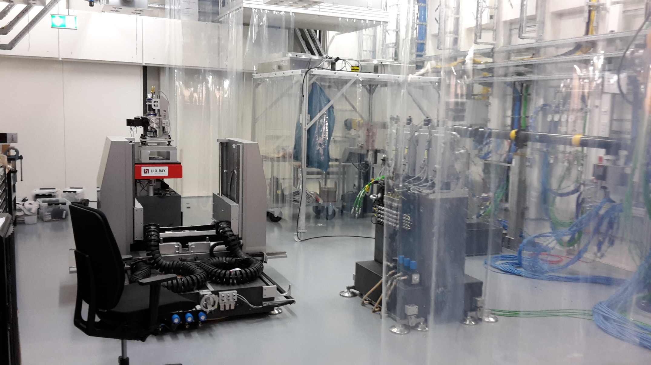
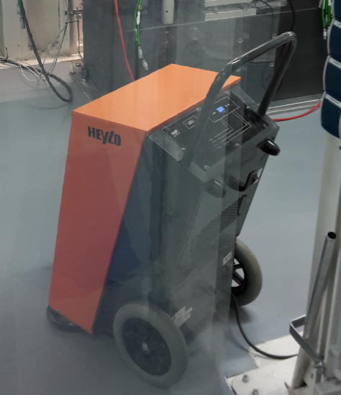
7.6.: FXE instrument hutch is getting filled…

Slide 6
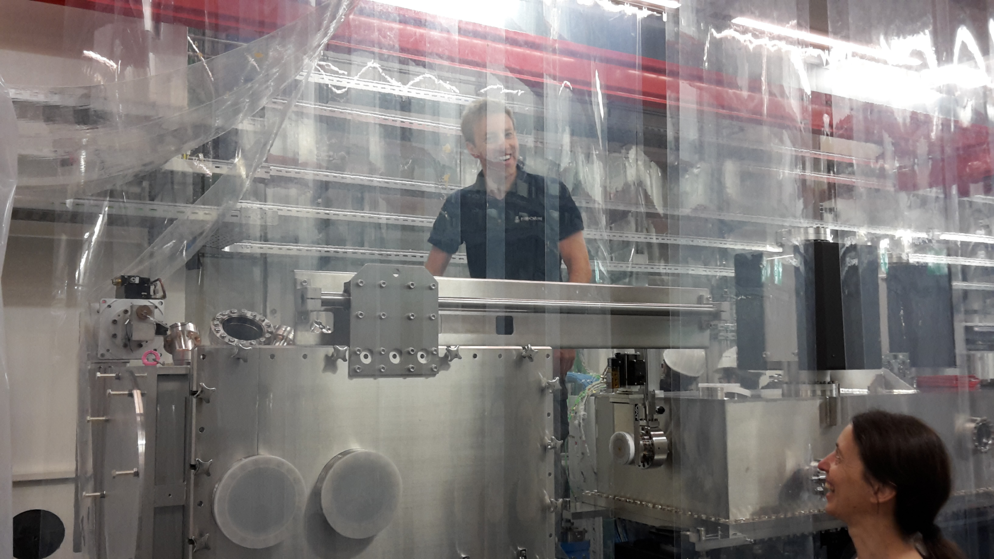
7.6.: Cleaning the SPB upstream interaction chamber

Slide 7
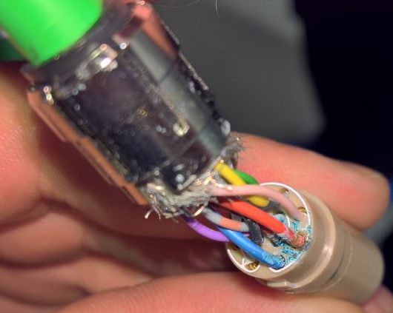
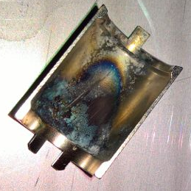
Corroded connectors / cables
3 employees from JOWO are available
to test and replace connectors + cables
Several connectors which were in
contact with water but appeared to
be intact have been opened
➔ more corrosion than we hoped.
➔ ALL potentially affected connectors
will now be opened.
➔ 40 connectors SPB-Optics replaced
+ measured until Mon.
➔ 15 FXE CRL-cables tested ➔ okay
➔ more cables @ SPB + FXE to be
tested next week

Slide 8
SASE3

Slide 9
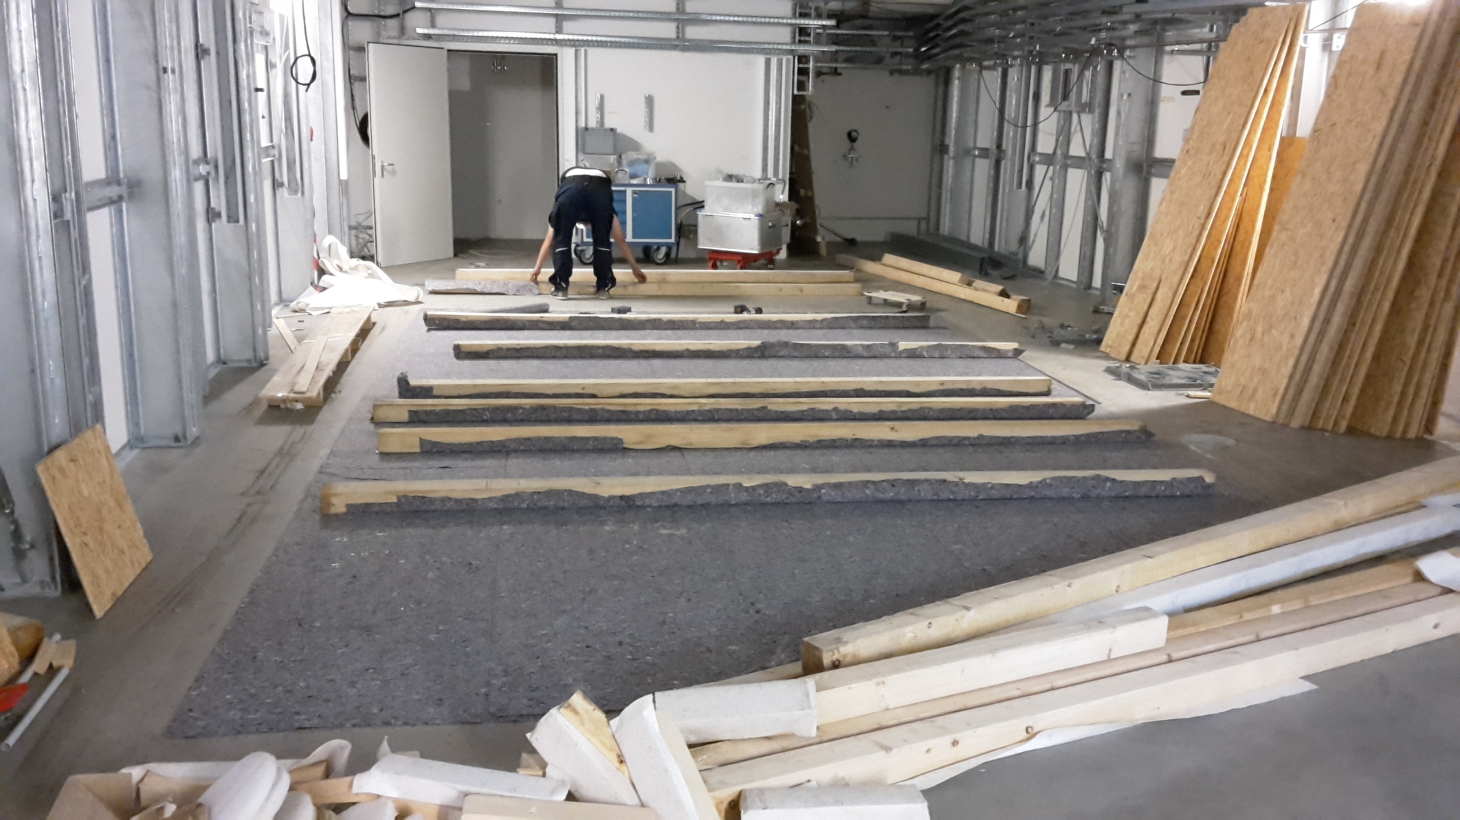
7.6.: SCS HQF-cover being reinstalled

Slide 10
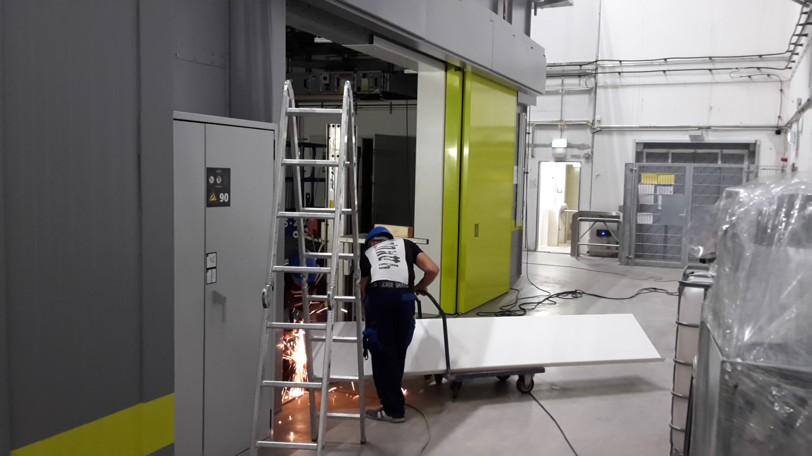
7.6.: Fa. Lien installing the door frames

Slide 11
SASE2

Slide 12
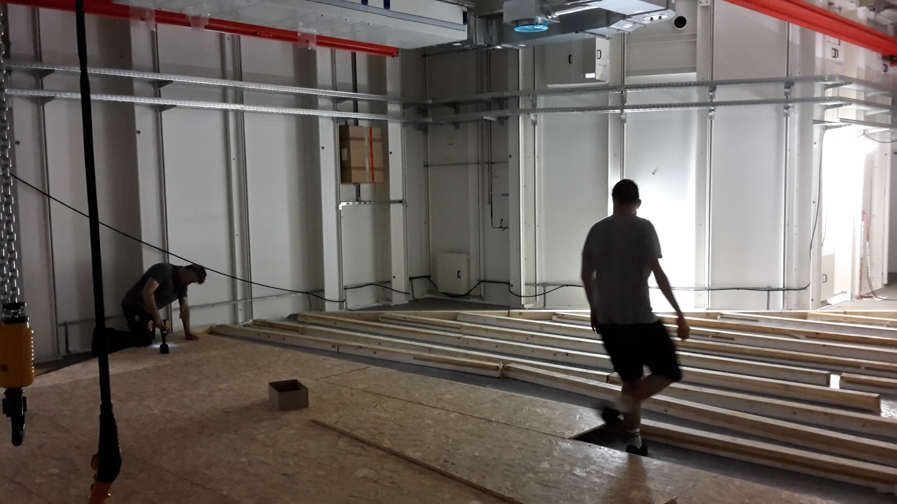
7.6.: MID HQF-cover being put back

Slide 13
Regarding cancellation of Elektro Hartmann
We need to know
All services which have not been provided by EH
All additional costs resulting from the termination of the contract
All shortcomings / defects, which have still not been fixed by EH
In short: Everything, which will or has
cost us money regarding Elektro Hartmann.
Most of this information will be provided by PI and TS. But if you have particular issue, feel free to remind us.

Slide 14
Upcoming Dates & Meetings
Today, 9:00: SASE1 Readiness
SASE1 Readiness Dispatch
  Mo, Wed 09:30 @ MCR
16.6., 8:30: Most probably meeting
16.6., 9:00: SASE1 Readiness

