Slide 1
Current Status Interlocks (09.06.2017)
Interlock Cabling work complete and electricity switched on to the system (02.06)
Testing and Commissioning of Interlocks (Happening Now)
Rehearsal of Interlock Test with DESY Radiation Protection Group (14.06)
Test with TÜV (20.06)
Other work should not take place inside the Hutches on 14th and 20th for the tests. (9-12 am)

Slide 2
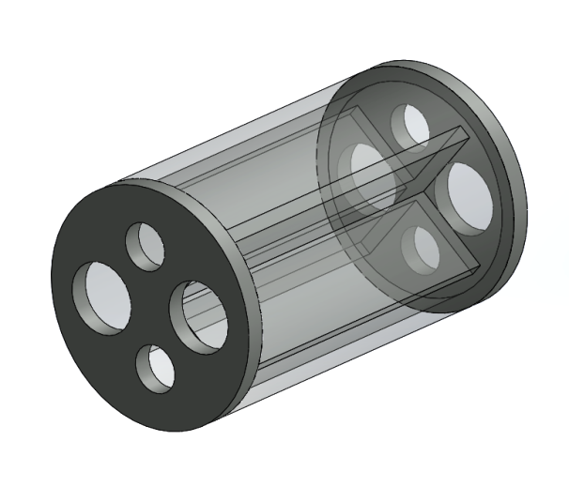
Current Status Shielding (09.06.2017)
Final gaps to laser rooms to be sealed (13.06.2017)
  Lead Collimated insert installed in FXE.
  Holes covered with Lead Sheets for SPB.
Walk through by Radiation Protection Officer and SPB and FXE (16.06)
  Tamper seals placed on all removable shielding.
  Signs on Chicanes

Slide 3
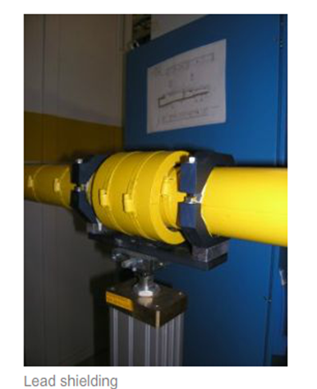

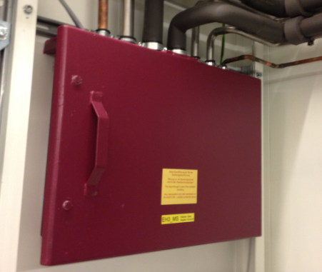

Signs and Tamper seals
Radiation Protection components ensure that there is no increased radiation in personnel access areas. These components are marked with yellow radiation protection stickers.
D.05 – 031
MODIFICATIONS OF THE SHIELDING REQUIRS THE AUTHORIZATION OF THE RADIATION PROTECTION OFFICER.
Media Chicane
D.09 – S01

Slide 4
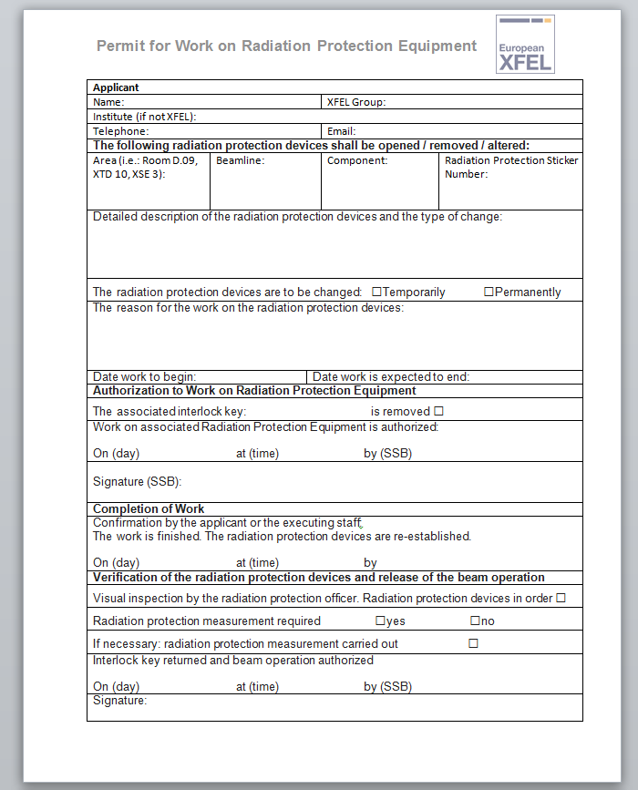
Permit for Work on Radiation Protection Equipment
Once Stickers have been place you will need permission from SRP to open a chicane or to remove or modify any type of shielding
Not required for user chicanes which are interlocked

Slide 5
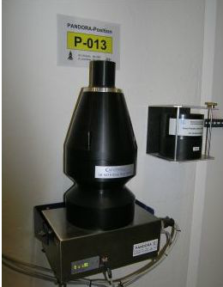
Area Monitoring
Pandora Detectors are in place
Temporary Pandora Detectors will be placed in the Radiation Hutches for commissioning
  Requires only a 220V outlet and an Ethernet cable
  Temp Pandoras not connected to any kind of inter lock
Pandora Detector
THESE DOSIMETERS MUST NOT BE MODIFIED, REMOVED OR SHIELDED.

Slide 6
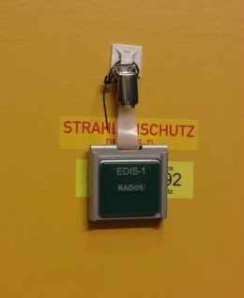
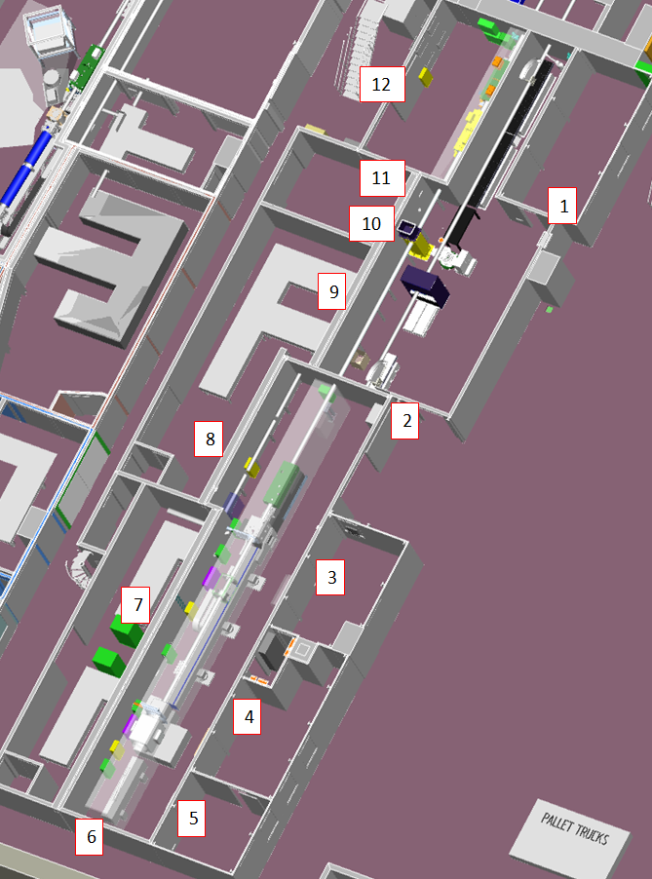
Area Monitoring
EDIS dosimeters are placed at all areas adjacent to the shielding (21.06)
RADOS dosimeter
THESE DOSIMETERS MUST NOT BE MODIFIED, REMOVED OR SHIELDED.

Slide 7
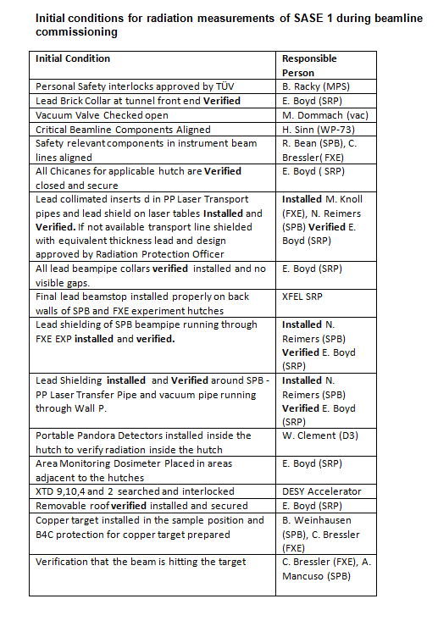
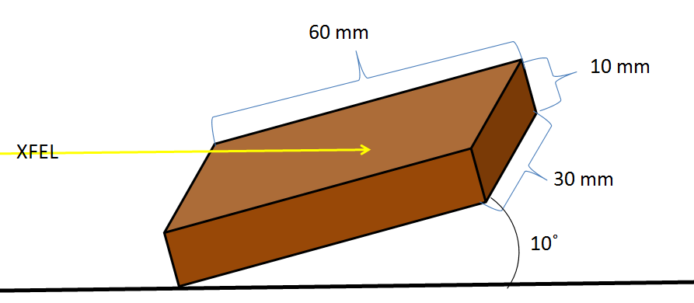
Initial Conditions Checklist
20.06
Done
Done
Done
26.06
21.06
16.06
16.06
16.06
16.06
16.06
26.06
21.06
26.06
16.06
26.06
START OF Commissioning
SPB and FXE have copper blocks, SPB will receive another mounted in the holder
START OF RADIATION MEASUREMENTS

Slide 8
Radiation Measurements of the Hutches
The actual Radiation Measurements performed by SRP on the radiation hutches will take approx. a half a work day for SPB OPT and an entire workday for SPB and FXE EXP
In total 3 days should be accounted for in the schedule for Radiation Protection Measurements, starting from the point when the beam is verified hitting the target
During radiation measurements no one is allowed in the adjacent areas of the hutch including control rooms.
All lead surfaces have to be measured and recorded
  Needs to be a way to reach high up places

Slide 9
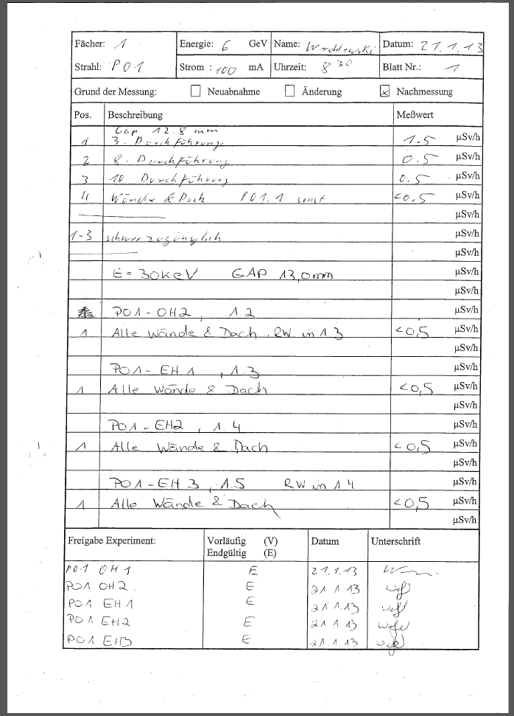
Recording Measurements
Example of form used at Petra
Experiences at Peta have not found radiation leaks in any of their lead hutches during commissioning.

Slide 10
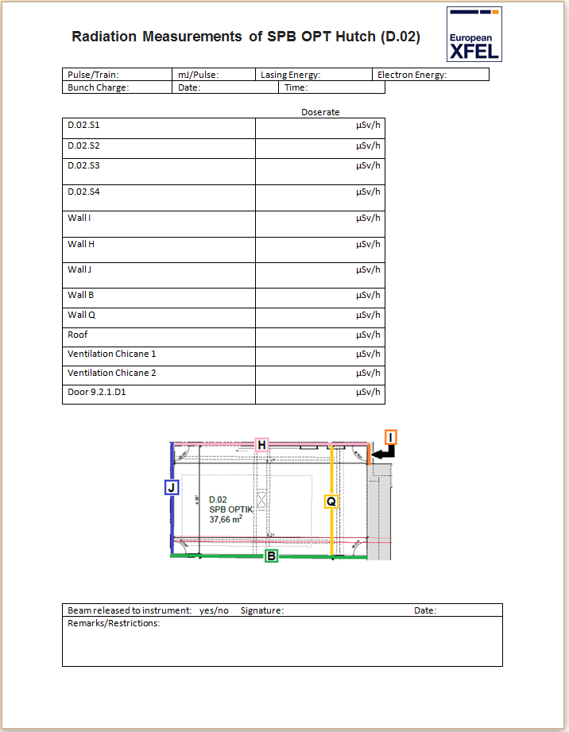
Recording Measurements

