Slide 1


Trigger
DESY, 2.7.2009
Rainer Stamen
Kirchhoff-Institut für Physik
Universität Heidelberg

Slide 2
Content
The Trigger Challenge
Basic Requirements, Concepts and Realisations
  L1
  HLT
Trigger shopping list for physics analysis:
  Before data taking
  During data taking
  During physics analysis

Slide 3
Some warning
This is NOT a: „All that that you need to know about Triggering crash course“.
I am only going to introduce the basic concepts and I will only show a few non representative examples.
The main part of „learning“ comes when you are back home .
I can only give you some advice what you need to learn and what you need to care about.
This lecture is about concepts. Don‘t quote me on numbers, performance figures, etc. (most of the plots which I am showing are outdated anyway)

Slide 4
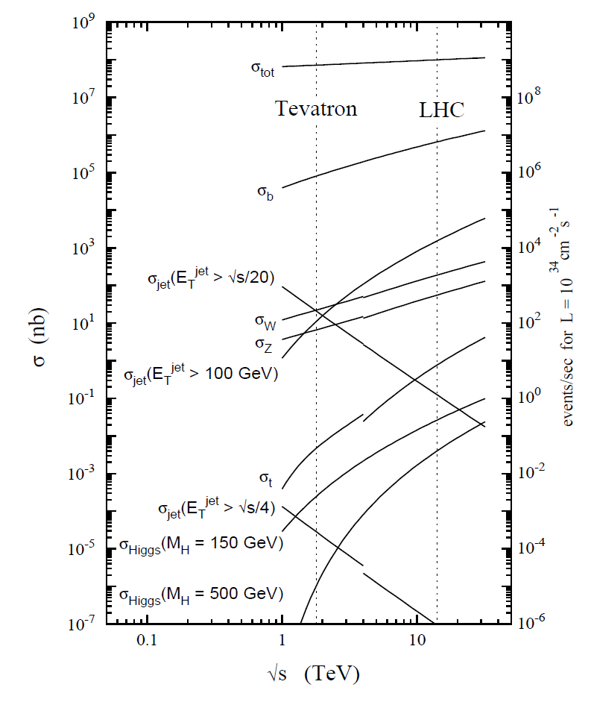
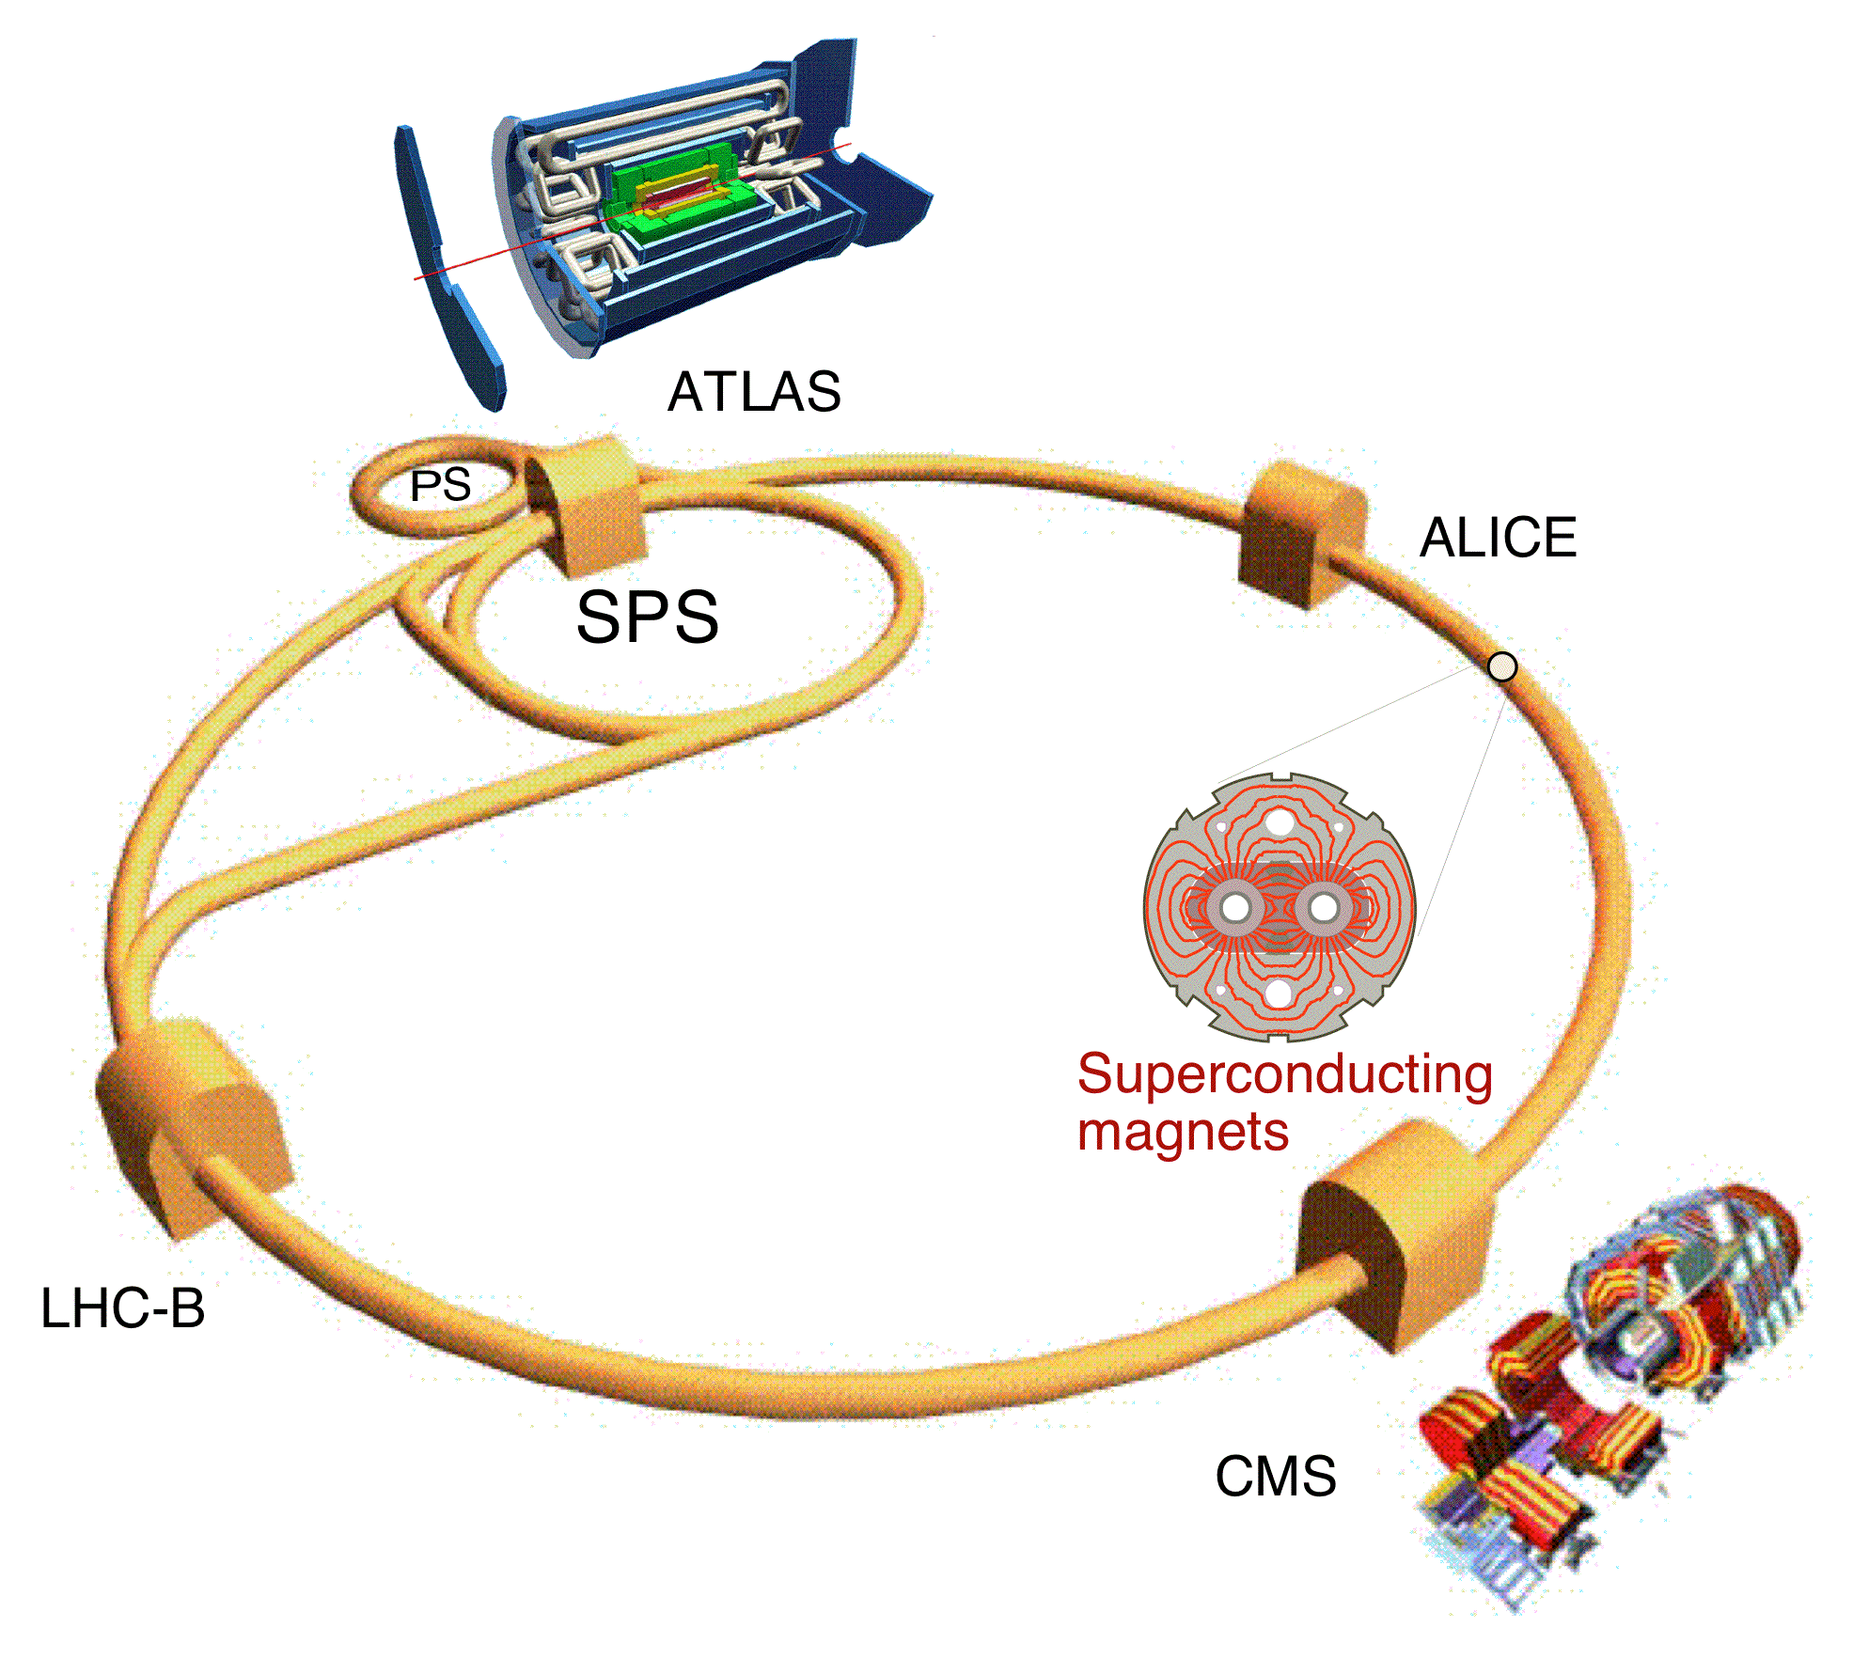
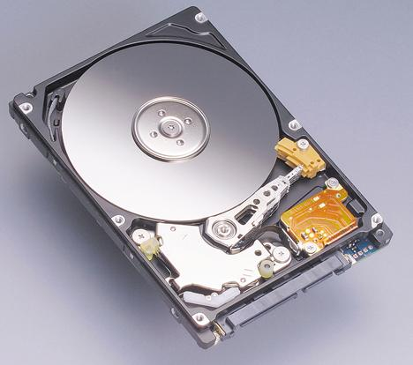
The Trigger Challange
High luminosity: L_{inst} = 10³⁴ cm⁻¹s⁻¹
Eventrate
- 40 MHz (BX rate)
(20 events per BX)
Datarate
- 60TB/s
Reduction: 1/200 000
Data Storage (forseen)
~ 200 Events/s
~ 300 MB/s
(limited by offline
ressources)

Slide 5
The Trigger Challange
Technical Possibilities
Physics Selection
Trigger
Online event selection
Multi Dimensional Boundary Conditions
Easy Data Analysis
Stable Data Taking

Slide 6
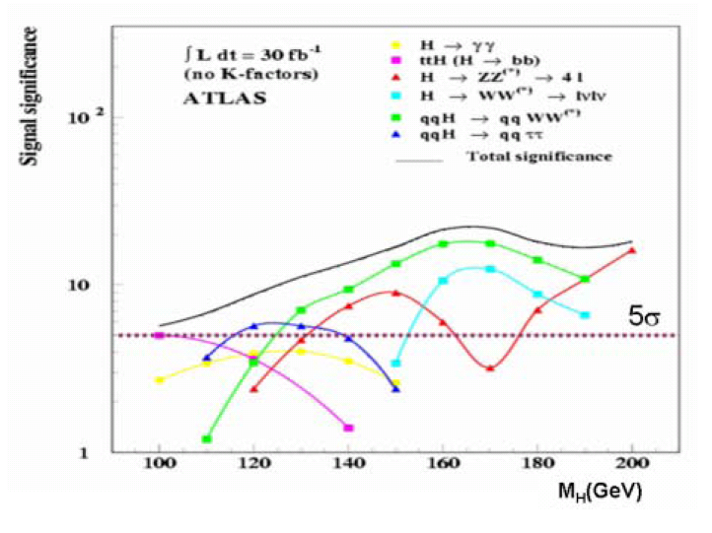
Physics Objects
Objects needed for
event selection
-> also needed for Trigger:
- Electrons
- Photons
- Muons
- Jets
- b-Jets
- forward jets
- Taus
- Missing Energy
- (B-physics triggers)
Trigger object close to offline Physics objects required

Slide 7
Realisation
Complete data readout not possible (60TB/s (already with zero supression))
Need quick decision based on reduced information
Then readout data and perform refined decision

Slide 8
Generic Trigger Design
Event rate
Data volume
Level 1
Hardware
Calorimeter, Muons
Level 1
Hardware
Calorimeter, Muons
L1
Level 2
CPU-Farm
All detector
(RoI based)
Higher Level Trigger
CPU-Farm
All detector
HLT
Available
ressources
Prozessing time
Event Filter
CPU-Farm
All detector
(partly RoI based)
ATLAS
CMS

Slide 9
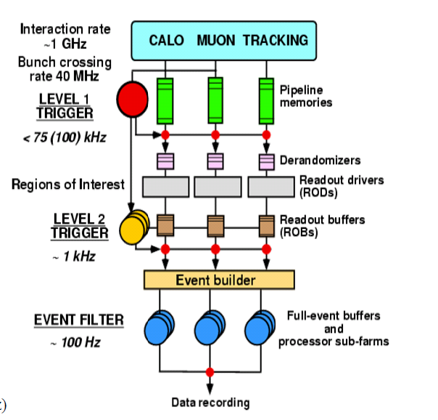
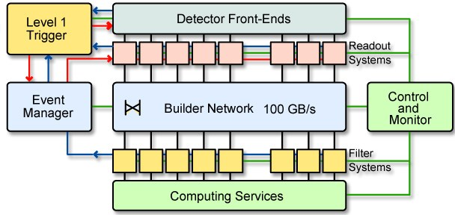
Trigger and Data Acquisition
ATLAS
CMS
In Reality the Trigger is intimately
connected with the Data Acquisition System

Slide 10
Concept of a Level 1 Trigger
your favourite detector
Pipeline memory for every channel
on detector (analogue or digital)
depth = 100-128 (2.5 – 3 μs)
1 cell of your
favourite detector
Readout
Long cables
L1 decision time: ~1μs
L1 Trigger
e.g. Calo Trigger
Central Trigger
Global Trigger

Slide 11
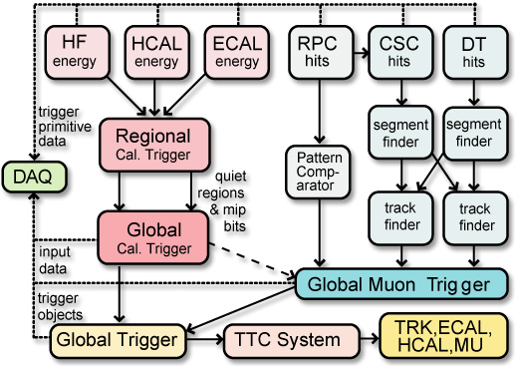
Level 1 Systems: CMS
Level 1 triggers on:
  4 highest E_{t} e±/γ
  4 highest E_{t} central jets
  4 highest E_{t} forward jets
  4 highest E_{t} tau-jets
  4 highest P_{t} muons
For each of these objects the rapidity, η, and ϕ are also transmitted to GT so HLT can seed on them.
In addition we trigger on inclusive triggers:
  E_{t} , MET, H_{t}

Slide 12
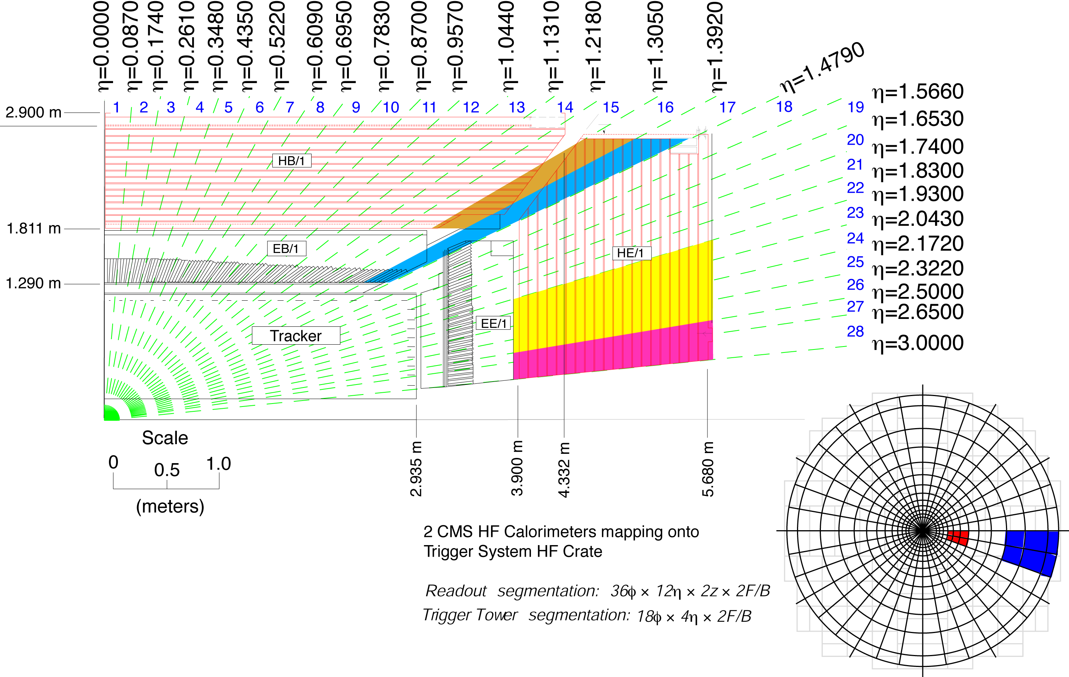
Level 1 systems:
CMS Calorimeter Trigger
Highly granular projective towers
ηxφ: 0.087x0.087

Slide 13
Level 1 systems: CMS Calorimeter Trigger: Algorithms
Electron (Hit Tower + Max)
  2-tower ΣE_{T} + Hit tower H/E
  Hit tower 2x5-crystal strips >90% E_{T} in 5x5 (Fine Grain)
Isolated Electron (3x3 Tower)
  Quiet neighbors: all towers
  pass Fine Grain & H/E
  One group of 5 EM E_{T} < Thr.
Jet or τ E_{T}
  12x12 trig. tower ΣE_{T} sliding in 4x4 steps w/central 4x4 E_{T} > others
τ: isolated narrow energy deposits
  Energy outside τ veto pattern sets veto
  Jet ≡ τ if all 9 4x4 region τ vetoes off

Slide 14
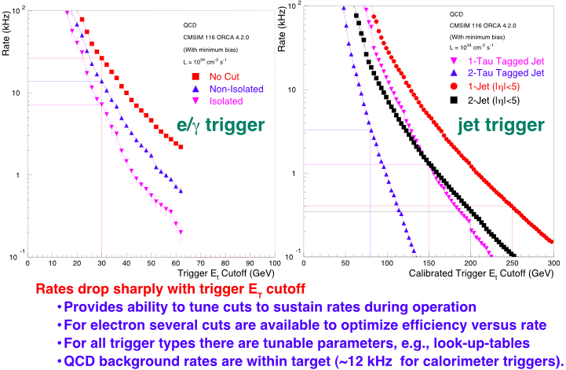
Level 1 Trigger simulation
Currently both experiments perform extensive simulations, to chose
the thresholds for day 1 (many large uncertainties involved)

Slide 15
Trigger efficiencies
These are efficiencies which you will see in one or two years from not
At the beginning this will be much worth

Slide 16
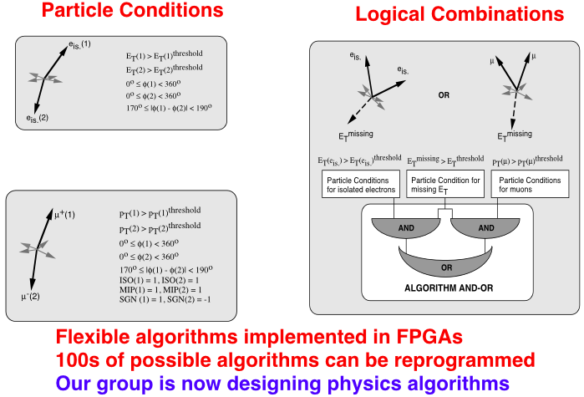
Topological L1-Triggers
(CMS only)
Can be very powerful, however needs good understanding of
performance

Slide 17
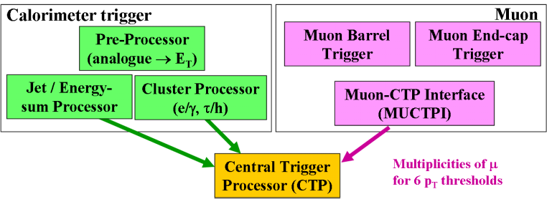
Level 1 Systems: ATLAS
Calorimeter Trigger ans Muon Trigger run in parallel
Level 1 receives information: (How often has a threshold being passed)
Calorimeter Trigger:
  8 Jet, 8 electron, 8 tau, 4 MET, 4 E_{Tsum}, 4 E_{TsumJets}
Muon Trigger
6 pt thresholds

Slide 18
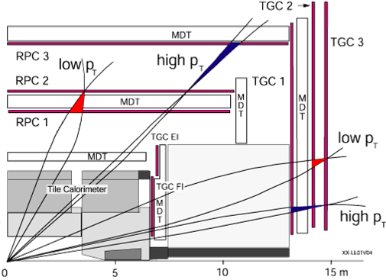
Level 1 systems:
(ATLAS: L1 Muon-Trigger)
Predefined patterns
- special Trigger
layers
- seeded from
middle layer
- different hardware
- overlap removal

Slide 19
Higher-Level-Trigger
Level 1 uses only coarse granularity information
Objects found by Level 1 can still be very much refined using information of finer granularity
ATLAS and CMS choose two different approaches:
  ATLAS employs consequently the RoI approach (small amount of data transfer, more complicated structure)
  CMS uses massive network capabilities (massive data transfer, easier structure in principle)

Slide 20
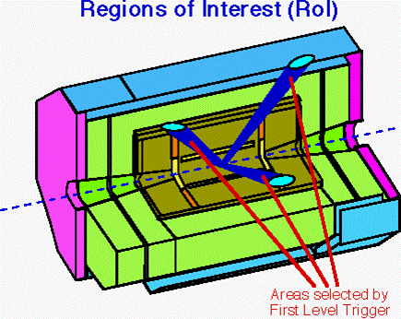
The Region of Interest Concept (RoI)
RoI found by L1 transfered to L2
L2 uses only data within the RoI
(2% of total amount of data)
used in full conseqence by ATLAS
In principle also available in CMS

Slide 21
The massive approach (CMS)
Network distributes events to PC Farm at 100kHz (1 MB/s)
Full event available for HLT

Slide 22
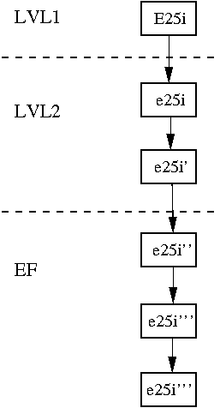
Trigger Chains/Paths and Stepwise Processing
Hardware
The Trigger processes the
data in Chains/Paths
Decisions are taken after
each step and chains/paths
are stopped and eventually
events are rejected
Effectively you divide the
HLT into a N-level Trigger
system
You gain lots of performance
w.r.t a system where you fully
reconstruct the event
L2 cluster alg.
L2 track alg.
EF cluster alg.
EF track alg.
EF Bremsstrahl.
recovery

Slide 23
Splitting of Trigger Chains

Slide 24
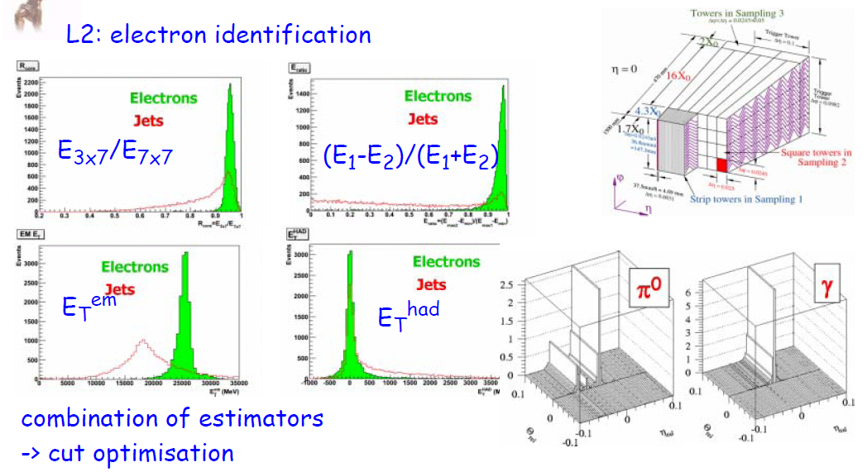
HLT Algorithms
-> As close to offline as possible, but still fast
Outdated, just for illustrational purpose

Slide 25
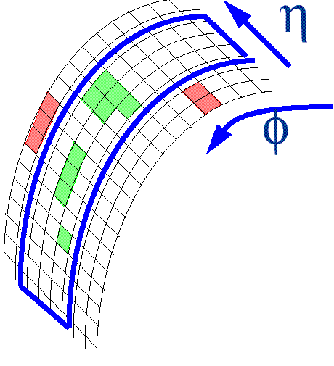
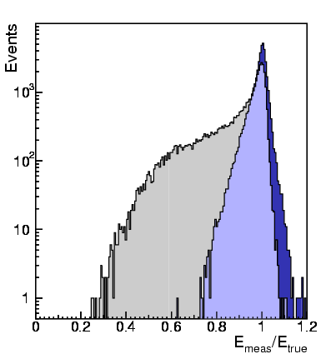
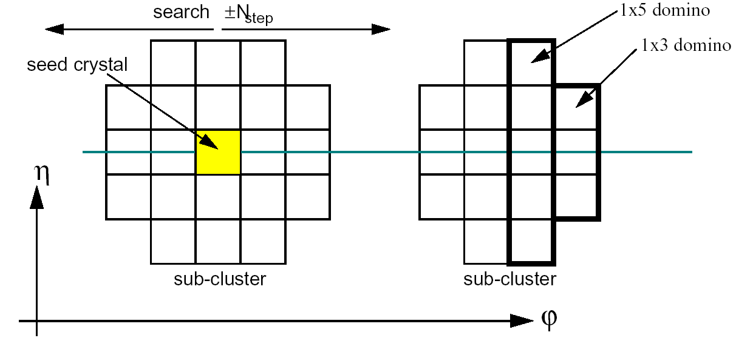
HLT CMS
“Level-2” electron:
  Search for match to Level-1 trigger
    Use 1-tower margin around 4x4-tower trigger region
  Bremsstrahlung recovery “super-clustering”
  Select highest E_{T} cluster
Bremsstrahlung recovery:
  Road along φ — in narrow η-window around seed
  Collect all sub-clusters in road → “super-cluster”
super-cluster
basic cluster

Slide 26
Trigger strategy and Trigger menu
Bring everything together
  Trigger Objects
  Physics selection (importance of signatures)
  Calibration Triggers
  Monitor Triggers

Slide 27
Trigger menu L1 (ATLAS)
Outdated, just for illustration purposes

Slide 28
Trigger menu HLT (ATLAS)
Outdated, just for illustration purposes

Slide 29
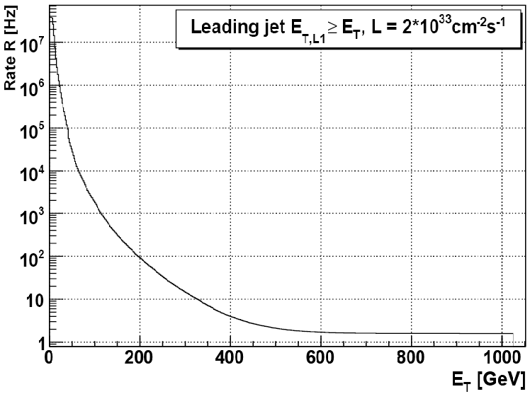
Trigger rates
Thresholds in Trigger
Menus are currently
optimised using MC
simulations
Overall rate is mostly
dominated from QCD
dijets
-> Study different triggers and different physics processes to optimize
all thresholds and to construct the full menu

Slide 30
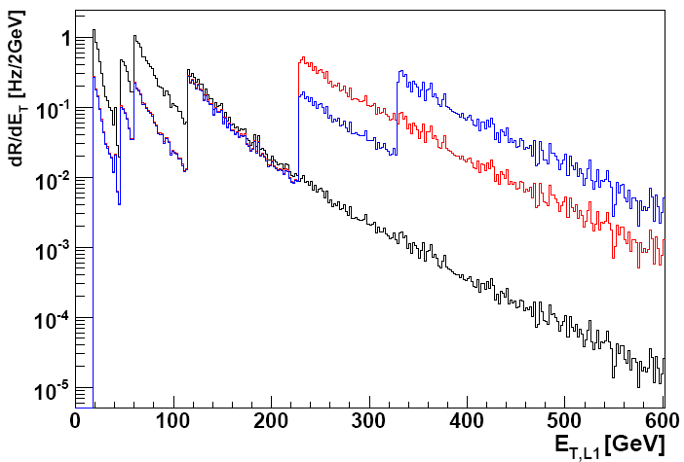
Prescales
3 different lumi scenarios
How to handle high
rates of low ET objects?
-> introduce low thresh-
holds and apply prescales
prescaled
Prescale P -> only take
every Pth event
unprescaled
Powerful tool to keep low ET physics (reduced rate, low effective lumi),
-> calibration triggers, monitor triggers, etc ...

Slide 31
The Trigger shopping list
for physics analysis
(there will be a lot of text from
now on, but it is important, At least I think)

Slide 32
General remarks
The Trigger is the most critical component in the experiment
Mistakes are not recoverable
Mistakes/bugs/errors in some reconstruction software can be painful but recoverable (e.g. reprocessing of data)
If you want to have the data, you better make sure that you get the data!!!
There are many ways to loose data
  Bugs (should not happen, but does)
  High prescales (e.g. introduced to satisfy the rate budget) -> basically switches off your trigger
  Raised threshholds (e.g. introduced to satisfy the rate budget) -> can cut into the physics
  Changed trigger algorithm (e.g. For stability reasons) -> can reject a special type of events (maybe yours)

Slide 33
Before beam: Setting up the trigger strategy
Is the trigger menu good enough for your data analysis?
  How does your event selection look like?
  What are the highest E_{T} objects of your analysis?
  What amount of data do I need/expect?
  Can I live with a prescale? (which might allow a lower threshhold)
  Do you need special beam conditions (e.g. low pile up)?
You need to understand the forseen trigger in detail
  Electrons in SUSY events are not the same as electrons in Z-> ee
  Oth order check: run the trigger simulation on your signal MC
  Each trigger has „hidden variables“ (e.g. Noise cuts)
How can the trigger menu potentially be changed?
  Threshold, prescale, algorithm change,...
  Remember, you are not the only person usng the trigger

Slide 34
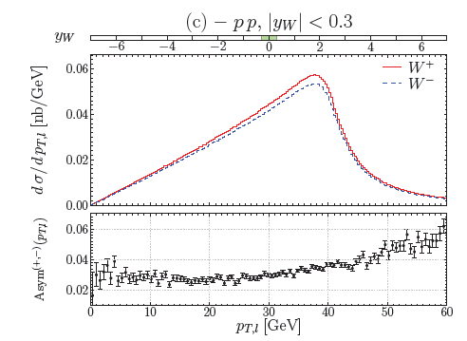
How to decide for the best trigger for your analysis
You should aim for the simplest
possible trigger which still gives
you enough statistics (you need
to understand all trigger effects
in your offline analysis)
90% efficieny and simple is
better than 95% efficiency
and complicated
However what you need depends really on what you want to do:
e.g. W -> eν events
Calibration: can afford higher lepton pT threshold
Precise mass measurement: needs low thresh. (fitting range)

Slide 35
During beam
You need to follow all developments in the trigger area:
  Prescales of YOUR trigger
  Efficiency of YOUR trigger
  Underlying Hardware problems/changes of YOUR trigger
Understand all the implications of changes on your analysis
electrons
your elec.
electrons
after mod.

Slide 36
During data analysis
No time to relax
The trigger efficiency correction is often a very critical part of the analysis
Understanding Trigger efficiencies can be a major part of your work
  Precision measurement
  Pathological point in phase space
  Combination of very different data sets (high lumi and low lumi)
  Combination of many triggers
  (e.g. Leptoquarks -> e jet, full detector acceptance)

Slide 37
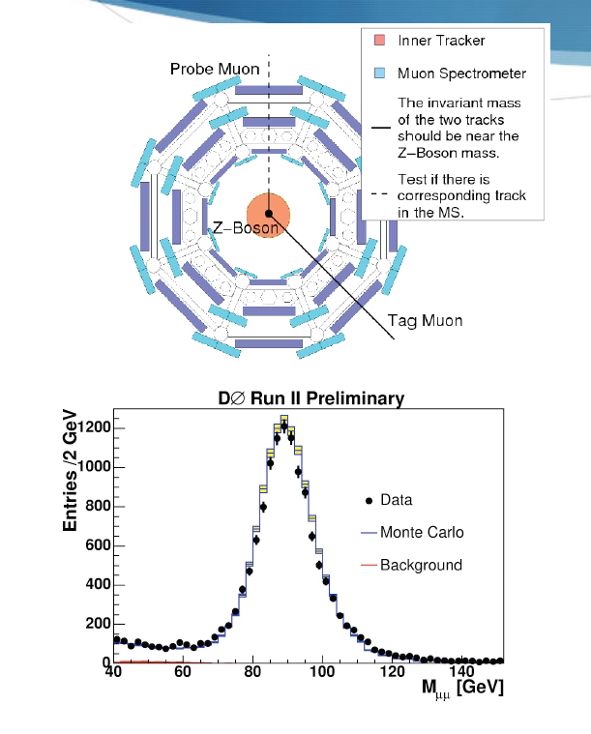
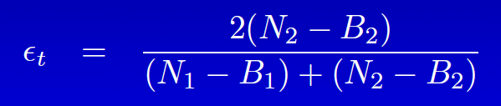
Measuring Trigger efficiencies
Tag and probe: Z-> μμ
- take events with two
rec. offline muons AND
triggered by a single muon
trigger
- determine the number of events
N₁(N₂)where 1(2) muons issued
the trigger
- Fit to the e.g Z mass (including
background B_{1,2} determination)

Slide 38
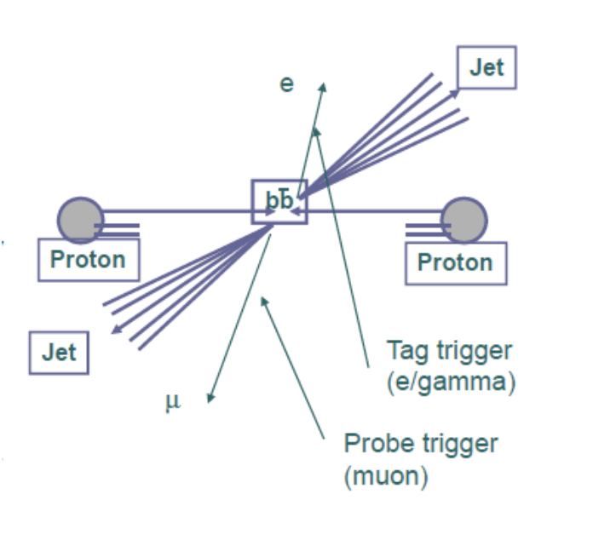
Measuring Trigger efficiencies
Triggering b-jets using muons
Another way of tag and probe
Reconstruct bb events
1. side muon decay
2. side electron decay
Select electron triggered events
Determine how often the
muon has issued the trigger
ε = (# events with muon triggers) / (total # events (satisfying the selection))

Slide 39
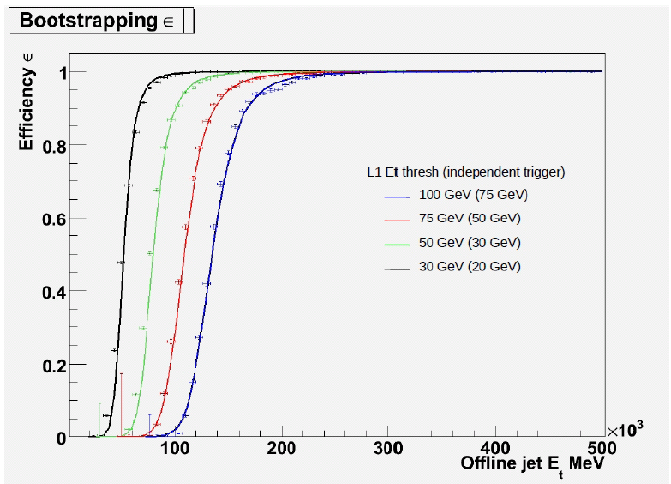
Measuring Trigger efficiencies
There might be case where
you don‘t have an
independent trigger
Bootstrapping
Determine the trigger
efficiency of your lowest
(jet) threshold
(e.g. using Min bias)
Determine the efficiency
of the next higher
threshold by using the
lower threshold as
reference
ε = ((# events thresh 1 and thresh 2) / (# events thresh 1)) * (# events thresh 1)

Slide 40
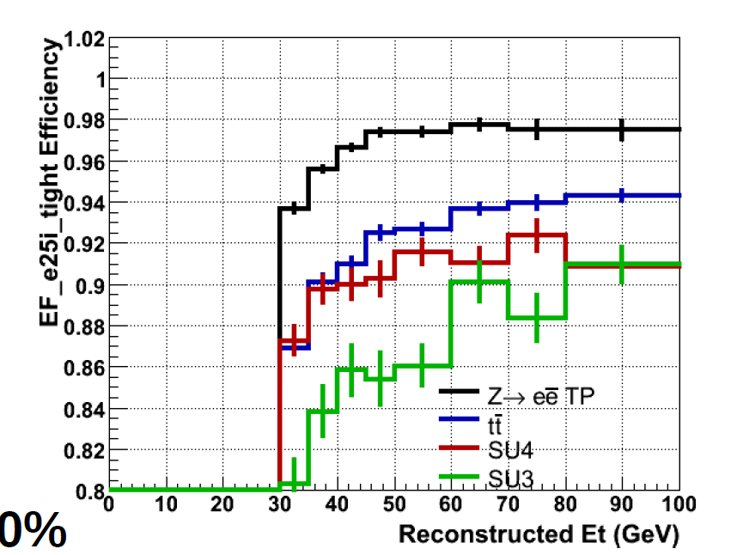
Warning!!!
Trigger efficiencies are
dependent on the physics
process which you study
e.g. Isolation criteria are
critical for high activity events
In principle you need to use your sample to correctly
determine the efficieny

Slide 41
Combining Triggers
There are cases where you need to use more than one trigger to select your events
  Covering the full phase space
  Covering the full detector acceptance
  Recover some statistics if your main trigger is prescales
  ...
You need to correct for prescales and efficiency, which is (relatively) simple in the one trigger case

Slide 42
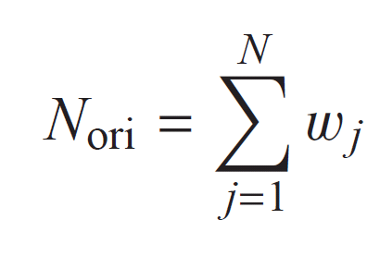
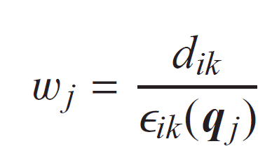
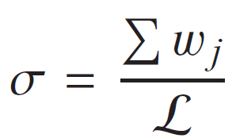
Combining Triggers
Assume 1 Trigger and 1 Trigger Level:
You loose events due to prescale d and efficiency ε
In order to calculate the „true“ number of events
with
Your measured
cross section

Slide 43
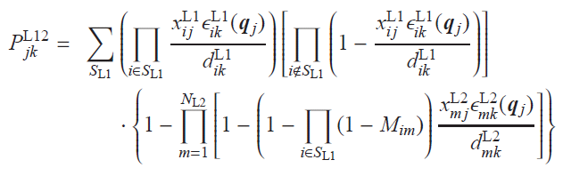
Combining Triggers
Assume more than one Trigger and assume a multi level Trigger system
1/w =
-> It gets complicated
More info here ( V. Lendermann et al. NIM A 604,707-718,2009)

Slide 44
Last Slide
Mastering the Trigger is very challanging (for everybody, even long time experts)
Instead of risking to loose data you should better annoy people with your questions
You should start thinking about the trigger Before Data Analysis

