Slide 1
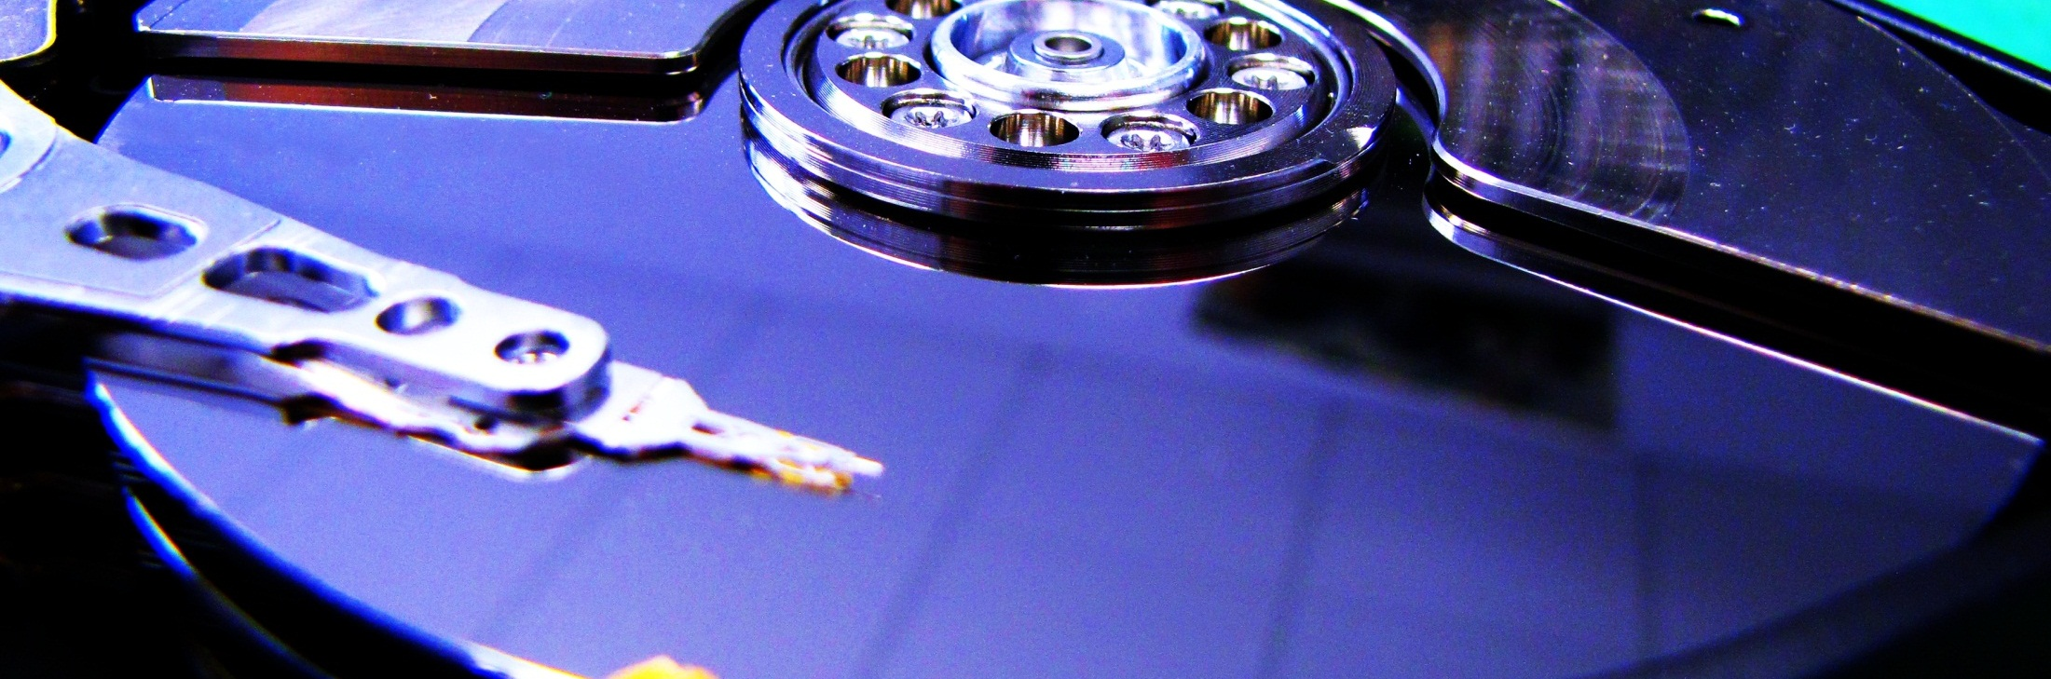

“The Challenge of Big Data in Science”
Opening
Achim Streit
The 6th International
LSDMA Symposium

Slide 2
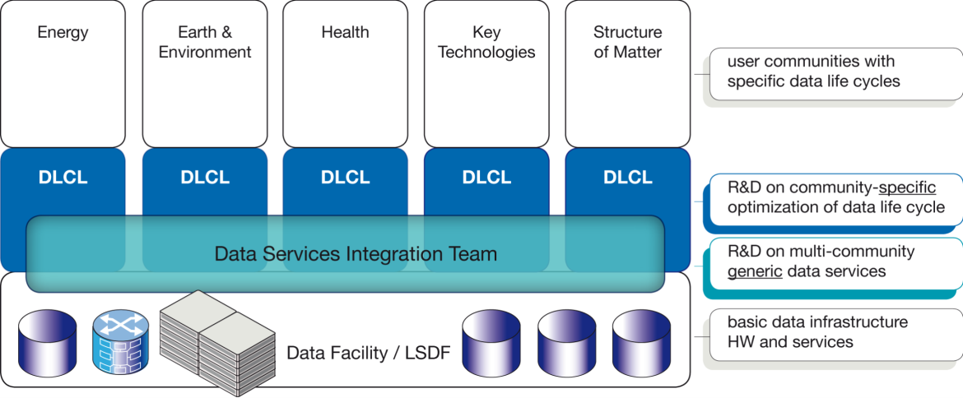

Structure and Aims of LSDMA
R&D
Data Life Cycle Labs
Joint R&D with communities
Optimizing the data life cycle
Specific data analysis tools and services
Data Services Integration Team
Generic, multi-community R&D
Interface between federated data infra-structures and DLCLs resp. Communities
Integration of data services in scientific working process

Slide 3











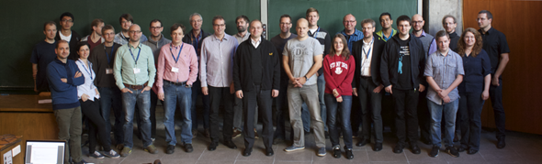
Facts and Figures
Helmholtz portfolio theme of the 2nd round
Initial Runtime 2012-2016
2017 ff.: integrated in Helmholtz programmes SBD (RF ST), MU (RF M)

Slide 4
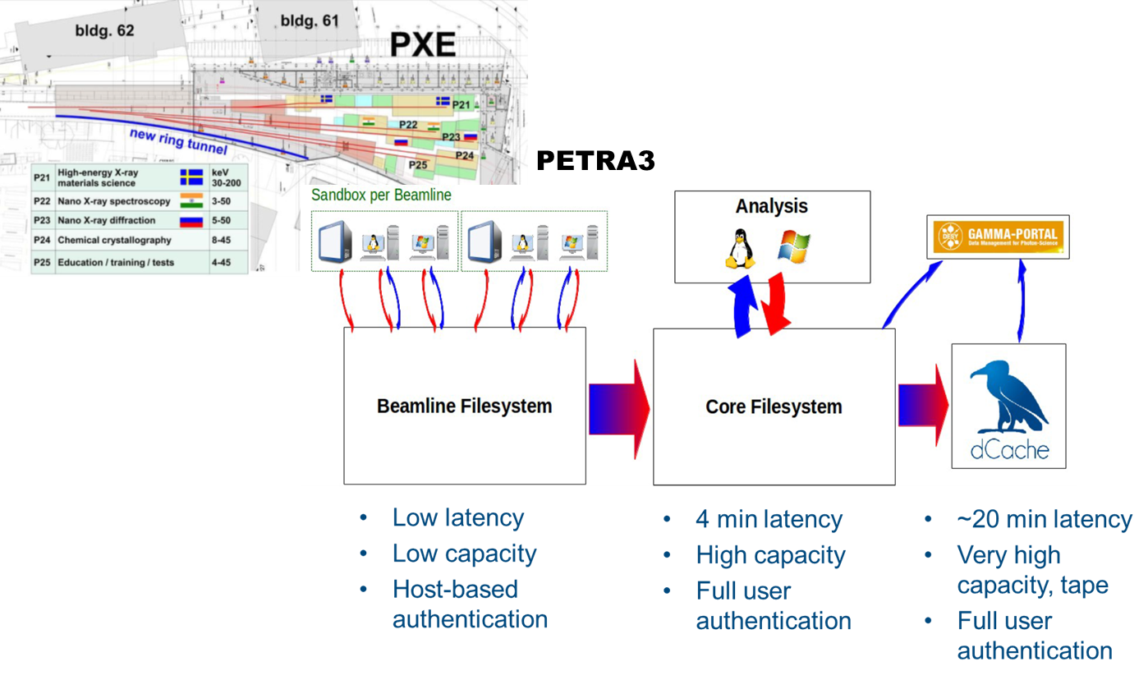
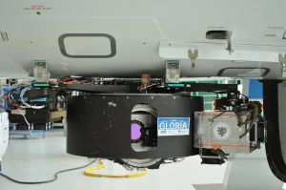
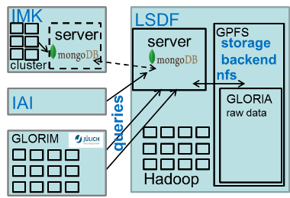
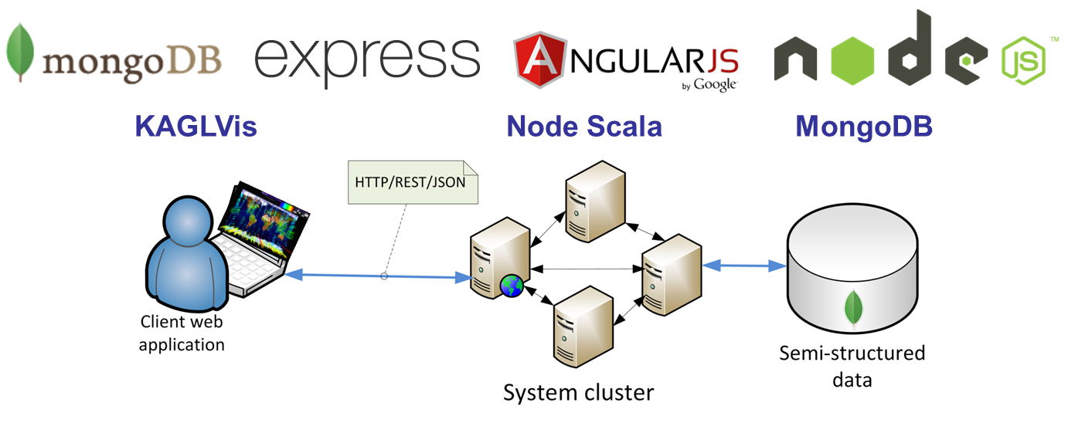
Highlights from DLCLs
Climatology
  Climate Analysis
  with MEAN Stack
  Distributed, scalable
  analysis framework for
  earth-observing data
Matter
  Optimized data
  management and processing workflow for PETRA 3

Slide 5
Highlights from DSIT
AAI / federated Identities
  Integration of FedID (eduGAIN) and OpenID in various services, SAML on the commandline, Interoperability of AAIs and Levels of Assurance
Generic informatics R&D on algorithms, data-structures, security
Archive technologies
  International harmonization of Quality of Services in Storage (QoS) via RDA and SNIA/CDMI
  Uptake of the approach within EUDAT, INDIGO, BW-Archive, RADAR, OPARA
Provenance extensions for UNICORE and KIT Data Manager
Generic Metadata approach across various communities

Slide 6









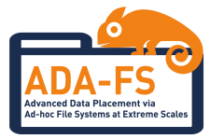













Collaborations, Projects, Initiatives

Slide 7
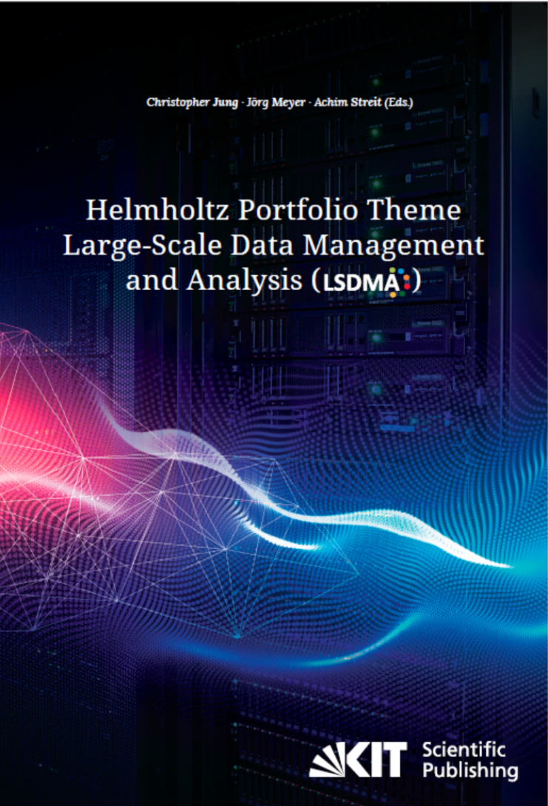
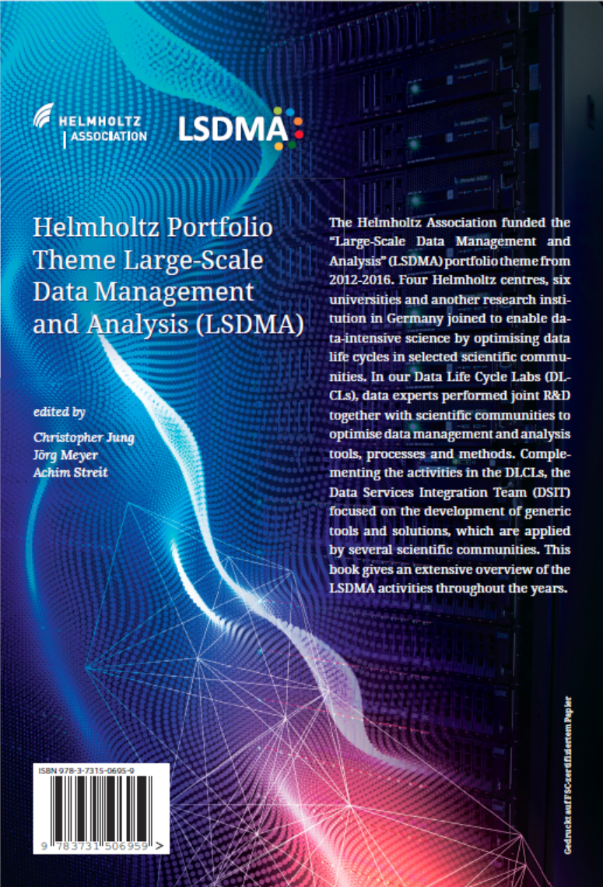
LSDMA Book
DOI: 10.5445/KSP/1000071931 ISBN 978-3-7315-0695-9

Slide 8
New activities arising from LSDMA
Helmholtz Data Federation (HDF)
Helmholtz Incubator “Information & Data Science”
Helmholtz Analytics Framework (HAF)
EC project EOSC-hub
EC project DEEP-HybridDataCloud

Slide 9
Agenda for Today
9:00 – 9:20 | Welcome, Introduction | Michael Decker Achim Streit
9:20 – 9:50 | The NFFA Europe Information and Data Repository Platform | Stefano Cozzini (CNR)
9:50 – 10:20 | Towards the Fenix Infrastructure | Dirk Pleiter (FZJ)
10:20 – 10:50 | Coffee break
10:50 – 11:20 | AI-driven decision automation in physics research and enterprises | Michael Feindt (BlueYonder)
11:30 – 11:50 | Helix Nebula Science Cloud | João Fernandes (CERN)

Slide 10
Agenda for Today – cont‘d
We plan to collect the slides and provide them on the Symposium webpage: https://indico.desy.de/conferenceDisplay.py?confId=18126
11:50 – 12:50 | Lunch break
12:50 – 13:20 | Accelerating Storage System Research Through a Common Framework | Michael Kuhn (University of Hamburg)
13:20 – 13:50 | Research Data and Management in Environmental Sciences - Characteristics, Status and Challenges | Lars Bernard (TU Dresden)
13:50 – 14:00 | Conclusion | Achim Streit

Slide 11
Logistics
Breaks
  Coffee break at 10:20 with coffee, tea, water, juice, fruits and cookies
  Lunch break from 11:50-12:50 with fingerfood here in the FTU
WIFI
  eduroam
  Guest account info in your conference bag

Slide 12
Thanks
To the organising team
  Melanie Ernst
  Manuel Giffels
  Diana Gudu
  Christoph Heidecker
  Jörg Meyer
  Ingrid Schäffner
  Matthias Schnepf
  Gabriel Zachmann

Slide 14

Helmholtz Data Federation (HDF)
Helmholtz Association is developing a federated research data infrastructure in Germany for the benefit of and open to the full German science system to promote and foster excellent science
  Addressing community-specific requirements
  Finding, accessing, linking, analysing scientific multi-disciplinary data
  Long-term preservation, curation, availability and usability of research data
  Data ownership remains with the scientific disciplines
  Secure federation of existing data centres with uplinks to EU/Intl.
Comprising three elements
  1) Innovative software technologies for data management
  2) Excellent user support and joint R&D
  3) Leading-edge storage and analysis hardware
National building block for the European Open Science Cloud (EOSC)

Slide 15
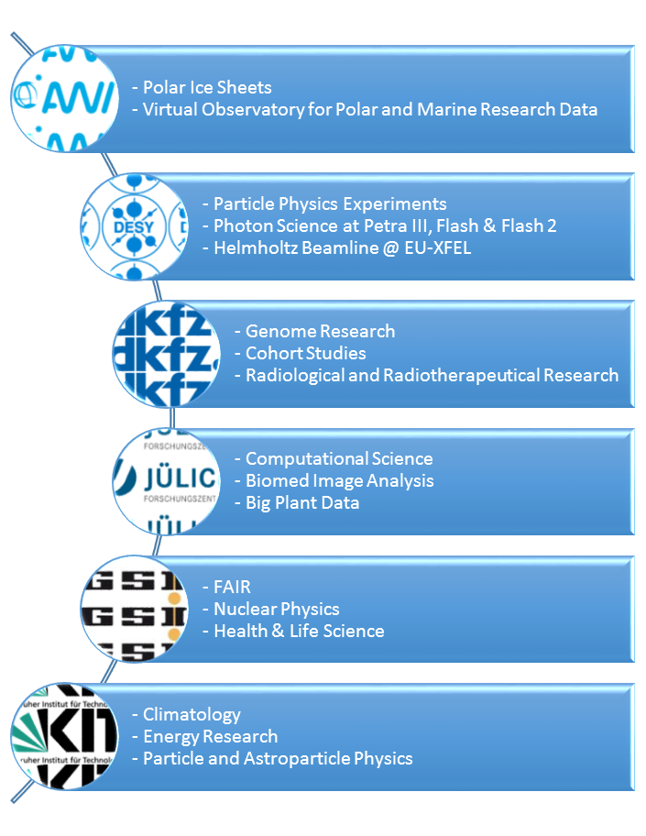
Helmholtz Data Federation (HDF)
Initial set of scientific cases identified
by the 6 Helmholtz partners
Reviewer statements:
  “Sharing of infrastructure, services
  and datasets opens the way for
  improved cross-disciplinary
  working and re-use of data.”
  “…will be a first example of a
  national shared research data
  infrastructure in Europe.”

Slide 16
Helmholtz Incubator
“Information & Data Science”
One of the 6 future topics of the Helmholtz Association (besides energy, personalized medicine, etc.) is to achieve an international leading position in the field of „Information & Data Science“
HGF-President Otmar D. Wiestler has initiated the Incubator „Information & Data Science“ with experts from all 18 centres
  Helmholtz has Big Data in all research fields
  High demand on interdisciplinary collaboration and joint R&D
Aims of the Incubator:
  Networking of the relevant actors in Helmholtz
  Identification of the most interesting topics and pilot projects
  Developing an education platform

Slide 17






Helmholtz Analytics Framework (HAF)
Goals
  Foster data science in Helmholtz
  Develop and exploit the
  Helmholtz Data Federation (HDF)
Objectives
  Create data analytics techniques
  in a systematic manner
    Domain-specific as well as
    generalizable and standardized
  Use case driven co-design between
  domain scientists, data experts and
  infrastructure professionals

Slide 18
Helmholtz Analytics Framework
Integration in Helmholtz Activities
Support in
programme
SBD
SimLabs + Data Life Cycle Labs
Terrestrial Systems
Climate Science
FZJ, KIT
HYIG
Multiscale Biomolecular Simulation, KIT
SimLab
Neuroscience
FZJ
Data
Life Cycle Lab
Neuroscience
FZJ
HAF
Use
Cases
(WP1)
Terrestrial Monitoring / Forecasting
Cloud & Solar Power Prediction
Stratospheric Impact on Surf. Climate
FZJ, KIT
Hybrid Data Analysis Integration for Structural Biology
HMGU, KIT, FZJ
High-Throughput Image-Based Cohort Phenotyping
FZJ, DKFZ
Multi-Scale Multi-Area Interaction in Cortical Networks
FZJ
Virtual Aircraft
DLR
Automated Volumetric Interpretation
DESY
Generic
Methods
(WP2)
Common Components for Data Analytics
FZJ, KIT, DESY, DLR
Helmholtz Data Federation
KIT, FZJ, AWI, DESY, DKFZ, GSI
Helmholtz research
infrastructure
Data Management Technologies
User Support
Storage and Analysis Capacities

