Slide 1
Current Status Interlocks (16.06.2017)
Interlock Cabling work complete and electricity switched on to the system (02.06)
Testing and Commissioning of Interlocks (Complete)
Rehearsal of Interlock Test with DESY Radiation Protection Group (Complete)
Test with TÜV (20.06)
Other work should not take place inside the Hutches on the 20th for the tests. (9-12 am)

Slide 2
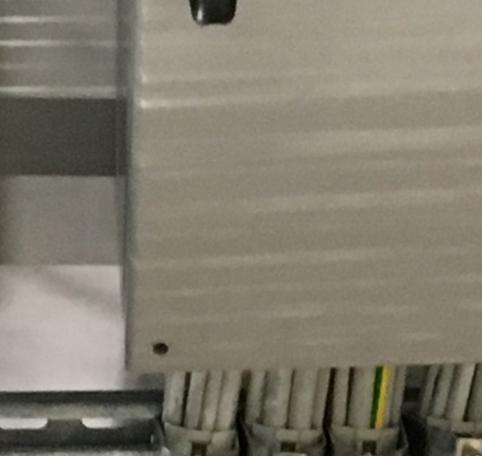
Current Status Shielding (09.06.2017)
Walk through by Radiation Protection Officer and SPB (16.06), FXE (19.06)
  Tamper seals placed on all removable shielding.
  Signs on Chicanes (when Chicanes are closed)
  Many Chicanes Missing Screws

Slide 3
Chicanes Missing Screws
INSIDE FXE EXP - D.05-S07, D.05-S08, D.05-S06 and both roof chicanes
OUTSIDE FXE EXP - D.05-S16, D.05-S09 and D.05-S15 (I forgot to check the outside of the roof chicanes, but will do that my next time down in the hall)
INSIDE SPB EXP - D.09-S10
OUTSIDE SPB EP- D.09-S09 (X2), D.09-S13, D.09-S05 (X2), D.09-S24
INSIDE SPB OPT - D.02-S02
OUTSIDE SPB OPT - D.02.S04
Chicanes need to be closed for TUV inspection on 20th

Slide 4
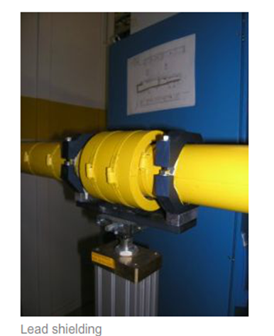

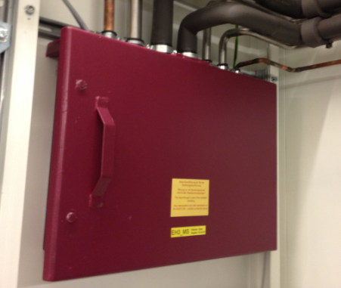

Signs and Tamper seals
Radiation Protection components ensure that there is no increased radiation in personnel access areas. These components are marked with yellow radiation protection stickers.
D.05 – 031
MODIFICATIONS OF THE SHIELDING REQUIRS THE AUTHORIZATION OF THE RADIATION PROTECTION OFFICER.
Media Chicane
D.09 – S01

Slide 5
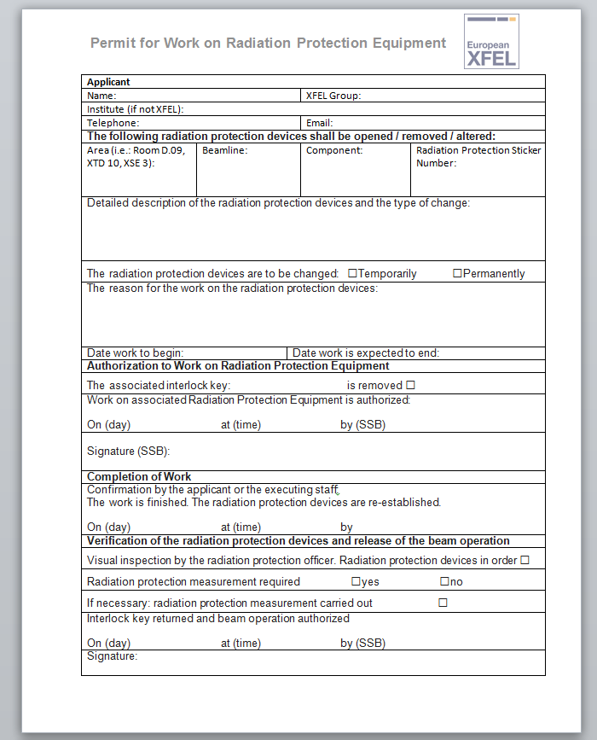
Permit for Work on Radiation Protection Equipment
Once Stickers have been place you will need permission from SRP to open a chicane or to remove or modify any type of shielding
Not required for user chicanes which are interlocked

Slide 6
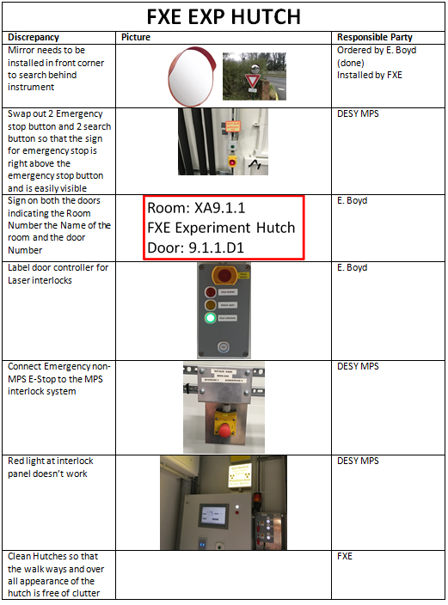
Results of Walkthrough

Slide 7
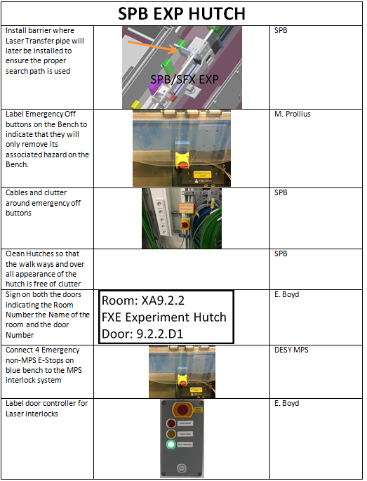
Results of Walkthrough

Slide 8
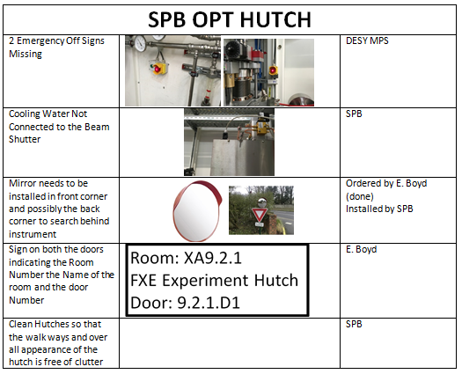
Results of Walkthrough

Slide 9
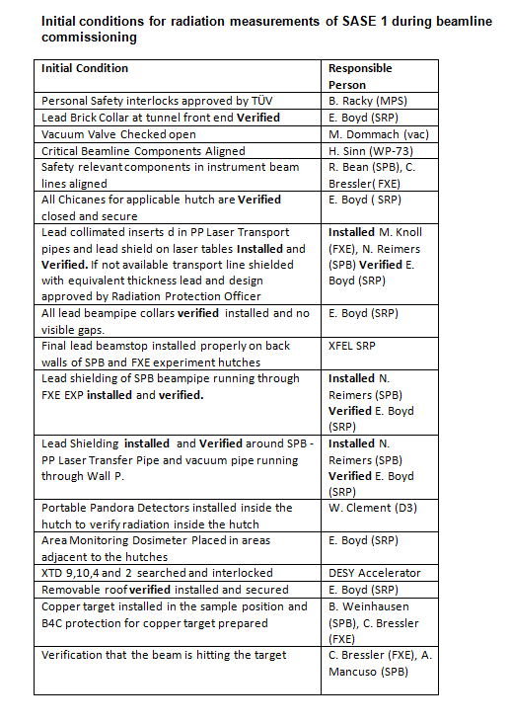
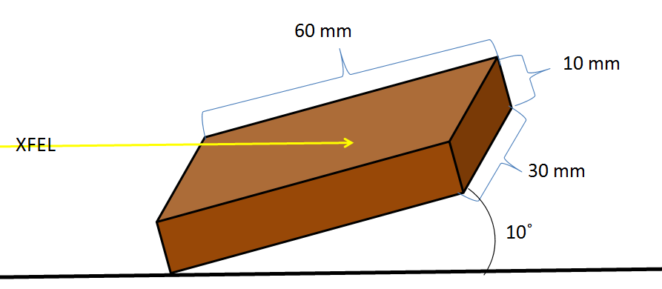
Initial Conditions Checklist
20.06
Done
Done
Done
26.06
21.06
16.06
16.06
16.06
16.06
16.06
26.06
21.06
26.06
16.06
26.06
START OF Commissioning
SPB and FXE have copper blocks, SPB will receive another mounted in the holder
START OF RADIATION MEASUREMENTS

Slide 10
Radiation Measurements of the Hutches
The actual Radiation Measurements performed by SRP on the radiation hutches will take approx. a half a work day for SPB OPT and an entire workday for SPB and FXE EXP
In total 3 days should be accounted for in the schedule for Radiation Protection Measurements, starting from the point when the beam is verified hitting the target
During radiation measurements no one is allowed in the adjacent areas of the hutch including control rooms.
All lead surfaces have to be measured and recorded
  Needs to be a way to reach high up places

