Slide 1
Chess2 measurements

Slide 2
Schematics
3.3
IFB
RowENB
3.3
ColENB
3.3
Injection
1.8
Load
Th
Inj_EN
3.6
Casc
1/2/4/8
In
InSF
Comp
Baseline

Slide 3
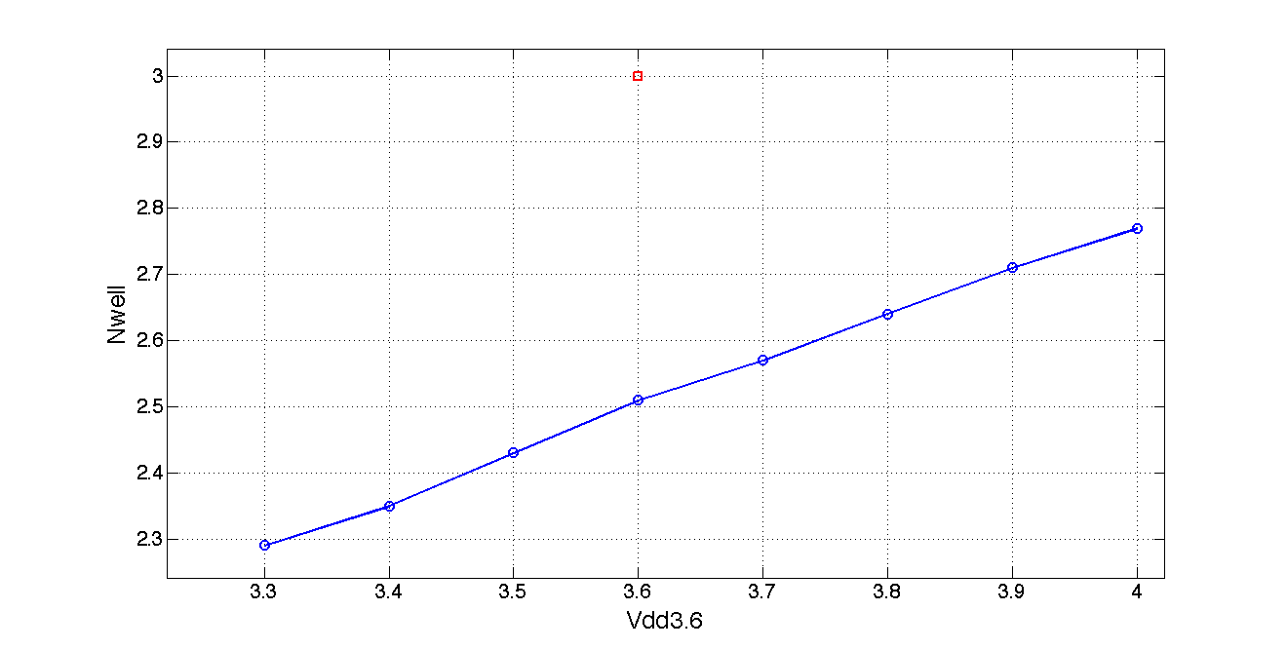
First observations
The DC value of the Nwell is 500mV lower than expected

Slide 4
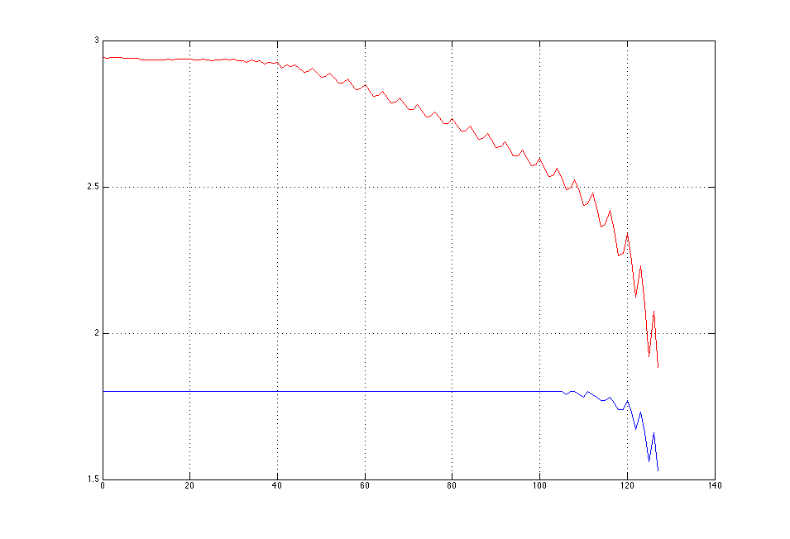
VPFB monitoring
Scan of VPFB and monitoring seem to provide very different answer.

