Slide 1
HDF-AAI-KOM

Slide 2
Agenda (recap)
Today
Introduction round
Why is it so important what we’re doing? (Achim Streit)
Motivations (Marcus Hardt)
Overview on current policies and regulations (Uros Stevanovic)
General Data Privacy Regulagion (GDPR)
Levels of Assurance (LoA)
Next steps in the DFN AAI to support LoA (Wolfgang Pempe)
Discussion
Decision on how to proceed
Tomorrow
Collect real use-cases
Discuss possible architectural model (Marcus Hardt)
Show demos (Diana Gudu, Bernd Schuller, Bas Wegh, Uros Stevanovic)

Slide 3
Motivation
Examples (CERN, Elixir, Dariah, ...) show:
Distributed users need to
access and share with peers datasets stored at
distributed computer centres.
Analyse datasets
In particular:
Sharing: PI from centre A gives user from centre B access to data stored at centre C
PIs do not want to talk to any IT to get this done
Therefore we need to establish federated identity mangement in HDF

Slide 4
Motivation
This boils down to technical and legal challenges:
How can local accounts be provisioned?
Deploy an account for a user without any further requirement/action?
=> What requirements do we have on the user identification?
=> Which terms of use will the user need to accept?
How can group membership be handled?
How to handle deprovisioning?

Slide 5
Our Job:
Tuesday (today):
How can we do this legally
GDPR: What does it imply?
Which requirements do we have on policies for
Level of user identification
Security incidents
Terms of use / acceptable use policies
Wednesday (tomorrow):
How can we do this technically
Most efficient approach
=> Leverage existing technologies
(No development of essential new components)
=> Integrated into existing infrastructures
=> Integrate with future infrastructures

Slide 6
Policy Options

Slide 7
How to move forward
Low risk services <=> High risk services
Wiki is different from VM or access to HPC
For start we could go with low risk services?
DFN AAI + Sirtfi + Minimal set of attributes + ...
For high risk services:
Evaluate requirements for higher quality Assurances
Refeds assurance framework
Use them to introduce “higher risk services” (i.e. more expensive hardware)
...using Attribute based LoA information (Option 4 of Wolfgang slide 18)
Tags must correspond to internationally accepted ones (REFEDS, ...)

Slide 8
How to move forward
Start off with DFN AAI and “Low risk services“
Evaluate “tags” for higher quality Assurances
Identifier uniqueness
Identity proofing and credential issuance, renewal and replacement
Authentication
Attribute quality and freshness
Use them to introduce “higher risk services” (i.e. more expensive hardware)
Tags must correspond to internationally accepted ones (REFEDS, ...)

Slide 9
Backup Slides

Slide 10
Missing points for low risk services...
Withdraw users consent
Must lead to removing all deployed accounts
Uros slide 23
Harmonise the AUP
Security Policy
Traceability and logging policy
Personal data
Acceptable Authentication Asusrance
Community Membership Management
Community Operations Security
Verfahrensverzeichnis
Should there be a draft for a common one
Or even a fully one

Slide 11
Wednesday

Slide 12
An architecture model

Slide 13
Motivation
Examples (CERN, Elixir, Dariah, ...) show:
Distributed users need to
access and share with peers datasets stored at
distributed computer centres.
Analyse datasets
In particular:
Sharing: PI from centre A gives user from centre B access to data stored at centre C
PIs do not want to talk to any IT to get this done
Therefore we need to establish federated identity mangement in HDF

Slide 14
SAML
Users are in SAML
213 IdPs in Germany
All our centres have one, too
Services require more than SAML can deliver
SAML was designed for web
Problems with
Scalable attribute release
Commandline access
API authentication
Delegation
Existing services
SSH
Grid / X.509
S3
Upcoming services
OpenStack
Saml is excellent for
Describing users
Policy modeling
Privacy awareness
International dimension
Whatever we do must be interoperable with European initiatives

Slide 15
Architecture design considerations
Use one central SP for whole HDF
Addresses attribute release
This SP acts as an IdP for all SPs in HDF
SP-IdP Proxy (in line with AARC Blueprint Architectures)
May expose additional authentication protocols
OpenID connect
Solves API and Delegation
Allows user-attribute management
User self management
Group management
Use external attribute sources
Include token translation to support additional services
https://aarc-project.eu/architecture/

Slide 16
Architecture – is it much work?
We’re lucky: 80% is already available
DFN Federation for IdPs (each HDF Partner already operates one)
SP-IdP Proxies: EGI-Checkin, INDIGO-IAM, EUDAT-B2Access
Token translation: WaTTS
This allows
Users with home-account
Authenticate to
SAML services (Web-portals)
OpenID Connect services (Web, REST-APIs, Unicore-Grid)
X.509 services (EGI-Grid)
SSH (Interactive commandline)

Slide 17
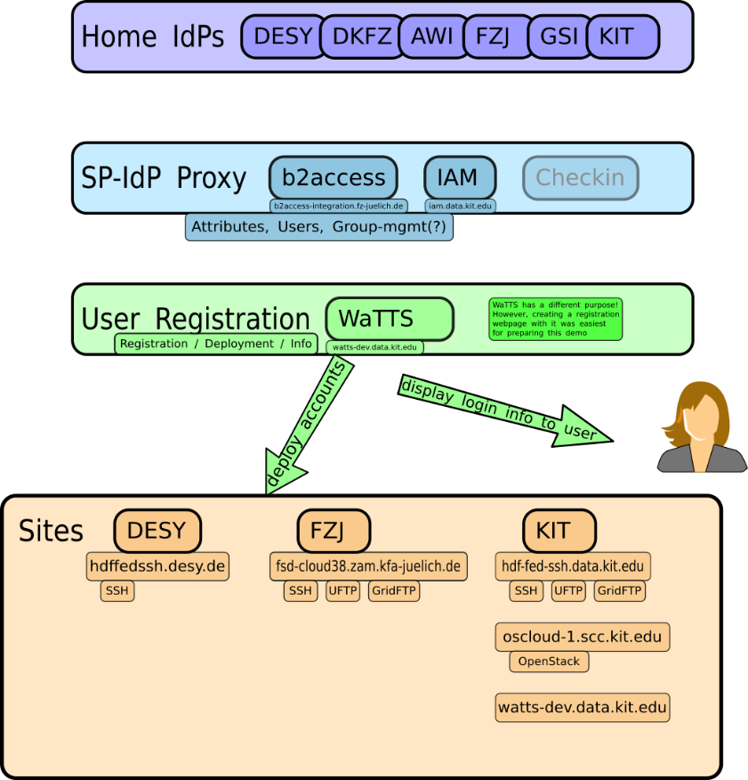
An architecture model

Slide 18
Architecture – What is left to dao?
Policies
Central sign-up Webpage
Group management
Existing solutions available
Evaluation pending
User Deployment method at sites
Requires Policies
Should respect group management
Requires good integration with site user-management
Ideally
HDF users end up in a sites user-management
Group membership enables access to services
So that HDF users may only use some resources
Unless the are also in group “desy” or “project x”
Only create accounts for users in selected groups (<=> projects)
Minimal effort for everybody to join
Does not break existing stuff
Future proof: in line with
AARC AAI Blueprint
EOSC

Slide 19
Demonstration setup
Assuming policies are in place
Chosen SP-IdP Proxy implementation:
B2Access
(considering EGI-checkin, INDIGO-IAM)
Group Management out of scope
WaTTS instead of a real User Registration website
User Deployment interface
Requires integration with local user management system
Each centre has to implement interface
Open: Which protocol to use
Candidates: SCIM, PRACE-Rest, ...
Push, pull, pubsub, ...

Slide 20
Demos

Slide 21
Demos
Goals
Demonstrate what is feasible using Home-Identities and shell
Harmonisation between different, technology bound identifications
SSH, X.509, OIDC
Demos
(all using home-ID and b2access as SP-IdP Proxy)
(all assuming that policy problems are solved)
Using WaTTS token translation
SSH
Unicore-FTP
GridFTP
dCache
OpenStack

Slide 22
Demo – Registration
User goes to “registration webpage”
Mimicked by WaTTS

Slide 23
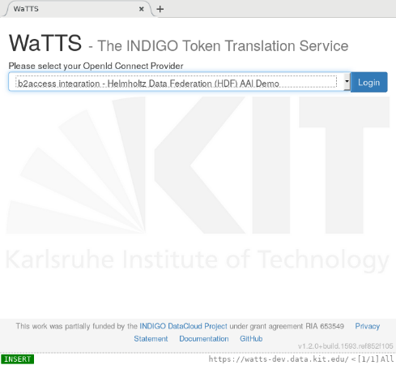
Demo – Registration
User goes to “registration webpage”
Mimicked by WaTTS

Slide 24
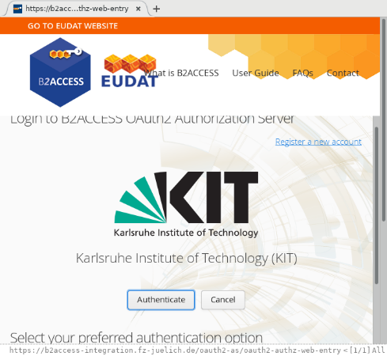
Demo – Registration
User goes to “registration webpage”
Mimicked by WaTTS
User chooses to authenticate at b2access SP-IdP Proxy

Slide 25
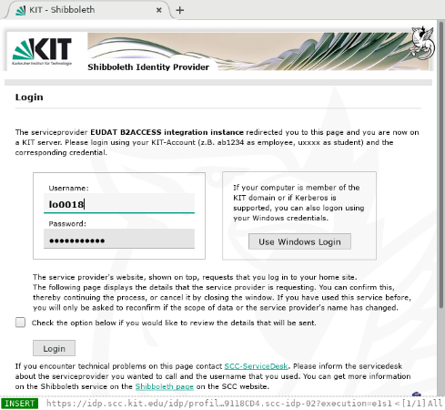
Demo – Registration
User goes to “registration webpage”
Mimicked by WaTTS
User selects to authenticate at b2access SP-IdP Proxy
To log into the proxy, user selects home-institute

Slide 26
Demo – Registration
User goes to “registration webpage”
Mimicked by WaTTS
User selects to authenticate at b2access SP-IdP Proxy
To log into the proxy, user selects home-institute
Attribute release + redirect back

Slide 27
Demo – Registration
User goes to “registration webpage”
Mimicked by WaTTS
User selects to authenticate at b2access SP-IdP Proxy
To log into the proxy, user selects home-institute
Attribute release + redirect back
Attribute release + redirect back

Slide 28
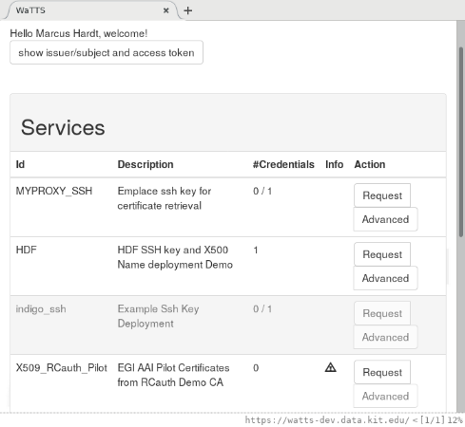
Demo – Registration
User goes to “registration webpage”
Mimicked by WaTTS
User selects to authenticate at b2access SP-IdP Proxy
To log into the proxy, user selects home-institute
Attribute release + redirect back
Attribute release + redirect back
Back at WaTTS: Select “HDF” plugin

Slide 29
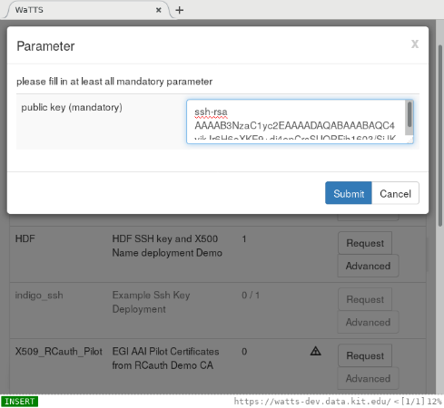
Demo – Deployment
User goes to “registration webpage”
Mimicked by WaTTS
User selects to authenticate at b2access SP-IdP Proxy
To log into the proxy, user selects home-institute
Attribute release + redirect back
Attribute release + redirect back
Back at WaTTS: Select “HDF” plugin
Deployment of account to 3 sites

Slide 30
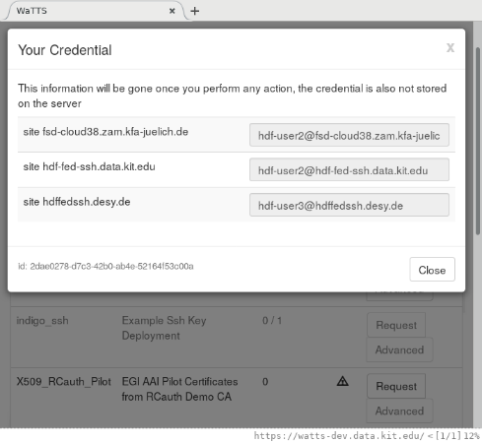
Demo – Deployment
User goes to “registration webpage”
Mimicked by WaTTS
User selects to authenticate at b2access SP-IdP Proxy
To log into the proxy, user selects home-institute
Attribute release + redirect back
Attribute release + redirect back
Back at WaTTS: Select “HDF” plugin
Deployment of account to 3 sites

Slide 31
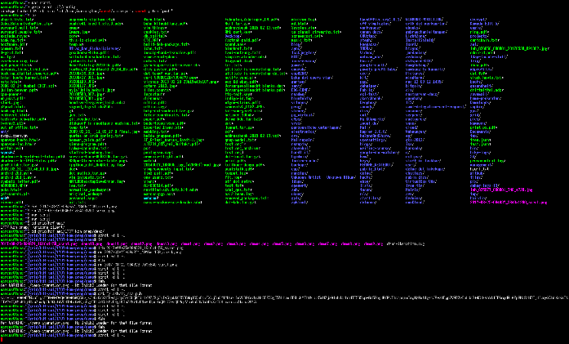
Demo – SSH
Login to FZJ

Slide 32
Demo – UFTP
Login to FZJ
Use UFTP to transfer a file to KIT

Slide 33
Demo – GridFTP
Login to FZJ
Use UFTP to transfer a file to KIT
Use GridFTP to transfer a file to KIT

Slide 34
Demo – Harmonised identities
Login to FZJ
Use UFTP to transfer a file to KIT
Use GridFTP to transfer a file to KIT
Login to KIT
Witness that all files are there
And belong to the same user!

Slide 35
Demo – OpenStack
Point browser to OpenStack Dashboard
Choose Indigo IAM to authenticate
Log in at home IdP
Redirect + redirect
Start VM

Slide 36
Demo recap
All nice and great, BUT:
Policies have to be in place to enable the technology from legal and organisational point of view
Security (Incident response)
Identification of users
Privacy

Slide 37
Conclusions

Slide 38
Next steps
All:
Policies
Attribute release + Persistent and Unique Identifiers
Attribute release to central proxies (b2access-integration, iam.data.kit.edu)
Check with your DPO on policies in the context of the GDPR
Implement these in your IdP
Establish Security Incident Response procedures (according to Sirtfi)
Kick of networking of CERTS of our centres
User Deployment
Agree on an interface
Implement Interface at Centres
Integrate with HDF-services
KIT
Develop and Distribute the policies to partners
FZJ + KIT
Evaluate Group Management
b2access and iam with regard to group management
Surfnet guys offered testing their eduteams as an Attribute Authority

Slide 39
Backupslides

