Slide 1
Helmholtz Data Federation (HDF)
AAI Kick-Off Meeting

Slide 2
Helmholtz Data Federation (HDF)
Helmholtz Association is developing a federated research data infrastructure in Germany for the benefit of and open to the full German science system to promote and foster excellent science
Addressing community-specific requirements
Finding, accessing, linking, analysing scientific multi-disciplinary data
Long-term preservation, curation, availability and usability of research data
Data ownership remains with the scientific disciplines
Secure federation of existing data centres with uplinks to EU/Intl.
Comprising three elements
1) Innovative software technologies for data management
2) Excellent user support and joint R&D
3) Leading-edge storage and analysis hardware
National building block for the European Open Science Cloud (EOSC)

Slide 3
Relevanz / Strategische Bedeutung
Hohe strategische Bedeutung als Zukunftstechnologie im Thema „Informationsverarbeitung“ für die Weiterentwicklung der Helmholtz-Gemeinschaft: „… great potential to contribute to solving major challenges facing society (including pure attainment of new insights)”
National: Keimzelle für Wissenschaftsorganisationen-übergreifende, Forschungsdaten-Föderation; offen für Nutzer im gesamten deutschen Wissenschaftssystem
International: „Architekten-Rolle“ und Führungsposition für Helmholtz und Deutschland im Thema Big Data; „... will be a first example of a national shared research data infrastructure in Europe”
„… has a unique potential to enable the integration or correlation of data across disciplines”

Slide 4
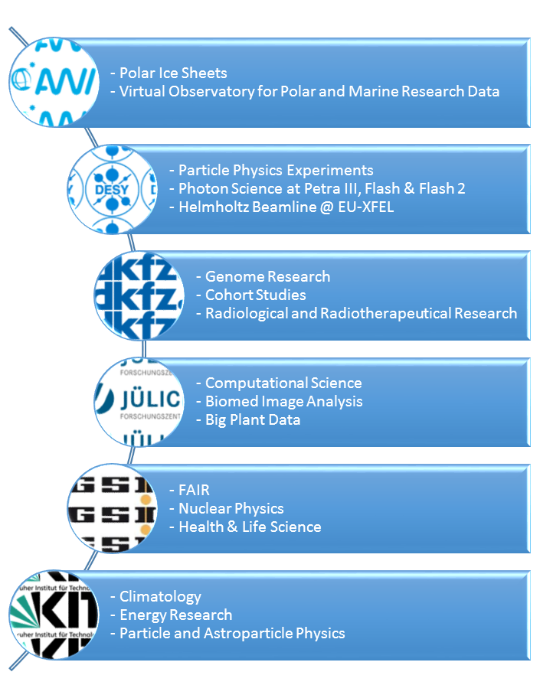
Initiale Use Cases
“Sharing of infrastructure, services and datasets opens the way for improved cross-disciplinary working and re-use of data.”

Slide 5
Arbeitsplan (wie vom EB erarbeitet und priorisiert)

Slide 6
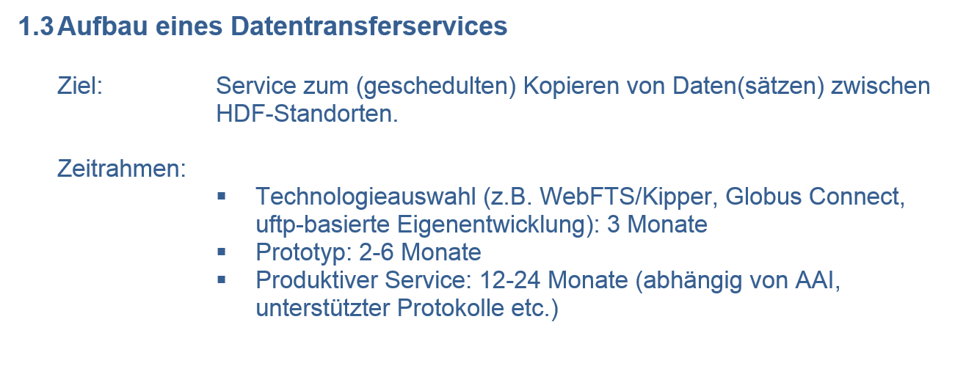
Arbeitsplan (wie vom EB erarbeitet und priorisiert)

Slide 7
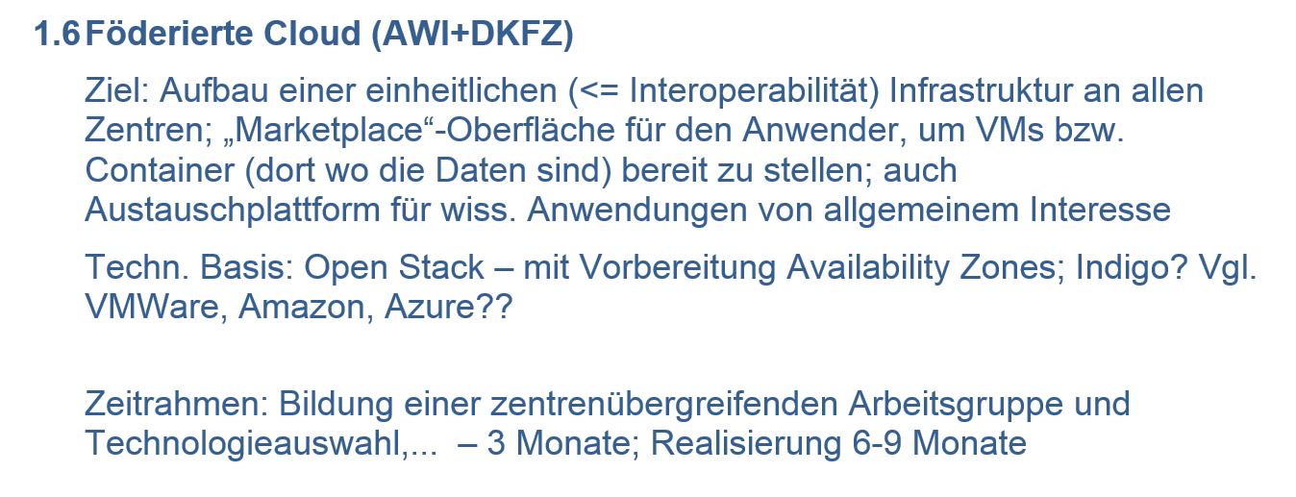
Arbeitsplan (wie vom EB erarbeitet und priorisiert)

