Slide 1
DAQ and Data Management Status
Krzysztof Wrona, Janusz Szuba
ITDM
Schenefeld, 30.06.2017

Slide 2
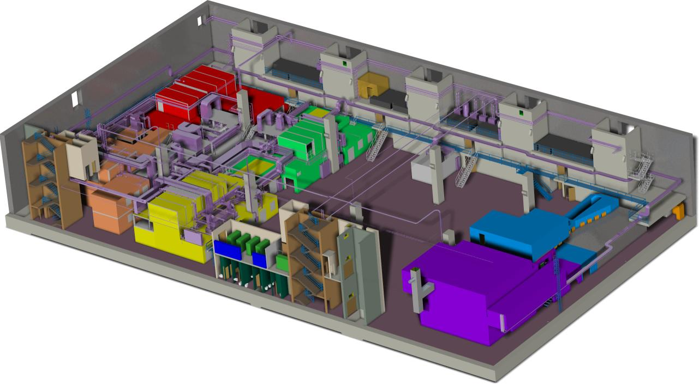
Experiment Hall IT/DAQ Infrastructure
  4 computer rooms in the experiment hall (red, a.k.a. balcony rooms)
  Dedicated rack rooms for the instruments (orange)
SASE3
SASE1
SASE2

Slide 3
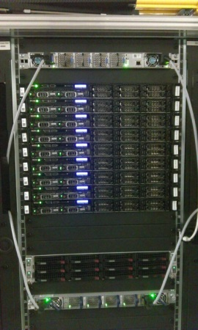
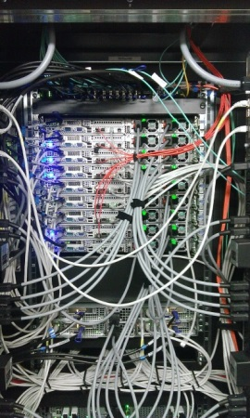
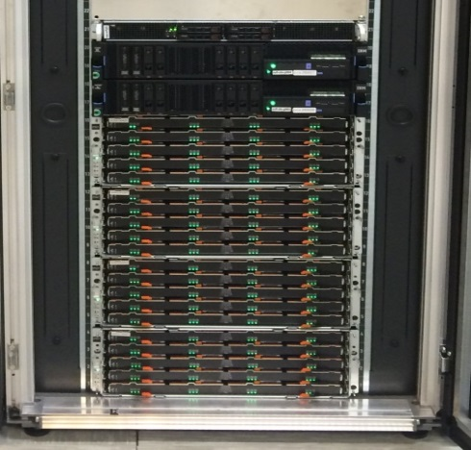
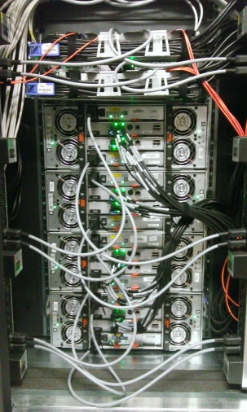
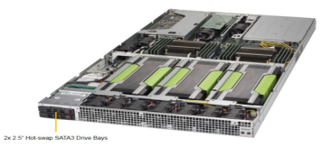
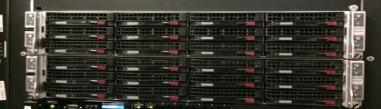
DAQ hardware in SASE1
PC Layer receives data from “Data Sources”
  23 x DELL Power Edge R630
    10GE SFP+ interface for data receiving from detector/train builder
    IB FDR 56Gbps to online storage and computing cluster
Online storage – data cache, scratch space
  Two GL4 systems for SASE1 with 4/8 TB disks – total ~1.8PB storage deployed
Online cluster – fast feedback from users
  12 GPU nodes for calibration pipeline (2 server installed)
  8 nodes (160 CPU cores) for looking at the data – 5 installed, 1 fully configured

Slide 4
Online storage
Folder | Permission | Quota | Retention
/gpfs/p<proposal_id>/raw | gxdaq:rw, gprop:r, gxdata:r | No | Data migration to offline and removed
/gpfs/p<proposal_id>/usr | gprop:rw | 5TB | Sync with offline, both directions online visible only during beam time
/gpfs/p<proposal_id>/proc | gxdaq:rw, gprop:r, gxdata:r | No | Data removed after beam time
/gpfs/p<proposal_id>/scratch | gprop:rw, gxdata:rw | No | Data removed when needed
/gpfs/cal | gxcal:rw, all:r | No | Cache of the offline system
/gpfs/dl | gxctrl:rw | No | To be decided (discussion with CAS)
  raw – data stored by DAQ (data cache)
  usr – beamtime store
  proc – data processed by dedicated pipelines e.g. calibrated data
  scratch – folder where users can write temporary data
  dl – data logger, cal – calibration data
  Permissions are always based on groups: gxdaq, gprop, gxcal,gxctrl
    gprop – group for experiment team
  p<proposal_id> – name constructed from the unique proposal id from UPEX
  “raw” folder will not be visible to users. Data accessible only via reader service

Slide 5
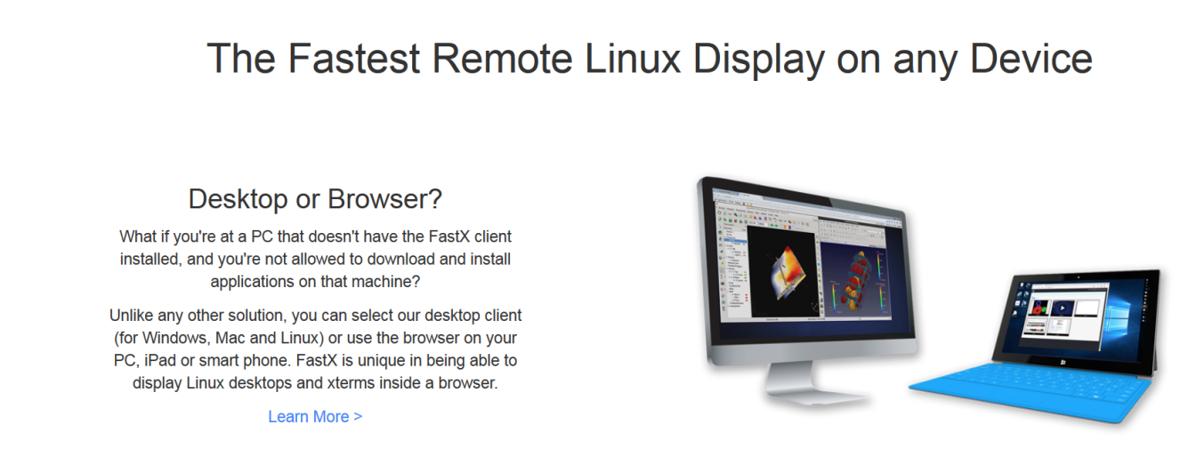
Access to data during beam time
Online cluster servers (ONC)
  Servers for running instrument specific pipelines
    calibration, correction, specific processing pipelines
    Assuming Karabo based software supported by CAS
  Servers for users to look at data and perform individual data processing
    Interactive or batch processing (resources managed by slurm, to be configured for user operation)
    Access to scratch, proc, cal and usr folders
During the beam time ONC resources are available only to the experiment team members and instrument support staff
Access to ONC from XFEL workstations in the control hutch or in dedicated locations in the XHQ
  Access through FastX to login nodes (see for details remote access)

Slide 6
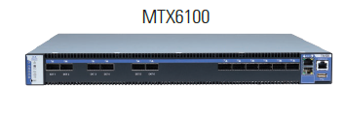
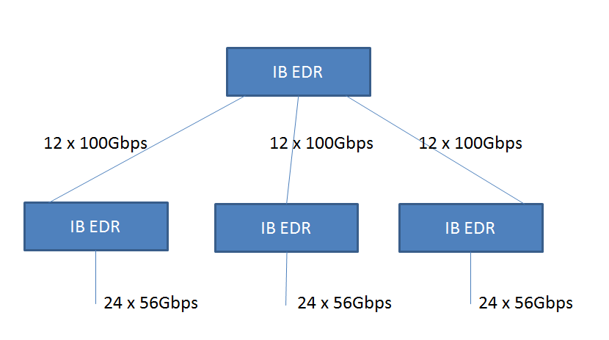
IB connectivity between nodes in balcony rooms and to DESY DC
IB fabrics per SASE
EDR (100Gbps) IB switches
  1 top switch, 3 leaf switches
  Non-blocking architecture
  Clients are only FDR (56Gbps)
    Exception – newest ESS systems
Status: SASE1 in production
MetroX
  Shared for all SASEs
  Long distance IB connection (~4km) between online and offline systems using Mellanox Metro-X solution (up to 240Gbps per beamline)
  3x long range fiber uplinks connected
    Extendable to 6 or 12 x 40Gbps
  6x IB FDR links to local IB switch
Status: in production

Slide 7
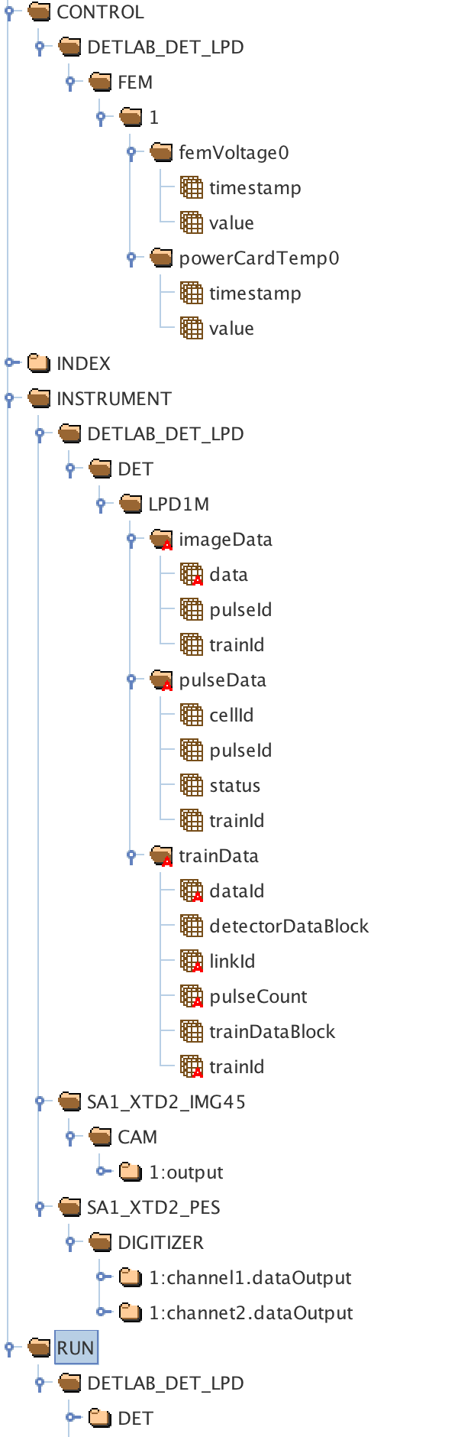

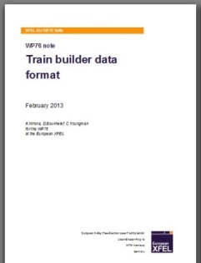
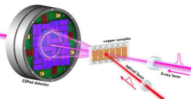
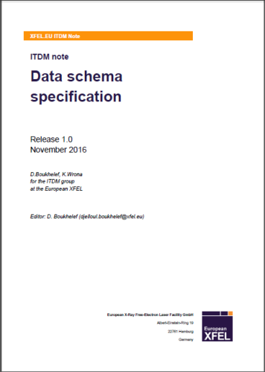
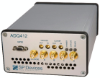
Data Aggregator software status
Control data
  These are parameters of Karabo devices
    Implemented on ITDM and Karabo side
    Requires scalability tests with many Karabo devices – part of the CAS SQUAD
Instrument data
  Data acquired and processed by electronic devices (e.g. uTCA, Train Builder)
    Implemented on ITDM and detector side for both AGIPD and LPD
  Data acquired and sent out to PC layer by software device controlling the hardware via Karabo pipeline (slow cameras, digitizers, fastADC)
    Developments on Karabo side to adjust with agreed specification and a lot of testing
    Any changes to the protocol could imply severe delays
FEM Ctrl device
header
images
PC layer device
descriptor
detector
This is being handled
within CAS SQUAD
Digitizer device
raw
FPGA pre-processed

Slide 8
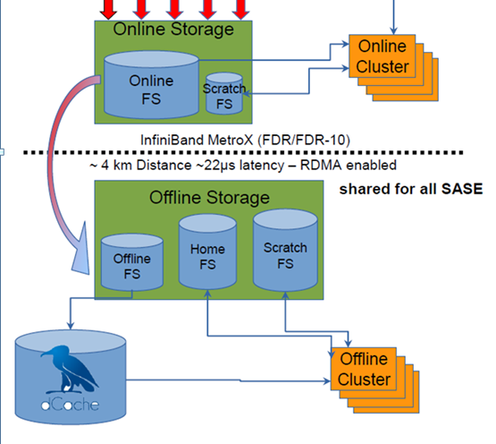
Data processing On Site
Good quality data from the experiments (online storage) is migrated to the XFEL offline data analysis facility located at DESY Data Center
  Ingest buffer, Data archiving
Design of Computing Cluster for data analysis
  Computing Cluster ~300TFlops
  Optimized access to raw data
  Possibility of caching intermediate results on scratch storage
Export of the results or reduced/corrected datasets

Slide 9
Offline data storage
Offline data storage classes
  Raw and calibration data repositories
    commodity storage, distributed system (dCache) with pNFS access protocol
    Raw data files organized according to experiment runs with appropriate ACL (access control list) defined using NFS4.1 ACL
    Planned capacity: 10PB (2017), 56PB (2020), 96PB (2023) + additional SFX: 2PB (2017)
  Archive
    tape backend for data repositories (service provided by DESY, in production)
  Ingest buffer
    receives data from online cache
  Scratch/proc space
    ~3PB provided by XFEL
    used for hot data processing, export of calibrated data, no backup, fast access
  Beamtime store,
    Used for data upload before experiment and storing results
    e.g. 5TB per beamtime, backup
We have changed the names how they appear on the filesystem but the functionality is the same
See next slides

Slide 10
Offline storage
Short name | Folder
“dcache.raw” | /pnfs/desy.de/exfel/raw/<instrument>/<instrument_cycle>/p<proposal_id>
“raw” | /gpfs/exfel/d/raw/<instrument>/<instrument_cycle>/p<proposal_id>/
“usr” | /gpfs/exfel/u/usr/<instrument>/<instrument_cycle>/p<proposal_id>/
“proc” | /gpfs/exfel/d/proc/<instrument>/<instrument_cycle>/p<proposal_id>/
“scratch” | /gpfs/exfel/u/scratch/<instrument>/<instrument_cycle>/p<proposal_id>/
“exp” | /gpfs/exfel/exp/<instrument>/<instrument_cycle>/p<proposal_id>/ /raw -> link to “raw” or “dcache.raw” /usr -> link to “usr” /proc -> link to “proc” /scratch -> link to “scratch”
Users will be given a single “exp” folder per beam time through which all data will be accessible
  Users can only write to “usr” and “scratch”
  “raw”, “dcache.raw” and “proc” are managed by XFEL services. Users have read only permissions
  Links will be managed by XFEL service

Slide 11
Offline storage
Short name | Folder
“dcache.cal” | /pnfs/desy.de/exfel/cal/
“cal” | /gpfs/exfel/d/cal/
“dl” | /gpfs/exfel/d/dl
“user.home” | /home/<user-id>
“exfel.data” | /gpfs/exfel/data/ /<user-id> /<group-id> /scratch
  Special folder for internal XFEL staff: “exfel.data”
  “dl” – Karabo data logger – details to be discussed with CAS
  “cal” and “dcache.cal” – calibration constants managed by calibration catalogue

Slide 12
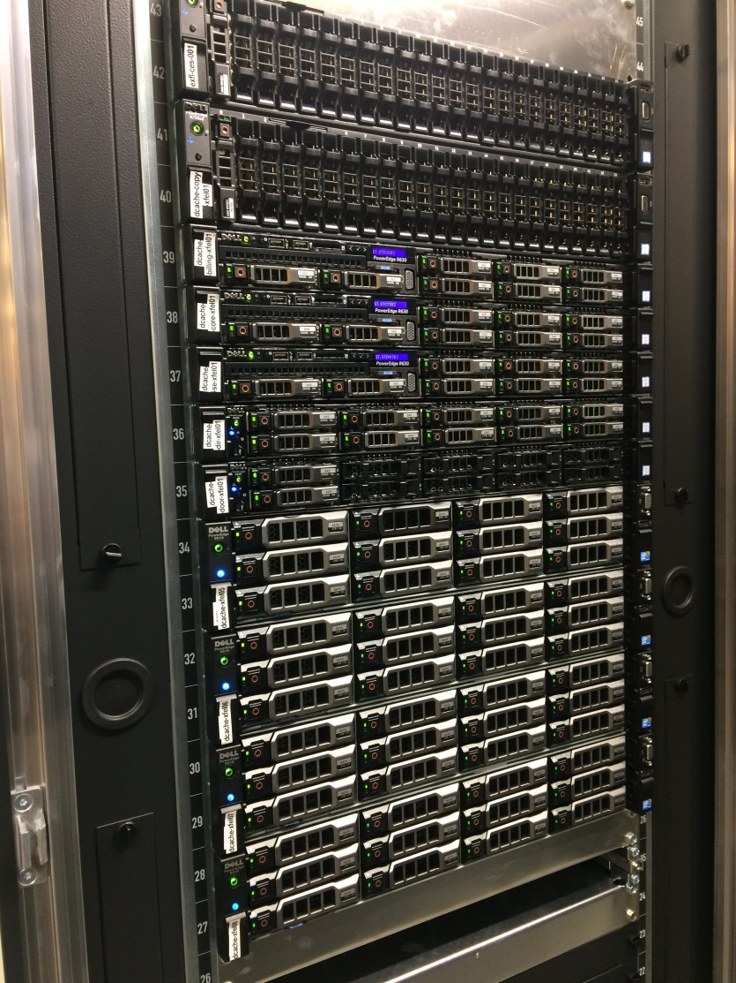
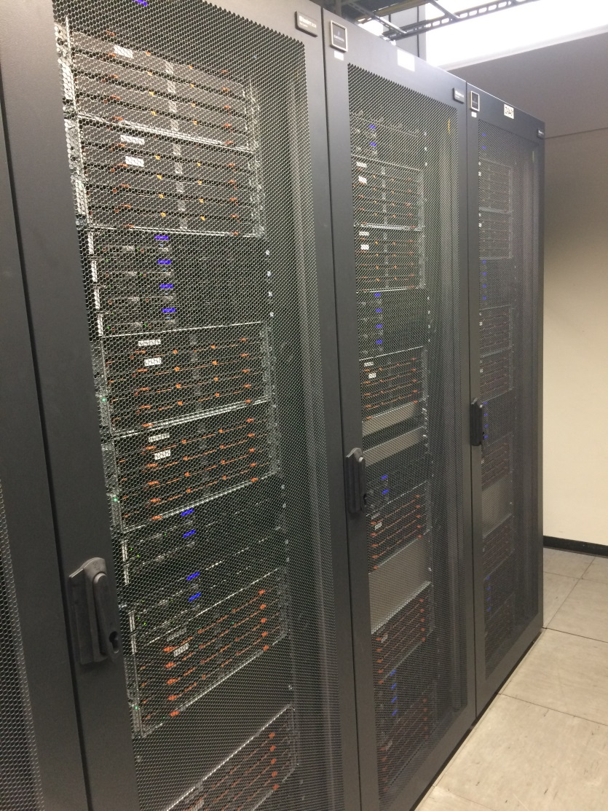
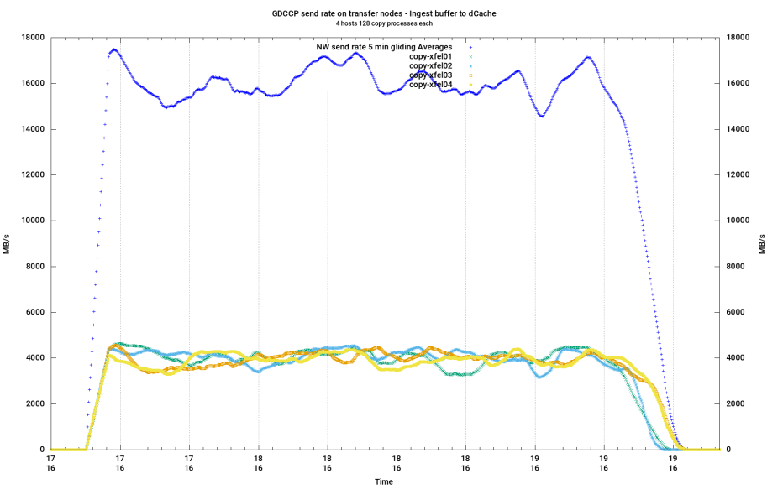
dCache storage
5.5PB of dCache storage deployed
Achieved average data ingest rate over 2 hours: 16GB/s
Core dcache services
dCache storage nodes

Slide 13

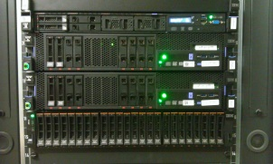
Storage - installation status
Offline – fast data access
  One GL4 system with 4TB disks connected through MetroX with online IB fabrics (used for data transfer tests, 600TB)
  One GL4 system with 8TB disks in production as storage for offline analysis cluster (1.2PB)
  One GS1 for metadata

Slide 14
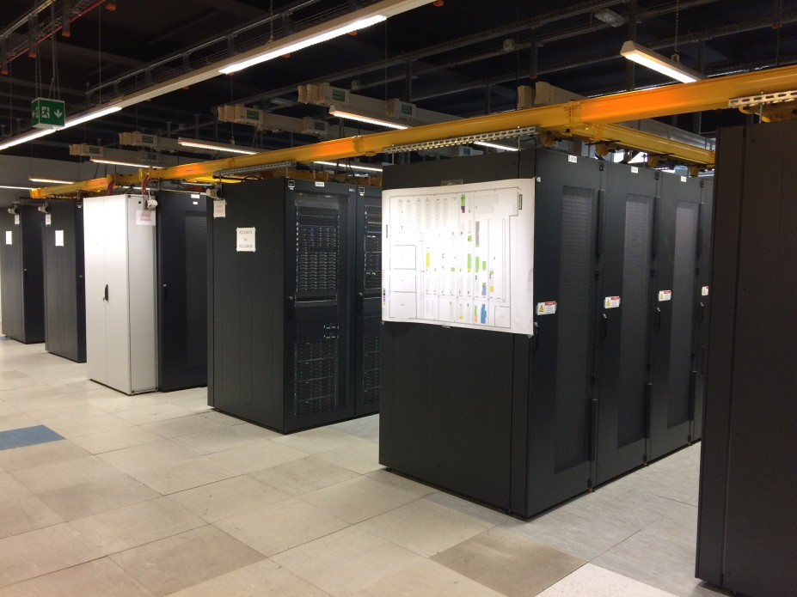
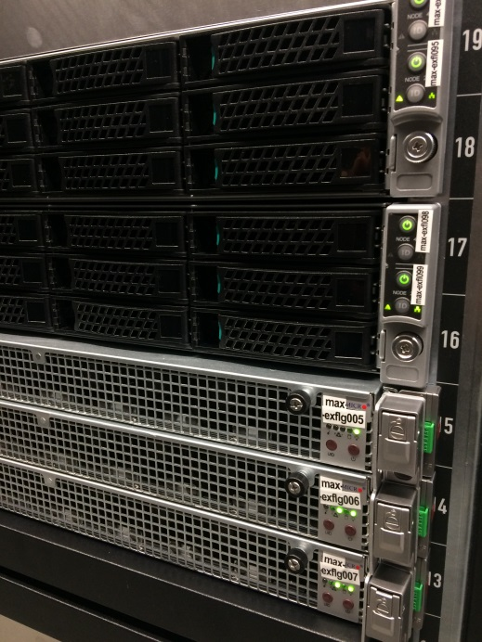
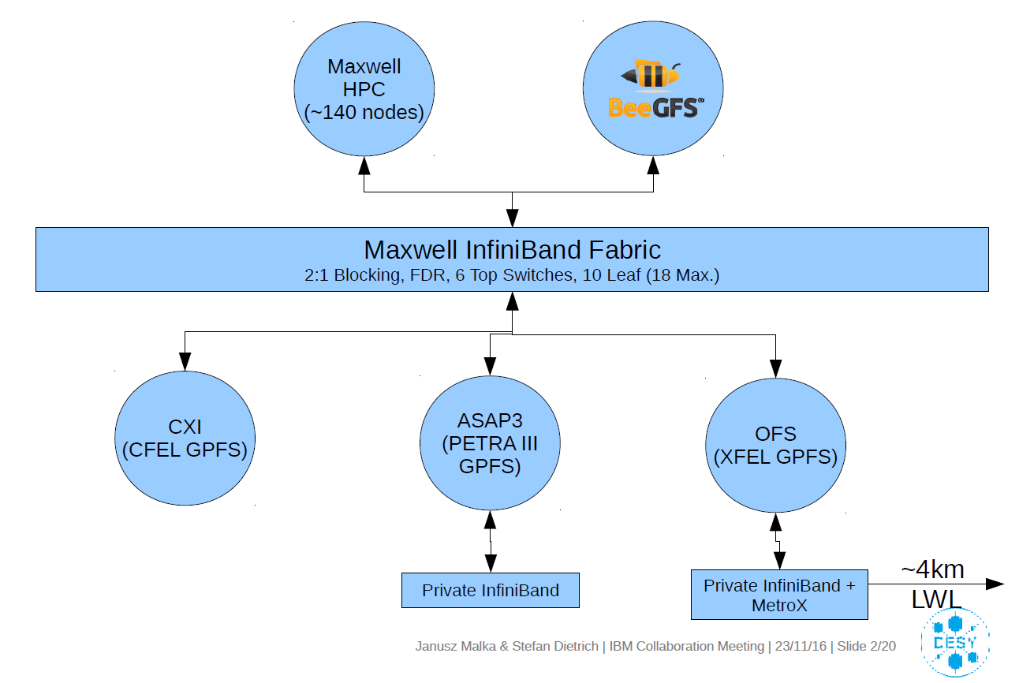
Status of Computing cluster
Recently deployed XFEL resources:
  80 nodes/3200 cores
  ~112 TFlops
  Intel Xeon E5-2698v4
    20 cores, 2.2GHz
  512GB RAM
Overall XFEL resources in Maxwell cluster
  100 CPU nodes
  7 nodes with GPU cards
computing
storage
storage
storage
storage

Slide 15
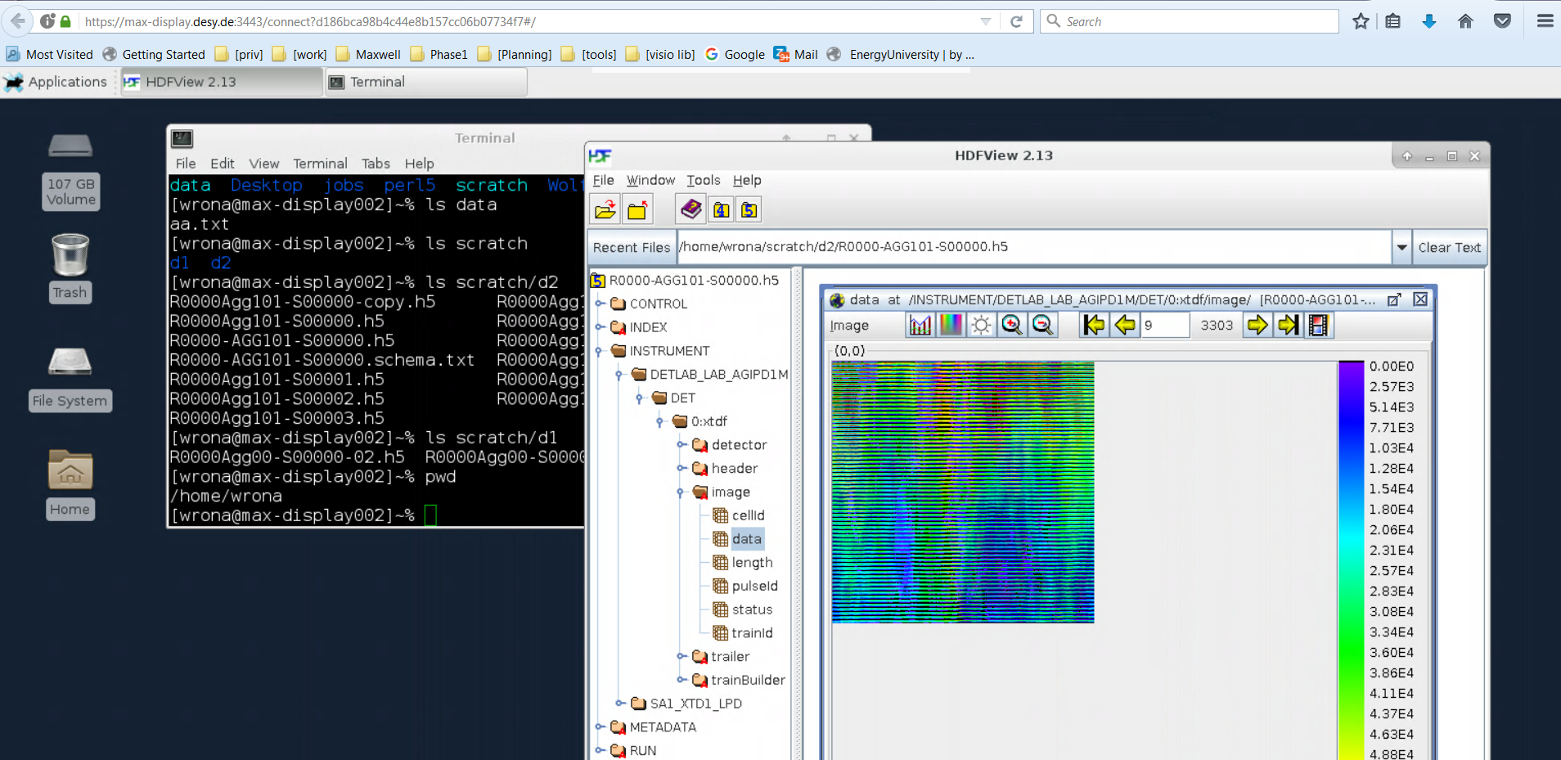
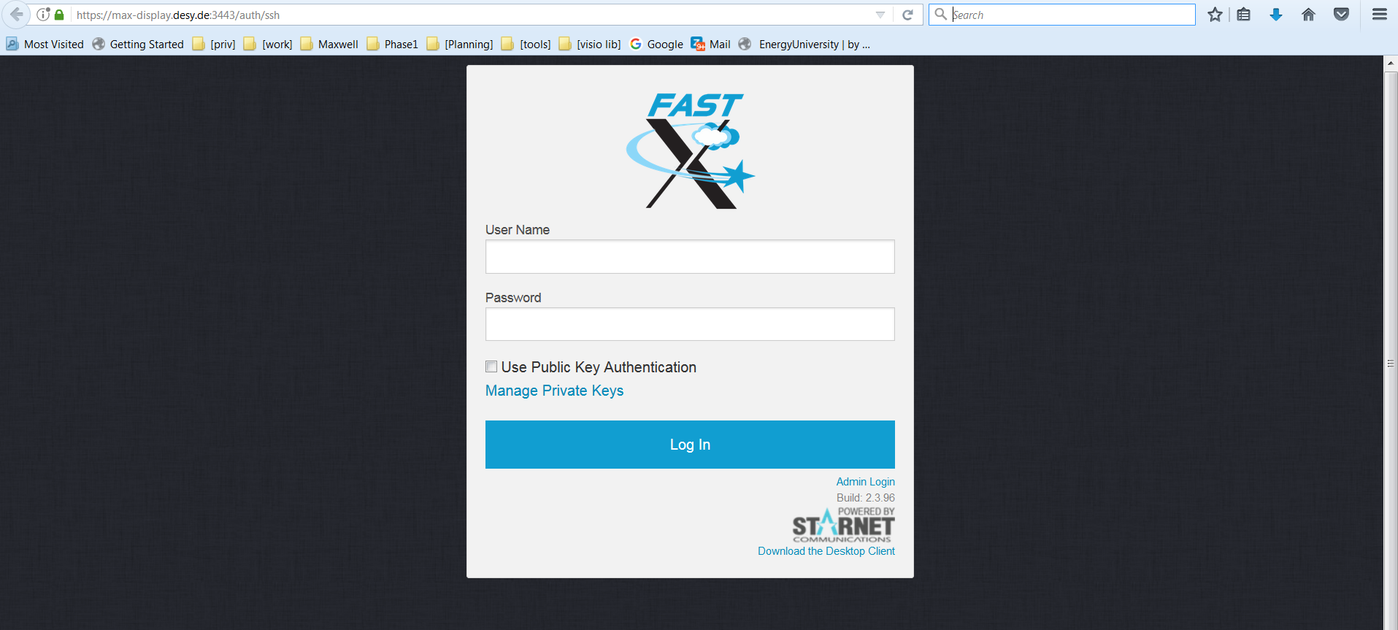
Remote Access
Using FastX in a browser or as an installed client
Dedicated nodes in DMZ, specially monitored for security issues
Dummy data
https://max-display.desy.de:3443/

