Slide 1
79th Section Coordination Meeting XHEXP1
30.6.2017

Slide 2
Agenda
SASE1-3 Status Updates (G. Wellenreuther)
  Regarding safety requirements in SASE1

Slide 3
SASE1

Slide 4
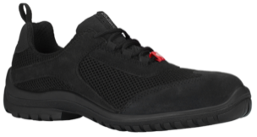
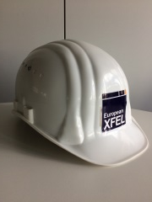
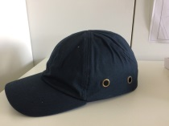
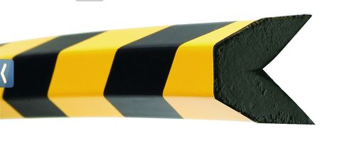
Personnel safety equipment in XHEXP1
In general:
Access only with guide or after finishing the appropriate training.
Pay attention & be careful – in particular SASE3 and SASE2 are still under construction!
Wear helmets & safety boots, carry transponders.
Special rules for ground floor rooms in SASE1 & UN2:
All construction work is done here, so the requirement to carry helmets and to wear safety boots is lifted.
For installation work you should wear safety boots and a bump cap.
For all other activities, sturdy, closed shoes are sufficient.

Slide 5
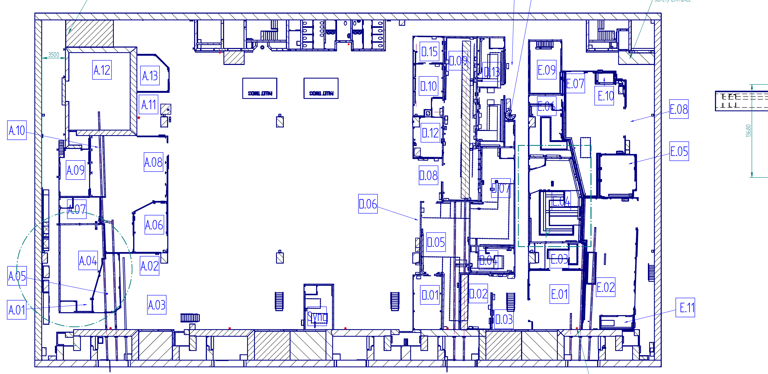
Areas, in which helmets and safety boots might not be required.

Slide 6
SASE3

Slide 7
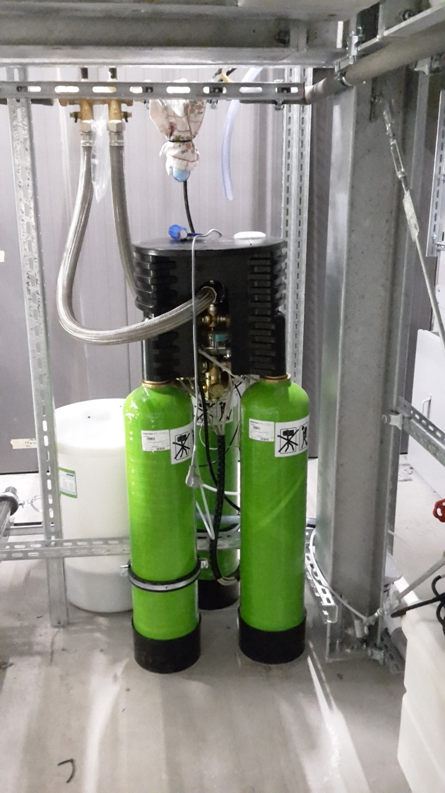
29.6.: Enthärtungsanlage

Slide 8
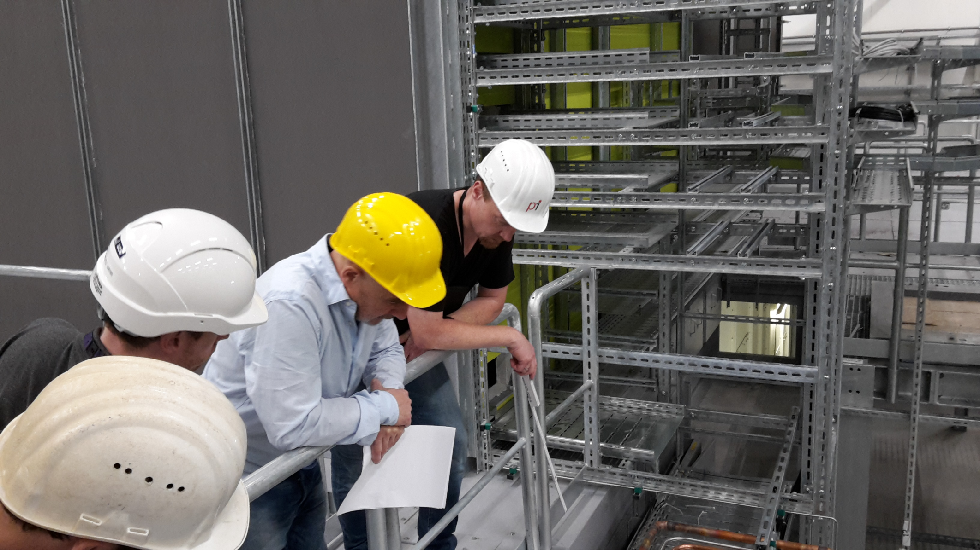
29.6.: Urgent electrical works in SASE3 (and 2) – meeting with Fa. Wille

Slide 9
SASE2

Slide 10
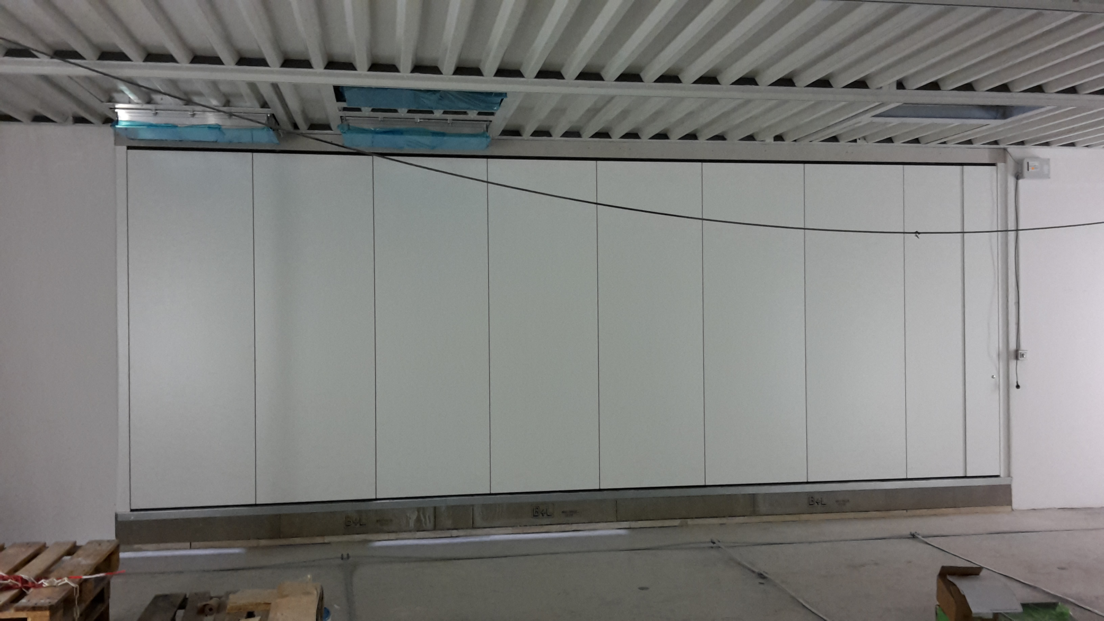
29.6.: Folding door/wall by Dorma

Slide 11
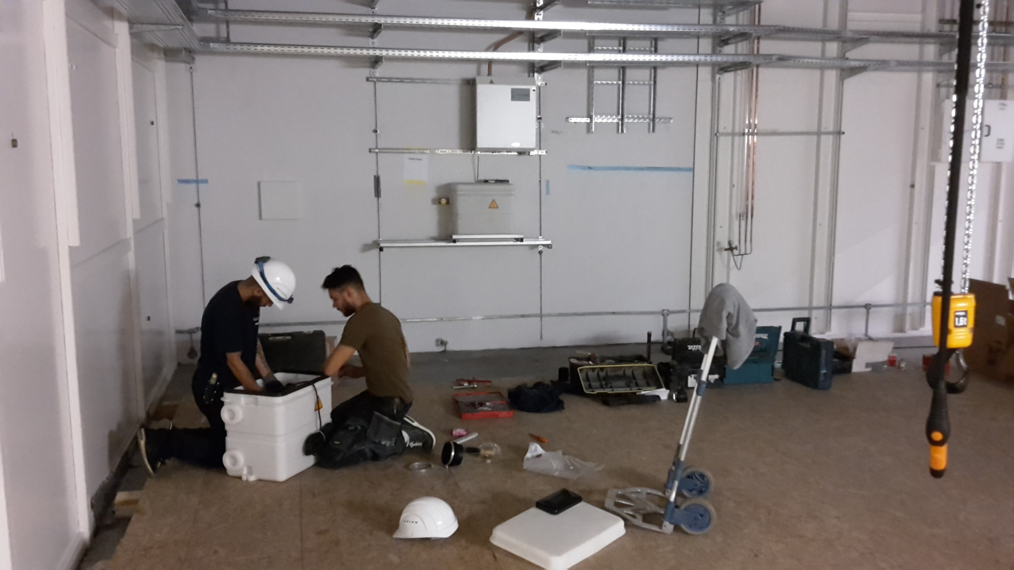
29.6.: Santec installing condensate-pumps in A.08

Slide 12
Tunnel access schedule / upcoming shutdown
Upcoming shutdown week 3.-9.7.
Schedule for the access of the tunnels (PSPO):
https://docs.xfel.eu/share/page/site/PSC/wiki-page?title=Tunnel_access_schedules&listViewLinkBack=true
Schedule of all works during the shutdown week
(D. Nölle, XFEL Logbook):
http://ttfinfo.desy.de/XFELelog/show.jsp?dir=/doc/Schedule&pos=2017-07-03T07:00:00
If your work is not listed, please inform Harald and Dirk!

Slide 13
Upcoming Dates & Meetings
Today, 9:00: SASE1 Readiness
SASE1 Readiness Dispatch
  Mo, Wed 09:30 @ MCR
7.7., 8:30: No meetings (G-20 summit / lots of people telecommuting)
14.7., 8:30: Regular TC meeting
14.7., 9:00: SASE1 Readiness

