Slide 1
MT Management Meeting
Einführung (Ties)
Neuigkeiten aus der Geschaeftsstelle (Ilja Bohnet)
Stand der Diskussionen innerhalb der Themen zur Aufstellung für POFIV (Marc/ Andreas)
Stand der Diskussionen zum neuen Thema DMA (Michael)
Stand der allgemeinen Beiträge zur POF, Vorbereitung des allgemeines talks zu MT in den Begutachtungen (Ties etal)
Diskussion: Wechselwirkung Zentren / Programm: wie koordinieren wir das, um optimal aufgestellt zu sein. (alle)
Diskussionen: wo haben wir mögliche Schwächen (alle)
Planungen MT 2017/ 2018

Slide 2
Strategy Paper I
To achieve our goals we must create the necessary technological preconditions. This generally
involves pushing the limits of the technically feasible. In the coming years, we will address the following
challenges:
Construction and implementation of the experiments for the HL-LHC. The planned high luminosity operation at the LHC confronts the detectors with enormous challenges. Construction and commissioning of the detectors is a central goal of the coming years. Here, DESY will assume a central role in Germany and worldwide.
Development of novel sensors and detector systems for future experiments of particle, hadron and astroparticle physics, and FELs. With the rapidly increasing performance of accelerators and radiation sources and with large new observatories, detector systems and the gain of knowledge from data must keep pace. The number of pixels and the integration density of particles and X-ray detectors massively increase and this allows us to develop detectors of so far unrivalled capacity.
Technology development for the advancement of accelerator facilities. To adapt the accelerator facilities of our research field to the ever increasing user requirements regarding the performance parameters, we develop the superconducting radio frequency technology for the efficient cw operation and we extend our methods and techniques for the diagnosis and control of particle beams.
Demonstration of a compact plasma accelerator for FEL and electron test beams An important step for the use of plasma acceleration is to demonstrate its application in an accelerator under realistic conditions. For this purpose, we develop a concept for this kind of accelerator and our target is to realize – in international cooperation – an accelerator together with the users.

Slide 3
Strategy Paper II
Our experiments produce huge amounts of data which are processed in globally networked infrastructures
(dedicated large-scale computer centers, and Tier-1 GridKa and Tier-2 centers). From
these data, complex algorithms generate new knowledge about the microcosm. Because of its
enormous scientific spectrum, our large-scale facilities as FAIR, XFEL, LHC, CTA and others pose
unique challenges on data management and analysis; from high data rates in the real-time analysis
systems, complex big data analysis methods and algorithms up to data management for heterogeneous
international research groups.
· GRIDKA
The GridKA computer center is the German Tier-1 center and it serves the LHC experiments,
Belle and other communities. The experience from the build-up and operation of GridKa is of
central importance in the development of a mutual plan to master the enormous data handling
and storage challenges in the coming years. A further upgrade is particularly important with regard
to the high-luminosity phase of the LHC.
· TIER2
TIER2 at DESY offers service to the users of the LHC and other communities and it provides
computing power for analysis. It has to be upgraded within the coming years in order to fulfill
the growing requirements of particle physics and photon science. Apart from an increased
need of equipment, the development of intelligent algorithms is also essential to efficiently process
all data.

Slide 4
Dates of center reviews
The center reviews will take place between November 2017 and February 2018:
- HZG (chair Georg Pharr): 07.11. – 09.11.2017
- GSI (chair Hideto Enyo): 21.11. – 23.11.2017 MT
- FZJ (chair Meigan C. Aronson): 12.12. – 15.12.2017 MT
- HZB (chair Andrew Harrison): 09.01. – 12.01.2018 MT
- HZDR (chair Manfred Fiebig): 16.01. – 19.01.2018 MT
- DESY (chair Hugh Montgomery): 05.02. – 09.02.2018 MT
- KIT (chair Andrew Taylor): 13.02. – 16.02.2018 MT
Management meeting Matter zur POF Vorbereitunge / letzten Abstimmung: 19.7.2017

Slide 6
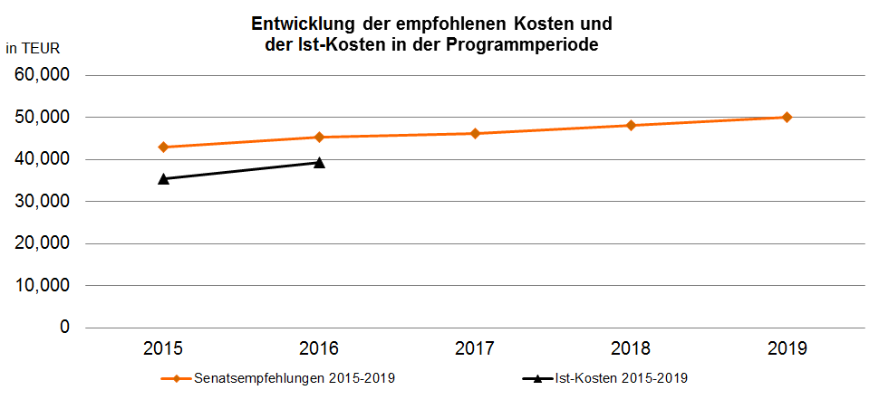
Program development - Indicators
Indicators:
Overall good development, within expectations
Publications
FTE scientists
PhD theses
Still funding below proposal
Redirect funds to XFEL
Delay for bERLinPro
Shifts from personnel to invest

Slide 7
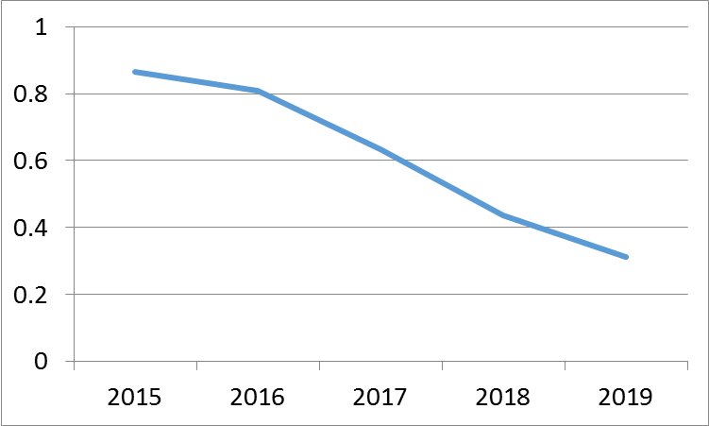
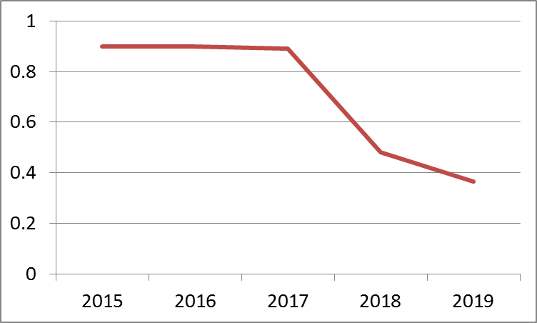
Program development: Milestones
Monitoring of program milestones
About 100 milestones ARD and DTS
Show average degree of readiness
Overall good progress is visible
ARD milestones
DTS milestones

Slide 8
Strategic Recommendations
ARD: Stress Plasma Acceleration:
Significant progress in plasma acceleration
FLASH Forward, LUX are reaching ready-state
Intense effort at many labs
Athena proposal was not prioritized within Helmholtz
Program and Matter is discussing the next steps how to adjust
DTS shall develop a shared infrastructure:
Intense discussions on a distributed detector laboratory (DDL) shared between the partners of DTS
Clear view is developing on focus points
Common post processing facility
Common facility to produce cryogenic detectors
Sharing of test facilities
Details are being worked out, funding is unclear

Slide 9
Shared Infrastructures
ARD
DTS
ATHENA
a distributed infrastructure for plasma wake-field acceleration research
DDL
A distributed detector laboratory providing technologies and facilities to all partners for optimal synergies and common benefit.
Proposal has not been prioritized
New reduced proposal being prepared
Proposal is being worked on, submission etc. to be decided.
We need to re-discuss how to position MT in this area
I would propose that we discuss and decide within MT a coherent approach to this, which minimises negative interference.

Slide 10
Strategic Adjustments
CW operation of SCRF
Successful operation of a module under CW conditions
Nitrogen infused cavities as a way to better cavities
Source R&D and development as part of the SCRF platform
Strong push to understand CW operation now that XFEL construction is “done”
Computing/ Big data
Data play an ever more important role: the detector / the accelerator do not stop after the preamp…
Intense discussions how this can be treated in MT/ Matter
Intend to initiate a new program topic “Data Management and Analytics” (DMA) for POFIV, activities will slowly ramp up during POFIII

Slide 11
New Program structure for POFIV
Matter and Technologies in POFIV
DESY, GSI (HIJ, HIM), HZB, HZDR, KIT
DESY, GSI (HIJ, HIM), KIT
DESY, FZJ, GSI,HZB, HZG, HZDR, KIT
ARD
DTS
DMA
SCRF technology
Sensors, ASICS, Interconnect
Matter Information Fabric
Hadron accelerators
Data Acquisition
Digital Scientific Methods
ps and fs beams
Detector Systems
Digital Experiment and Machine
Novel accelerator concepts

Slide 12
New things in POFIV
Everybody realises that existing cross-topic activities are not working
Matter forum: 1% of research money will be available to program
Governance?
What do we want to do with this
Cooperation with other programs and program areas
Coperation agreement planned with Information

Slide 13
Questions to Reviewers

