Slide 1









Andreas Jankowiak, HZB
Spokesperson ARD
July 10th, 2017
Matter and Technology Management Board
HGF, Berlin

Slide 2
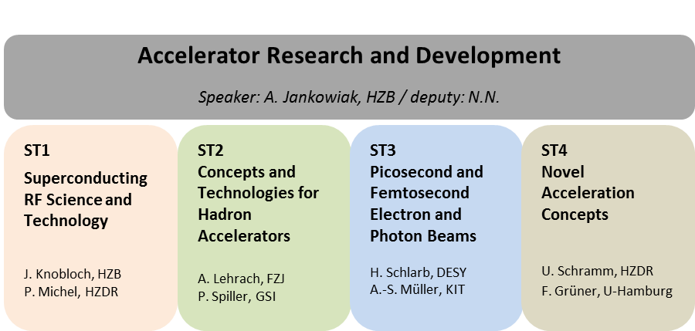








ARD in POF III – Sub-Topic structure
/ deputy Speaker: J. Osterhoff, DESY
DESY
GSI
HIM
HZB
HZDR
FZJ
GSI
HIJ
HIM
HZDR
DESY
FZJ
HZB
HZDR
KIT
DESY
FZJ
GSI
HIJ
HZDR
HZB
KIT

Slide 3
Transition from POF III to POF IV
POF IV: successful ARD structure can be transferred with some adaption (“dynamics”)
Goals and Challenges:
Advance cw SRF systems (Linac/SR) and sources - further mature this technology
R&D for conventional accelerator facilities - pushing to the limits, broadening the scope
Unprecedented beams in terms of intensity, power, brilliance, density, pulse length
Advance novel accelerator technology - demonstrate usability for different applications
ARD test infrastructures (inevitable for our research)
ELBE (HZDR), POLARIS/JETI (HIJ), bERLinPro (HZB), SINBAD/FLASHForward (DESY),
Accelerator Technology Platform (KIT) – in full swing
ATHENA (Phase1, DESY&HZDR), SupraLab (HZB) – coming into full operation
Harvesting the fruits we nurtured in POF III

Slide 4
ARD POF IV structure
ST1
CW SRF Science
and Technology
ST4
Novel Accelerators
and their Applications
LINACs, SR, ERLs
Bright sources (compact) / injectors
From development to maturity
Novel Accelerators and their Applications
“Zukunftsthema” PWA (IVF) successful
ST2
Concepts & Prototypes
for the Advancement of
Conventional Accelerators
ST3
Advanced beam controls,
beam diagnostics, and
beam dynamics
broadening the scope
FAIR et al. needs to be addressed
ultra short pulse challenge
unprecedented beams
spectral flux

Slide 5
ARD challenges in POF IV (Strategy Paper)
Scientific Challenges / Technological Challenges
Exploring the physical limits of particle acceleration
We must further optimize accelerator technology in order to keep the existing and future
user facilities as European XFEL and FAIR at the top of global research. For future experiments,
we will generate and characterize particle beams of highest density, highest performance,
highest brilliance and ultra-short pulse length in the attosecond range. The further development
of the superconducting accelerator technology continues to be a central challenge.
Exploring the physical mechanisms of plasma acceleration
The acceleration of charged particles opens the way to novel ultra-compact accelerators.
Much progress in the understanding of accelerator mechanisms and physics of plasma is
necessary to bring this revolutionary technology to application maturity.
Technology development for the advancement of accelerator facilities
To adapt the accelerator facilities of our research field to the ever increasing user requirements
regarding the performance parameters, we develop the superconducting radio frequency
technology for the efficient cw operation and we extend our methods and techniques for the
diagnosis and control of particle beams.
Demonstration of a compact plasma accelerator for FEL and electron test beams
An important step for the use of plasma acceleration is to demonstrate its application in an
accelerator under realistic conditions. For this purpose, we develop a concept for this kind
of accelerator and our target is to realize – in international cooperation – an accelerator
together with the users.

Slide 6
ARD in POF IV – open questions
Implications of
- KIT (Accelerator Technology Platform)
- FZJ (closing COSY?, contributions to FAIR?, new activities?, in different program?)
Implications of
- start of XFEL operation
- FAIR status
Implications of
- German/European roadmap process (PETRA IV, FLASH cw, BESSY III, DALI,
XFEL, …)
- LEAPS Technology Roadmaps
Pilots in 2018/2019 (15 Mio€), Full Phase 2020+ (350 Mio€, 7a), incl. Matching
Talent management:
Implementation of a mandatory mentoring system for PhD students (cross centre)?
Implementation of a “Joint ARD/DTS Helmholtz Graduate School”?
(six centres, two institutes, many partner Universities = strong foundation)
Including mentoring systems / courses for selected engineers and technicians?

Slide 8
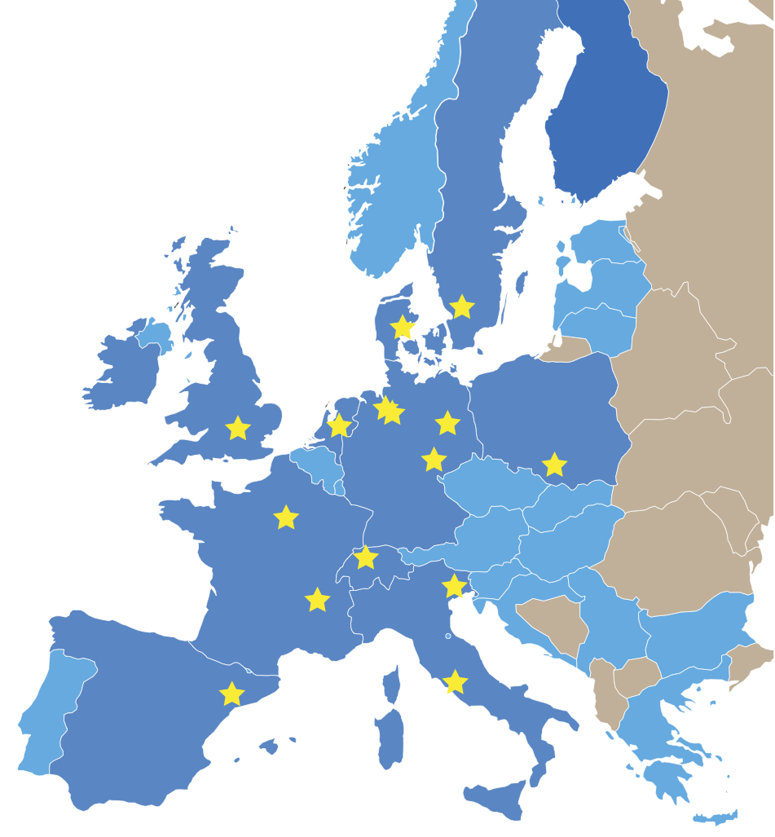

















LEAPS - League of European Accelerator-Based Photon Sources
Launched: 2015
Chair: H. Dosch
(co-chairs A. Harrison, C. Quitmann)
Members: 15 Photon Facilities in EU
European Synchrotron User Organization

Slide 9
LEAPS - League of European Accelerator-Based Photon Sources
Goals:
Secure EU leadership for decades
Coherent Roadmap of all SR and FEL facilities in EU
Strong & diverse user community
Best practice
Push & disseminate technology
Integration & sustainability
Enable excellent science
Next generation light sources
Open science
LEAPS Charter
LEAPS Strategy Document (Nov 2017)
LEAPS kick off event / Brussel 13.11.2017
Pilot Phase 2018/2019 ??
Input to EC FP 9 2021-2027

Slide 10

LEAPS - Organisation
Members
European
Synchrotron & FEL
User Facilities
Advising bodies
Associates
Synchrotron and FEL Facilities outside Europe
Upcoming User Facilities
Review
Bodies
General Assembly
Members and Associates
LEAPS Chair
LEAPS
Working Group 1
Beamline technology
LEAPS
Working Group 4
Industry & Innovation
LEAPS
Working Group 5
Standardized Access
& Best Practice
LEAPS
Working Group 6
EDU, Training, Outreach
LEAPS Office
LEAPS
Working Group 2
Accelerators
LEAPS
Working Group 3
Data Management & Software
Research Organisations
Neutrons, Lasers, ELI, …
ATTRACT, …
ESUO
CALIPSO +
Universities
ESUO
Partners
Tasks
(tbd)
Tasks
(tbd)
Tasks
(tbd)
European LEAPS Conference
Erice ?
Topical Workshops
Summerschools
Working groups
FELs of Europe
...
Notes:
Original title of working group 1: „Detectors, Optics, Sample Environment“

Slide 11
LEAPS - Technology roadmap process
Need to define technology roadmap, valid for 7 years, starting 2020/21
→ extrapolate from the present activities (funded upgrades) to a more distant future
→ take into account the needs of upgrades of existing facilities presently under study /
preparation / discussion
(most likely some of them will start before outcome of Technology Roadmap is there)
→ take into account the needs of “new facilities”
→ do that as a joint activity, demonstrating that we are able and willing to join
forces (together with industry) to advance our field
→ identify and define common requirements and standards
→ concentration (?) on some major “technological developments”

Slide 12
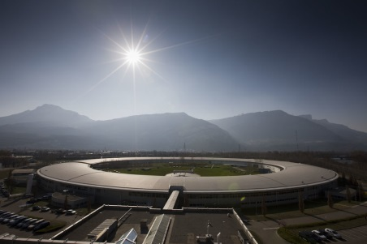
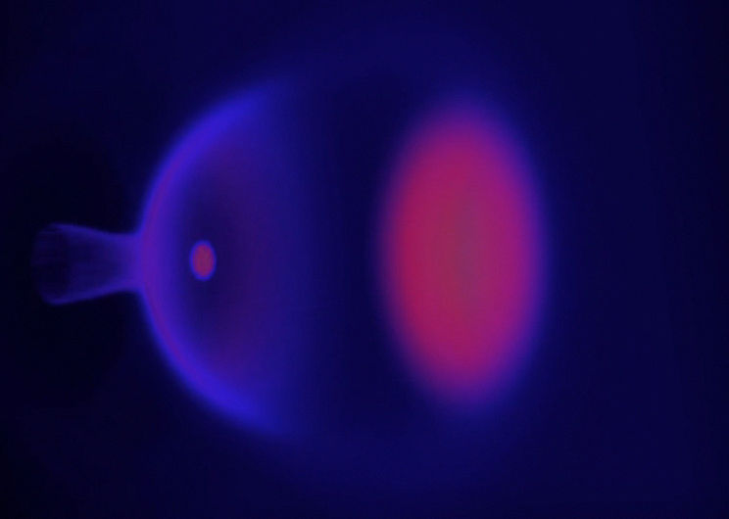
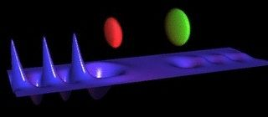
LEAPS - Accelerator technology roadmap process
Why?
Europe has a longstanding excellence in accelerator technology
and a network of world class accelerator based photon user facilities.
Europe has a world-leading accelerator, fast electronics & laser industry enabling accelerator innovation.
How?
Develop accelerator technologies and concepts for
i) ultimate brightness photon beams from synchrotrons and FELs
ii) Reach control and resolution in the attosecond time -, and Angstrom length regimes
iii) Develop compact, laser based accelerator technologies towards user readiness
What is the cost?
What is the benefit?
Coordinated European investment in accelerator R&D for photon science application will foster the European lead in a highly competitive international environment.
Enable new applications in industry, hospitals and small laboratories
Ca. 170 Mio€ for joint R&D on Synchrotrons and FELs
Ca. 45 Mio€ on joint R&D for compact sources (R&D related to EuPRAXIA DS

Slide 13
Accelerator technology roadmap – Work Packages I
Proposal | Submitting Authors | Labs interested in R&D | Total cost estimate Mio€ | Topic S=synchroton F=FEL C=compact source
Short period insertion devices | M.E. Couprie (SOLEIL) T. Schmidt (PSI) | SOLEIL, PSI, DESY, ELETTRA, ESRF, HZB, Diamond, Maxlab, ALBA, ANKA | 33.4 | S,F,C
High Gradient/Field magnets with very small aperture | P. Tavares (MAXLAB) | ALBA, ASTRID, HZB, Elettra, DESY, ESRF, MAX IV, PSI, SOLEIL | 10.6 | S,C
Seed laser systems | M. Danailov (ELETTRA) | DESY, ELETTRA, EU-XFEL,HZDR, LNF, PSI | 3.5 | F
Electron bunch control (advanced bunch compressor, Laser heater, collimation) | S. Di Mitri (ELETTRA) | DESY, ELETTRA, EU-XFEL, MAXLAB, PSI | 2.9 | F,C
Advanced schemes for tailoring FEL pulses | S. Werin (MAXLAB) E. Allaria (ELETTRA) | ELETTRA, PSI, DESY, SOLEIL, MAXLAB, Eu-XFEL, DESY | 14 | F, C
Low emittance Photo-injectors (cw/sc and pulsed/nc) | T. Kamps (HZB) | HZB, DESY, HZDR, PSI, ELETTRA, LNF, MAXLAB | 12 | F,C
LEAPS accelerating techniques cwRF | H. Weise (DESY) | DESY, EUuXFEL, NCNR (Poland) | 6.1 | F
FEL tests stand (either stand-alone or attached to existing FEL) | M.E. Couprie (SOLEIL), B. Faatz (DESY) | SOLEIL, DESY, ELETTRA, PSI | 24-41 | F
Tunable high power THz source for Eu-XFEL | Frank Stephan (DESY Zeuthen) | DESY, EU-XFEL (+ large number of potentially collaborating universities) | 5 | F
Very small aperture vacuum chamber | T. Schmidt (PSI) C. Herbeoux (SOLEIL) | ALBA, DESY, PSI, ANKA, SOLEIL, DIAMOND, MAXLAB | 10 | S,F

Slide 14
Accelerator technology roadmap – Work Packages II
Proposal | Submitting Authors | Labs interested in R&D | Cost estimate Mio€ | Topic S=synchroton F=FEL C=compact source
Injection systems for low dynamic aperture rings (kicker and pulser) | R. Bartolini (DIAMOND) | ALBA, Elettra, DESY, HZB, ESRF, MAXLAB, PSI, SOLEIL | 6.5 | S
sc / nc cavities for bunch length control + RF systems | Jens Knobloch, Andreas Jankowiak (HZB) | ALBA, DESY, HZB, MAX IV, SOLEIL | 15.9 | S,F
Diagnostics and Feedback for advanced photon beam stability | G. Rehm (DIAMOND) R. De Monte (ELETTRA) | DIAMOND, Elettra, HZB, MAX IV, ESRF, PSI, SOLEIL | 8.9 | S,F
Sub femtosecond timing and synchronization | S. Hunziker (PSI) | PSI, DESY, ELETTRA | 2.5 | F,C
Joint R&D on compact plasma accelerator for photon science (context EU design study EuPRAXIA) | R. Assmann (DESY), M. Ferrario (INFN), U. Schramm (HZDR) | DESY, INFN, HZDR, ..., EuPRAXIA (EU) Consortium (38 institutes) | 45 | C
Total sum both tables ca. 217 M€
It is expected, that own contributions in the order of 20 to 50% are necessary

Slide 15
Accelerator technology roadmap – Pilot Projects
Maybe EU commission is willing to finance (from existing, not spend money) a
LEAPS pilot phase (35 Mio€ (?) in total, 10 - 15 Mio€ (?) for technology roadmaps
starting 2018
Ideas for Pilot Projects
Comparative study of undulator technologies and future requirements
towards a coherent R&D program for short period devices
Survey of injector technologies and future requirements
towards a coherent R&D program for low emittance/high brightness injectors
Laser systems as power drivers for plasma acceleration/industry involvement
Define R&D roadmap towards a PM magnet only demo storage ring

Slide 16
LEAPS Technology Roadmaps - Overview
LEAPS Technology Roadmaps (ca. 350 Mio€ / 7a, including own contributions)
Chairs: Edgar Weckert (DESY), Jean Daillant (SOLEIL)
1) Beamline Technology – Edgar Weckert / Jean Daillant
(Optic components, mirrors, gratings, detectors, sample preparation / environment, …)
2) Accelerator Technology – Hans Braun (PSI)
FEL – Thomas Tschentscher (XFEL)
Storage Rings – Andreas Jankowiak (HZB)
Compact Accelerators (aka PWA) – Ralph Assmann (DESY)
3) Data Management and Software – Mark Heron (Diamond Light Source)

Slide 18
Interaction Centre / Programme in the Review
Somewhat late to influence review
documents
Review Documents are in preparation
and (as I expect) in an advanced state
(HZB will sent to SAC end of July)
Not too late for evaluation
Maybe use list of activities in ARD and DTS
and always refer to!
What is done in the centre under evaluation?
Which whom is it done?
What is not done in the centre?

Slide 20
News from ARD
BESSY VSR – fully funded since June 2017
Total of 29.4 Mio€, thereof:
  10.1 Mio€ own contribution HZB
  7.5 Mio€ State of Berlin / EFRA = SupraLab@HZB
  11.8 Mio€ HGF Strategic Invest (HGF Senat, 05.06.2017)
Schedule:
  First module (2 x 1.5 GHz) in 2020/21
  Full installation (2 x 1.5 GHz + 2 x 1.75 GHz) in 2021/22

Slide 21
News from ARD
ATHENA - Senat Commission Matter strongly pushes for realisation of ATHENA
(reduce scope and costs, re-submit, HGF (=Matter ??) should made funds available)
Re-Submitted / Applied for ATHENA Phase I end of June 2017
Phase I: two common flagships ATHENA-e and ATHENA-p (2019 – 2022, only 1a delay)
17 Mio€ strategic invest and increased own contribution of 3.95 Mio€
Participating centres: DESY & HZDR
Collaborating centres and partners: FZJ, HI Jena, KIT, HZB
TU Dresden, U HH, U Strathclyde
Phase II: applications for science, medicine, industry will be developed, start 2021 or later

Slide 22
News from ARD
ARD Workshops and others (many are missing in INDICO)
ARD ST1 workshop
Perspectives on Photocathode Lasers for Photo Injectors, HZDR, 11.04.2017
ARD ST3 workshop
5th ARD ST3 Workshop – MaT, DESY Zeuthen, 19.-21.07.2017
Workshop (ARIES)
Topical Workshop on Injection and Injection Systems, HZB, 28.-30.08.2017
Workshop
Verbundforschung in der Physik der kleinsten Teilchen, KFB – TU Da, 31.08 – 01.09.2018
Workshop (could/should be an ARD-ST1 workshop)
Operating SRF-systems reliably in a “dirty” accelerator, HZB, 14.-15.09.2017
Workshop
European Workshop on Photocathodes for Particle Accel. Apl. – EWPAA 2017,
HZB, 20.-22.09.2017

Slide 24
4th Matter and Technologies Days 2018, HZB / Berlin
Will take place with some gap to the centre evaluations:
Monday, 11.06.2018 till Thursday, 14.06.2018
(can be shifted by 1d if required)
preparing for 40 students (?) and max. 200 participants
Mo., 11.06.18 | Tu., 12.06.2018 | Wed., 13.06.2018 | Th., 14.06.2018
Student Retreat | 1st Plenary Day | ARD&DTS parallel | 2nd Plenary Day
12.00 – 20.00 + Tu., 09.00 – 12.00 - Welcome - Talks + Guests - Poster session - Reception / Outing | 12.00 – 19.30 – 21.00 - Registration - Plenary talks - Speed talks - Poster session - Reception | 09.00 – 18.00 – 22.00 - ARD&DTS parallel - MB meeting - Tours - Dinner (Berliner Buffet) | 09.00 – 14.00 Plenary talks Close Out
HZB (lecture hall) | WISTA, A´hof, Bunsen Saal & HZB (evening) | HZB (lecture hall + “cinema”) | WISTA, A´hof, Bunsen Saal

Slide 25
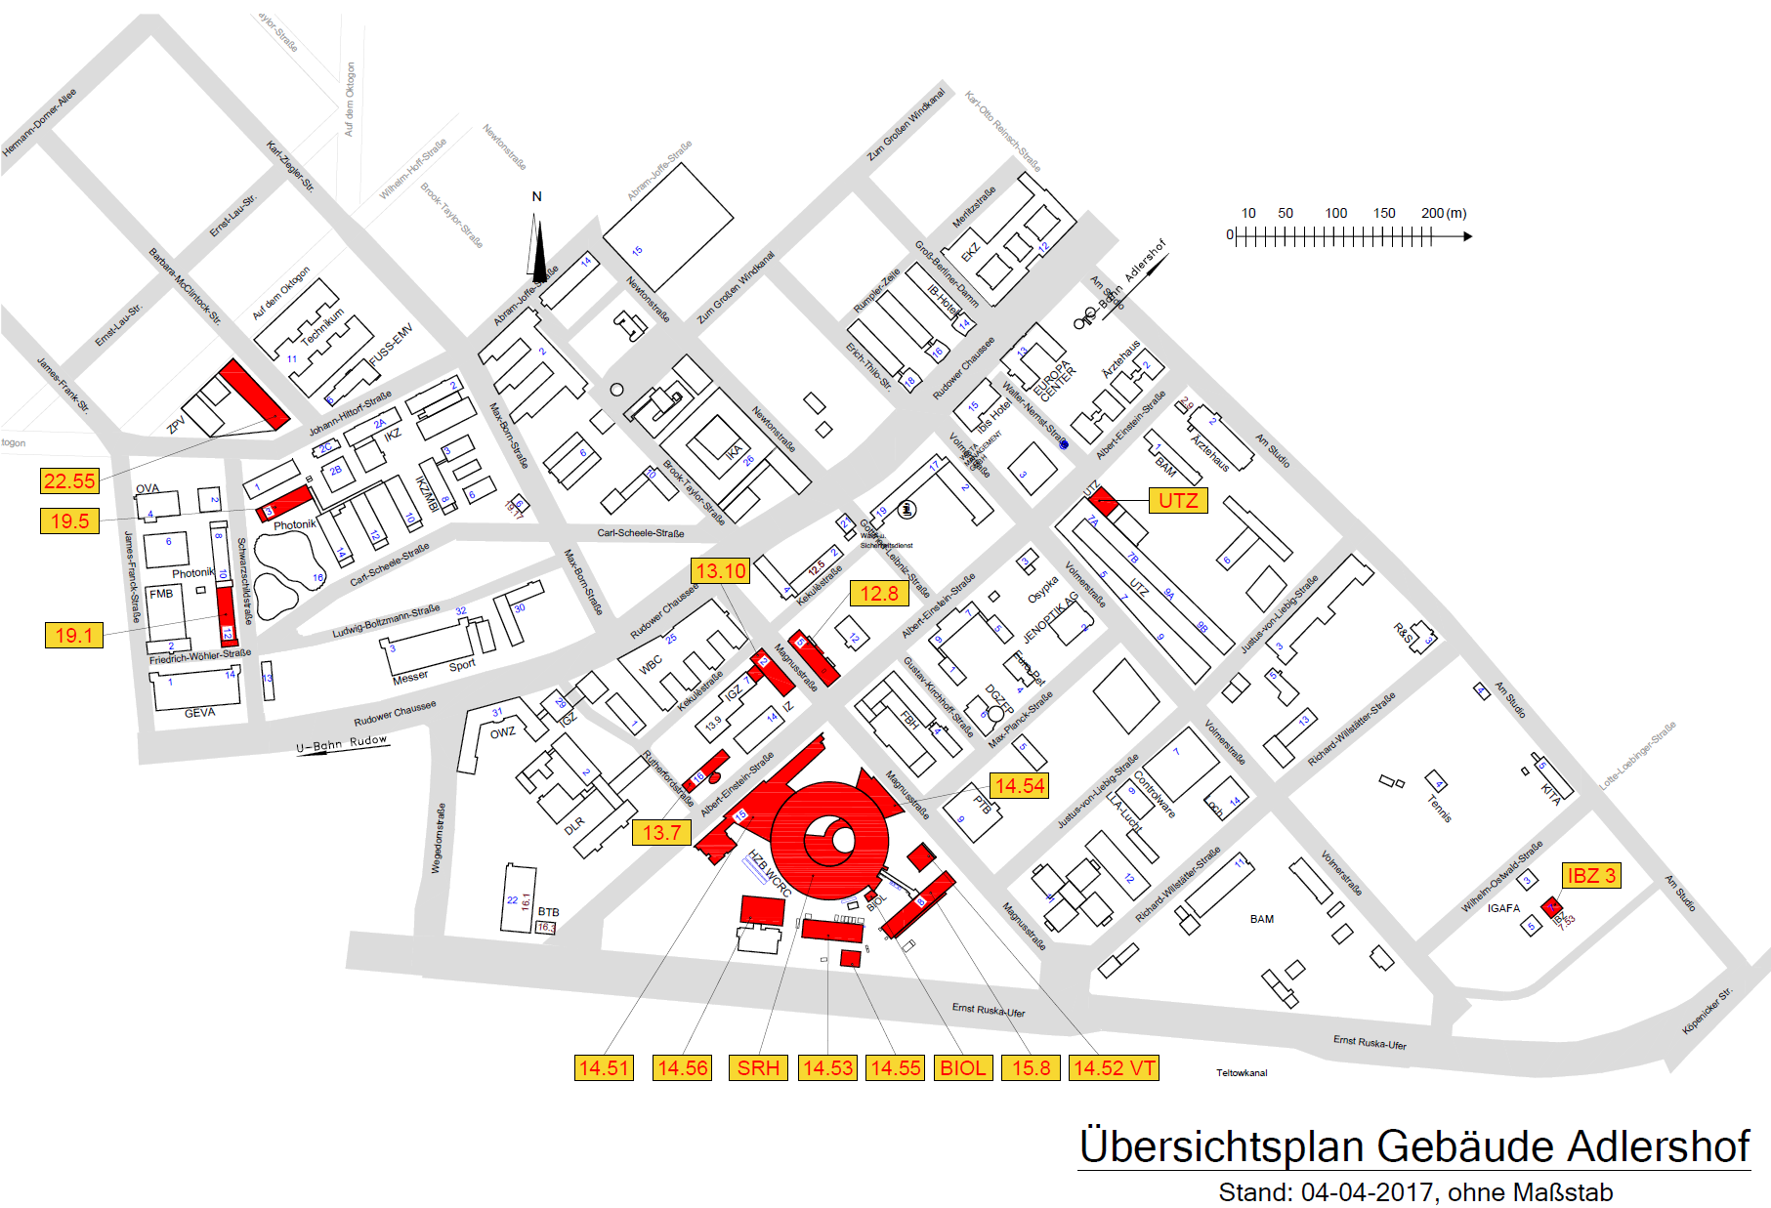
4th MaT Days 2018, HZB / Berlin - Venue
S-Bahn station
Adlershof
Day 1 and day 3
Registration, plenary sessions, coffee
(200 people, “parlamentarische Bestuhlung”)
Student retreat, day 1 evening and day 2 parallel sessions
Reception, posters, ARD&DTS parallel sessions (2 x 100 people), coffee,
MaT MB meeting, tours, dinner

Slide 26
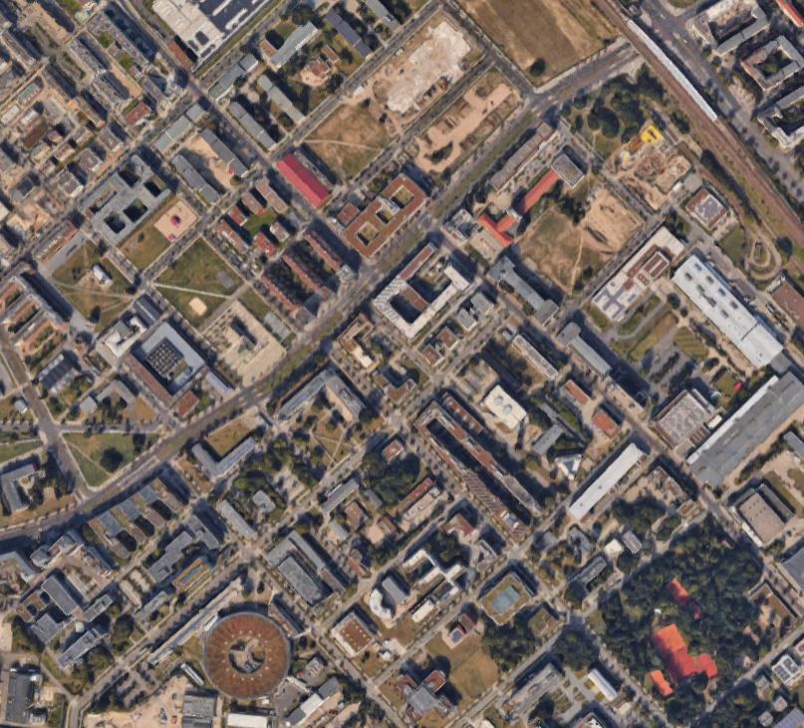
4th MaT Days 2018, HZB / Berlin – Restaurants, Hotels
Hotels in
Köpenick,
ca. 10min with Tram
S-Bahn
Adlershof
Hotels
Restaurants
Mensa, HU

Slide 28
DESY in POF IV
ST1 - CW SRF Science and Technology
next generation SRF linac technology beyond state of the art (XFEL)
(injectors, sources, high Q at high gradients)
ST2 - Concepts & Prototypes for the Advancement of Conventional Accelerators
R&D on advanced concepts and beam dynamics in storage rings
(e.g. XFEL-O in large SR, extreme beams - DLSR beyond present beam energies)
ST3 – Advanced beam controls, diagnostics, and dynamics
advanced beam control for ultra fast science
(dynamics, diagnostics, synchronization at the 1 fs level)
ST4 – Novel Accelerator Concepts and their Applications
making PWA and dielectric microstructure acceleration usable (reproducibility/stability)
(SINBAD / ATHENA exploration)

Slide 29
FZJ in POF IV
ST2 / ST3 Concepts & Prototypes / Advanced beam controls, diagnostics, and dynamics
push further into the precision frontier
TDR for deuteron EDM storage ring, ultra high precision beam position monitoring,
development of electrostatic beam deflectors and multipoles
stochastic cooling for low energy deuteron beams
beam dynamics of light ion beams and co-propagating electron beams
space charge compensation (FAIR interest), bunched electron cooling (cooling high energy
beams)

Slide 30
GSI in POF IV
ST1 – CW SRF Science and Technology
CW Linac for heavy ion beams
(multigap-crossbar H-field, new preparation techniques – HPR, BCP, Ar-disch., e-pol.)
ST2 – Concepts & Prototypes for the Advancement of Conventional Accelerators
hadron ring accelerators
(fast, sc high field magnets (6T, 1 T/s), highest intensities, high beam quality, diagnostic,
deceleration)
nc hadron linacs
(cw injectors, sources, high res. spectrometer, cw RFQs, high power RF, stripping, diagnostics)
ST4 – Novel Accelerator Concepts and their Applications
(LPWA, acceleration of LPWA beams, time resolved studies of accel., ion acc. with mass
limited targets)

Slide 31
HZB in POF IV
ST1 - CW SRF Science and Technology
Mature SRF Photoinjectors as viable Sources for Accelerators
high current, short pulses, low emittance, robust ctahodes, flexibility&reliability
drivers for compacts Accelerators, FELs and ERLs
Mature CW SRF at highest Q, highest Fields / Transfer to Industry
understand and mature procedures&processes to maximize Q in accelerators
advance materials to full cavities towards “1-W, 4-K SRF systems”
simplifiy complex. mach. designs, cost reduction, established productions steps
ST2 / ST3 - Concepts & Prototypes / Advanced beam controls, diagnostics, and dynamics
Exploration of VSR for highest flexibility in user operation and for DLSRs
beam dynamics, bunch separation, bbbtbt diagnostics, CW SRF at diff. frequencies
Exploration of bERLinPro
flexibility, reliability, beam loss management, different applications
R&D on advanced concepts and beam dynamic in storage rings / 2025+ Light Sources
beam dynamics, bunch separation, bbbtbt diagnostics, CW SRF at diff. frequencies
ST4 – Novel Accelerators and their Applications
Advanced Insertions Devices

Slide 32
HZDR in POF IV
ST1 - CW SRF Science and Technology
Development of SRF Photoinjectors
ST3 - Advanced beam controls, diagnostics, and dynamics
Development of beam diagnostic systems, integrate POFIII DTS activities
high data rate detector systems, ….
HIBEF development issues
ST4 – Novel Accelerators and Applications
High power laser development
Laser acceleration research
HIBEF development issues

Slide 33
KIT in POF IV
ST2 / ST3 - Concepts & Prototypes / Advanced beam controls, diagnostics, and dynamics
Accelerator Technology Platform: ANKA, FLUTE, and related technologies
test bed for photon science technology development, SCU development for FEL and DLSR
(industry cooperation)
PICCOLO mode of FLUTE – towards attoseconds science
fs and below pulses, stability & reproducibility, diagnostics, feedback, synchronization,
THz TCAV, laser pulse shaping, low emittance gun, compression, phase space lineariser
Strengthen beam diagnostic R&D
use accelerator technology platform, sensor networks, feedback, controls
data science & advanced ICT (big data, deep learning)
ST4 – Novel Accelerators and their Applications
Continue and strengthen IVF “Plasma Accelerators” activities
LPWA for FEL and as Injector, very large acceptance storage ring
understand cosmic accelerators in the lab.

