Slide 1
Data Management & Analysis in MATTER

Slide 2
Data Management & Analysis (DMA) A new Topic in MT, a cross-programme activity in MATTER, a role model in Helmholtz
fosters research in MATTER by digital methods
new methods arise from the needs of researchers in MATTER
new methods are created by world-leading scientists in MATTER
new methods are adapted to research in MATTER, giving new insights
brings together domain scientists, method scientists & IT
cross-department, cross-domain, cross-disciplinary effort needed
fosters exchange of knowledge, methods & solutions
within MATTER (cross-programme activity)
with FB INFORMATION
within Helmholtz
nationally & internationally

Slide 3
Data Management & Analysis in Matter & HGF
HGF
FB Materie
FB Information
MU
MT
MML
P1: Von Daten zu Wissen und Handeln
DMA
DMA a cross-programme activity in MT (ARD,DTS)

Slide 4
Overview of DMA
The Digital Scientific Method
(ST2)
The Digital Experiment & Machine
(ST3)
The Matter Information Fabric
(ST1)

Slide 5
The Matter Information Fabric Digitalization of large-scale facilities
Development of big data management systems and infrastructures for the outstanding large scale facilities within Matter
Development of special systems for the extreme big data ingest and transport from detectors and sensors
Development and adaption of new technologies within/to Matter
Adaption of identification systems and access rights management according to standard solutions
Adaption of new resource provisioning models to Matter
Developments for the organisation of facilities like proposal systems etc.
Intelligent user interfaces and scientific gateways for the large facilities in Matter
Development of Open Access/Open Data strategies
Data formats (Open data formats, standardization, meta data)

Slide 6
The Matter Information Fabric Digitalization of large-scale facilities
Development of big data management systems and infrastructures for the outstanding large scale facilities within Matter
Development of special systems for the extreme big data ingest and transport from detectors and sensors
Development and adaption of new technologies within/to Matter
Adaption of identification systems and access rights management according to standard solutions
Adaption of new resource provisioning models to Matter
Developments for the organisation of facilities like proposal systems etc.
Intelligent user interfaces and scientific gateways for the large facilities in Matter
Development of Open Access/Open Data strategies
Data formats (Open data formats, standardization, meta data)

Slide 7
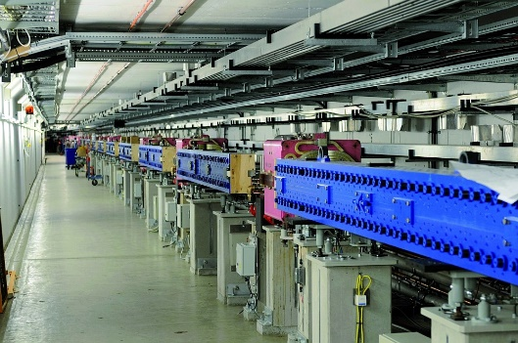
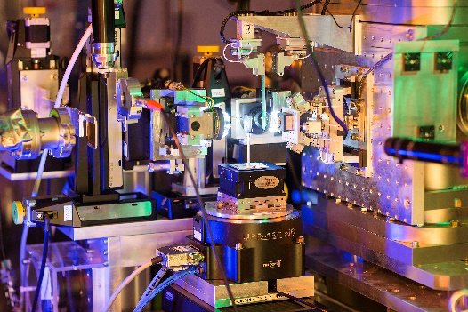
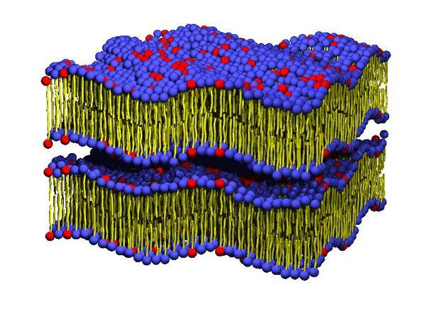
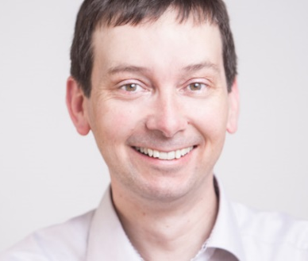
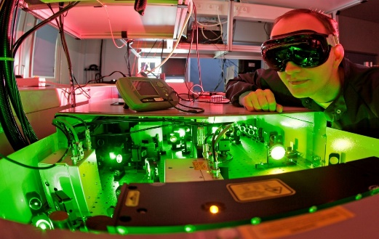
Example 1: Data Ingest
Data
from a large variety of source
of varying rate (streaming, event, slow/fast)
of varying volume
of varying priority
…
Particle Physics
Astro-particle Physics
Photon Science

Slide 8
The Digital Scientific Method Analysis, Modeling and Algorithmic Development rooted within Research in Matter
Strong Integration of Modeling, Simulation, Experiment & Analysis in a single, digital loop
Development and application of state-of-the-art methods for forward and inverse problems (e.g. Machine learning in Imaging, Simulations)
Development and application of algorithms & techniques for in-situ, realtime analysis of data at high rates
Development and application of algorithms & techniques for data reduction and treatment
Development of digital workflows specific to applications in Matter
Adaption of generic and existing data mining tools for applications in Matter
Development of Visualization tools/analysis tools for Matter specific applications

Slide 9
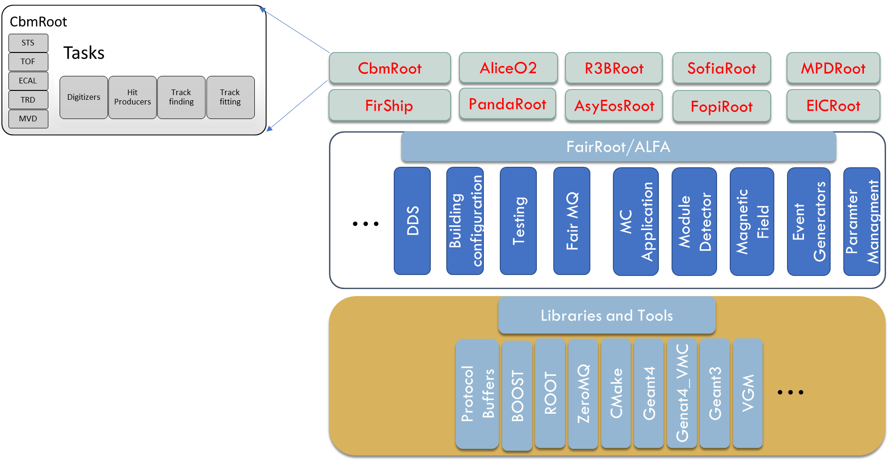
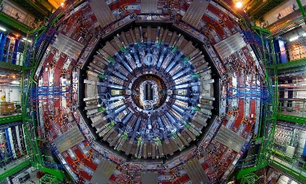
Toolsets vs. Frameworks
Track finding
Monte Carlo validation
Event displays
….
Collaboration vs.
Facility vs.
Single User View

Slide 10
The Digital Scientific Method Analysis, Modeling and Algorithmic Development rooted within Research in Matter
Strong Integration of Modeling, Simulation, Experiment & Analysis in a single, digital loop
Development and application of state-of-the-art methods for forward and inverse problems (e.g. Machine learning in Imaging, Simulations)
Development and application of algorithms & techniques for in-situ, realtime analysis of data at high rates
Development and application of algorithms & techniques for data reduction and treatment
Development of digital workflows specific to applications in Matter
Adaption of generic and existing data mining tools for applications in Matter
Development of Visualization tools/analysis tools for Matter specific applications

Slide 11
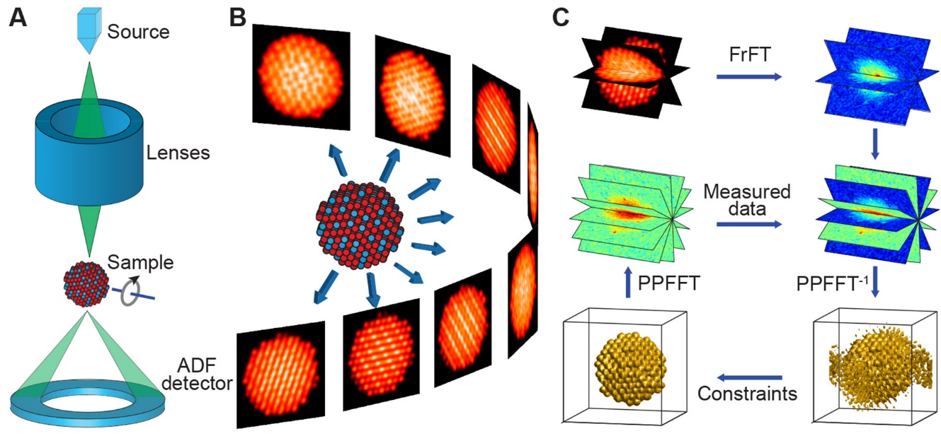
Example 2: Real time 3D+X Tomography
HI Jena
with Cryo-TEM in Diabetes Research
with Sychrotrons in Materials Research
with HHG sources in Biology
with XFELs in Plasma Physics
with Bremsstrahlung in Fluid Physics
…
Large, cross-disciplinary spread

Slide 12
The Digital Experiment & Machine Analysis, Modeling and Algorithmic Development rooted within Research in Matter
Development of start-to-end simulation systems for experiments
Development of realtime systems/fast feedback systems for experiment control
Development and adaption of fast and specific systems for the online and offline analysis of high data rates and volumes
Meta data systems for data taken at the large facilities of Matter
Data preservation and long term management of data and the analysis software
Introduction of common software to the communities
Models for data policies, f.i. ownerships

Slide 13
The Digital Experiment & Machine Analysis, Modeling and Algorithmic Development rooted within Research in Matter
Development of start-to-end simulation systems for experiments
Development of realtime systems/fast feedback systems for experiment control
Development and adaption of fast and specific systems for the online and offline analysis of high data rates and volumes
Meta data systems for data taken at the large facilities of Matter
Data preservation and long term management of data and the analysis software
Introduction of common software to the communities
Models for data policies, f.i. ownerships

Slide 14
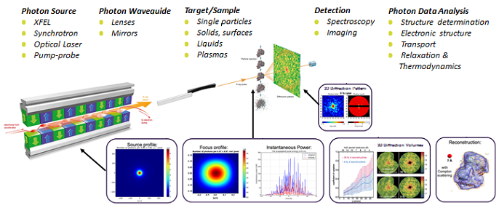
Example 3: Start to End Simulations
Hugely important for large-scale facilities

Slide 15
Topic DMA and Programme P1 in INFORMATION
FB „Materie“, Topic DMA in MT
FB „Information“, Programm „Von Daten zu Wissen und Handeln“
FZJ
DESY
Computational & Data-Intensive Science
The Matter Information Fabric
Methods, Algorithms & Tools
GSI
Big Data Analytics
The Digital Scientific Method
Supercomputers, Big Data Systems, Strategic Infrastr.
HZB
The Digital Experiment & Machine
Security, Privacy, and Dependability of IT-Systems
HZDR
From Knowledge to Action
HZG(TBC)
KIT
Together with Information, Matter can pioneer in
creating structures that foster knowledge exchange

Slide 16
Topic DMA and Programme P1 in INFORMATION
FB „Materie“, Topic DMA in MT
FB „Information“, Programm „Von Daten zu Wissen und Handeln“
FZJ
DESY
Computational & Data-Intensive Science
The Matter Information Fabric
Methods, Algorithms & Tools
GSI
Big Data Analytics
The Digital Scientific Method
Supercomputers, Big Data Systems, Strategic Infrastr.
HZB
The Digital Experiment & Machine
Security, Privacy, and Dependability of IT-Systems
HZDR
From Knowledge to Action
HZG(TBC)
KIT
Together with Information, Matter can pioneer in
creating structures that foster knowledge exchange

Slide 17
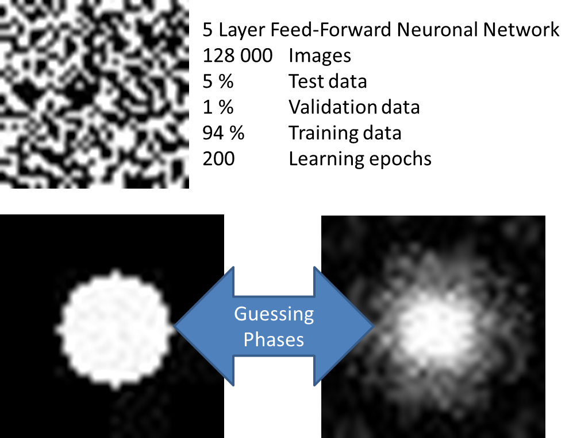
DMA & INFORMATION P1
Example: Machine Learning
Method research in INFORMATION
Adapt methods to applications in MATTER (e.g imaging, accelerator optimization)
Competence needed on both sides
Requires structure & governance

Slide 18
Bringing DMA to life
Structure
Size (estimated 40-50 FTEs)
Connect to centers (Key people identified, need to find researchers)
Content (Subtopics identified, content under discussion)
Exchange (IT vs. Method Scientists vs. Domain Scientists)
Governance (Subtopic speakers, connection to MU/MML/MT, INFORMATION)
‚First light‘ projects
Why wait for POF4?
3-4 FTE size projects possibly financed by additional resources
Proposals!
Pilote project within Helmholtz
Draw Experience from ARD/DTS, connect to Incubator-Process

Slide 19
Bringing DMA to life
Structure
Size (estimated 40-50 FTEs)
Connect to centers (Key people identified, need to find researchers)
Content (Subtopics identified, content under discussion)
Exchange (IT vs. Method Scientists vs. Domain Scientists)
Governance (Subtopic speakers, connection to MU/MML/MT, INFORMATION)
‚First light‘ projects
Why wait for POF4?
3-4 FTE size projects possibly financed by additional resources
Proposals!
Pilote project within Helmholtz
Draw Experience from ARD/DTS, connect to Incubator-Process

Slide 20
Status of current activities
List of current subjects of common interest in DMA sent around, feedback in end of July, answer from FZJ (Neutrons) already received
List also includes potential contacts for certain areas of interest at centers
In parallel visits to all centers to identify key people (visited DESY in end of June, going to GSI tomorrow)

