Slide 1
SASE1 - Karabo Control
Sandor Brockhauser
CAS
Schenefeld, 14/07/2016

Slide 2
From 2.1.11 (May 18) to 2.1.12 (June 8)
GUI:
Close ALL scenes and macros when the project closes
Always allow scenes and macros to be closed
Fix: Only display check mark next to active device configuration in project tree
Make sure min/max values are min<max (#16087)
Fix: Update device status in navigation panel correctly
Code: Clean up navigation panel data model
Fix: Don't show a message box when opening from DB
Fix: Don't resize scene views when not intended.
Search filter for navigation panel
Add a "Revert Changes" action for scenes
Booleans can use trendline now in gui
Enable duplication of scenes by resetting the UUID (#17195, #17083)
Fix valueChanged in displayimageelement
Fix a race condition with schema injection and the GUI (#16852, #16826)
Grayed out alarm acknowledge buttons not clickable anymore (#17202)
Remove alarm/warn labels correctly whenever the device is in normal state again (#17332, #17336)
ML:
Fix dropping of broker messages
Speed up message consumption
Fix: Assure proxies unregister when owning device dies
Show proxies nicely in iKarabo
Fix that node elements of ML devices do not raise an exception in the validator (#17203)
Fix: Make logging work in onInitialization
Framework:
Performance: Don't let GUI greedily subscribe to pipeline outputs
Fix unit tests for hostnames with dots
Fix data logging problems concerning the initial configuration (#16835)
Integrate AGIPD SQUAD changes (!1647)
Allow PEP 440 pre-release tags
Use daemontools to manage Karabo server processes
Fix writing scenes after UUID reset
Improve schema retrieval of DataLogger (fully async now)
Fix the Python integration tests
Deployment: Make sip relocatable
Kill bound API process if device server dies
Add set/get/has DaqDataType to the bound API
Add commandline tools for killing and removeing device servers
Add a server control webserver
Deployment: Add libquadmath to Karabo
Add interlock unit tests for state behavior
Make sure python device server gets killed properly
Debug: Monitor and archive GuiServerDevice performance by default.
Debug: Add process id to logs and expectedParameters (bound Python and C++)

Slide 3
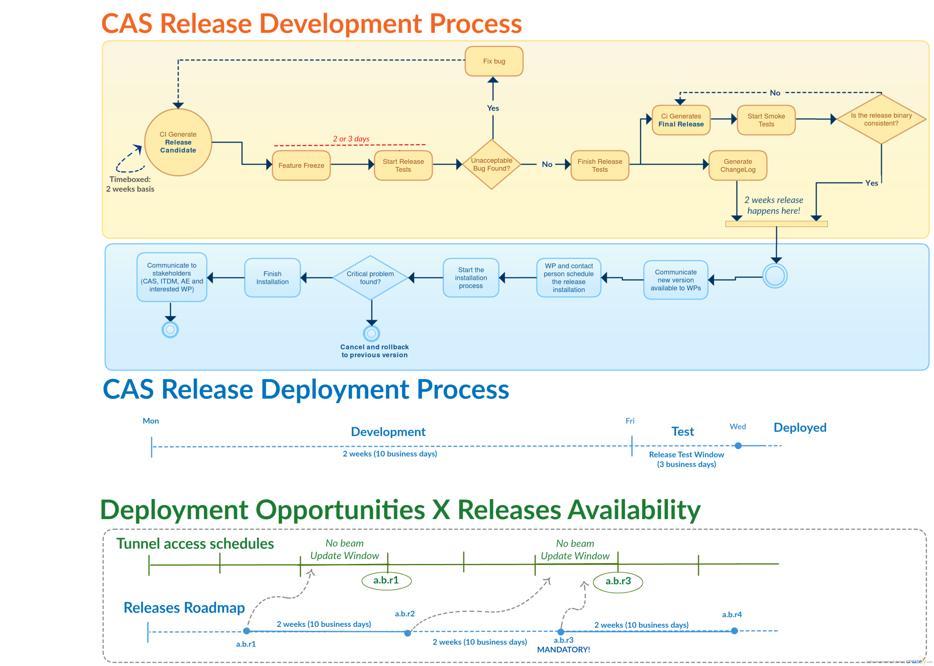

Slide 4
Changes towards the Planned 2.1.13
CORE FIXES:
Fix the eXistDB installation
  Fix karabo.project_db unit tests
  Merge branch 'updateTimeClasses' into 'master'
  Merge branch 'fix/webserver' into 'master' to support daemontools
  Only connect ONCE to device.signalStatusChanged
  Fix a rename missed when merging
  Added karabo_deprecated decorator to karabo.common
  NDArray support for the middle layer
  Allow attribute updates to read-only parameters
  Stop using the config shell script for project DB domain
  Merge branch 'fix/sparkline_index_error' into 'master'
  Don't use 2.0.3 for Python package versions
  Merge branch 'limitdecimals' into 'master'
  Fix python device server kill
  Attribute updates are not forwarded to devices
  Upgrade to daemontools-encore
  Fix found unprotected access to schema and configuration
GUI:
Several fixes related to alarm feature (icon, tests, high/low combo)
  Fix evaluation of middlelayer device alarm handling
  Fix evaluation of python device alarm handling
  Proper handling of server or device shutdown for alarms
  New GUI splash screen
  Fix GUI segfault
  Publish and remove in the instanceInfo
  GUI: Allow scenes to have widgets for injected properties
  GUI: Improve the error message when scene links are broken
  Don't bump the model when initializing plot views
  GUI: Show the monitoring icon in the project panel too
  Change popup widget windowsflag for mac users (but mac is still not supported)
  GUI: Add match case and use regular expression option to navigation panel
  GUI: Show only one dialog when GUI busy before closing
  GUI: Popup flags for expected user experience
  GUI: Use list widget to show possible scenes to select from for scene link
  GUI: Rearrange the tree widget deck chairs
  GUI: Cleanup tree widget items
  Add network i/o monitoring to the GUI server
  Fix of state color field working with non state string
OTHER FIXES AND IMPROVEMENTS:
Make SingleBit match the style of ColorBool widgets
  Add the ability to find a node which contains a given string
  Save the last configuration directory after saving configuration
  Clean up the installation of OpenMQ
  Finish removing the var/config/config
  Move time ticks processing to the DeviceServer
  Improve 'macroserverconfigurable'
  C++ wxternal updates need actual timestamp with trainid.
  Remove old syntax support for waitUntilNew
  Fix DataLogger concerning schema updates
  list device id as command line parameter
  Add asyncConnect for C++ to get rid of need to block threads.
  Apply configurations loaded from file
  Minor data log issues
  Allow bind_weak for const member functions
  Support new syntax for queue
  Support the use of asyncConnect in DataLogger
  Add timeout argument to the 'getAvailableSlots' call.
  Fix locking mutex twice
  Use an Enum for DeviceStatus

Slide 5
Next Priorities
Bugfixes for Improved Stability
DAQ Integration
MiddleLayer Devices and ScanTool
FXE / SPB EuE Projects

