Slide 1
80th Section Coordination Meeting XHEXP1
21.7.2017

Slide 2
Agenda
SASE1-3 Status Updates
Update: Safety gear in XHEXP1
Electrical Safety

Slide 3
SASE1

Slide 4
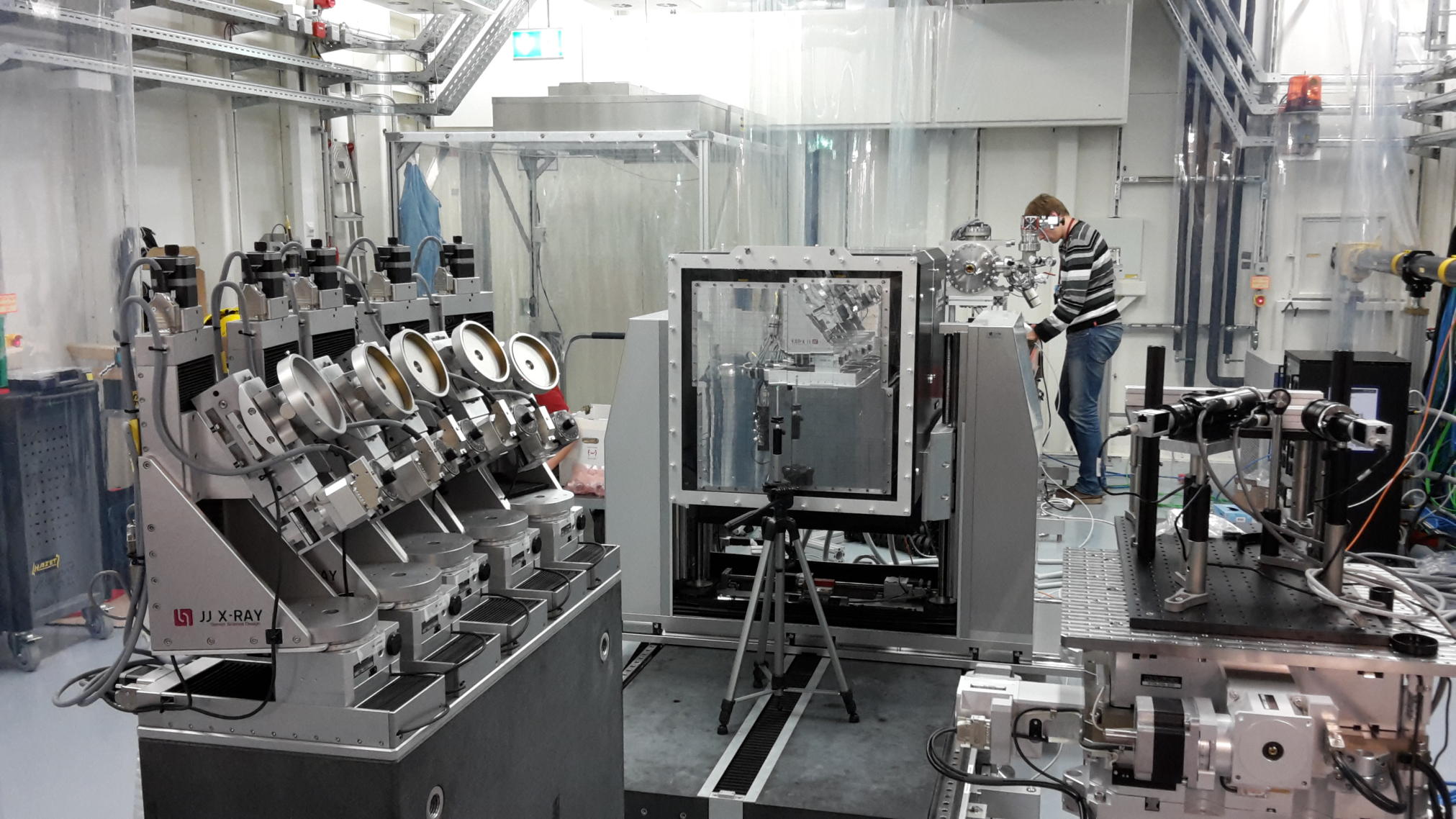
18.7.: LPF @ FXE

Slide 5
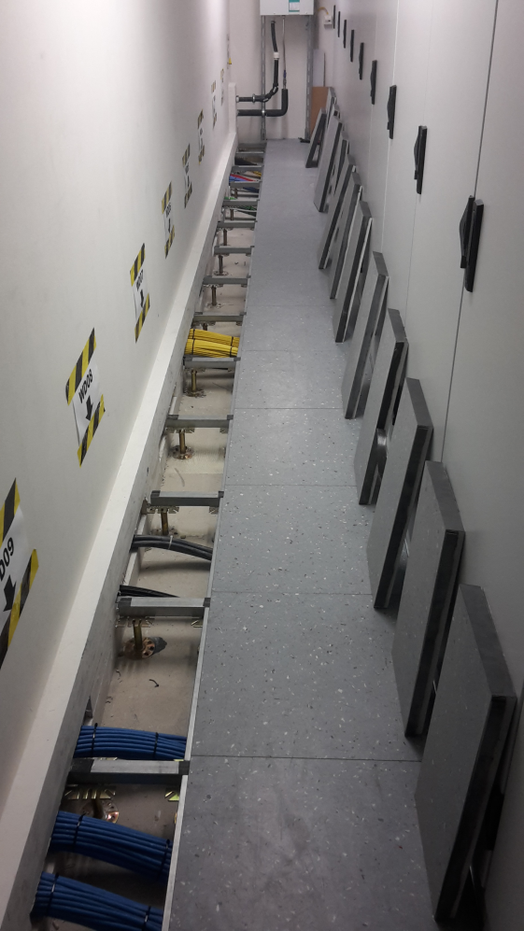
Status Update SASE1
Company svt
  is working in the rackrooms to close the cutouts.
  Smoke detection is switched off due to dust being potentially created.
  Works will be finished until 11.8.

Slide 6
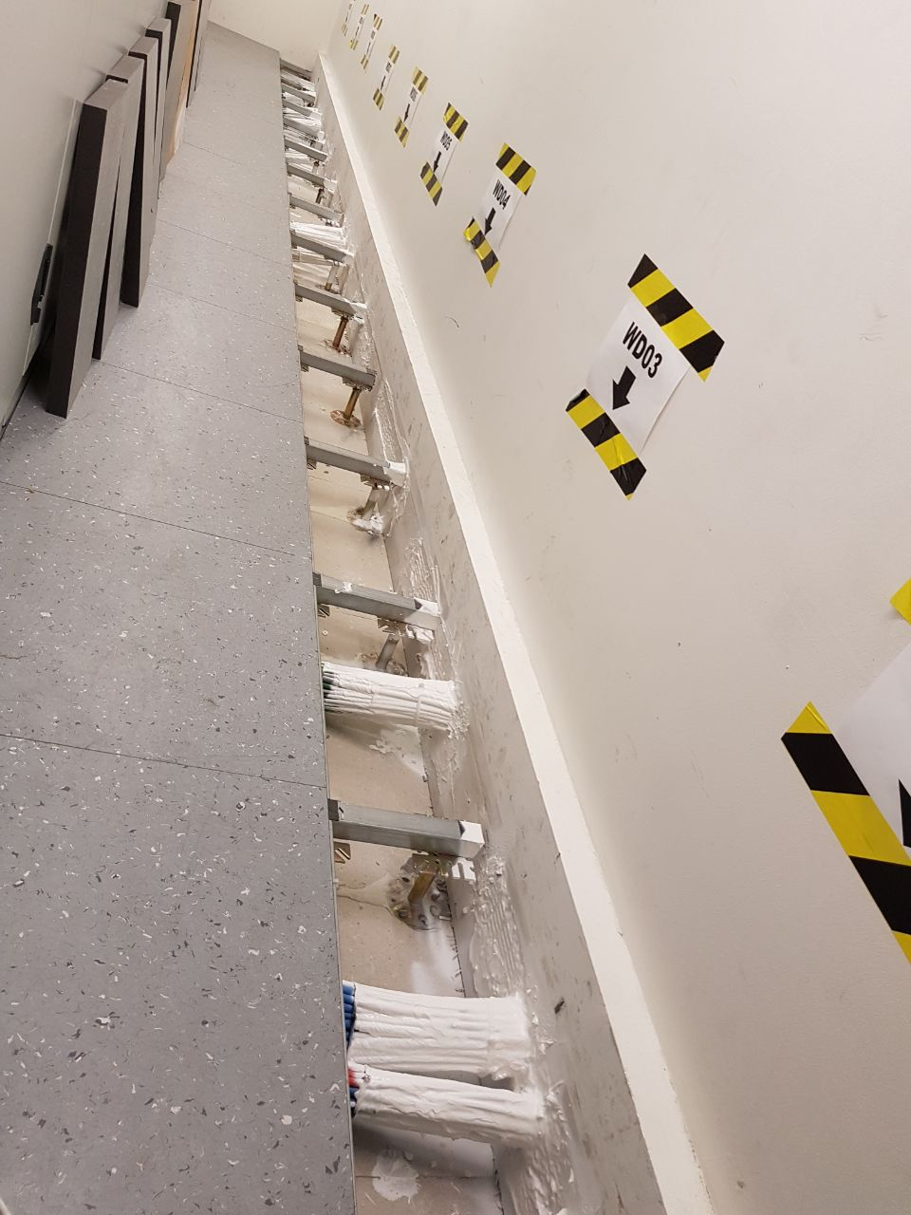
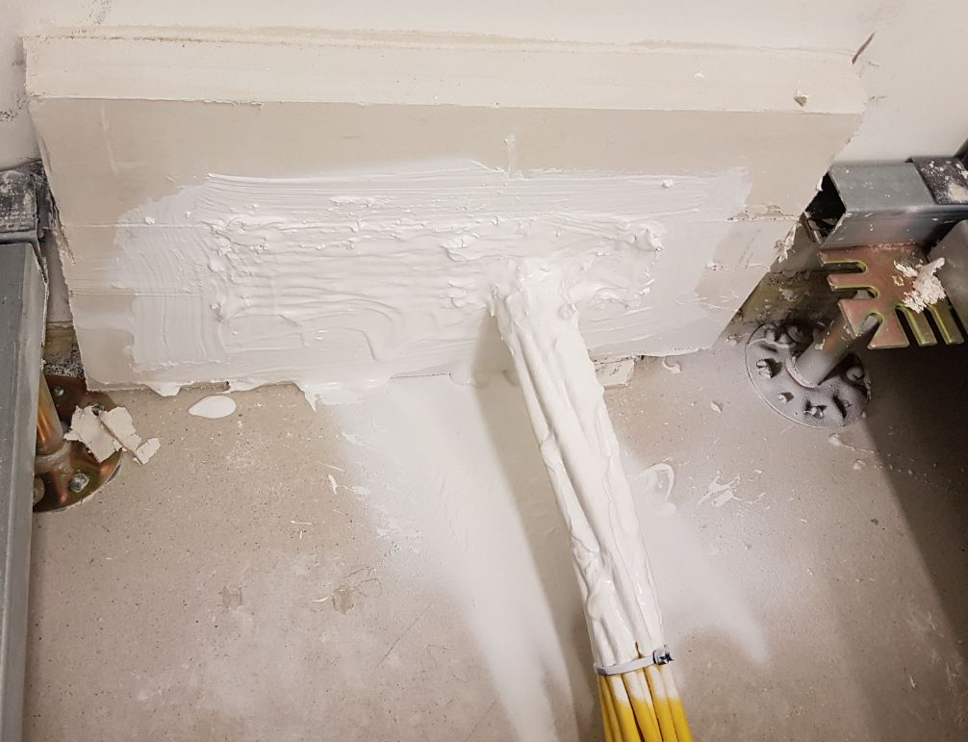
Status Update SASE1

Slide 7
Status Update SASE1
Weiss Klimatechnik
  Needs access to all precision climatized zones (2-3h per room are required)
  ➔ C. Holz (TS) tries to organize this for Oct. shutdown
  48h-measurement in D.05 still to be done in addition

Slide 8
SASE3

Slide 9
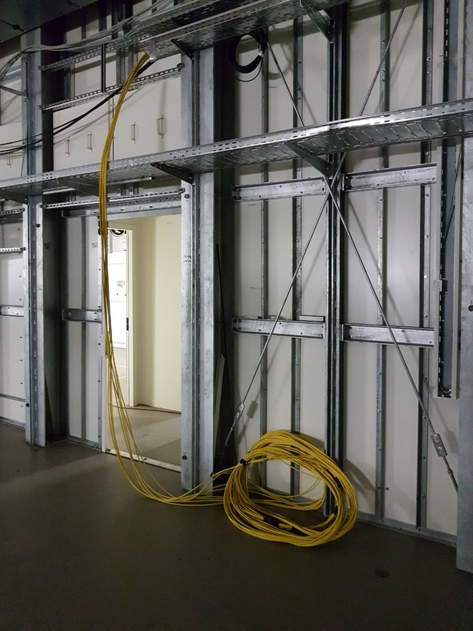
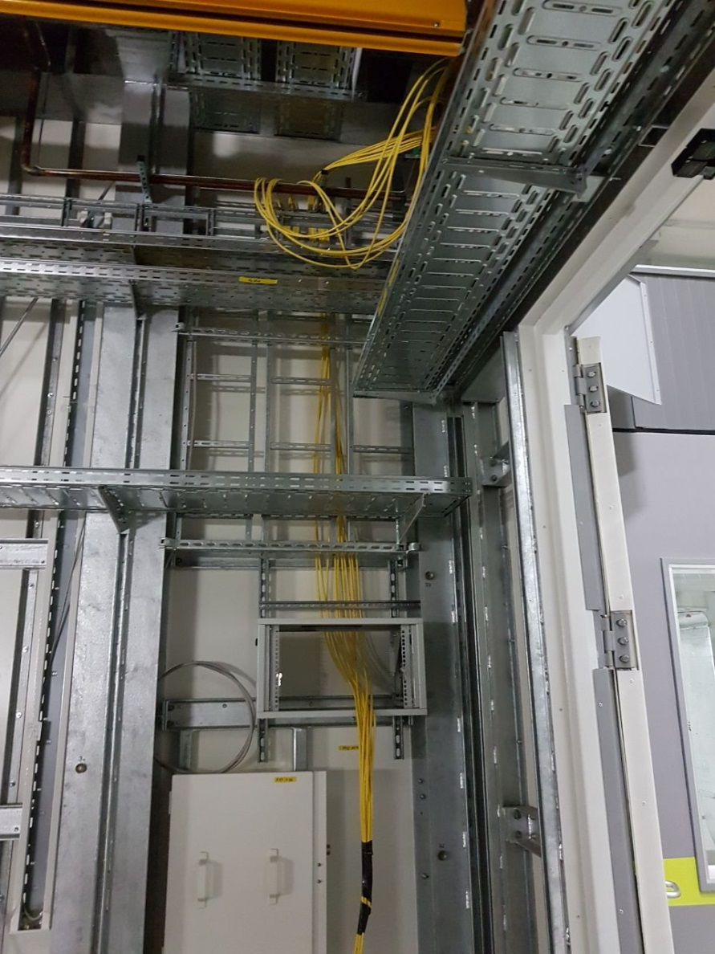
17.7.: First IT-cables arriving in SQS E.07

Slide 10
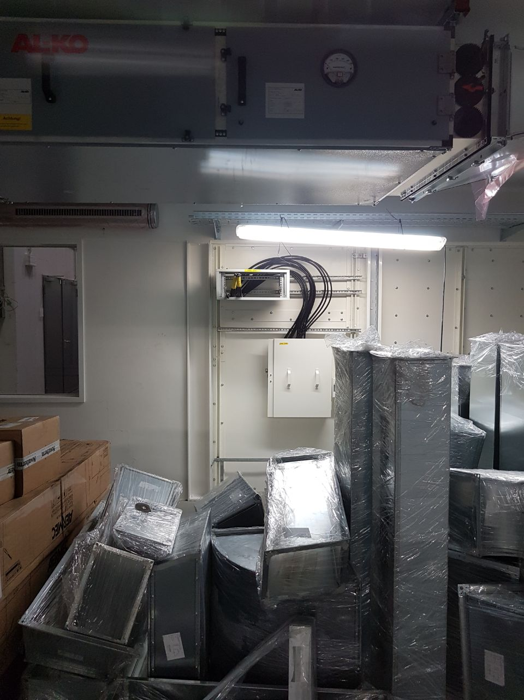
19.7.: First Coax-cabels arrive in SQS-control.

Slide 11
Status SASE3 + SASE2
Company Wille has been ordered with immediate works required in SASE3 + SASE2
Four companies have been asked to provide offers for electrotechnical installations in SASE2 + SASE3
  Tenders open until 26.+27.7.
Ordering of PKGs and plena:
  Plena + curtains: Ordered for SASE3 & SASE2
  Schema + sensors: Reviewed & forwarded to Engie (Do) & Caverion (Fr) ➔ T. Tietz (TS)
  PKGs: Ordered for SASE3 & SASE2, but not yet ordered @ WKT ➔ Christoph Staeps

Slide 12
SASE2

Slide 13
Status SASE2
Vater Phase I cabling:
  Racks ordered ➔ delivery expected at end of Sep.
  Remaining Montageplanung being prepared by Vater, supposed to be checked by XFEL beg. of August
Actemium Phase II cabling:
  Tender documents & PR & MB-proposal are under preparation
  Tender to be started in August

Slide 14
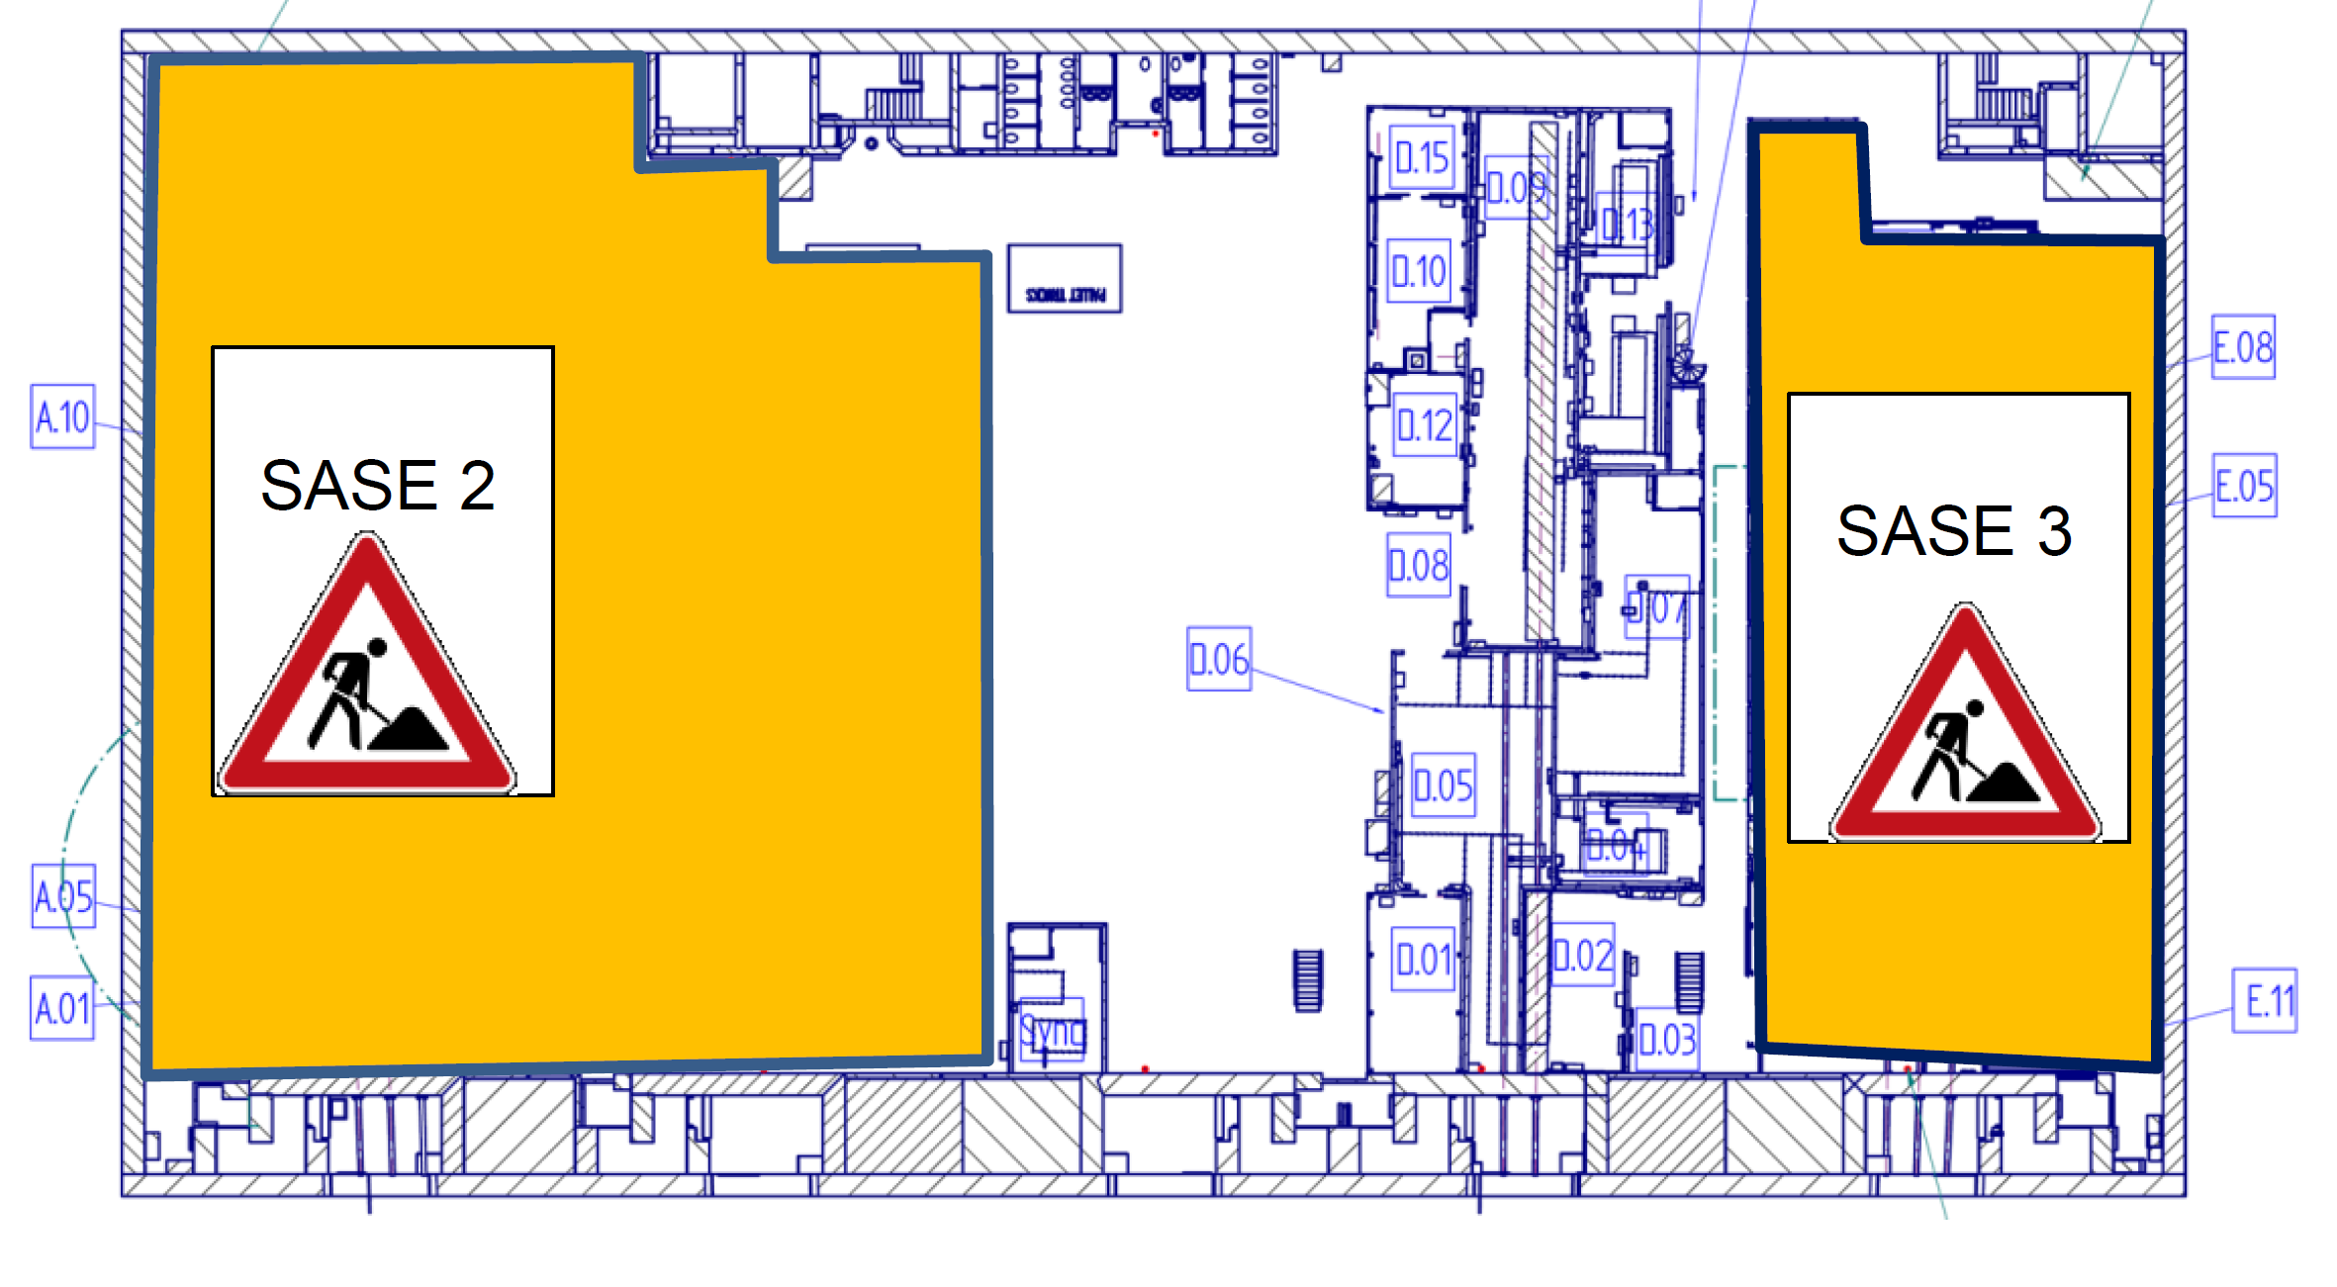
Update: Safety gear in XHEXP1
Everybody has received a safety note on this topic.
Markings + signs are being applied by Safety & TS.

Slide 15
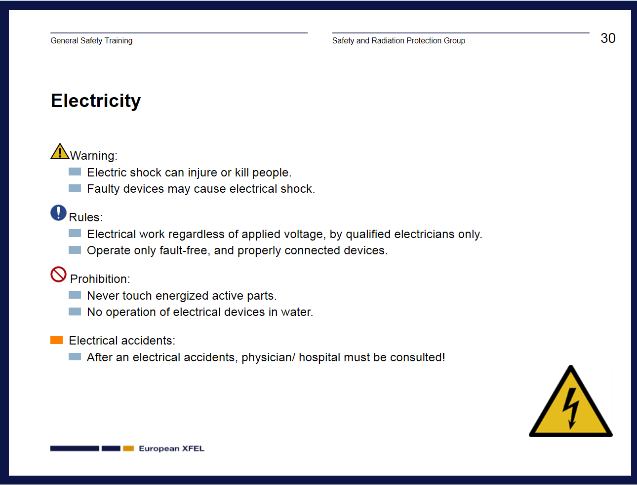
All of you should know this: Electrical safety slide from „General Safety Training“

Slide 16
Electrical works?
Switching on/off lights / „everyday“ devices (PCs…)
Switching fuses
Opening a device and replacing a fuse
Using a multimeter, e.g. to test a cable
Repairing a motor cable / opening a connector
Testing a RCD (FI-Schutzschalter)
Working in an electrical cabinet
Creating / modifying a cable
Connecting a standardized connector to power or to a device (Schuko / Euro, LEMO, BNC, SHV…)
…

Slide 17
What a normal person („elektrischer Laie“) is allowed to do:
Switching on/off lights / „everyday“ devices (PCs…)
Switching fuses
Opening a device and replacing a fuse
Using a multimeter, e.g. to test a cable
Repairing a motor cable / opening a connector
Testing a RCD (FI-Schutzschalter)
Working in an electrical cabinet
Creating / modifying a cable
Connecting a standardized connector to power or to a device (Schuko / Euro, LEMO, BNC, SHV…)
…

Slide 18
Any other activities can only be done by:
Responsible Electricians
(T. Schoen, U. Brüggmann, O. Engelmann)
Trained electricians
(e.g. electrical engineer / technician – being a physicist or any engineer is not sufficient!)
Electrotechnically trained individuals
(„elektrotechnisch unterwiesene Personen“ EuP)
Which works these persons can do has to be specified by Safety and the group leader, based on the individuals education, experience and training.

Slide 19
How to go on?
Safety + TS are developing a ca. 1 day training for you to qualify as EuPs.
Maybe a reduced 4h course is possible (focussing on risks & work on ≤24 V signal cables).
TS & Safety would like to have most experimental staffers trained as EuPs ➔ Register @ Safety
Most groups seem to have two potentially „trained electricians“ to do electrical work ➔ when in doubt ask TS
Safety & TS have to expedite their efforts to get the organizational side & the associated trainings done ASAP

Slide 20
Upcoming Dates & Meetings
Today, 9:00: SASE1+SASE3 Readiness
SASE1+SASE3 Readiness Dispatch by A. Violante
  Mo, Wed 09:30 @ MCR
28.7., 8:30: Regular TC meeting if there is the necessity
28.7., 9:00: SASE1 Readiness

