Slide 1
Tests on Chess 2 ASIC
Dionisio Doering, Yubo Han, Pietro Caragiulo, Larry Ruckman, Camillo Tamma, Mazin Khader, Su Dong

Slide 2
Outline
Tests with new values for pre-amp configuration
Tests with the default values
Considerations

Slide 3
Pixel description

Slide 4
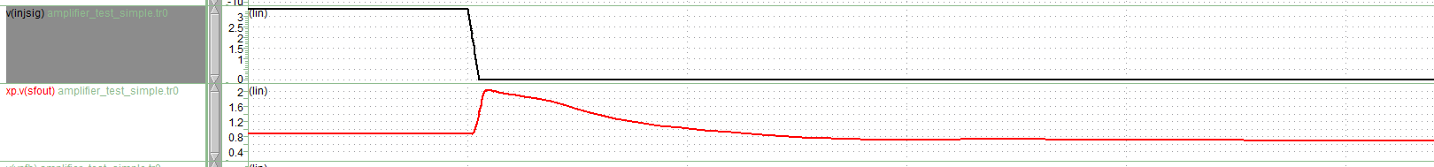
Simulation
default parameters gave very small signals
the plots are from alternative parameters (see next page) investigated by Pietro

Slide 5
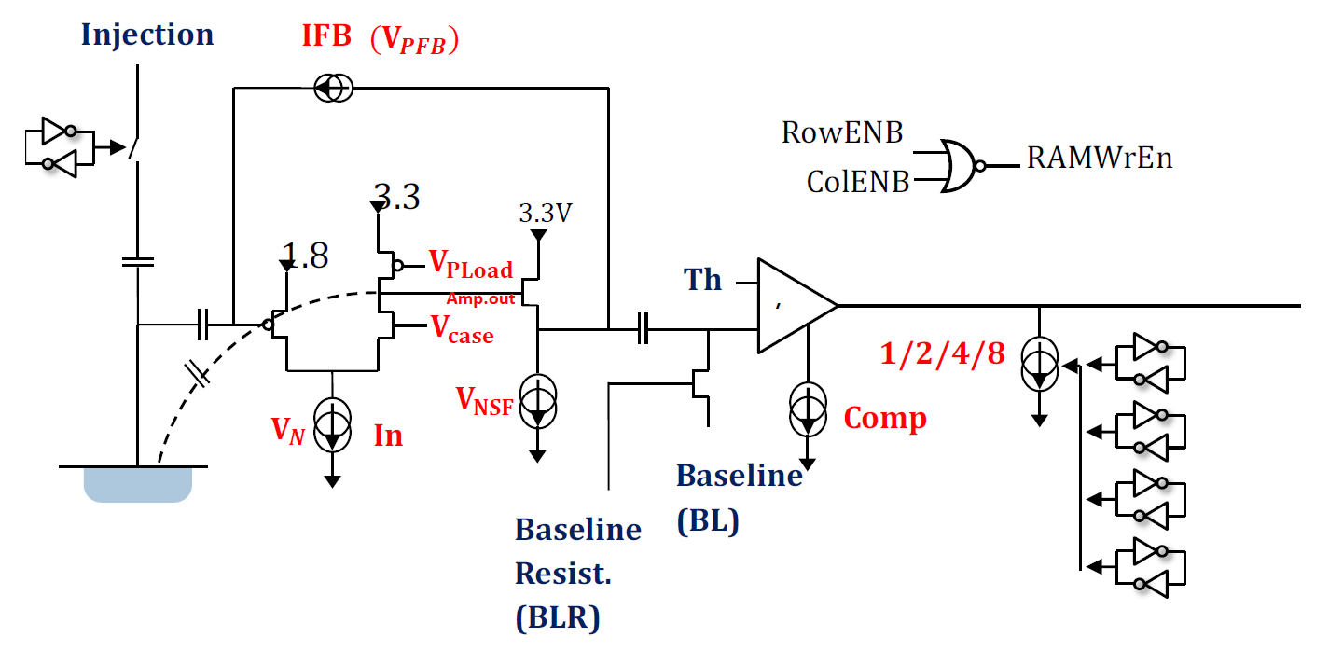
Tests with the new parameters:
Name | Before | After
VNatt | 31 | 30
VNres | 0 | 1
VPLOADatt | 30 | 28
VPLOADres | 1 | 2
VNSFatt | 27 | 31
VNSFres | 0 | 3
Vcase | 1.7 | 1.7

Slide 6
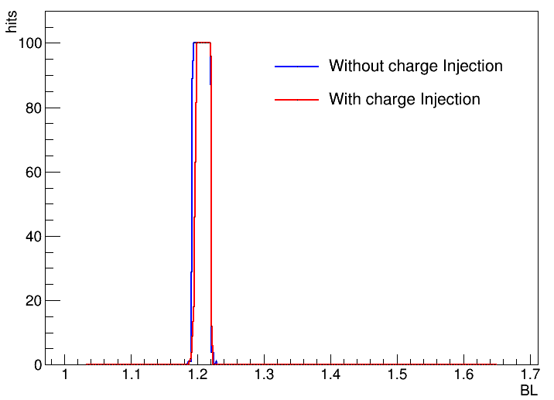
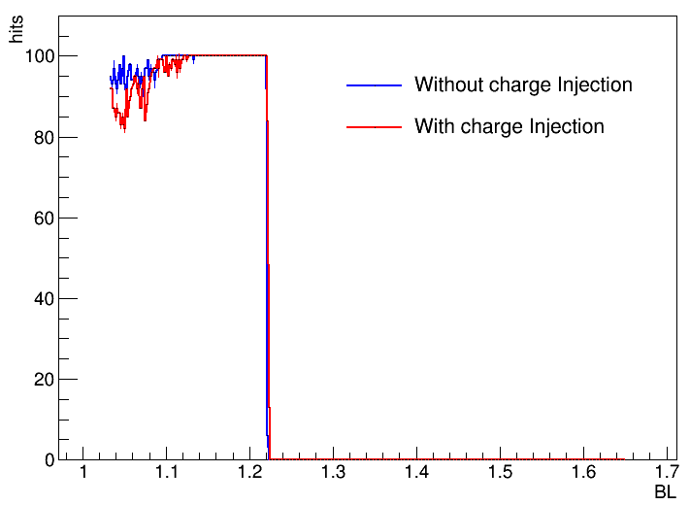
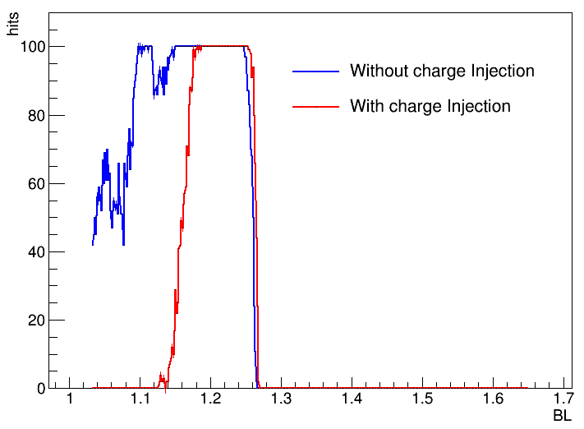
Tests with the new parameters
TH = 1.4V
BL sweeps from (0x500 to 0x800 with step 2) 1.03V-1.65V with step 1.6mV;
BLR=BL+0.6V
With and without charge injection
Num. hits vs. BL
Matrix 0
Matrix 1
Matrix 2

Slide 7
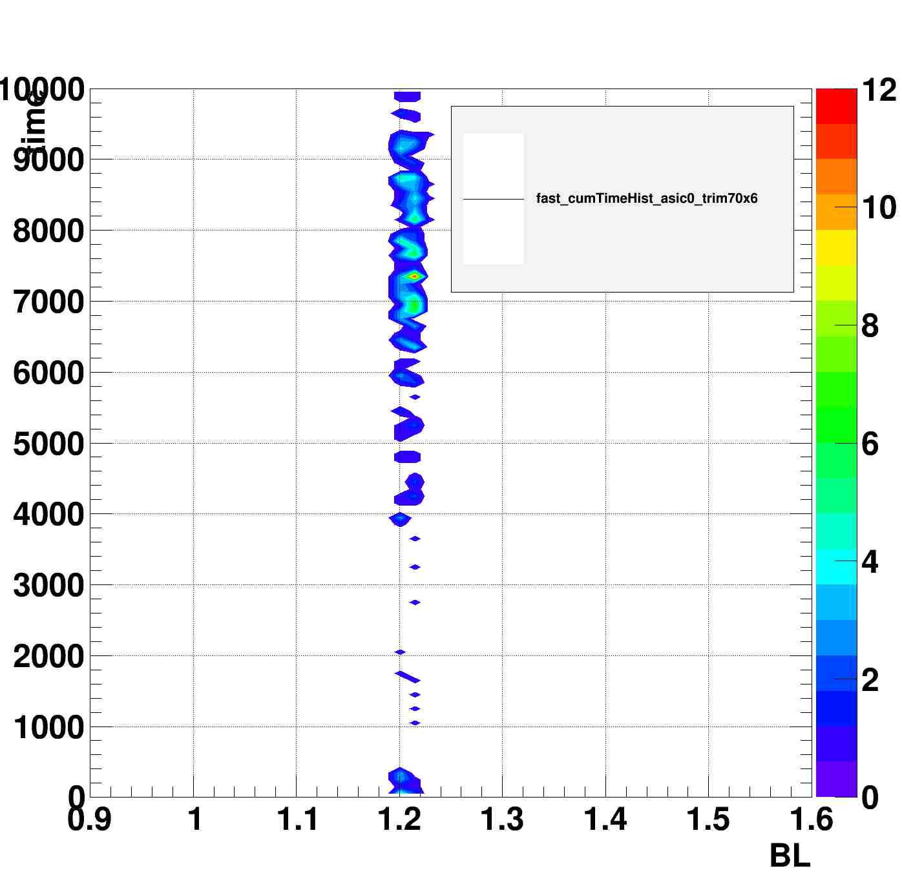
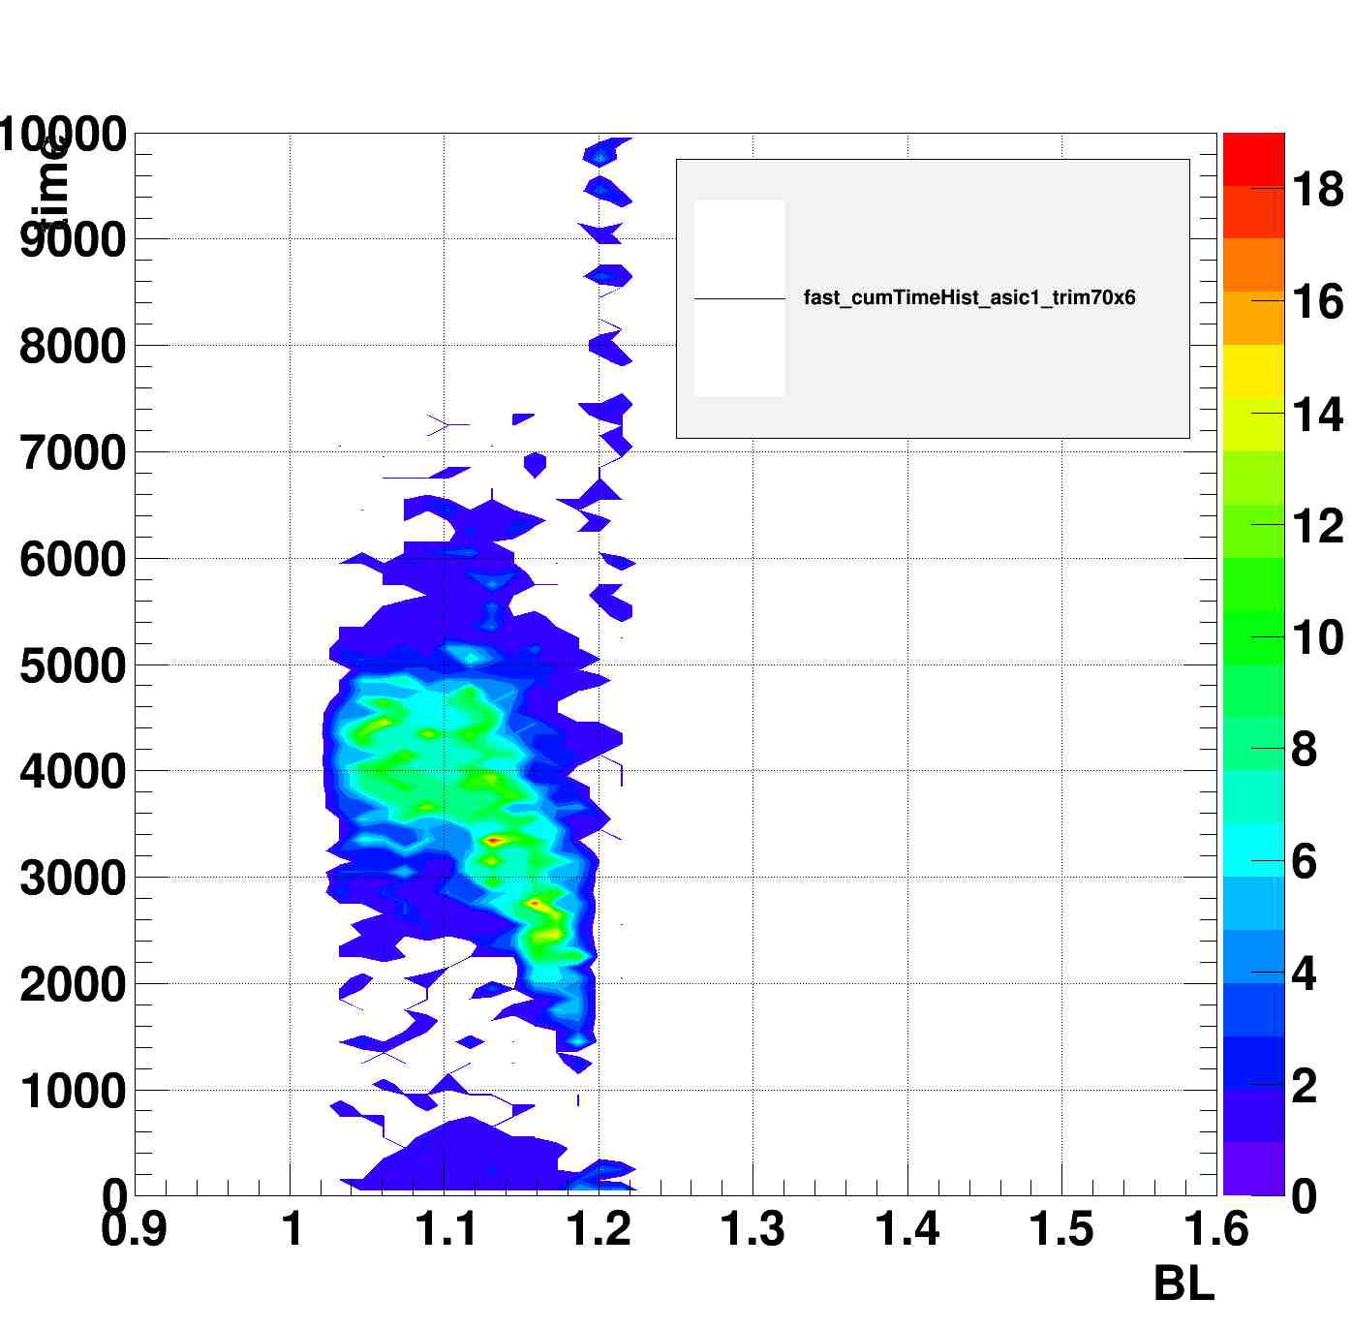
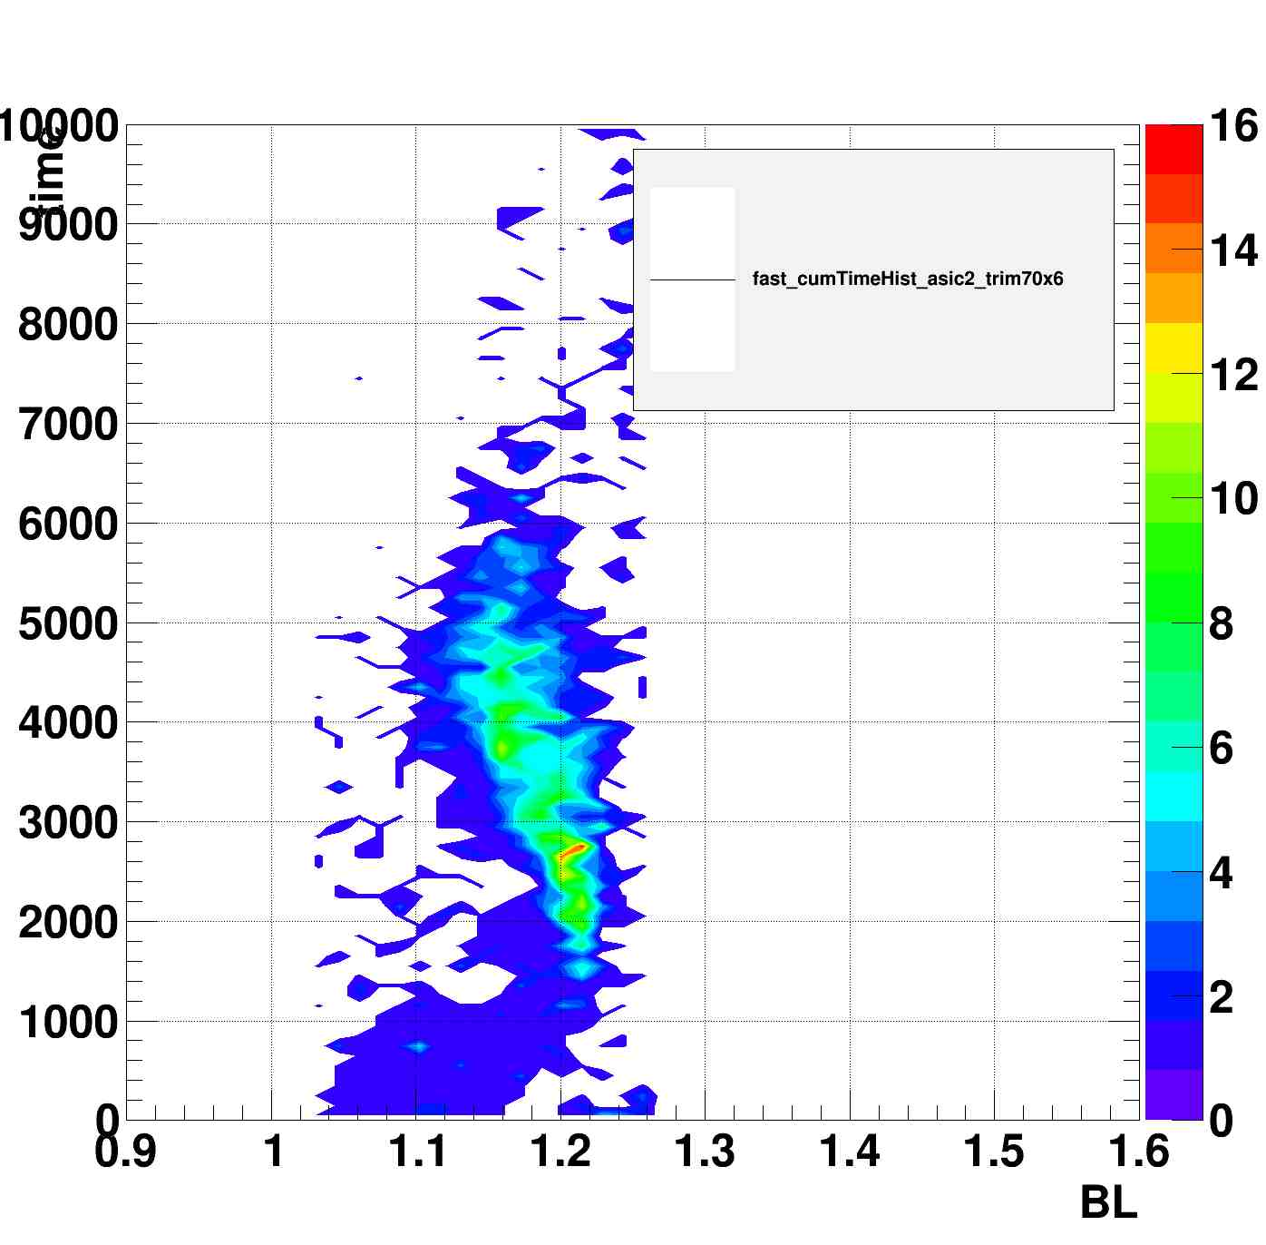
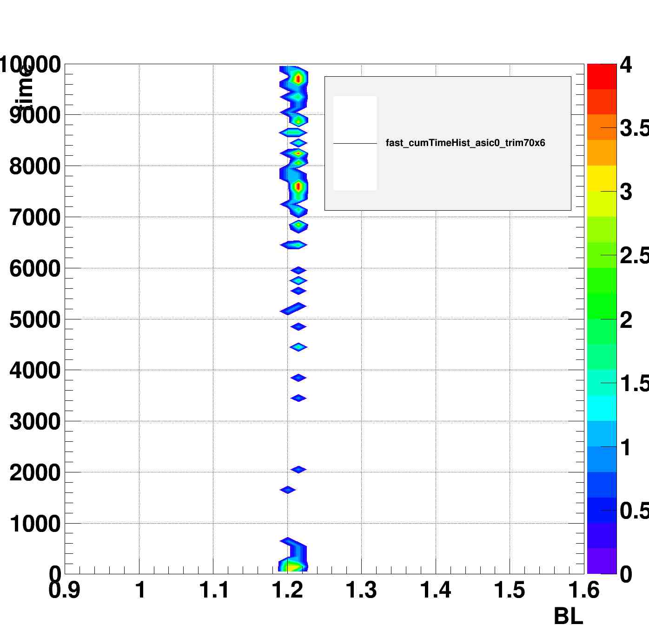
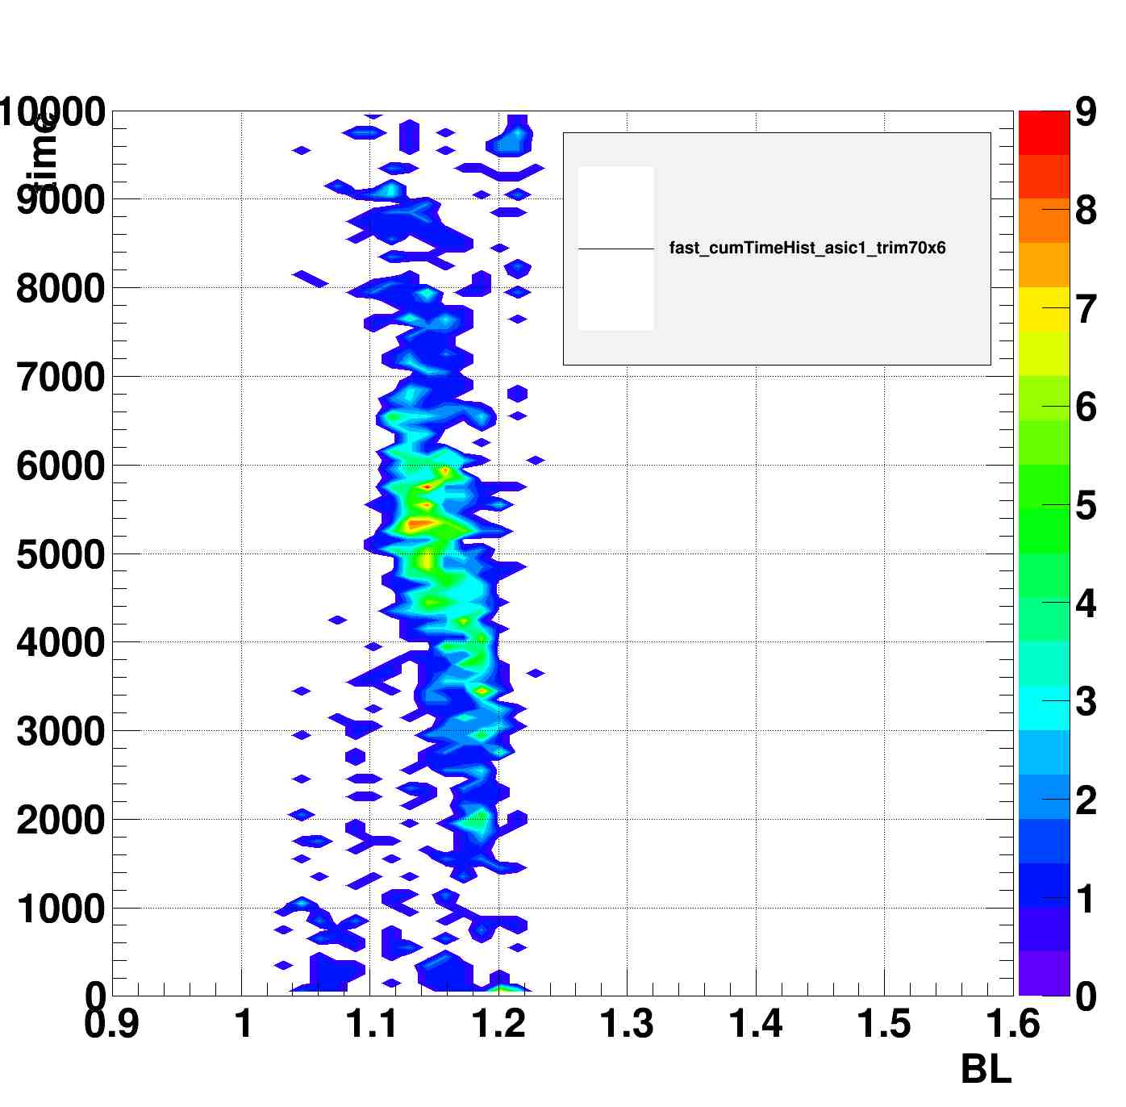
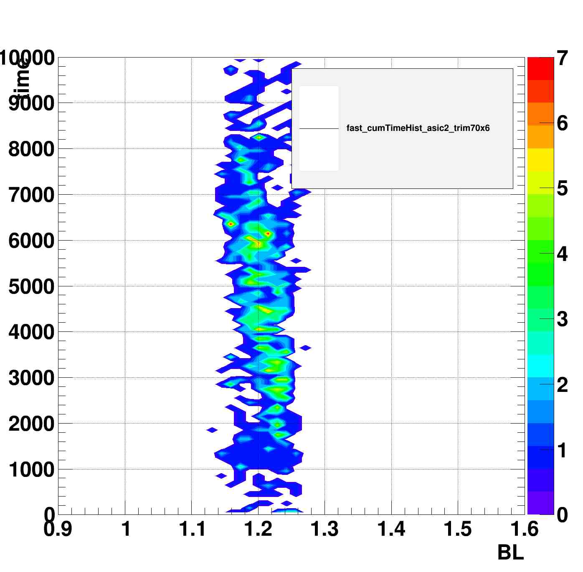
Without
Charge injection
Matrix 0
Matrix 1
Matrix 2
Time vs. BL, Z = num.hits
Time vs. BL, Z = num.hits
Time vs. BL, Z = num.hits
Enable charge injection
Matrix 0
Matrix 1
Matrix 2

Slide 8
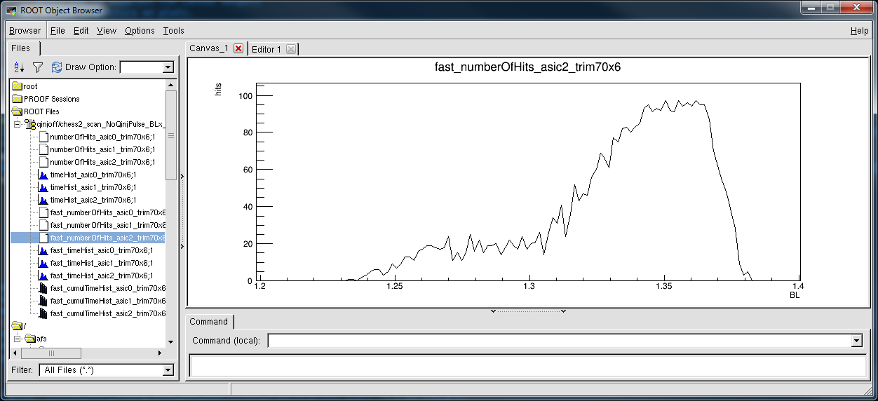
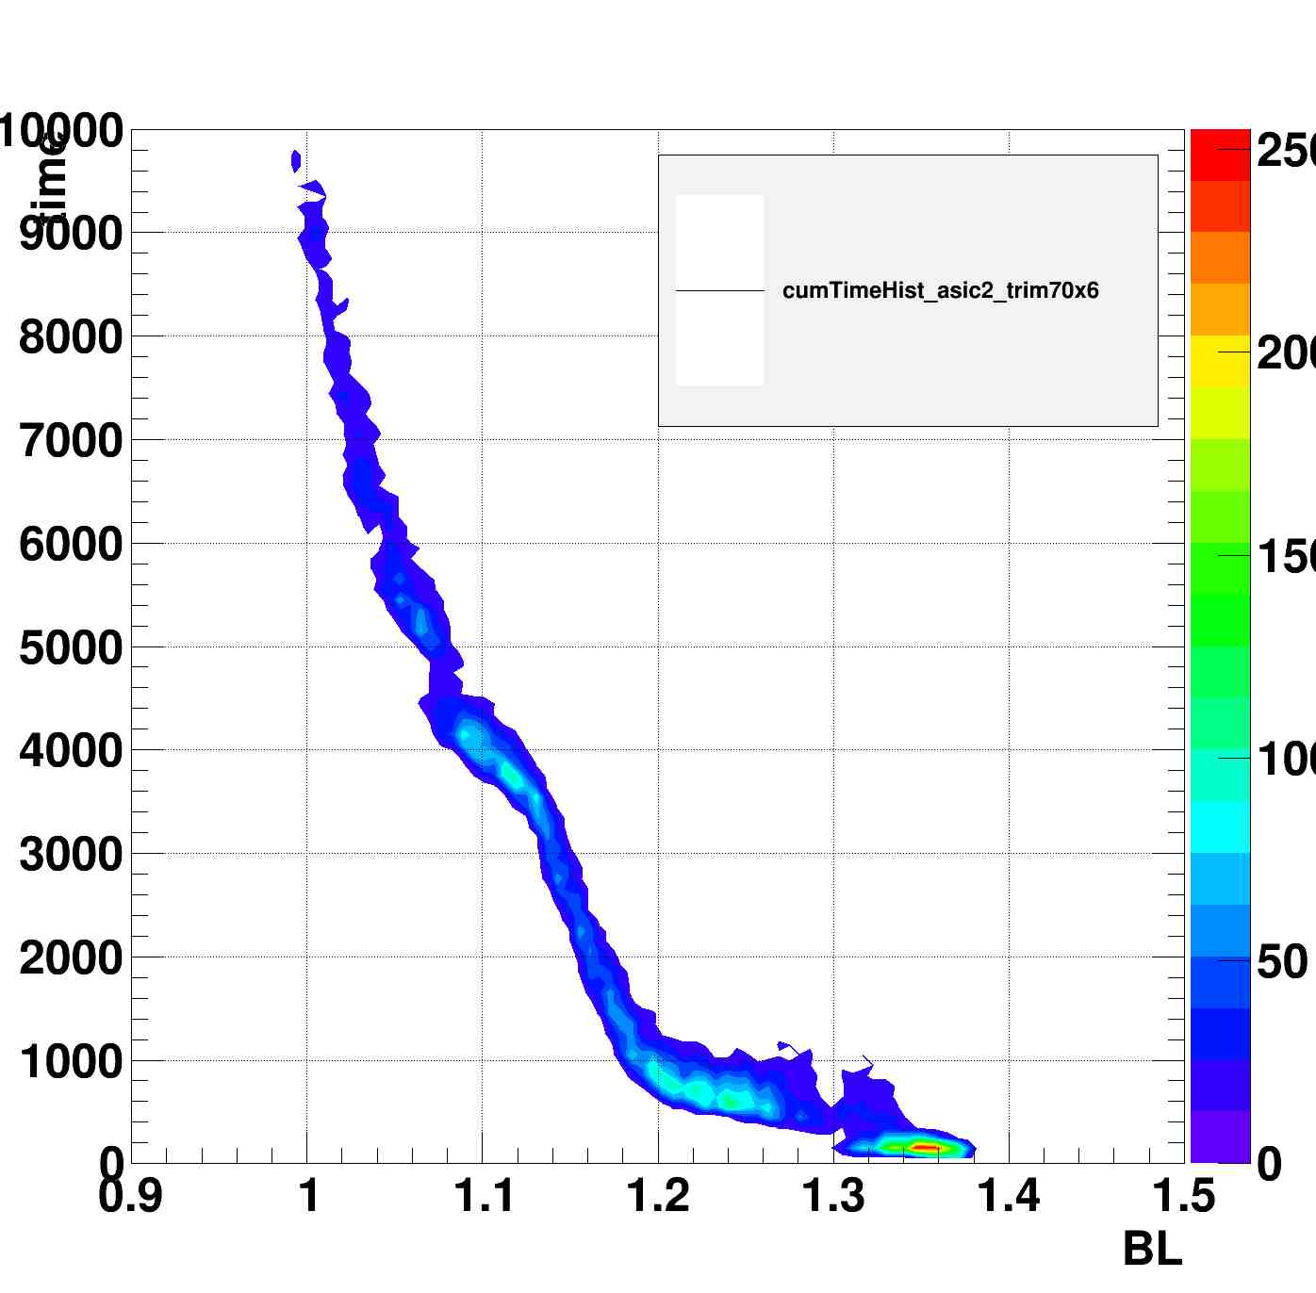
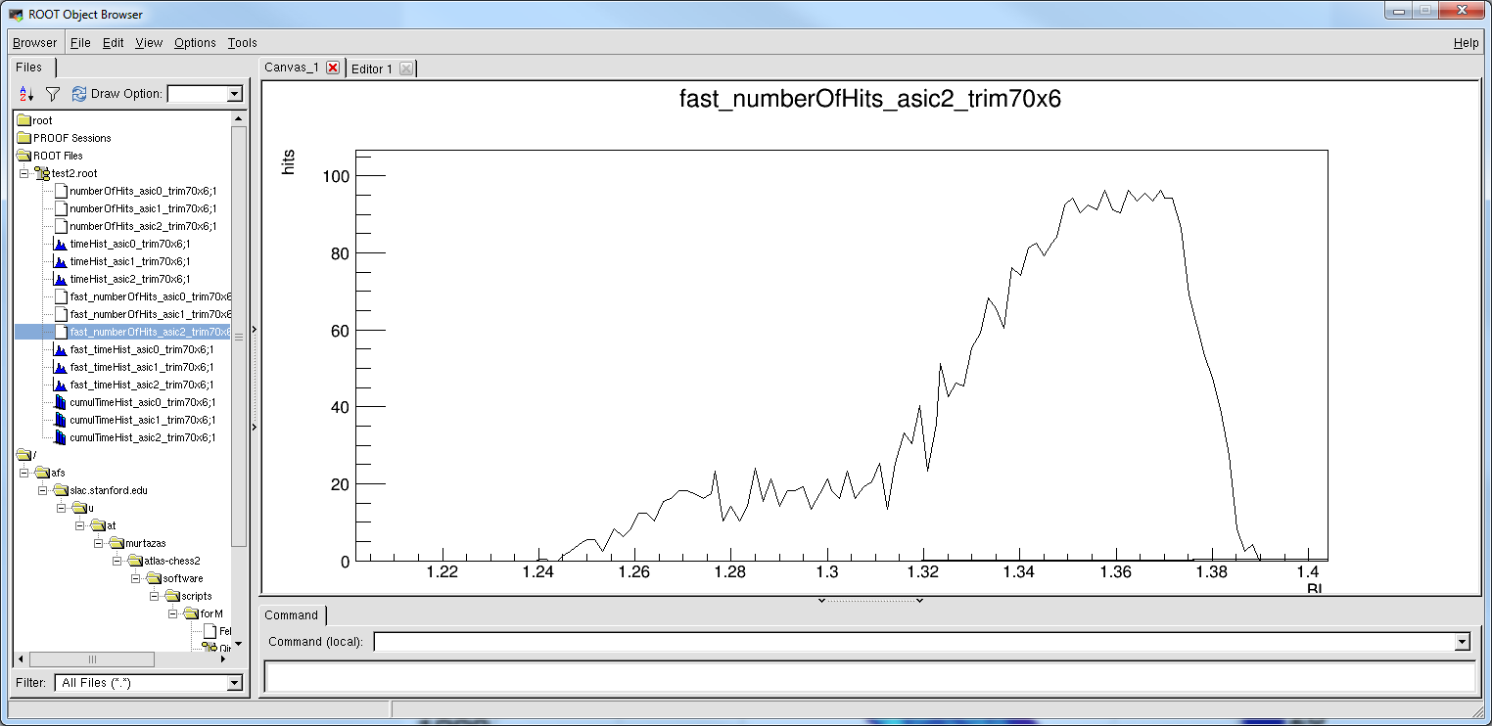
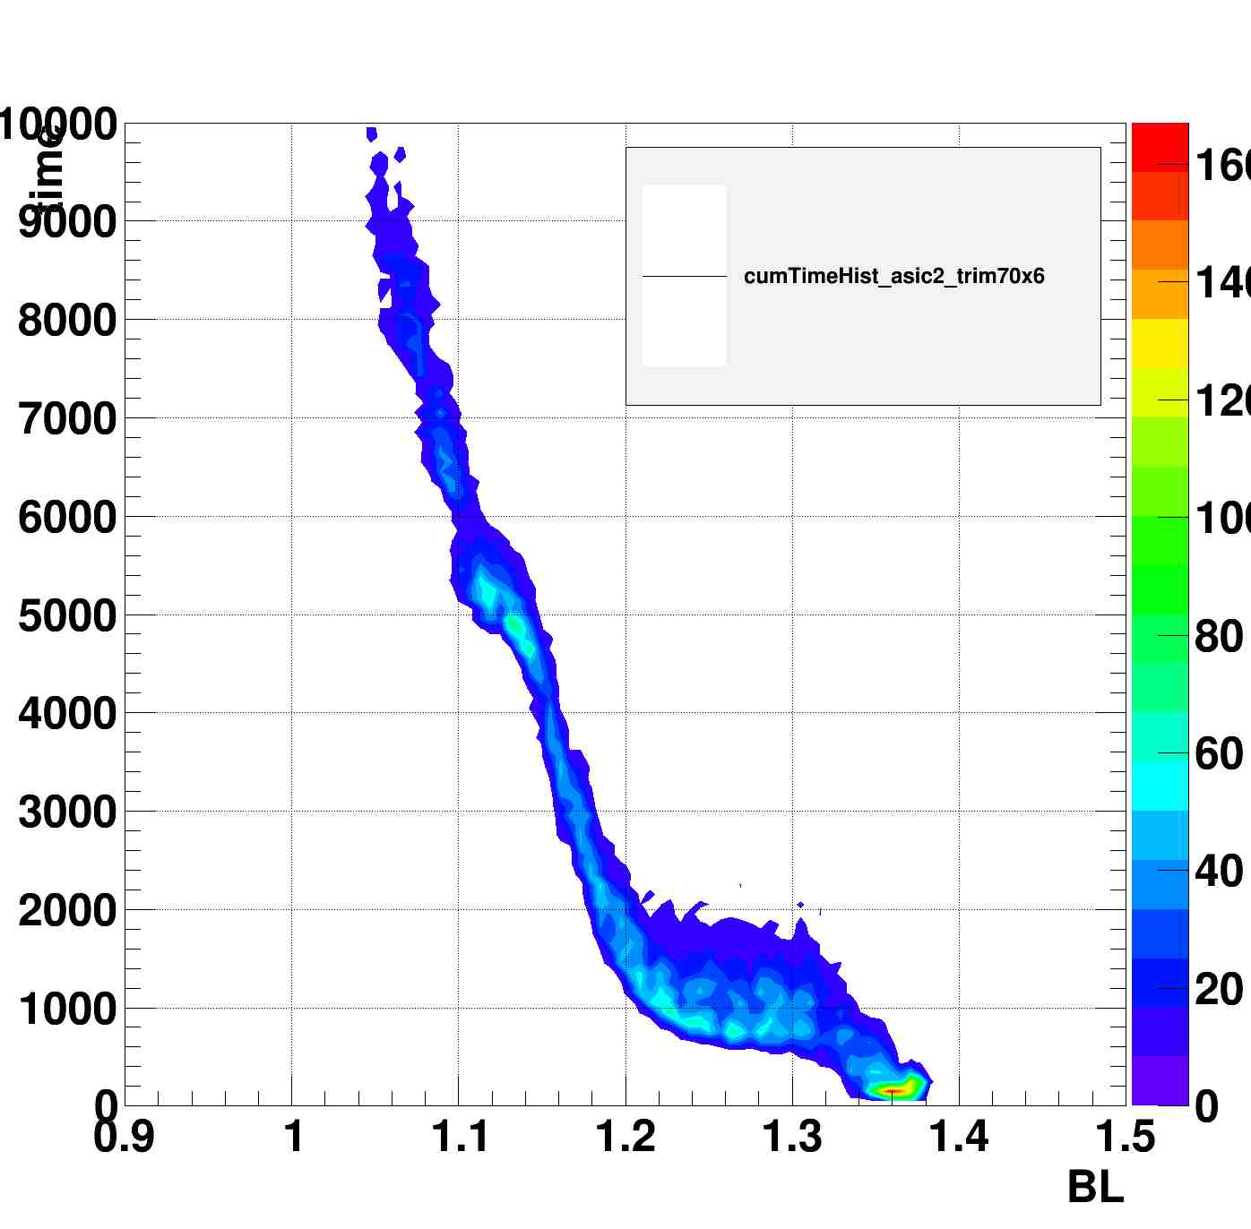
Qinj on vs. Qonj off
Num. hits vs. BL
Time vs. BL, Z = num.hits
Try to repeat the test with the default pre-amp configuration values but didn’t get hits.
Power cycle the board and repeat the test with default parameter value, still got empty data.
Q:Why we can not get the same results with the default value?
  3.3V tests
  Scripts?
Qinj off
Obs.: Matrix 2 and times < 500ns
Num. hits vs. BL
Time vs. BL, Z = num.hits
Qinj on
Obs.: Matrix 2 and times < 500ns

Slide 9
Consideration
Don't see Qinj signal with default parameters, and simulation also suggests very small signals
Alternative parameters in simulation suggests we should see ~1V level Qinj signal, but still didn't see significant signal on device
  Caveat: Not reproducing previous no-Qinj result. Did we change some default config values by accident ?
  Did the previous 1.8->3.3V voltage tests changed something in the device ?
  Are we just seeing the slow undershoot ?
Updating test code in Git and documentation: Can other sites run tests on your devices ?

