Slide 1
Measuring the Nwell in CHESS2

Slide 2
CHESS2 Pixel Schematics
3.3
IFB
RowENB
3.3
ColENB
3.3
Injection
1.8
Load
Th
Inj_EN
3.6
Casc
1/2/4/8
In
InSF
Comp
Baseline

Slide 3
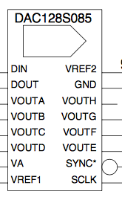
CHESS2 Nwell bias scans
Monitoring current
A
3.6
FIB’ed Nwell monitoring
V

Slide 4
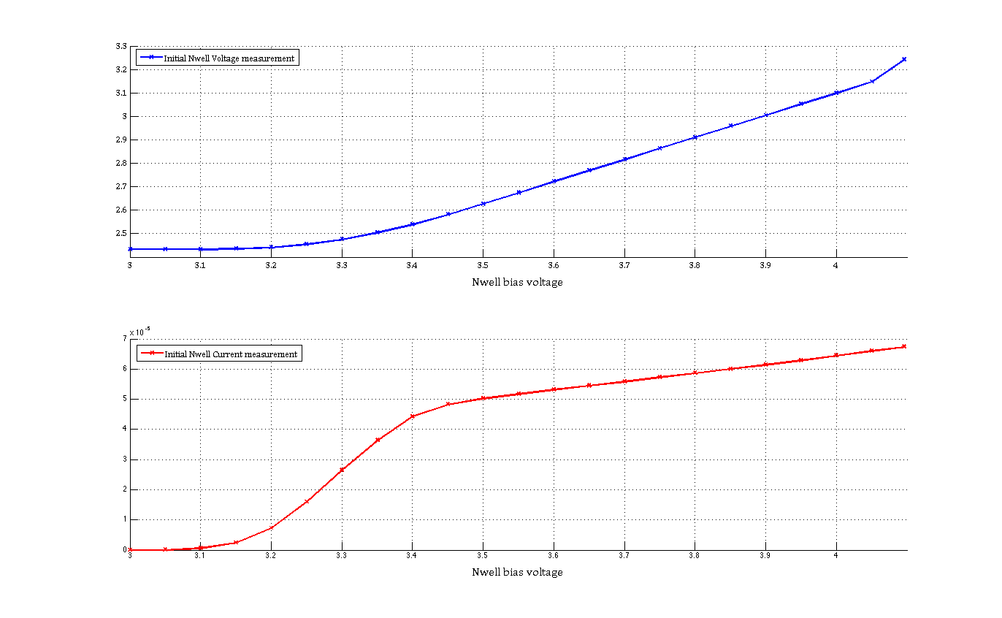
Initial measurements

Slide 5
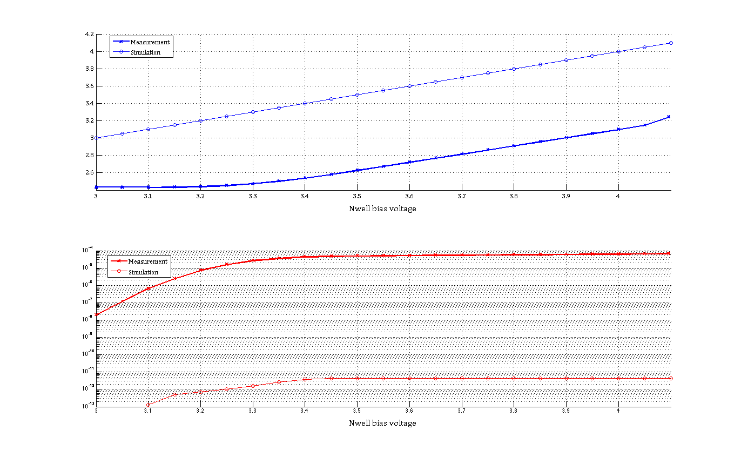
Comparison with simulation

Slide 6
CHESS2 Nwell bias scans
Light Cover added
Monitoring current
A
3.6
FIB’ed Nwell monitoring
V
Cooling added to 12.5C

Slide 7
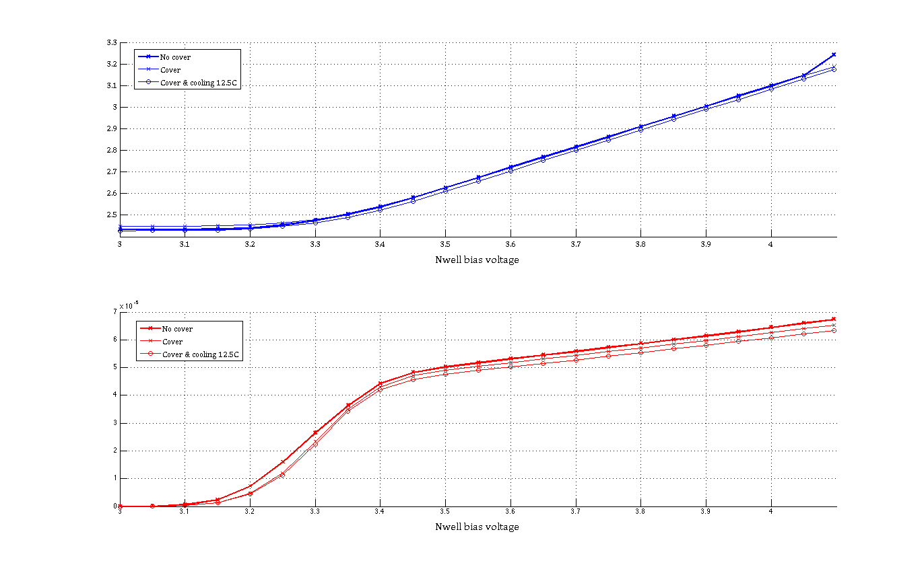
Initial measurements

Slide 8
CHESS2 Nwell bias scans
Light Cover added
Monitoring current
A
3.6
FIB’ed Nwell monitoring
V
e⁻
Leakage current added in simulation
Cooling added to 12.5C

Slide 9
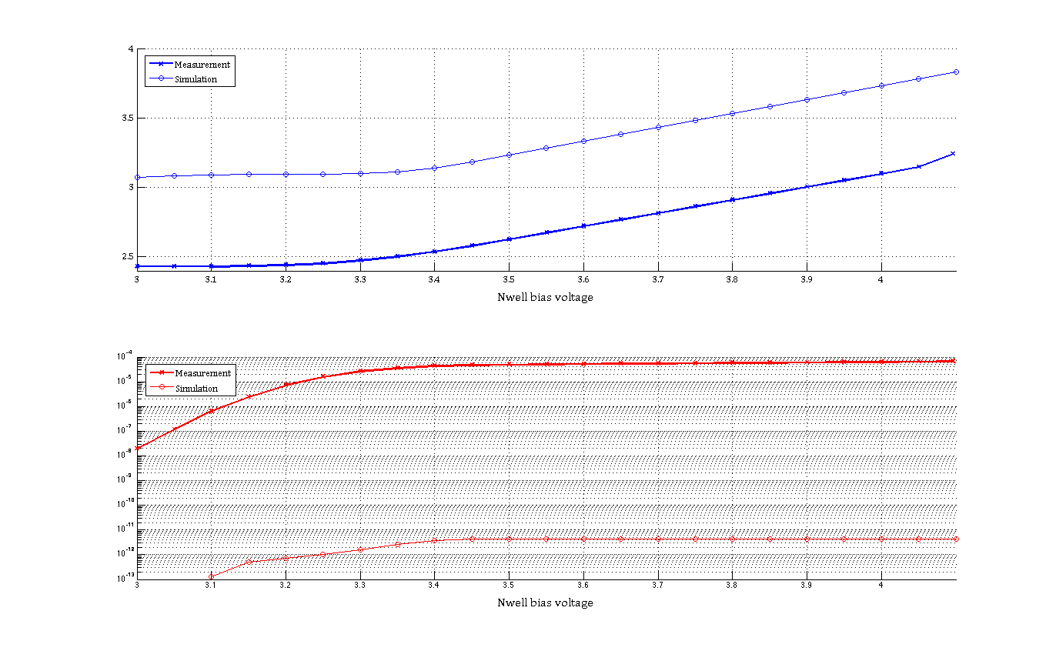
Comparison with simulation

Slide 10
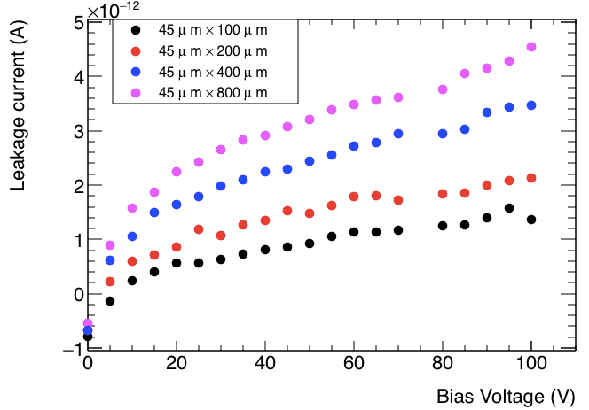
Reminder of CHESS1 measurements
No HV applied leakage current should be very low

Slide 11
Comparison with simulation
60uA measured
4pA simulated
60uA for 32*144pixel:
13nA of leakage per pixel
Can’t explain were the leakage is coming from.

Slide 12
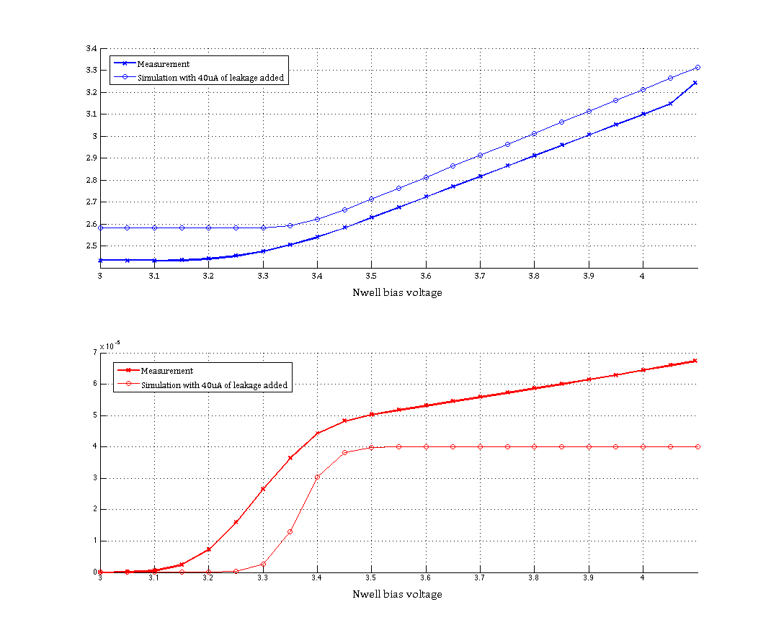
Adding 40uA leakage current to simulation
40uA of leakage added in simulation

Slide 13
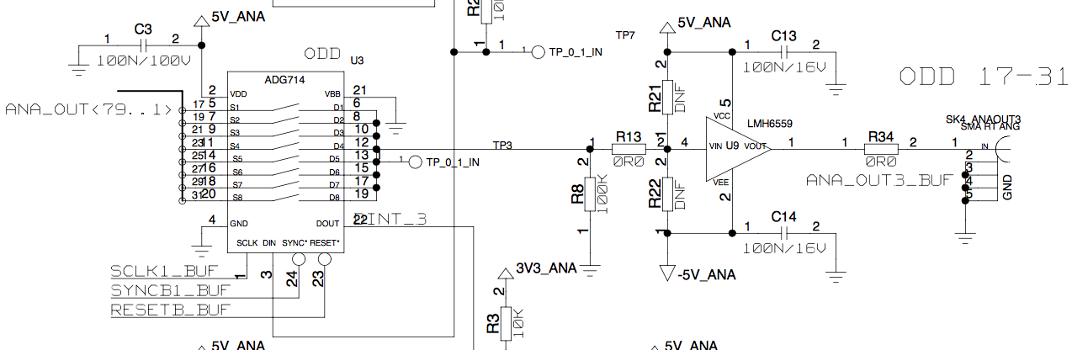
CHESS2 Nwell bias scans
100kOhm
Light Cover added
=
V
.524V
Monitoring current
A
3.6
FIB’ed Nwell
e⁻
Leakage current in simulation
V
Cooling

Slide 14
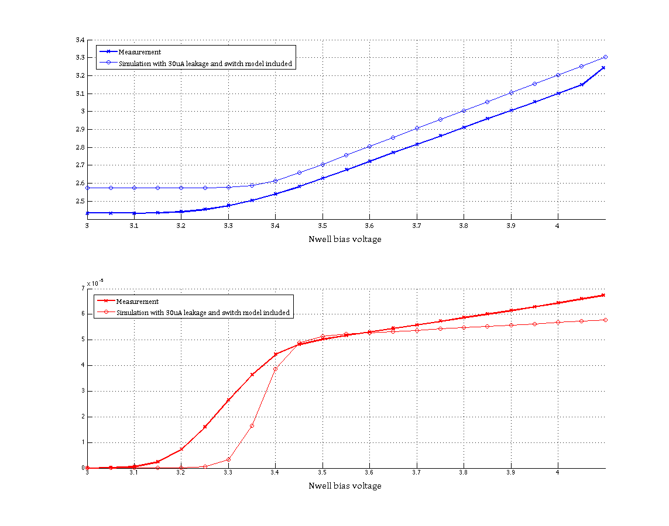
Adding 40uA leakage current to simulation + model of the switch
Here:
30uA of leakage added in simulation

Slide 15
Conclusion
It seems that we have more leakage current in the Nwell than predicted.
This leakage current origin is unexplained
Model of the readout board explains to some extend the ’resistive’ behavior measured wrt. to the Nwell bias applied but not perfectly.
Even with added leakage current we see a 100mV discrepancy between simulated nwell potential and measured nwell potential.
Next step: measure the leakage current on bare Nwells in CHESS2 + Nwells with disconnected amplifiers.

