Slide 1
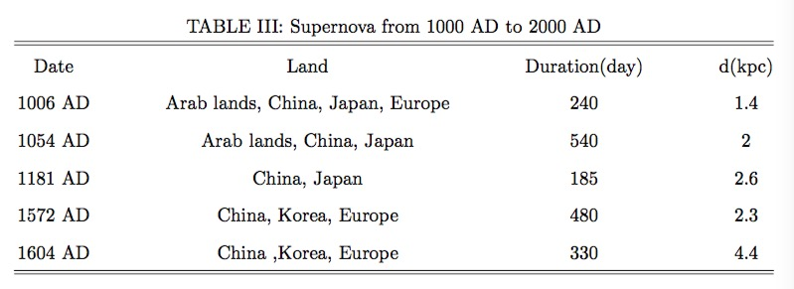
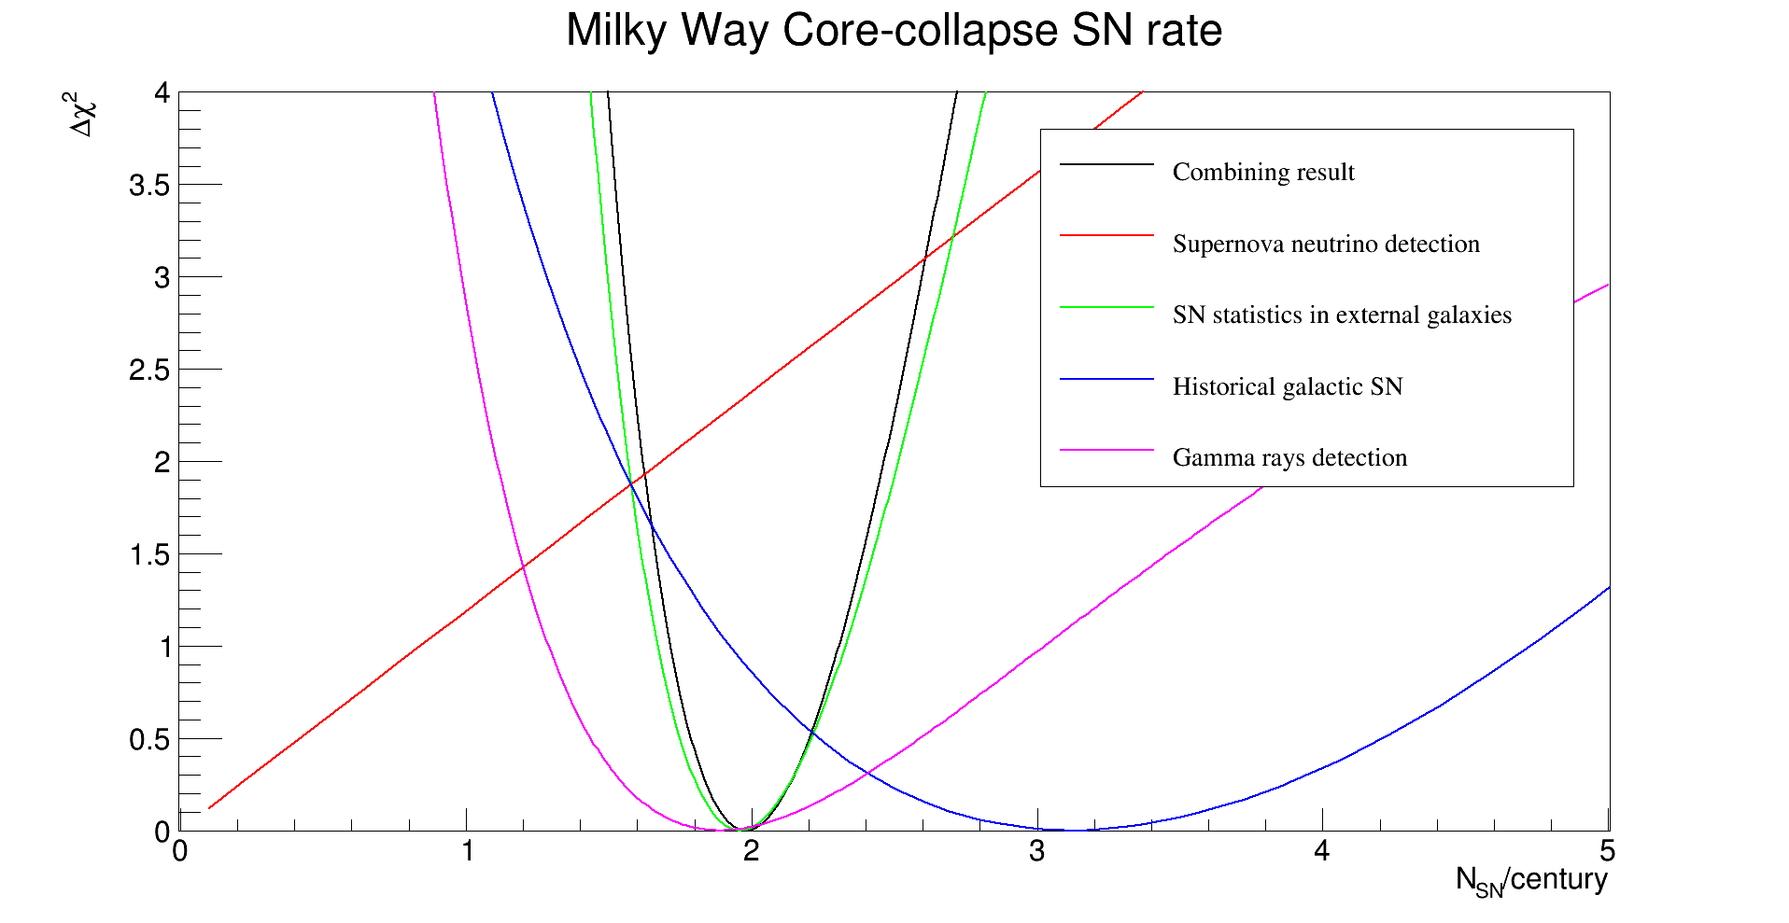
Galactic core-collapse supernova burst rate from different estimation methods
Yan Zhang^{1,2}, Yufeng Li¹, Liangjian Wen¹, Shun Zhou¹
1. Institute of High Energy Physics, CAS, Beijing 100049
2. University of Chinese Academy of Science, Beijing 100049, China
Supernova neutrino is one of the focal points in the field of neutrino research in recent years, many experiments hope to detect neutrino burst once again caused by core-collapse supernova (i.e. type Ib/c and type II). Many methods have been applied to estimate galactic core-collapse supernova rate, this work discusses four kinds of reliable methods: detection of supernova neutrinos, SN statistics, historical galactic SN and ${}_{}^{26}{Al}$ gamma rays detection methods. Combination of four different calculating methods we estimate that the frequency of core-collapse supernovae to be 1.98 events per century.
Introduction
Different methods have been used to estimate the core-collapse supernova rate in the Galaxy. For example, supernova neutrinos detection, observations of extragalactic galaxies supernova, historical supernova records, measuring the mass of galactic ${}_{}^{26}{Al}$, Pulsars, supernova remnants, etc. In comparison with the other methods, the previous four methods have more reliable data support. This work selects four most reliable methods to introduce the galactic core-collapse supernova rate estimation and combines these methods to obtain more accurate estimation.
Four Estimation methods
Ⅰ. Detection of supernova neutrinos
Ⅲ. Historical galactic SN
Through the detection of supernova neutrinos in the Milky Way over a period of time, we can estimate the frequency of supernovae or give the upper limit at a certain of confidence degree. Many running neutrino experiments have the ability to detect supernova neutrinos in the Milky Way Galaxy. Up to now, several experiments reported the results of galactic supernova neutrino detection, they are Baksan [1], LVD [2], SK [3], etc.
Another way to estimate the rate of supernova is through historical supernova observations. Over the past millennium, five supernova explosions have been observed in ancient Chinese, Arab lands, Korean, Europe and Japan (Clark & Stephenson 1977, see table II) [5]. Löffler & Tammann adopted Monte Carlo calculations to produce 1500 supernovae, and computed the apparent magnitude distribution by a model which consists of a thin, an old and a thick stellar disk as well as of a halo population, and contained a realistic distribution of dust [6]. In their work, the SNe were assigned as the peak luminosities, the ratio of SNe II and lb to SNe la was assumed to be 9:1. Assumed that $0_{ .}^{m}0$ is the highest observable SN peak apparent magnitude in ancient times. The result is that 39 Galactic SNe are needed per millennium to explain the five observed events with ${m\left(max\right)<0}_{ .}^{m}0$, that is about 3.9 supernovae (include Ia, Ib and II) per century.
Ⅱ. SN statistics in external galaxies
By scanning external the galaxies near the Milky Way through an astronomical telescope
in a period of surveillance, we can take an estimate of the supernovae rate in Milky Way
Galaxy by making the basic assumption that the Galaxy has an average SN rate for its
morphological type. The best estimate is the 1997 E.Cappellaro et al merger analysis of five experiments (C97) [4]. The estimation method they used was ”the control time method”.
For all galaxies samples, first we need to prepare the SN light curves $m_{sn}(t)$ of all SN types, then we can compute the control time ${ct}_{i,j}^{sn}$, that is the interval time during which the SN stays in the $j^{th}$galaxy brighter than the limiting magnitude of the $i^{th}$ observation. The
total control time in the $j^{th}$ galaxy with a total of n observations ${tct}_{j}^{sn}$ can be expressed:
${tct}_{j}^{sn}=\sum_{i=1}^{n}{Δ}t_{i}L_{i}c_{i } ,$
where:
${Δt}_{i}= \left\{\begin{aligned}{ct}_{i,j}^{sn}, if{ t}_{i}−t_{i−1} ≥{ct}_{i,j}^{sn} or i=1; \\ { t}_{i}−t_{i−1}, otherwise.\end{aligned}\right.$
$L_{i}$ is the galaxy luminosity and $c_{i}$ is a correction factor account for the uncertainty against SN discovery in the nuclear regions of galaxies. Finally, we can obtain the total control time for a galaxy sample with $N_{G}$ galaxies as
$C=\sum_{j=1}^{N_{G}}{{tct}_{j}^{sn}}$ ,
and the SN rate as
$μ=\frac{N_{sn}}{C} ,$
where $N_{sn}$ is the number of SN in the galaxy sample with NG galaxies. The unit of rate $μ$ is SNu, i.e. SNe per ${10}^{10}L_{⨀}$ per century.
Ⅳ. Gamma Rays from in Milky Way
In 1979, Galactic ${}_{}^{26}{Al}$ was discovered with its 1.809 MeV gamma ray by the High Energy Astronomy Observatory C spectrometer (Mahoney et al 1982) [7]. This gamma radiation is mainly produced by nuclear reactions of massive stars in the Milky Way, especially in the stage of core-collapse supernova and the Wolf-Rayet phases. This gamma ray can almost pass through the plane of the Milky way galaxy completely, so we can estimate the rate of core-collapse supernovae by measuring the mass of ${}_{}^{26}{Al}$ which is maintained steadily over time. The INTEGRAL experiment reported their result respectively [8]. The mass of ${}_{}^{26}{Al}$ maintained in steady state by a core-collapse supernova rate $ν$ via:
$M=μ∙τ∙Y ,$
where the rate $μ$ is measured in SN number per century, $τ$ is the mean life of ${}_{}^{26}{Al}$, and $Y$ is Nucleosynthesis Yields. In the method from [9], Yields are moderated by the steep initial mass function (IMF), in the relevant mass range $10\sim 100 L_{⨀} .$
Numerical result
In order to merge these several methods, a basic assumption is that the supernova explosion followed a Poisson distribution in a period of time, so we can establish the likelihood function corresponding to the Poisson distribution for different observation methods.
Summarize the above four likelihood functions, we obtain the
combined likelihood function to estimate supernova rate:
$χ^{2}\left(μ\right)=−2\log\left(L_{1}L_{2}L_{3}L_{4}\right),$
Fig. 1 show the results of combined ${Δχ}^{2}$ calculation of four different methods, and the estimation is painted on the black line. After combination, we estimate that the frequency of core collapse supernovae is $μ={1.98}_{−0.27}^{+0.32}$ events per century.
FIG. 1: The ${Δχ}^{2}$ distribution of Milky Way Core-collapse SN rate of four different methods.
Summary
Reference
This work investigates the method of estimating the generation rate of collapse supernovae. Four methods are selected for merging analysis to get a more accurate estimate, including supernova neutrinos detection, observations of extragalactic galaxies supernova, historical supernova records, measuring the mass of galactic ${}_{}^{26}{Al}$. It is estimated that the galaxy will have a collapse supernova about every fifty years, which means we have a great chance to detect supernova neutrinos again.
[1] Novoseltseva, etc. "The search for neutrino bursts from supernovae with Baksan underground scintillation telescope." Physics of Particles and Nuclei, 47, 968 (2016). [2] Bruno, G and Molinario, A and Fulgione, W and Collaboration, C. "The core collapse supernova rate from 24 years of data of the Large Volume Detector." arXiv:1701.06765 (2017). [3] Ikeda and others. "Search for supernova neutrino bursts at Super-Kamiokande." The Astrophysical Journal, 669, 519 (2007)
[4] Cappellaro, E and Turatto, M and Tsvetkov, D Yu and Bartunov, OS and Pollas, C and Evans, R and Hamuy, M. "The rate of supernovae from the combined sample of five searches." [5] Astronomy and Astrophysics, 322, 431 (1997). Clark, D. H.,& Stephenson, F. R. 1977, The Historical Supernovae (Oxford: Pergamon) [6] Tammann, GA and Loeffler, W and Schroeder, A. "The Galactic supernova rate." The Astrophysical Journal Supplement Series 92, 487 (1994)
[7] Mahoney, WA and Ling, JC and Jacobson, AS and Lingenfelter, RE. "Diffuse galactic gammaray line emission from nucleosynthetic Fe-60, Al-26, and Na-22-Preliminary limits from HEAO 3." The Astrophysical Journal, 262, 742 (1982).
[8] Diehl, Roland and others. "Radioactive 26Al from massive stars in the Galaxy." Nature, 439, 45 (2006).
[9] Timmes, FX and Diehl, R and Hartmann, Dieter H. "Constraints from 26Al Measurements on the Galaxy’s Recent Global Star Formation Rate and Core-Collapse Supernovae Rate." The Astrophysical Journal, 479, 760 (1997)
Acknowledgement
work was in part by the National Natural Science Foundation of China under Grant Academy of Sciences under Grant No. XDA10010100, by the National Recruitment Program for Young Professionals and the CAS Center for Excellence in Particle Physics (CCEPP).
This work was in part by the National Natural Science Foundation of China under Grant Nos. 11135009 and 11305193, by the Strategic Priority Research Program of the Chinese Academy of Sciences under Grant No. XDA10010100, by the National Recruitment Program for Young Professionals and the CAS Center for Excellence in Particle Physics (CCEPP).
XXVIII International Conference on Neutrino Physics and Astrophysics

