Slide 1
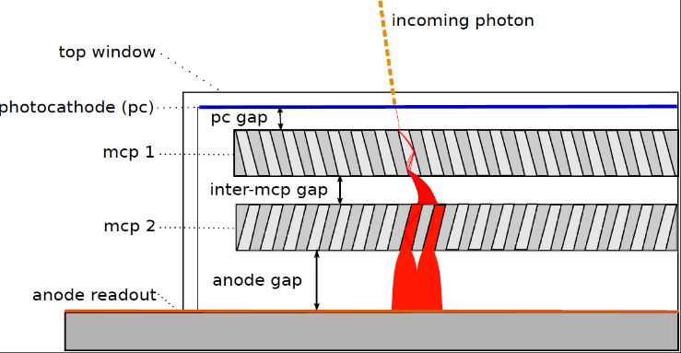
The “Gen-II” LAPPDTM: Large-Area Ceramic-Body Planar MCP-based Photo-Detectors E. Angelico, A. Elagin, H. Frisch, E. Spieglan University of Chicago
Large-Area Picosecond
Photo-Detector
Gen-I LAPPDs are now commercially
available through Incom Inc.
20x20 cm²
~15mm
Gen-II LAPPD development is a joint program between the University of
Chicago and Incom Inc.
Single PE time resolution <50ps

Slide 2
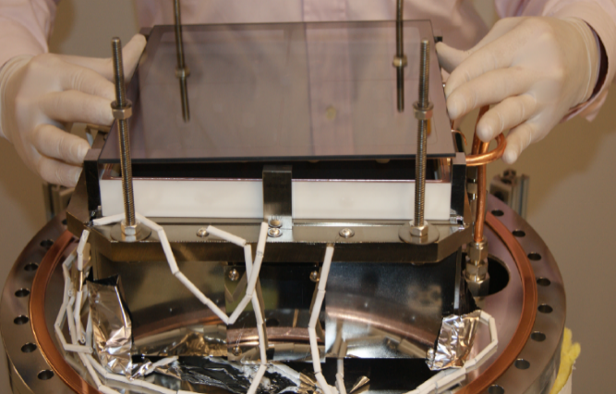
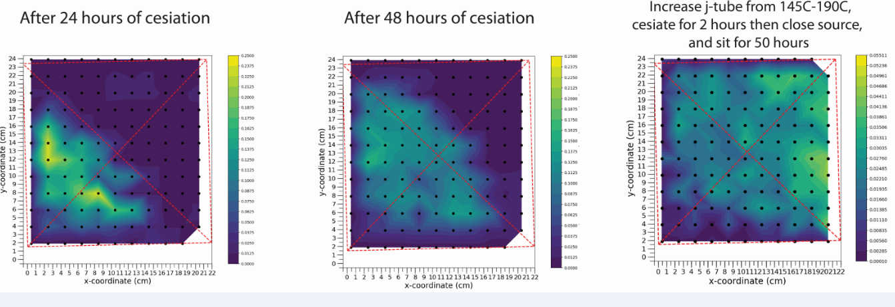
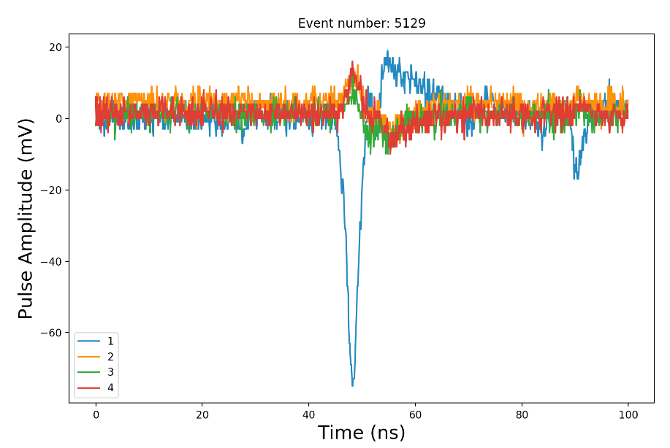
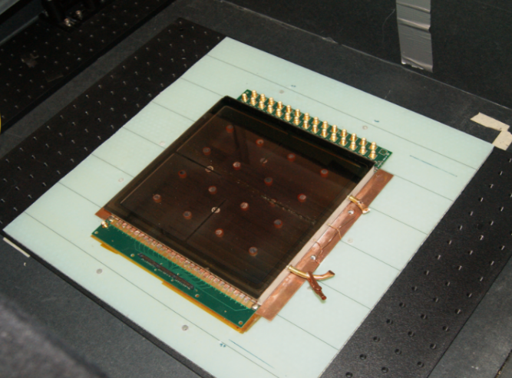
PMT-like Batch Production
Air transfer of the window
with pre-deposited Sb layer
The goal is to develop an inexpensive process
scalable to a production rate of > 50 LAPPDs/week
Indium seal and bake-out are done at the same time
Cs vapors are introduced from an external source
Many devices can be processed at the same time
using shared vacuum distribution system
A photo-sensitive material
(Cs-Sb) is formed over the
entire 20x20cm² surface
of the window
Arbitrary units
Arbitrary units
Gen-II LAPPD tile #21
Pulses from tile #21
MCPs work after
exposure to Cs

