Slide 1
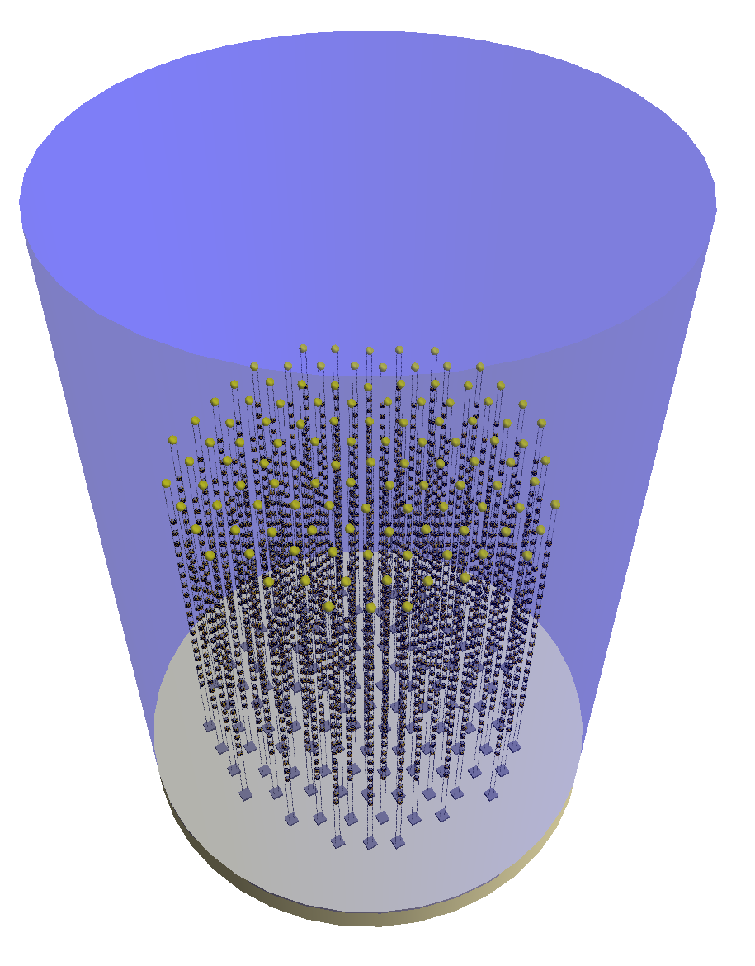
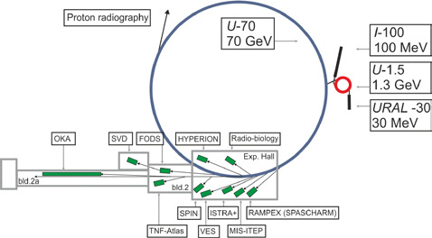
LBL Experiment Protvino - ORCA
KM3NeT/ORCA detector under construction, first neutrinos seen
Ready within few years, many Mtons fiducial volume
Protvino U70 proton accelerator operational at E_{p} = 70 GeV
Neutrino beam (to be constructed) at E_{ν} = 2-7 GeV is optimal for baseline of 2590km
115 lines, 20m spaced
18 DOMs/line 9m spaced
1.5 km circumference
Intensity upgrade
Injector - booster
Staged approach ?

Slide 2
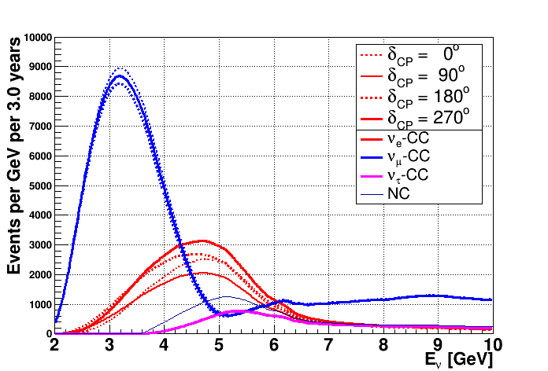
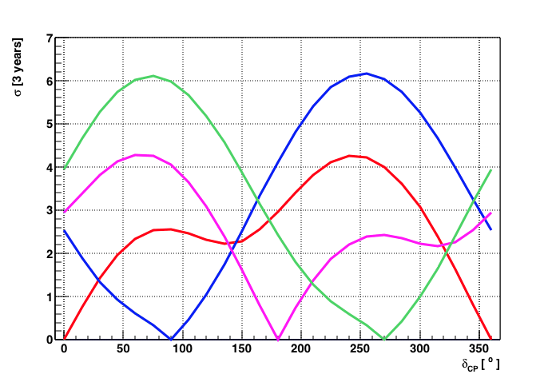
Physics potential
Both Neutrino Mass Hierarchy and CP violation accessible
No degeneracies, small cross section systematics
First high statistics LBL experiment
3 years at 450kW running → ν_{e} event rate varies by 3300 events with CP phase !
High precision measurement of δ_{CP} within few years
σ contours of 4 test points
Events
6600-9300
31000 ± 500
3520 ± 30
5900
KM3NeT/P2O
preliminary
KM3NeT/P2O
preliminary

