Slide 1


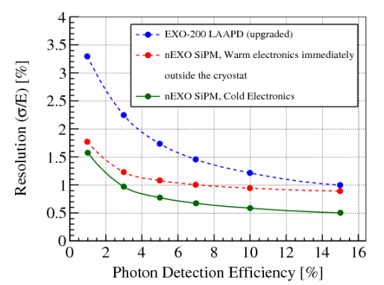
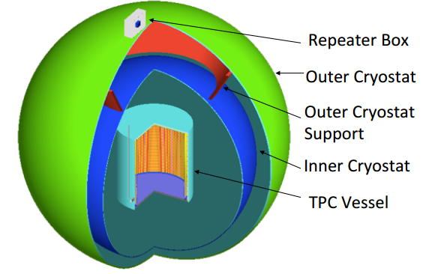
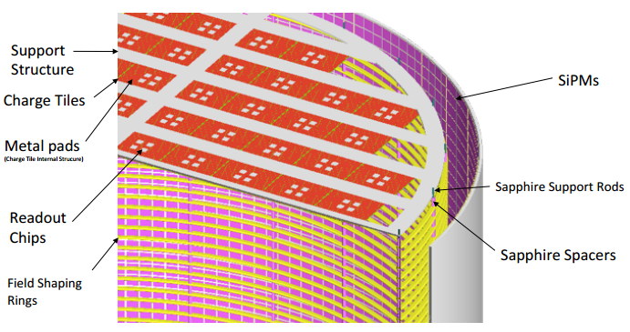
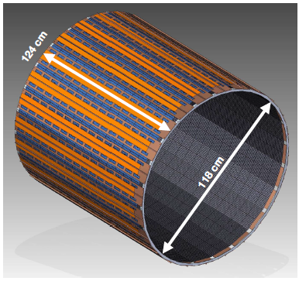
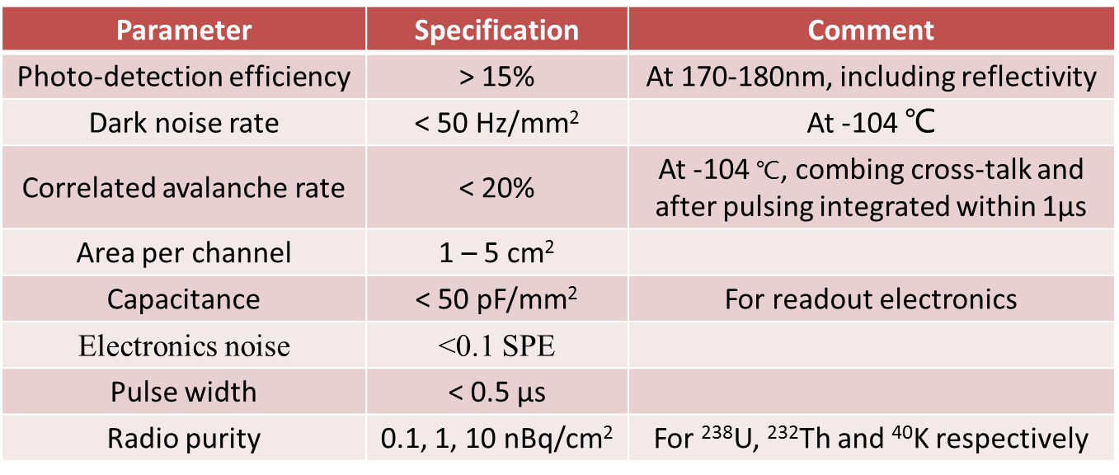
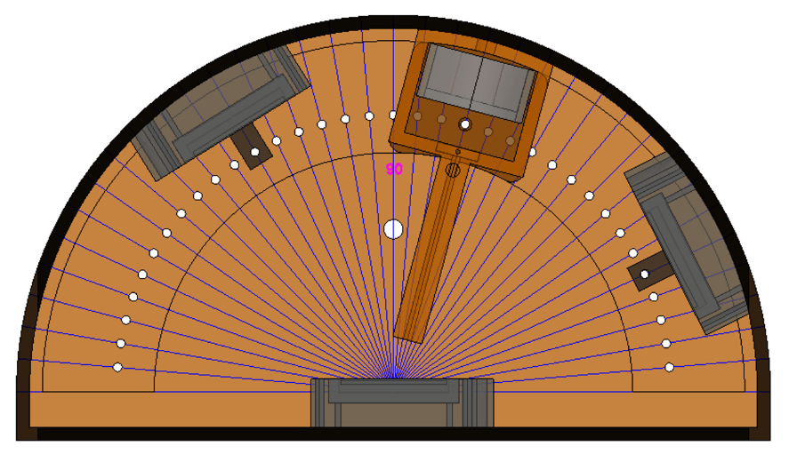
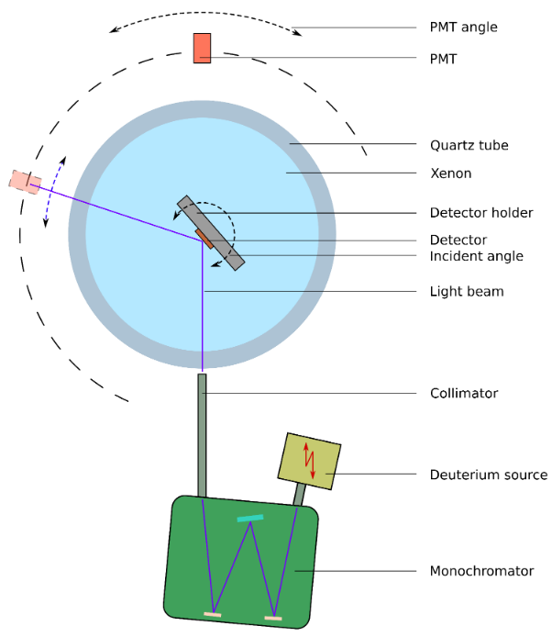
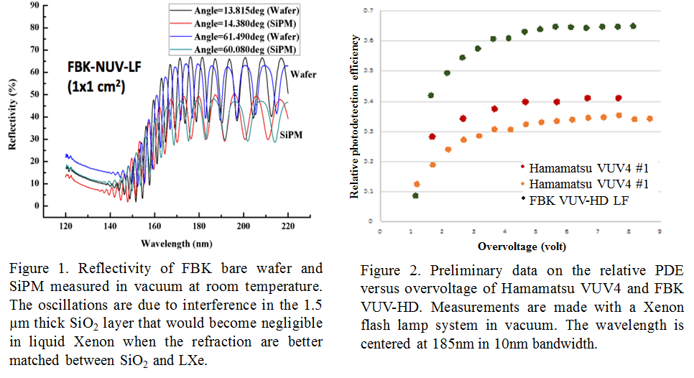
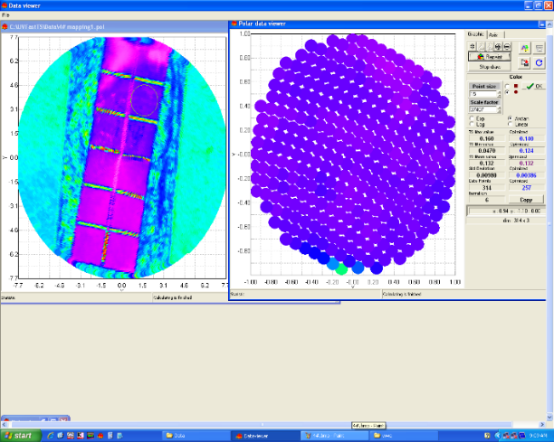
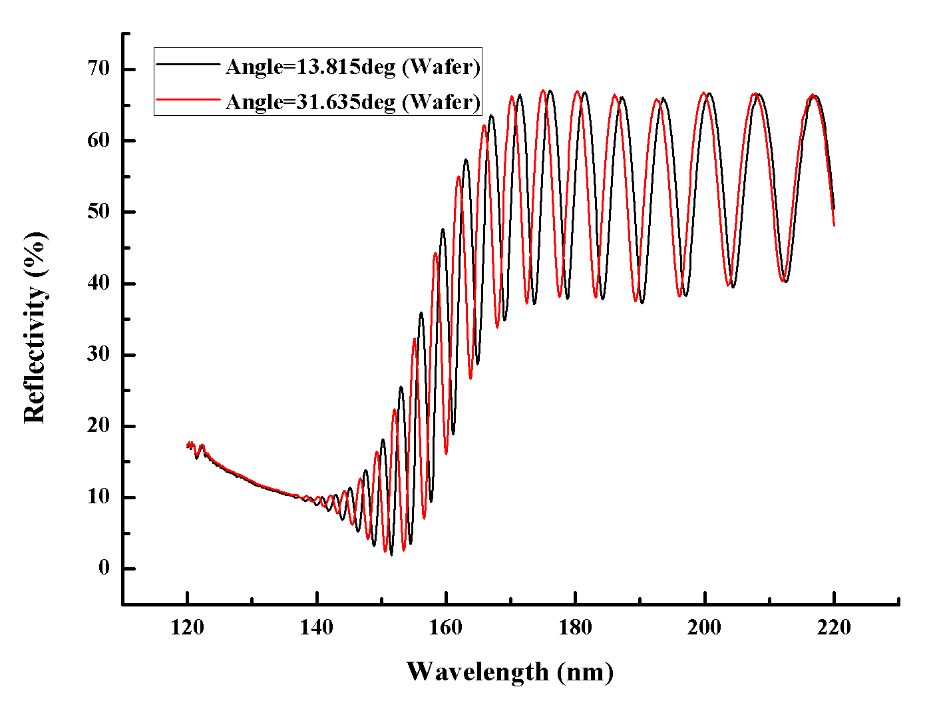
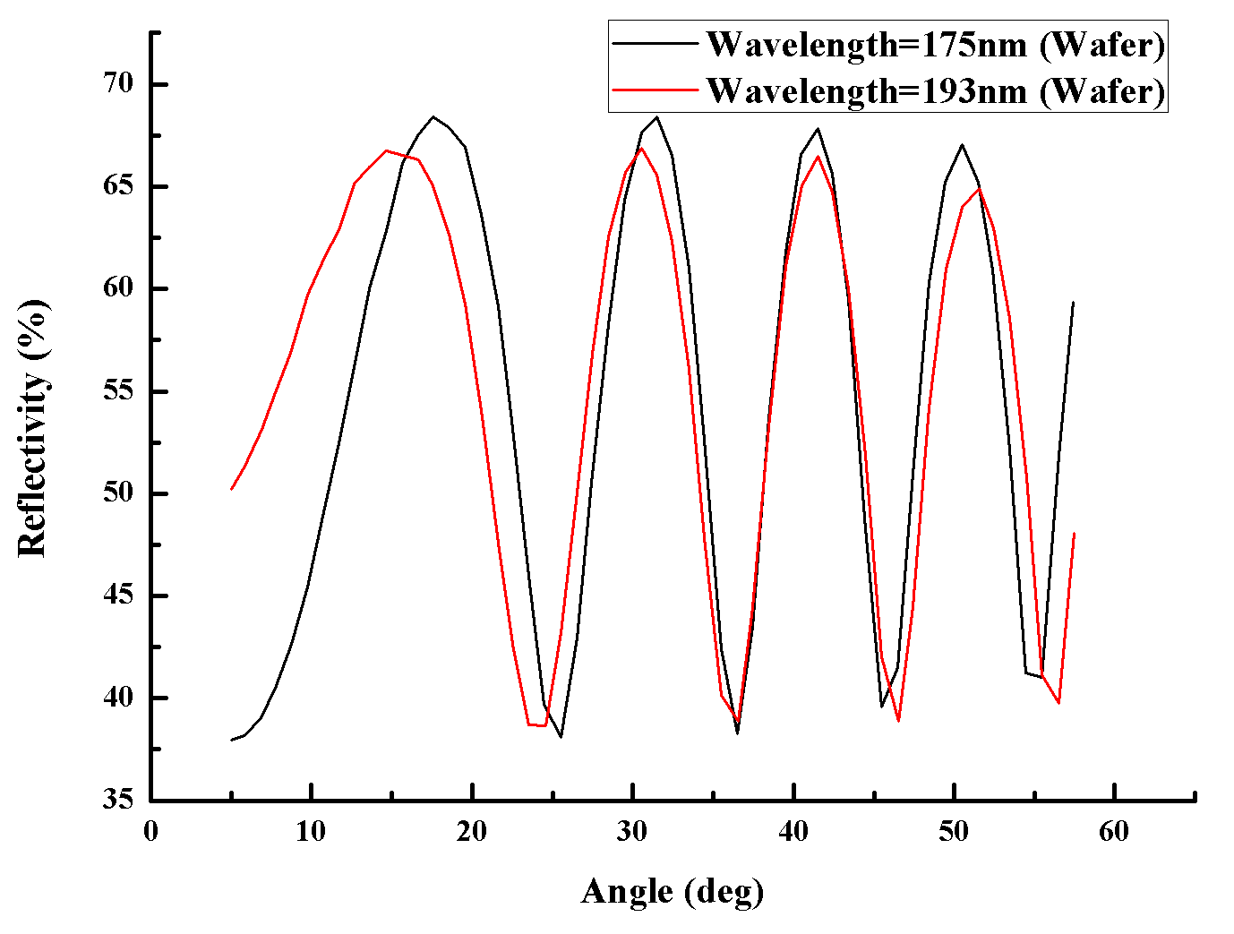
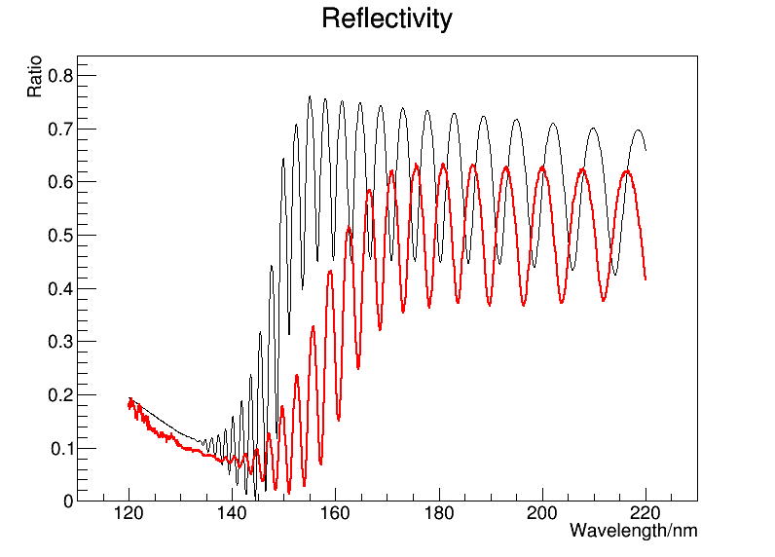
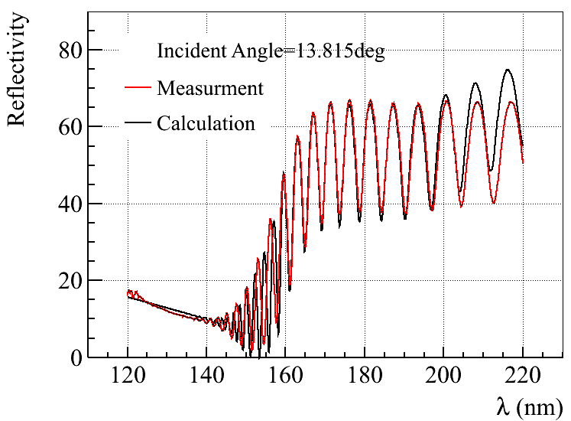
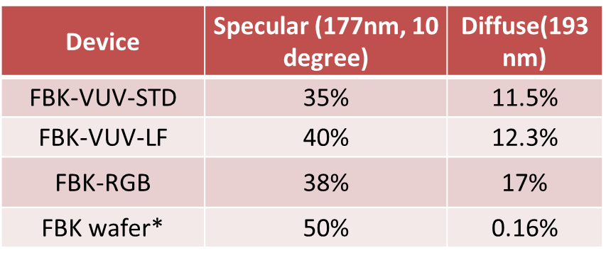
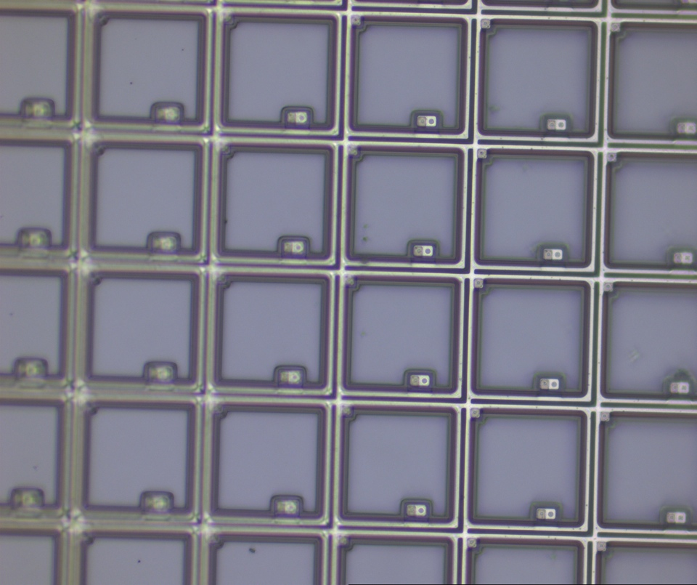
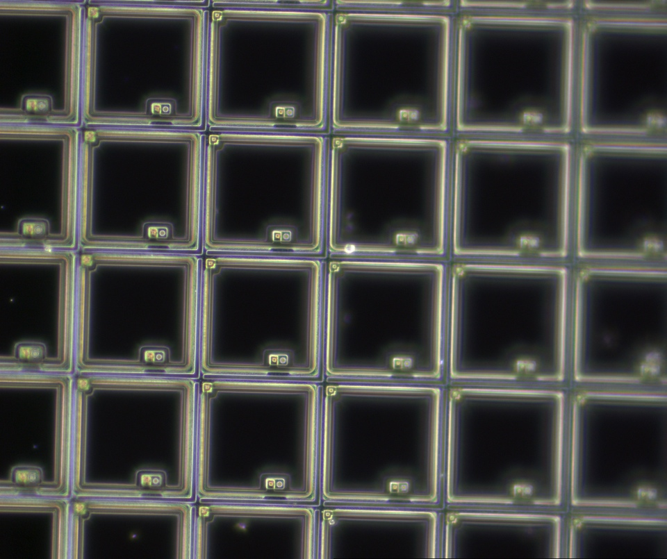
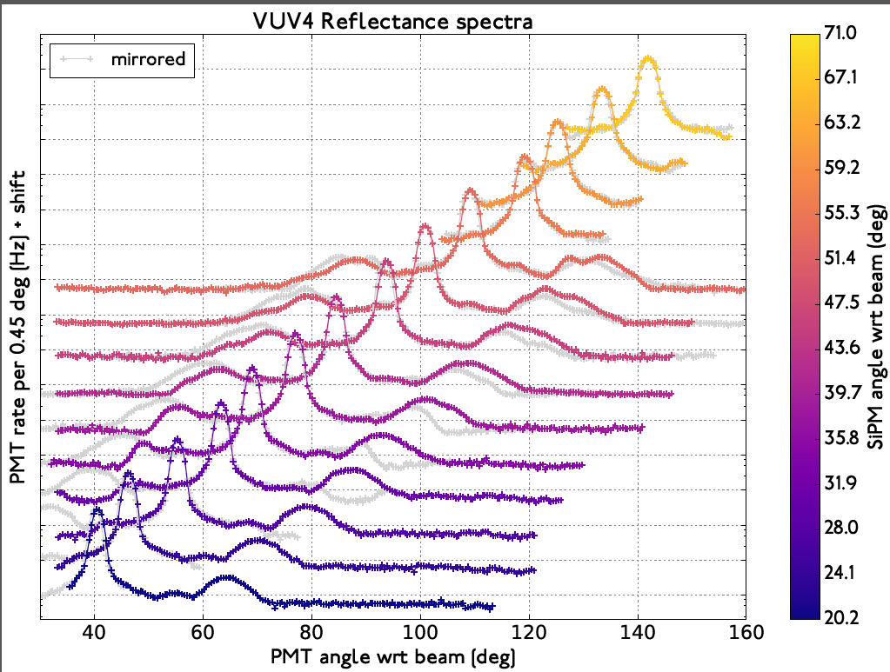
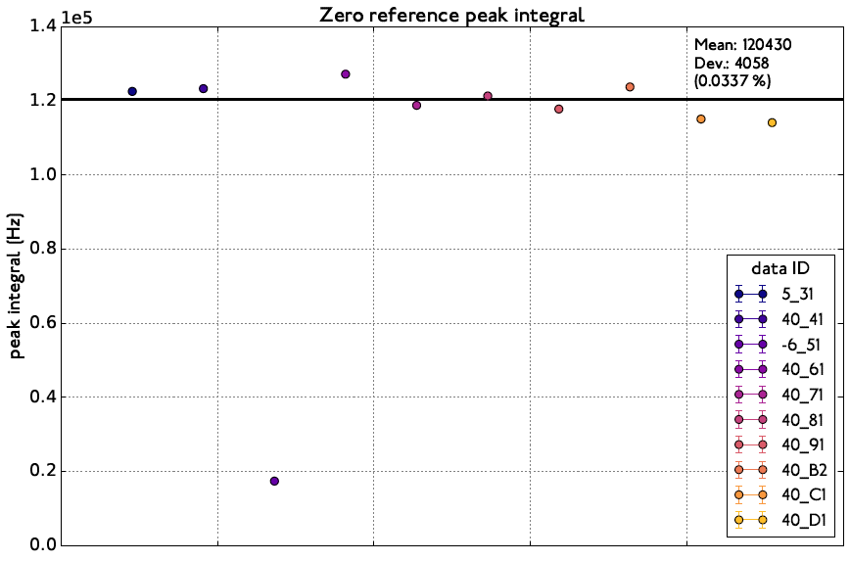
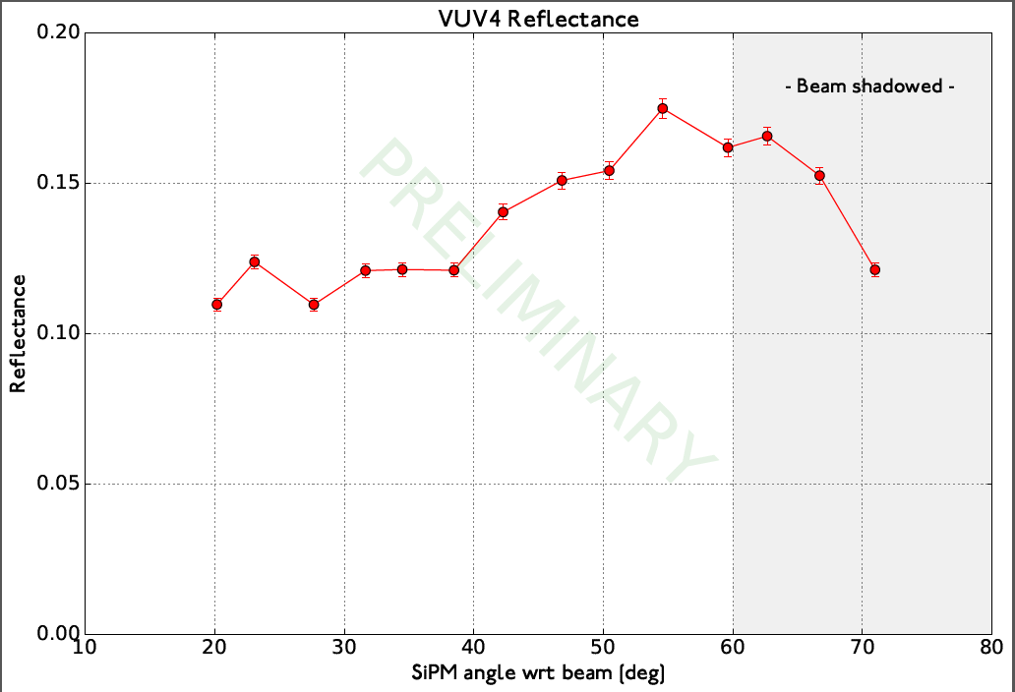

Study of Photon Transport in nEXO
Pin Lv
On behalf of nEXO collaboration
Institute of High Energy Physics (IHEP, China)
nEXO Program
Photo-Detector System
Photon Detection Efficiency
Extrapolated from EXO-200.
A monolithic detector -- 5 ton enriched liquid Xenon TPC.
A pad like charge readout tile used to collect charges.
Large area VUV sensitive SiPMs used to collect 175nm scintillation lights.
Designed energy resolution is 1% at Q-value.
Sensitivity of nEXO [1]: T_{1/2} = 9.2×10²⁷ years (90% C.L.) at 10 years exposure, covering the Inverted Hierarchy.
Total area: ~4.5 m², area per channel: 5-6 cm².
Photon detection efficiency (PDE) is important for desired energy resolution.
R&D items
  SiPM characterization
  Reflectivity measurements
  SiPM performance in high field
  Silicon/quartz interpose
  Large area testing
Requirements
The overall detection efficiency for LXe scintillation light in nEXO is affected by the photon transport efficiency (PTE) and photon detection efficiency (PDE) of the SiPMs.
PTE
nEXO detector geometry
Reflectivity of components in TPC
Reflectivity of SiPMs (>50% for VUV)
PDE
  Fill factor × QE × Transmittance × P_{trigger}
So, PTE and PDE of SiPM are coupled by the reflectivity, which therefore becomes an important parameter to be
measured
More details about SiPM PDE, please see poster#74 “Characterization of VUV-Sensitive SiPMs for nEXO ”
Setups of Reflectivity Measurement
Reflectivity measurements in vacuum or N₂/Ar
* IHEP
& Work with flowing nitrogen or argon.
& 3D measurements, automatically controlled
& Both specular and diffused reflectivity
& Wavelength: 115 nm - 400 nm
& Beam diameter: < 5 mm
& Under testing
Reflectivity Measurements in Liquid Xenon
* LIquid Xenon Optical (LIXO) at University
of Alabama
Institute of Optical and Electronics (IOE), China
& Specular reflectivity measurement
# Angle of incidence: 6-60°
# Wavelength: 115nm-400nm
# Beam Diameter: <5mm
& Diffused reflectivity measurement
# Integral sphere, a hole on the sphere
to exclude specular reflection light
# Wavelength: 193nm
# Beam diameter: ~1mm
& Both setups are commercial and
available.
Light source
* Friedrich –Alexander University (FAU)/University of Münster
& Specular reflectivity
& Measured in LXe, low temperature
& Wavelength: 115nm-400nm (D₂ lamp)
& Scanning angle: 0 – 150 degree
& 1-D measurements
& Specular + diffused
& Available
Holder2
Holder3
Holder1
Light source
The reflection sample/SiPM holder1, the holder2 for the SiPM in specular peak position, and holder3 for the SiPM to monitor diffusely reflected light
SiPM
* 1-D measurement, under commissioning.
* ²⁵²Cf used to generate LXe scintillation light
PMT
vvvvv
Reflectivity Results Measured in Vacuum (Preliminary)
Comparison: measurements and Fresnel calculations
  The refractive indices of Si and SiO2 were taken from literature [2].
  The thickness of SiO2 was measured by the manufacturer FBK.
Thin-film interference
Pure silicon wafer with 1.5 um SiO₂ fabricated by FBK.
  Using IOE setups
  Reflectivity versus wavelength (120 nm – 200 nm)
  Reflectivity versus angle of Incidence (AOI) (6° – 60°)
Red: calculation
Blue: measurement
Diffuse Reflectivity of FBK-RGB
Black: calculation
Red: measurement
Measured SiPM Reflectivities
Reflectivity vs Wavelength
Reflectivity vs AOI
with (n, k, d) from literature
with fitted (n, k, d)
The oscillation is caused by interference due to the thin SiO₂ layer.
Only examples are shown here.
The calculation did not agree with measurement!
Good agreement obtained by fitting n, k, d to measured data
Reflectivity Results Measured in LXe @Münster (Preliminary)
Summary
The reflectivity of Hamamatsu VUV4 in LXe
  VUV4 (S13370-6519, 6x6 mm, 50 µm pitch)
  Very clear specular reflection peaks!
  PMT dark rate has been measured and subtracted
  Secondary peaks symmetric around specular peak, which may caused by SiPM structure.
  VUV4 reflectivity in LXe seems to be low.
It`s important for nEXO to measure the reflectivity of components in TPC, especially for SiPMs.
The reflectivity of SiPMs and a pure siliconSeveral setups for reflectivity measurements have been established
wafer have been measured in vacuum and LXe.
Ongoing efforts
Contact
Pin Lv email: lvpin@ihep.ac.cn Tel: +86 (010) 88236807
We accidentally positioned
a rod in front of the PMT
thus blocking the light.
Reference
[1] nEXO collaboration, J. B. Albert et al., arxiv:1710.05075.
[2] http://www.rit.edu/kgcoe/microsystems/lithography/thinfilms/thinfilms/
thinfilms_mobile.html
The reflectance spectra for 14 different incident angle
PMT rate of incident light (zero reference)
The reflectivity for different angles of incicence
你好

