Slide 1

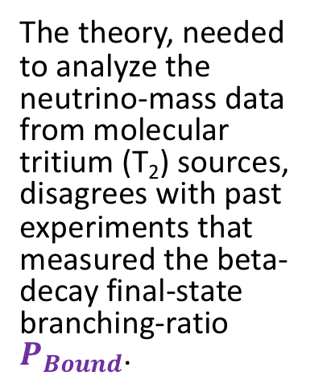
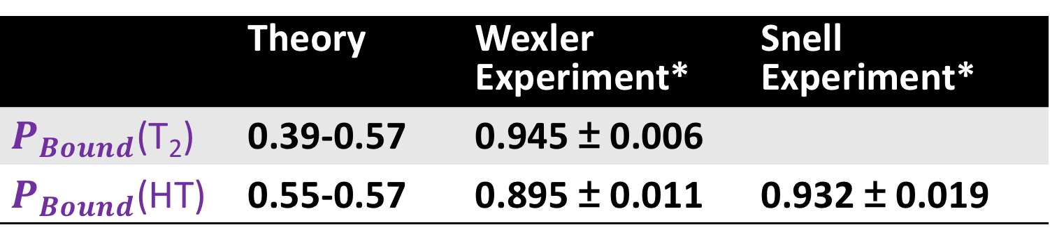

#6
(Poster No.)
Tritium Recoil-Ion Mass Spectrometer
Ying-Ting Lin for the TRIMS collaboration
The theory, needed to analyze the neutrino-mass data from molecular tritium (T₂) sources, disagrees with past experiments that measured the beta-decay final-state branching-ratio $P_{Bound}$.
$P_{Bound}$= $\frac{N_{Bound}}{N_{Bound} + N_{Dissociated}}$
 | Theory | Wexler Experiment* | Snell Experiment*
$P_{Bound}$(T₂) | 0.39-0.57 | 0.945 ± 0.006
$P_{Bound}$(HT) | 0.55-0.57 | 0.895 ± 0.011 | 0.932 ± 0.019
*cannot be directly compared to theory
S. Jonsell, A. Saenz,
P. Froelich, PRC 60, 034601 (1999)
S. Wexler, J. Inorg. Nucl. Chem. 10, 8 (1959)
A. V. Snell, F. Pleasonton,
H. E. Leming, J. Inorg. Nucl. Chem. 5, 112 (1957)
TRIMS: Tritium Recoil-Ion Mass Spectrometer

Slide 2
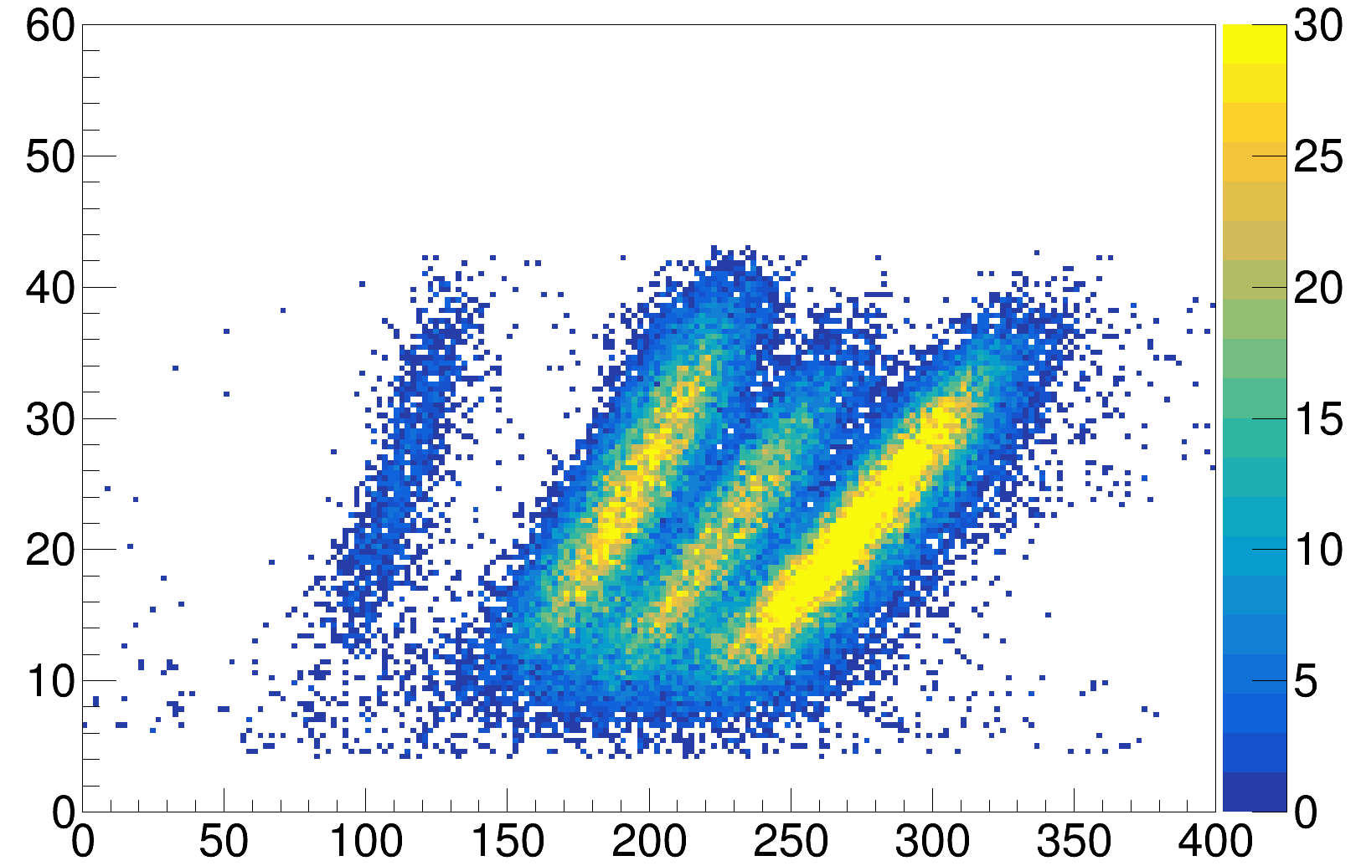
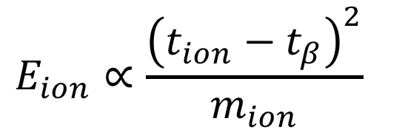
Physics Data (T₂, HT mixture): Energy vs TOF
Count
T⁺&³He⁺
³HeT⁺
$$E_{ion}∝\frac{{\left(t_{ion}−t_{β}\right)}^{2}}{m_{ion}}$$
³HeH⁺
Ion Energy (keV)
H⁺
Preliminary
Time-of-Flight (TOF) difference (ns) $≡$ (ion TOF) – (beta TOF)
TRIMS: Tritium Recoil-Ion Mass Spectrometer

