Slide 1


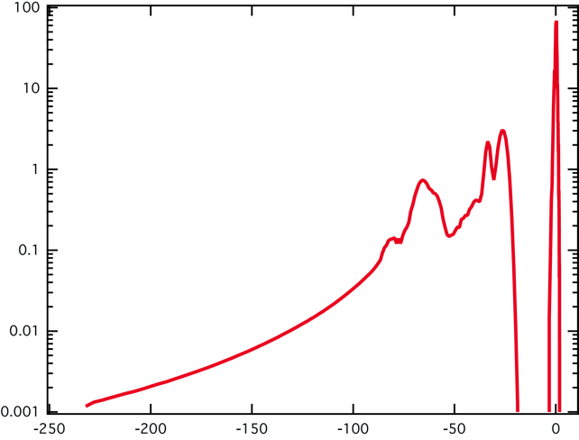
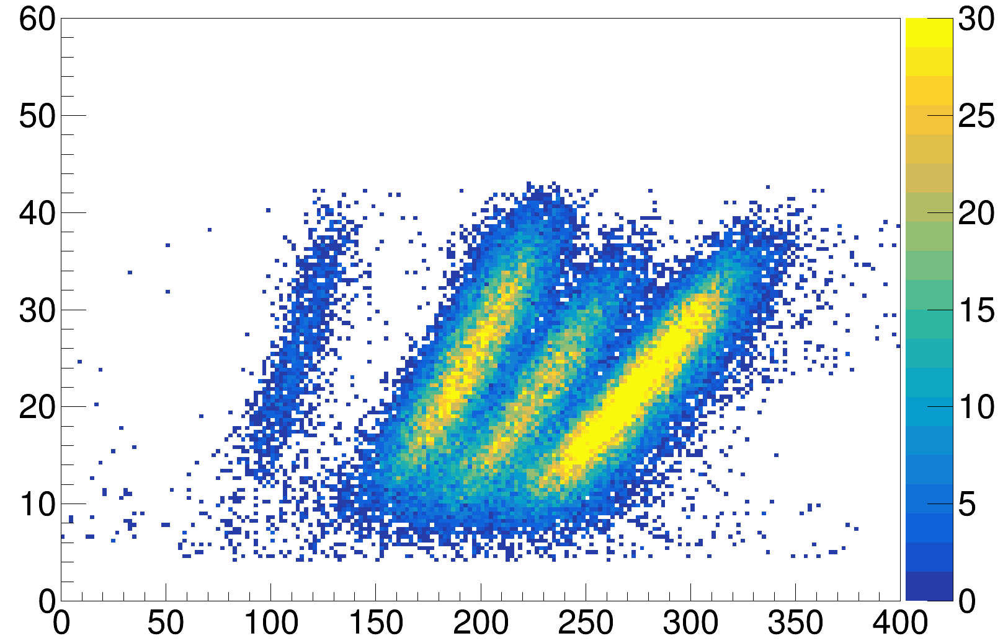
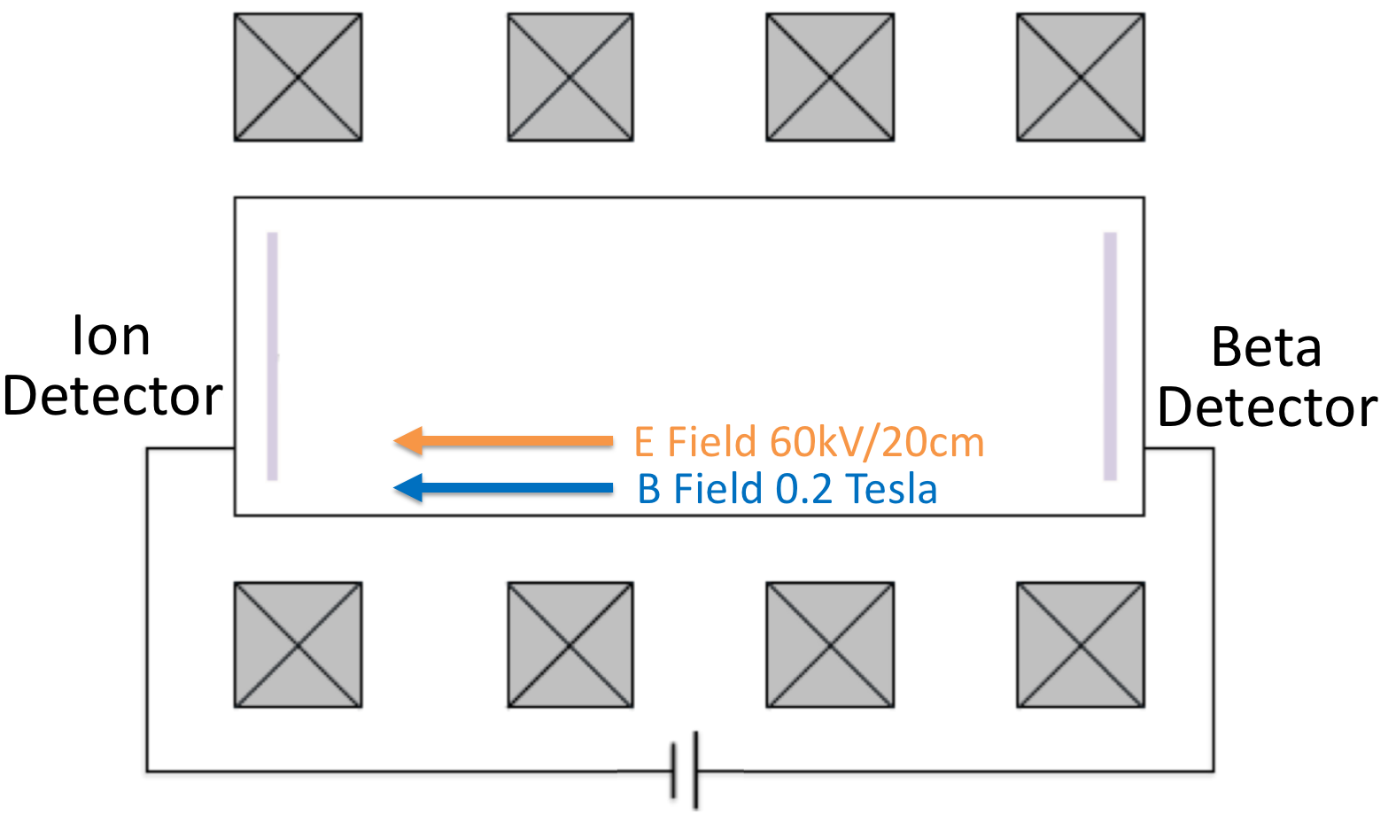
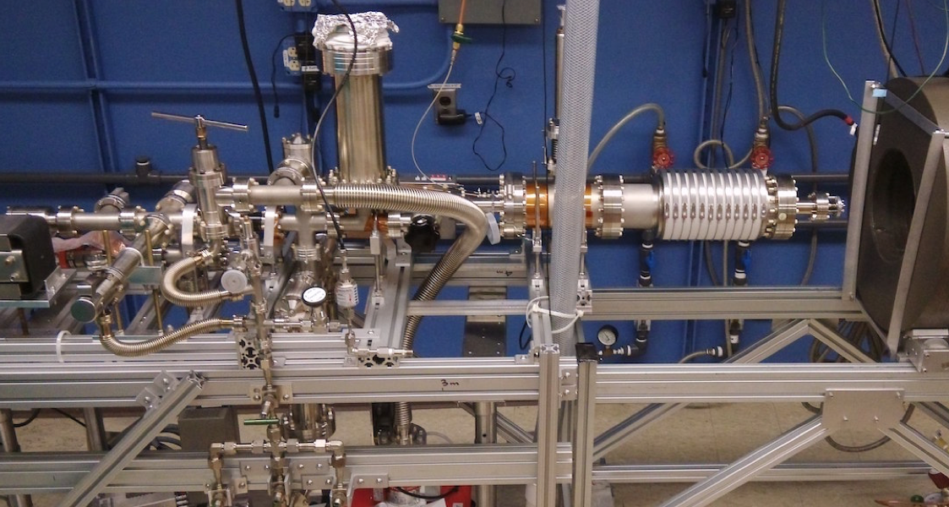

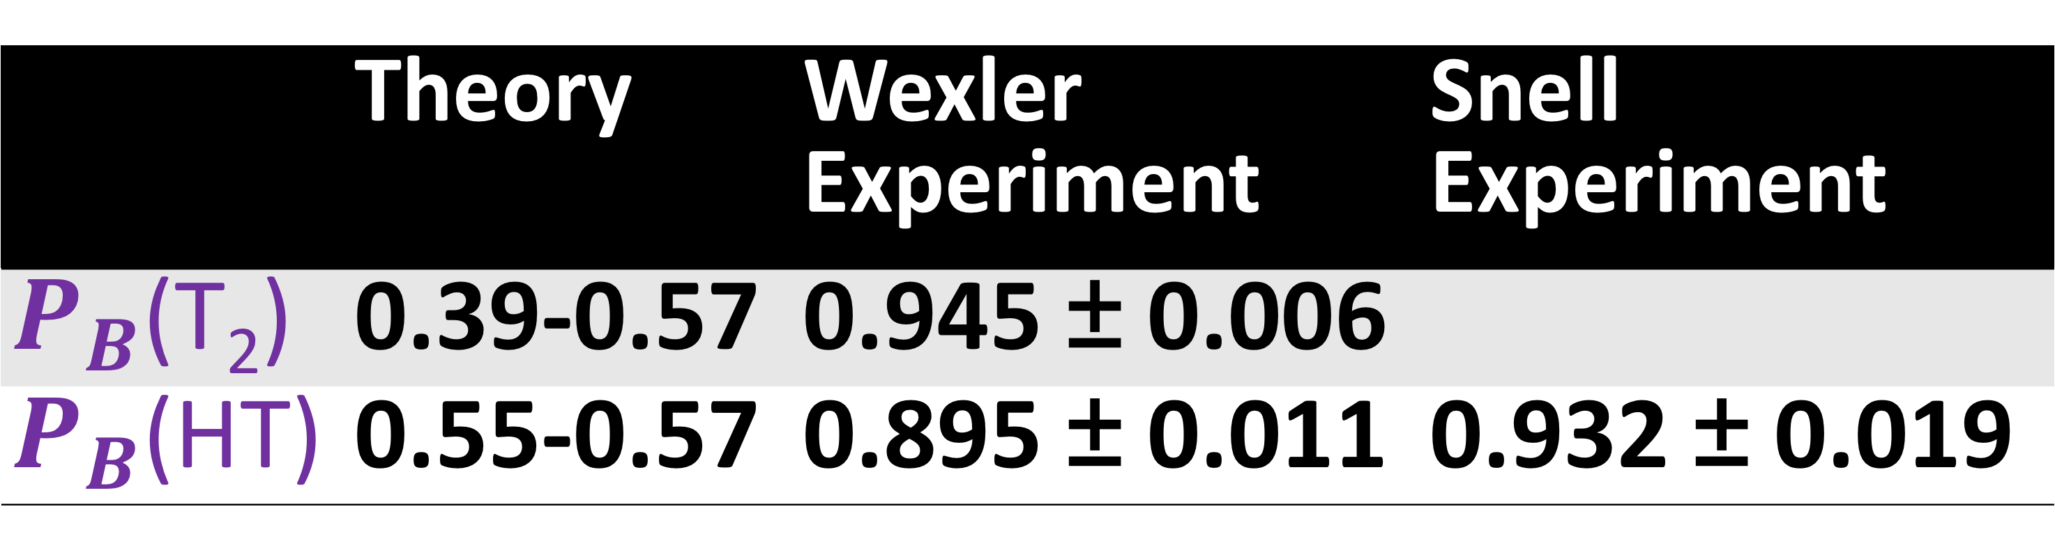
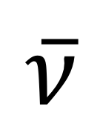
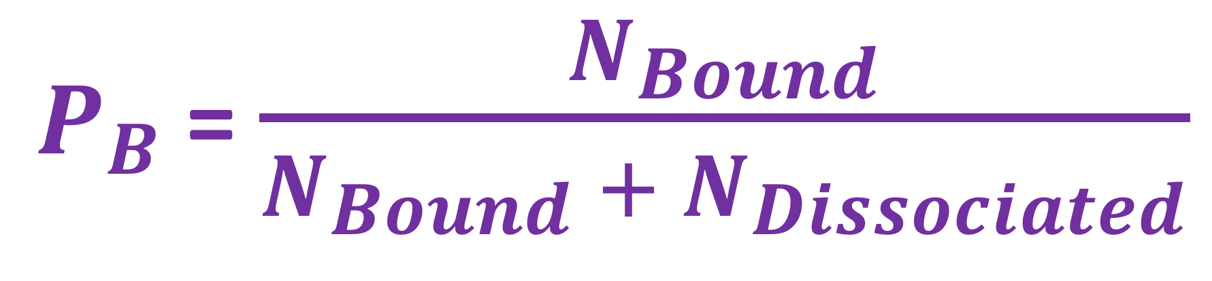
Tritium Recoil-Ion Mass Spectrometer
Ying-Ting Lin for the TRIMS collaboration
Branching-Ratio of Tritium Molecular Final States
T₂ Final State Distribution
(theoretical)
The molecular tritium (T₂) beta spectrum, needed for analyzing neutrino-mass data from T₂ sources, depends on molecular final states involving electronic, rotational, and vibrational excitations
Theory and experiment agree on energy levels
Direct measurement of the final-state distribution is, however, impossible
Theory and experiments from 1950s have an outstanding discrepancy on P_{B}!
$$\overline{ν}$$
e
Relative Probability (%/eV)
e⁻
³HeT⁺
Binding Energy (eV)
A. Saenz, S. Jonsell,
P. Froelich, PRL 84, 242 (2000)
 | Theory | Wexler Experiment | Snell Experiment
$P_{B}$(T₂) | 0.39-0.57 | 0.945 ± 0.006
$P_{B}$(HT) | 0.55-0.57 | 0.895 ± 0.011 | 0.932 ± 0.019
$P_{B}$= $\frac{N_{Bound}}{N_{Bound} + N_{Dissociated}}$
Direct comparison is difficult:
Theory applies to the beta spectrum near the end point, but the experiments measure the integral
Radiative vs dissociative lifetime is not well understood
The TRIMS Experiment
Physics Data
(T2, HT mixture)
Project goal: obtain the branching-ratio to the bound molecular state ³HeT⁺
By comparing the ion energy and the time of flight (TOF), we can distinguish the ion species by their masses
Count
H⁺
T⁺&³He⁺
³HeT⁺
{
{
{
{
³HeH⁺
Ion Energy (keV)
Ion Timing – Beta Timing (ns)
Outlook
TRIMS addresses the only known experimental disagreement with T₂ final-state theory
We are currently recording data for a percent-accuracy branching-ratio measurement for both T₂ and HT
We will measure the branching-ratio of doubly charged final states
References
Acknowledgments
L. I. Bodine, D. S. Parno, R. G. H. Robertson, Phys. Rev. C 91, 035505 (2015)
J. Angrik et al, KATRIN, FZKA-7090 (2004)
S. Jonsell, A. Saenz, P. Froelich, Phys. Rev. C 60, 034601 (1999)
A. Saenz, S. Jonsell, P. Froelich, Phys. Rev. Lett. 84, 242 (2000)
A. V. Snell, F. Pleasonton, H. E. Leming, J. Inorg. Nucl. Chem. 5, 112 (1957)
S. Wexler, J. Inorg. Nucl. Chem. 10, 8 (1957)
US DOE Office of Science, Office of Nuclear Physics, Award No. DE-FG02-97ER41020.
Notes:
- Binding energy until dissociation is ~3keV

