Slide 1
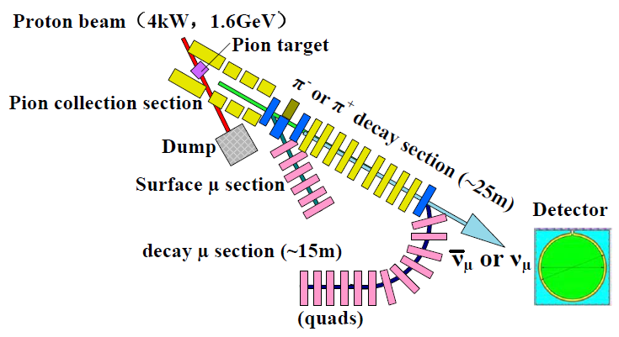
The Neutrino Beam of Experimental Muon Source at China Spallation Neutron Source
Nikos Vassilopoulos, IHEP, CAS

Slide 2
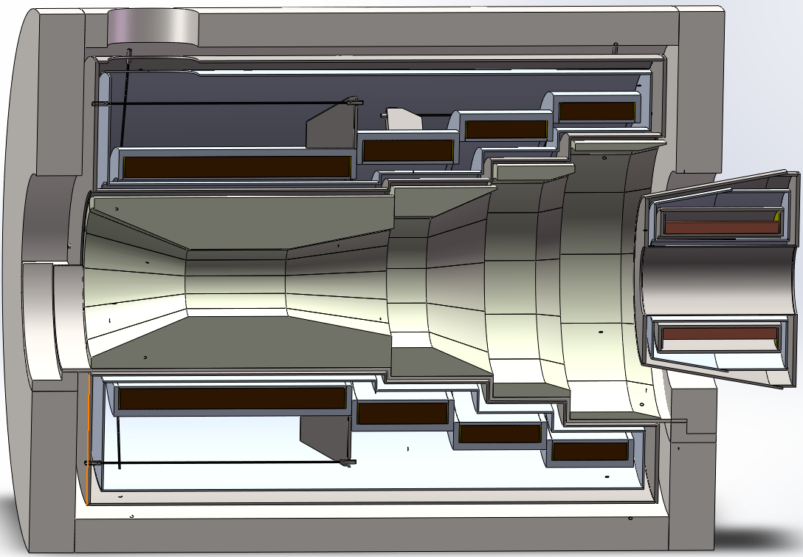
Description and motivation
Description
The experimental muon source project EMuS is foreseen at China Spallation Neutron Source and is being optimized for both muon and neutrino experiments
It is primarily intended for muon science as μSR techniques in matter physics and chemistry while its neutrino beam is an option for cross section measurements if valuable
Staged and cost-conscious design approach
Motivations
lack of recent cross section measurements at lower energies
R&D platform for MOMENT, a future muon-decay medium-baseline neutrino beam facility in China
EMuS as high power targetry and accelerator R&D platform
EMuS full scheme:
Schematics of the 5 T adiabatic capture SC solenoid:
Vacuum Cryostat
Baseline experimental scheme
Coil support
Thermal shield
p 100%
1st-coil
~52%
Gr target
W shields
SC coils

Slide 3
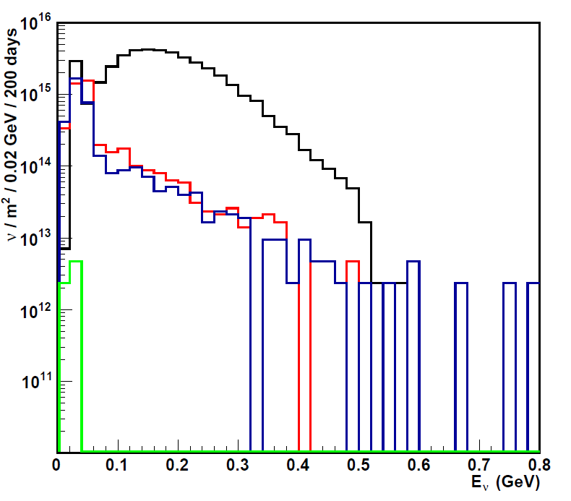
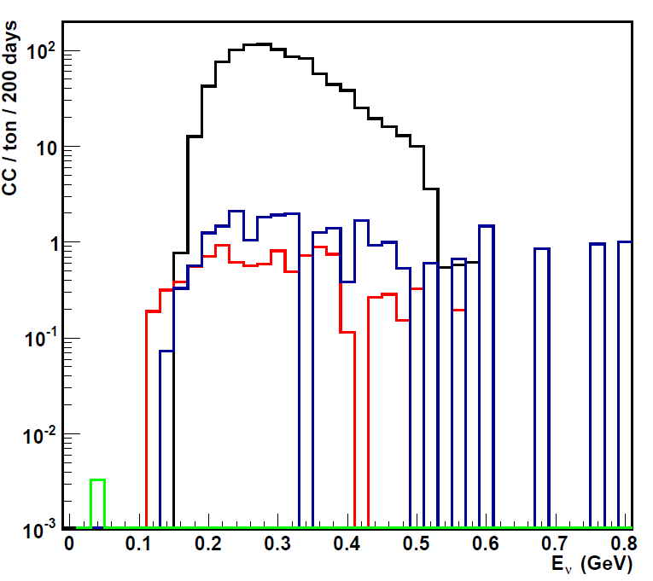
Results for the neutrino beam
Simulation parameters
Neutrino beam from pions at 3 m downstream of decay tunnel
100 % π⁺/π⁻ separation
Decay tunnel: L = 25 m, aperture = 30 cm
Flux ν_{μ} , <E_{ν}> ~ 200 MeV
CC ν_{μ} , <E_{ν}> ~ 300 MeV
-
ν_{e}
ν_{μ}
-
ν_{μ}
ν_{e}
1-8% stat. error, FLUKA | Ν _{ν} (x10¹⁶) / m² / 200 days |  | CC / ton / 200 days
 | > 53 MeV | % |  | %
ν_{μ} | 3.78 | 94.5 | 959 | 96.5
ν_{μ} | 0.13 | 3.2 | 10 | 1
ν_{e} | 0.09 | 2.3 | 25 | 2.5
ν_{e} | - | - | 0.004 | -
-
-
Detector performance analysis needed in order to investigate its value
CC ν_{μ} at <E_{ν}> = 300 MeV at EMuS
~ 1000 CC events / ton / year at CSNS – I
x 50 with capture system and decay channel upgrades at CSNS-IΙ
Preliminary study for the muon beam shows severe reduction in neutrino flux

