Slide 1
Integrated phase locked loop design
Nina Parkalian
Forschungszentrum Jülich GmbH
Central Institute for Engineering, Electronics and Analytics
IC Design
18-19 September 2017

Slide 2
Phase locked loop (PLL)
Generating sampling clocks for ADC and digital circuitry
High frequency clock synchronizes with a low frequency reference clock
Programmability to get best performance
Phase locked loop

Slide 3
Design specifications
The parameters of every block is determined to fulfill the requirements of the design:
Loop bandwidth: The optimum quantity is selected to guarantee stability and low
noise operation
Phase noise: Noise requirements are considered to prevent signal to noise
degradation in ADC
Increasing reliability: Due to the long term performance of the design
Power consumption
Area

Slide 4
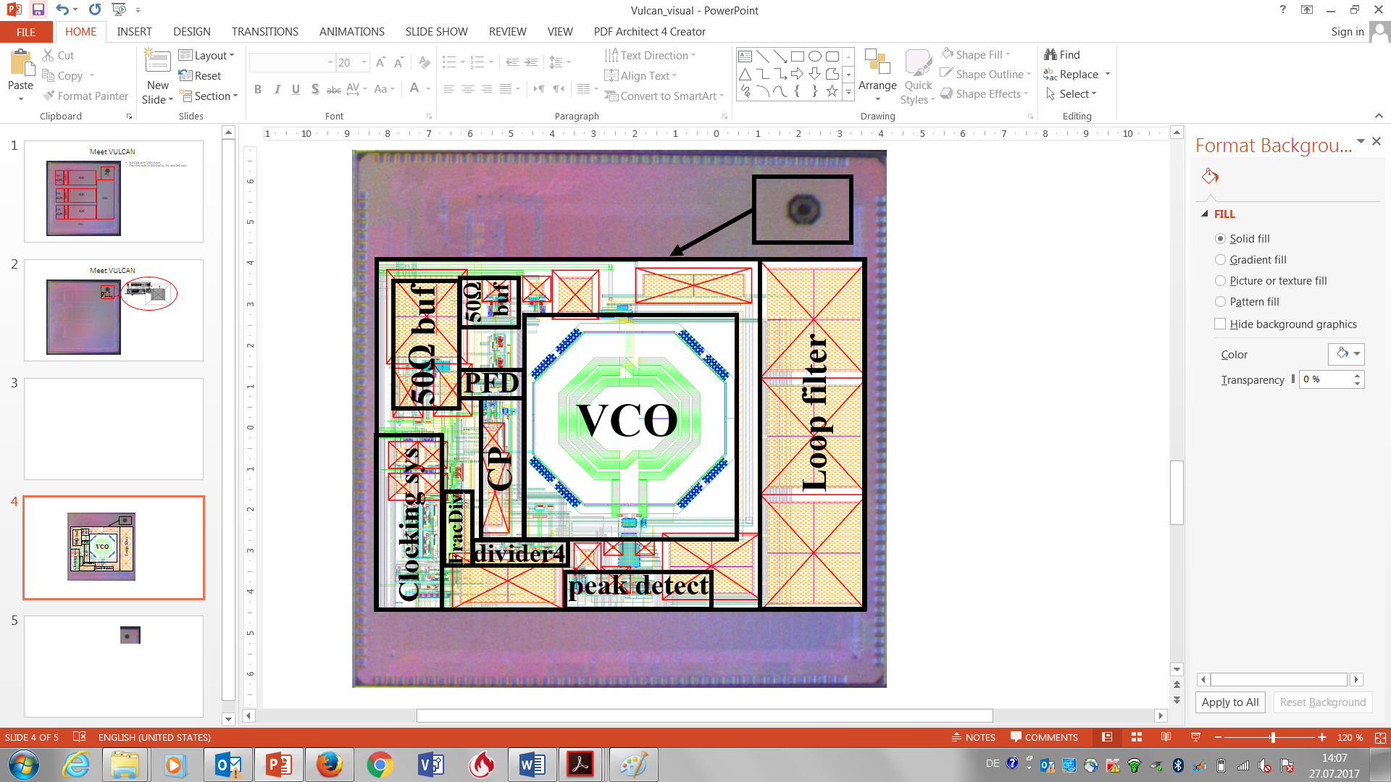
Chip fabrication in 65nm CMOS
The default values for the design parameters include:
Reference frequency: 31.25MHz
Oscillator frequency: 4GHz
Sampling clock frequency: 1GHz
Divison ratio: 128
Programmable options provide the following ranges:
15.625 MHz ≤ reference frequency ≤ 62.5MHz
128 ≤ division ratio ≤ 1008
62.5MHz ≤ sampling clocks ≤ 1GHz
3.6GHz ≤ VCO frequency range ≤ 4.28GHz
Power consumption: 30mW
Area: 0.72µm×0.5µm
Chip micrograph and PLL layout

Slide 5
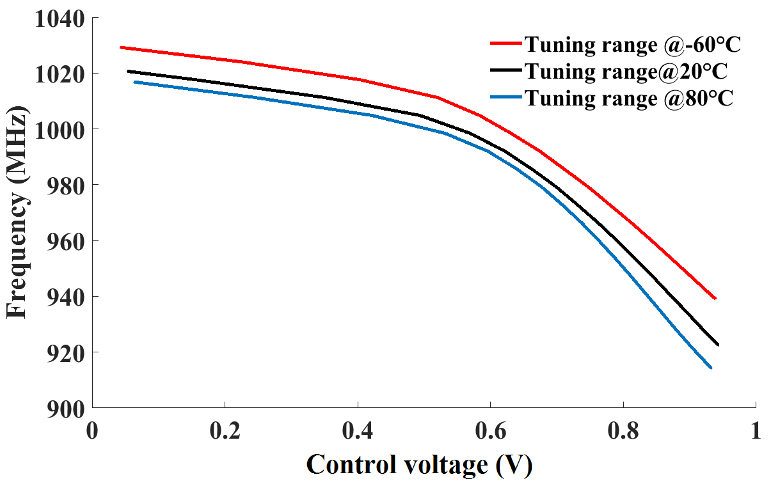
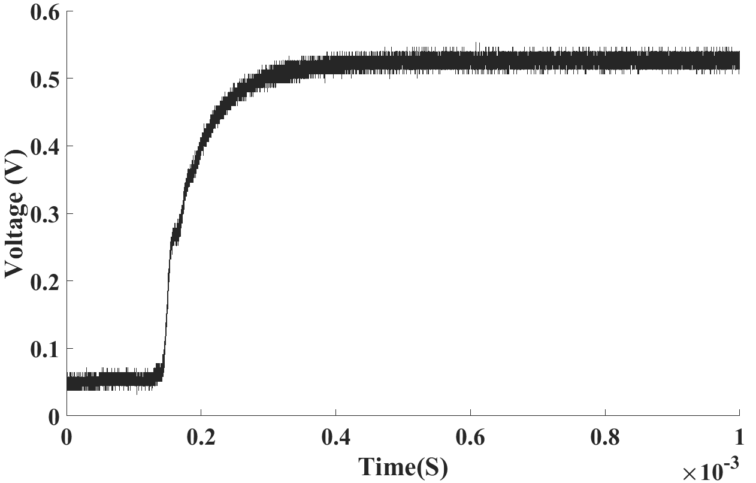
Measurement results
The results of tuning range of oscillator is compatible with the expectations from simulations
Measurements approve the functionality to generate a VCO frequency of 4GHz for sufficient
temperature range
Tuning range of oscillator
Locking process of PLL

Slide 6
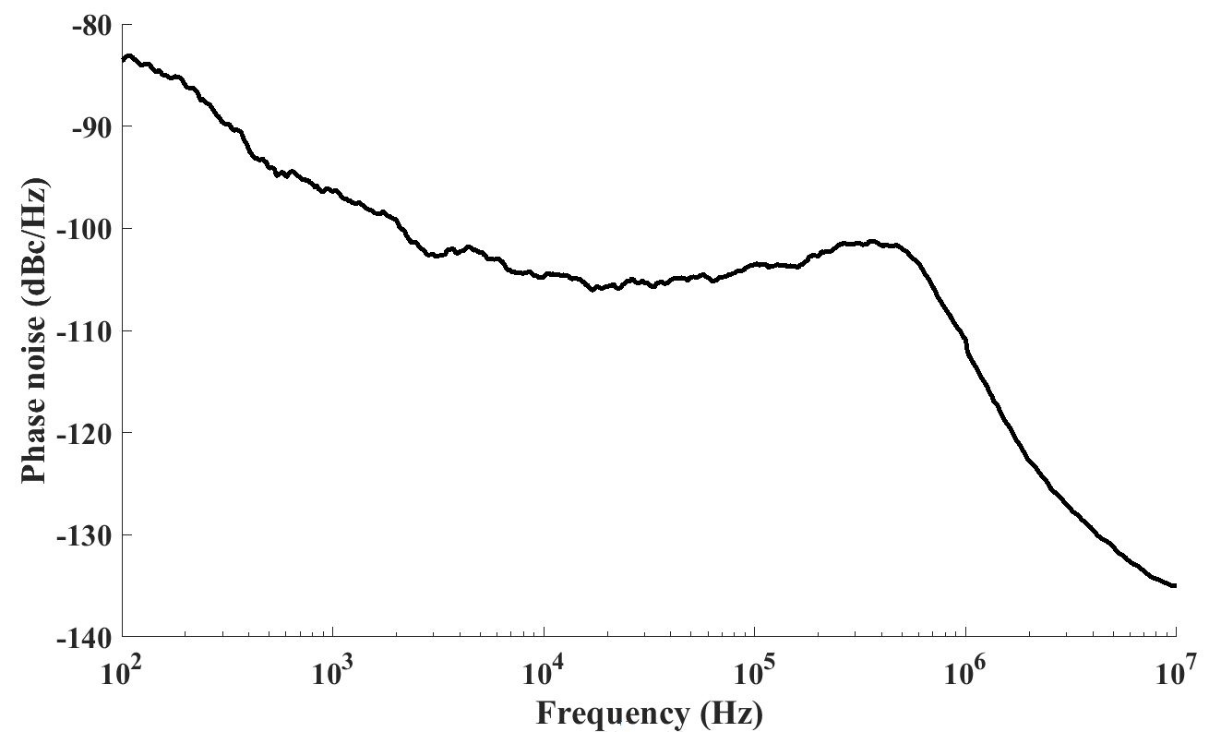
Phase noise
The maximum tolerable jitter for the ADC to prevent SNR degradation is 10 ps_{rms}
The measurements show 1.4 ps_{rms} jitter for the PLL
PLL phase noise
Effect of clock jitter on signal to
noise ratio (SNR) in ADC

Slide 7
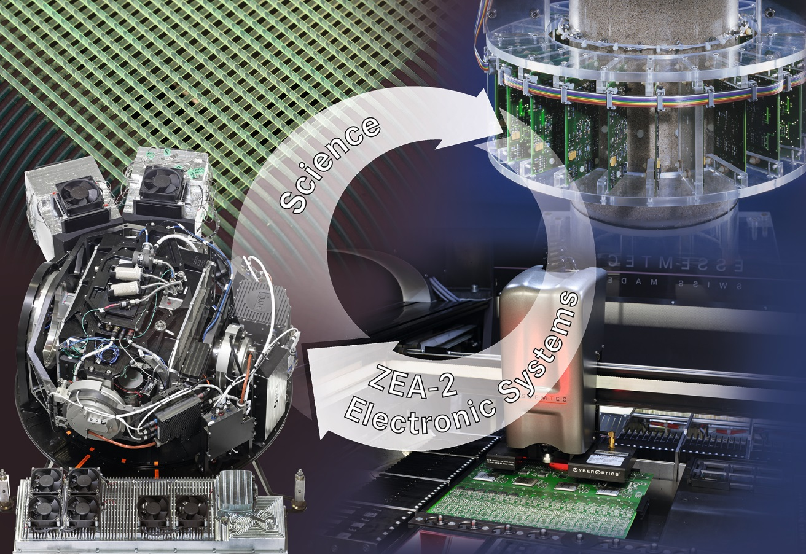
ZEA-2 – System-house for the Science

