Slide 1
VULCAN – Digital Control Unit
September 19, 2017 | Pavithra Muralidharan
On behalf of André Zambanini, Daniel Liebau, Michael Karagounis & Jochen Steinman (RWTH)

Slide 2
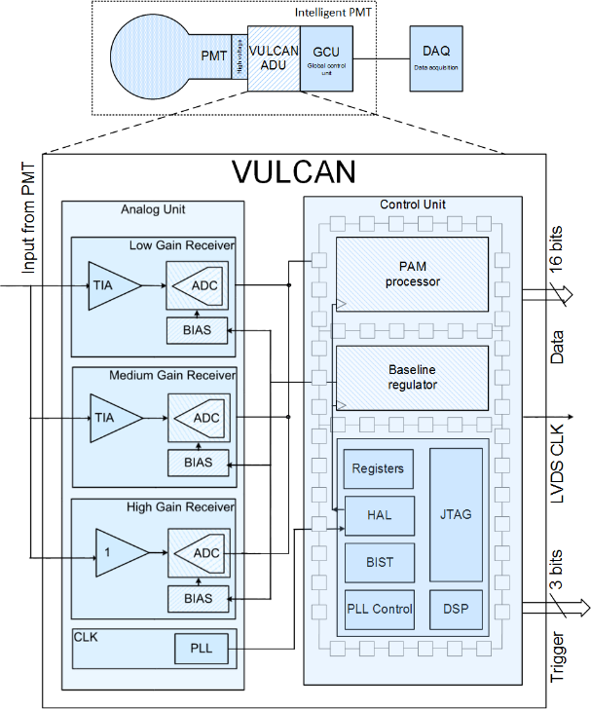
Overview
Vulcan Key Features
Sampling rate | 1 GHz
Bandwidth | 500 MHz
Input impedance | <10 Ω
Dynamic range | 1/16 - 2000 p.e.
ADC resolution High gain Medium gain Low gain | 8 bit [3 ×] 0.06 p.e./bit 0.4 p.e./bit 8 p.e./bit
Power | 1 W
Area | 22.09 mm²
I V
V_{analog} V_{digital}
V_{digital} Bitstream

Slide 3
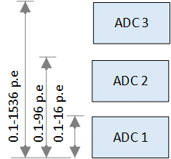
Front End
Three parallel signal chain
Different gain settings
Large dynamic range
ADC input ranges
I V
V_{analog} V_{digital}
V_{digital} Bitstream

Slide 4
Front End
Three parallel signal chain
Different gain settings
Large dynamic range
ADC input ranges
I V
V_{analog} V_{digital}
V_{digital} Bitstream

Slide 5
ADC Gain Selection
Data from one of the three ADCs best represents the signal
Data selection based on threshold level comparisons
Example: When signal crosses the first threshold ADC1 saturates
Data format: Reset+ Header (data source)+ Data

Slide 6
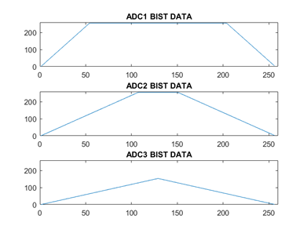
Data Processor - Measurement Results
Main data processor for Vulcan
Selection of best resolution data from three ADCs
Data reduction and compression (noise data)
    Input : 24 bit × 1 GHz = 3 GB/s
    Output : 16 bit × 500 MHz = 1 GB/s
Input signal
Mode change – Silicon verification

Slide 7
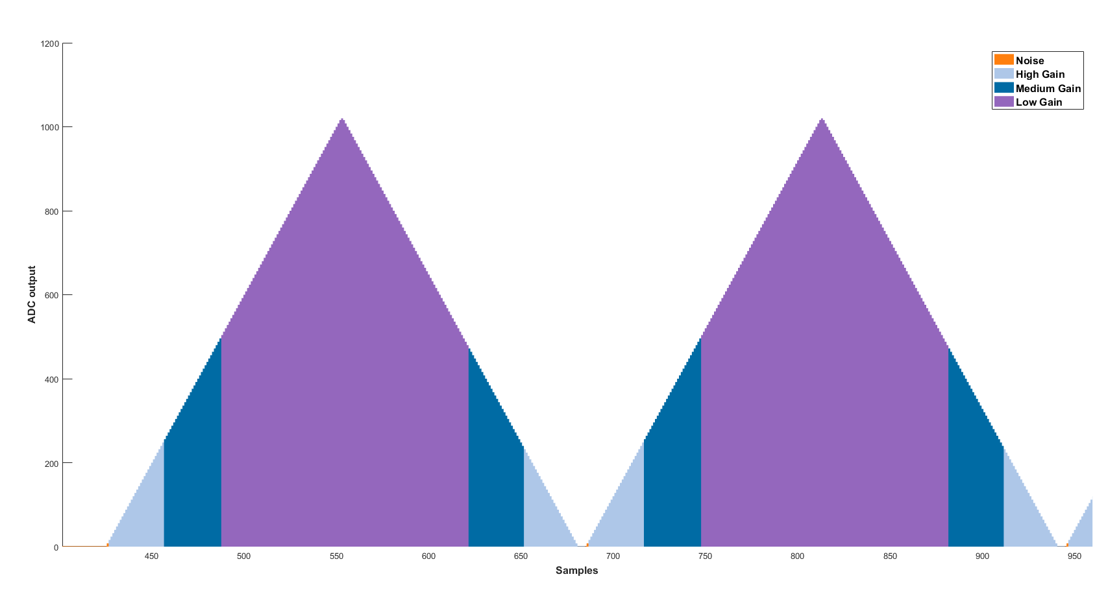
Offline Data Extraction
Extracted data
ADC output
Samples
Data extraction and plotting performed in MATLAB
ADC source extraction from Header data
Scaling the data in relation to the ADC gain setting

Slide 8
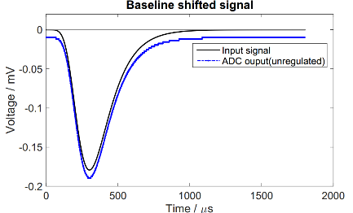
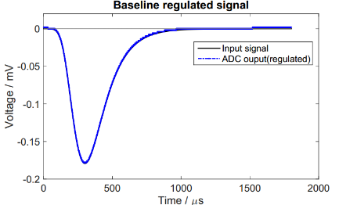
Baseline regulator
ADC baseline regulation
Biasing fluctuation and intersymbol interference shift the baseline
Unregulated ADC output indicates a different charge than the actual input
An improved fine tune baseline regulator has been included

Slide 9
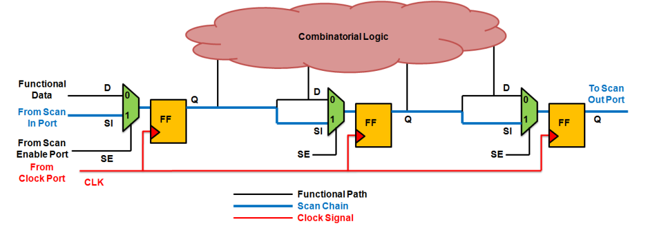
Reliability – Scan chain
Procedure:
Replace all flip-flops with scan flip-flops
Connect them serially in a chain
Feed in test vectors through scan chain
Record the output stream and cross compare results
Key features: Stuck at 0/1 faults, IDDQ test
Scan chain data path [1]
Standard procedure used in Industry
Identifying errors due to manufacturing
Increasing test access points without tremendously increasing input & output pins

Slide 10
1st prototype - Bug fix
Digital LVDS MUX
Defecit of driving strength
Solution: Introduce proper constraints for driving strength

Slide 11
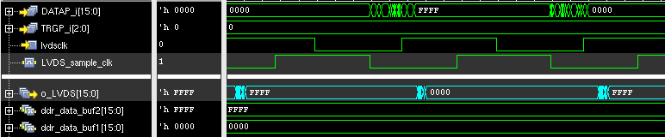
1st prototype - Bug fix
Source J. Steinman
Data is stable during sampling
Timing issues with the LVDS interface is fixed

Slide 12
Summary
1st prototype:
Measurements for functional testing were made on the prototype
Deviations were documented and causes were analyzed
2nd Submission:
All know bugs from the first prototype has been fixed in the second prototype submission
Testability feature has been introduced to delivery identify and discard the chips with errors introduced during manufacturing

Slide 13
References
[1] http://anysilicon.com/overview-and-dynamics-of-scan-testing/

Slide 14
Backup

Slide 15
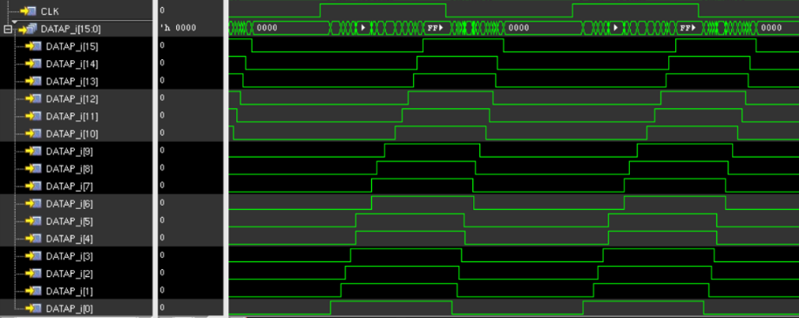
1st prototype - Bug fix
Before:
Timing issue in the first prototype
After:
Source J. Steinman

Slide 16
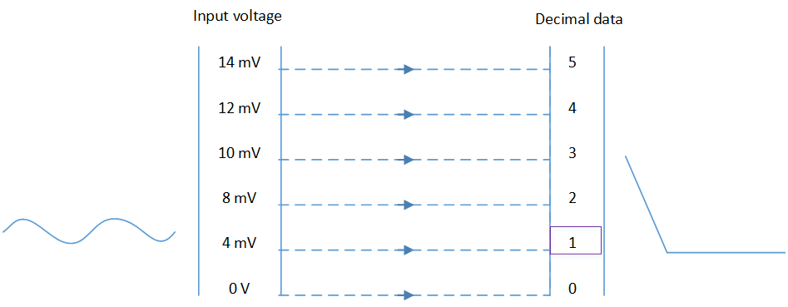
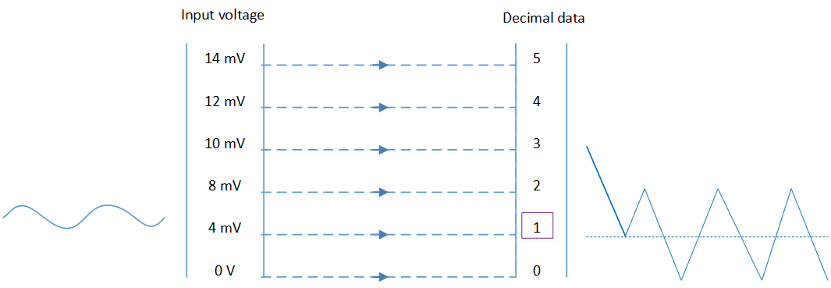
Baseline regulator
Baseline setting to a constant value
Baseline oscillating resulting in a constant ‘average’ value

